Slide 1


Project INF(N):
“Towards Research Data Management System”
Dr.
V. Dudarev
Prof. Dr.
A. Ludwig
Victor Dudarev, Alfred Ludwig

Slide 2
Agenda
    WebCompact (search for material libraries; sputter rates)
    INF Project:
      Defining requirements
      Database schema and flexibility
      Current state: implemented features and future plans
      Request to Register
      Live Demonstration
    Q&A.

Slide 3
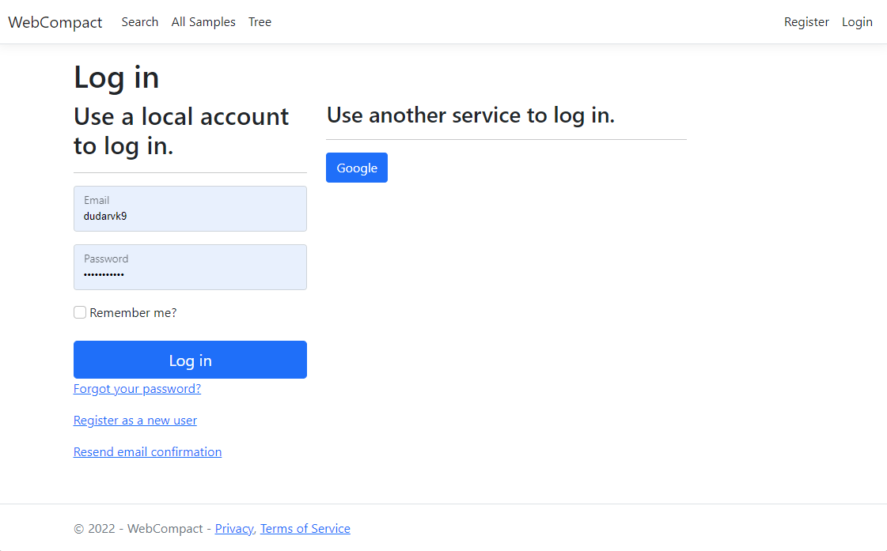
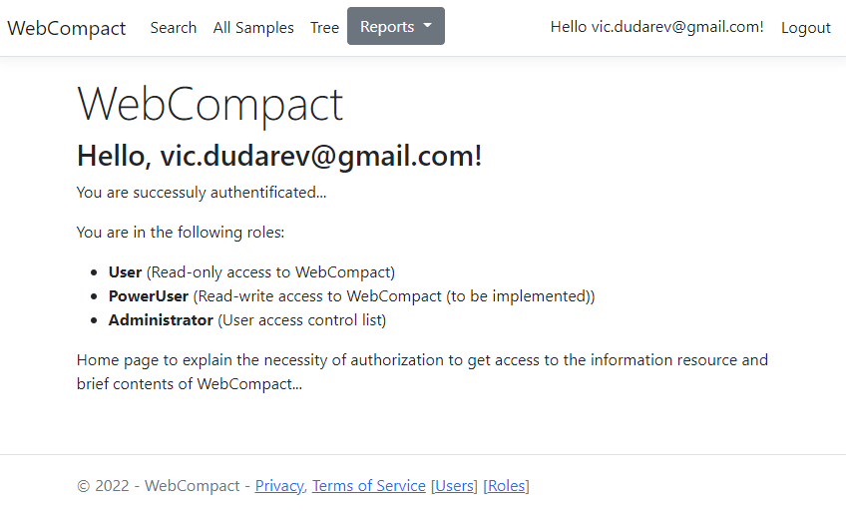
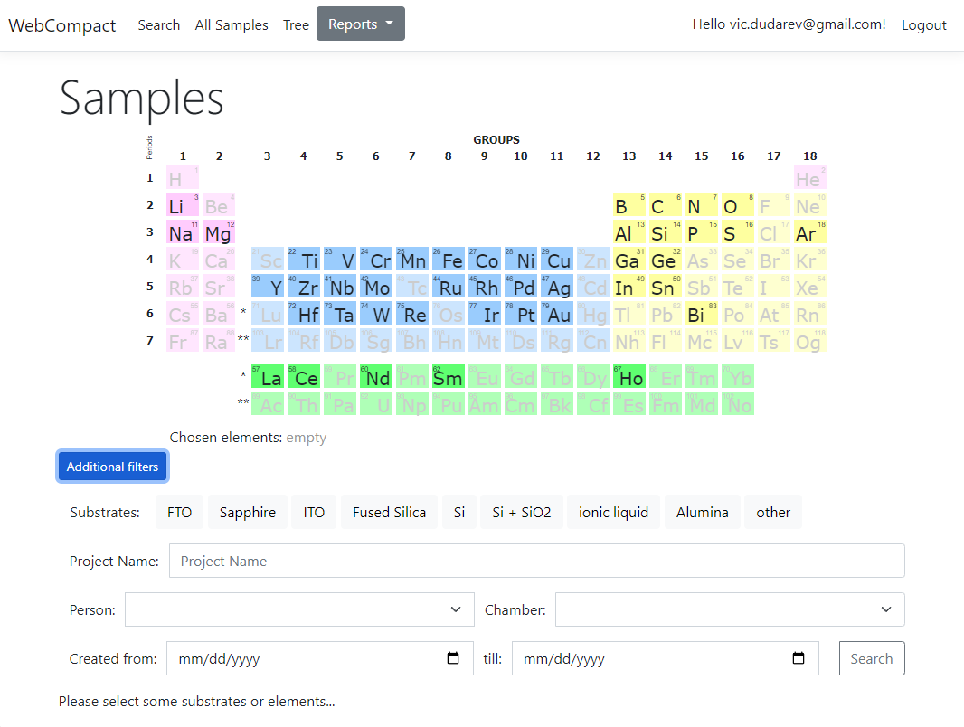
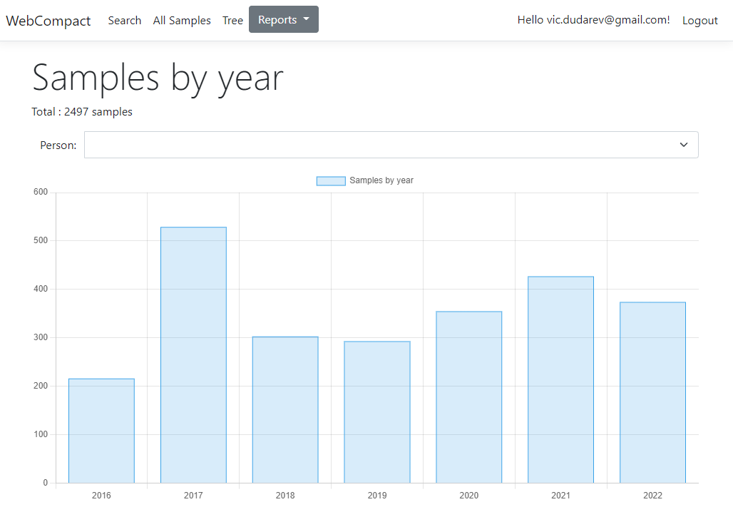
WebCompact https://webcompact.wdm.ruhr-uni-bochum.de/
Runs under .NET 7
Al-Ni-Co (TIFF + JPG + no tree): /sample/samplebyid/1471
Cr-N (JPG, BMP, TIFF + tree): /sample/samplebyid/3699

Slide 4
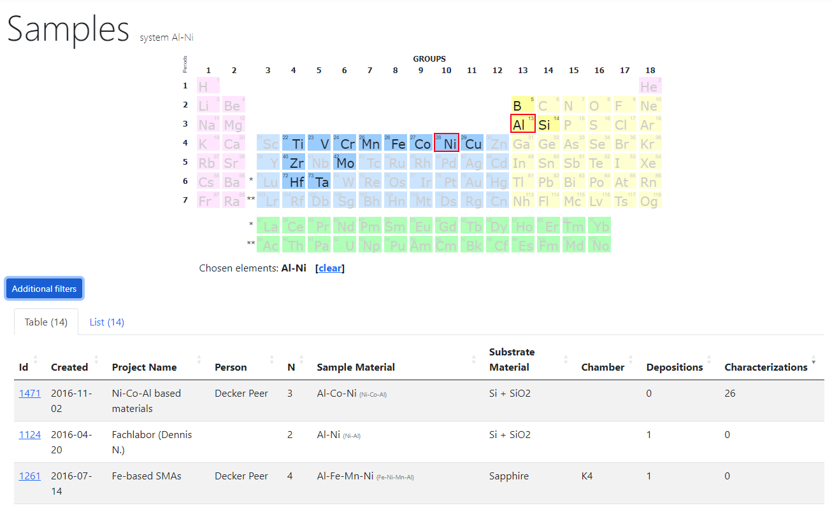
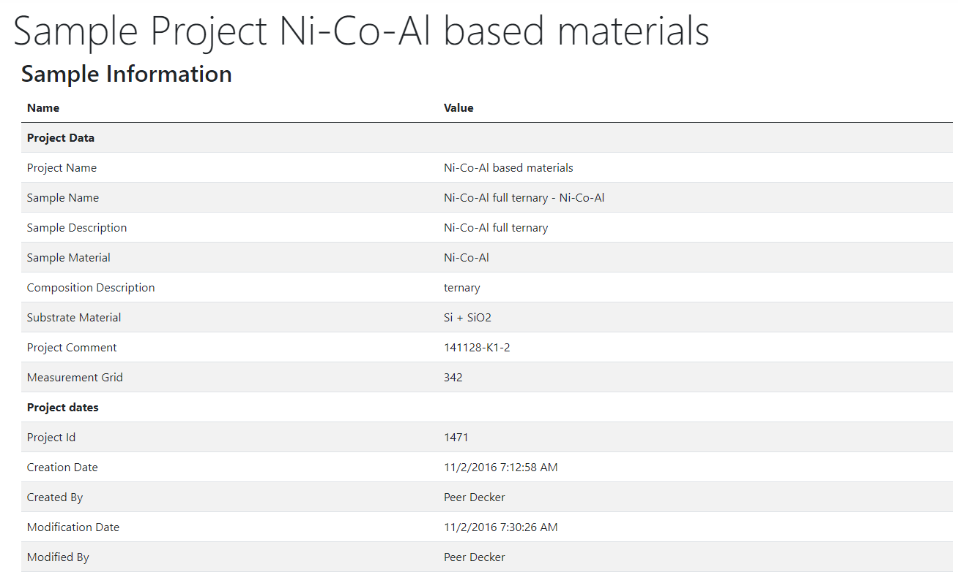
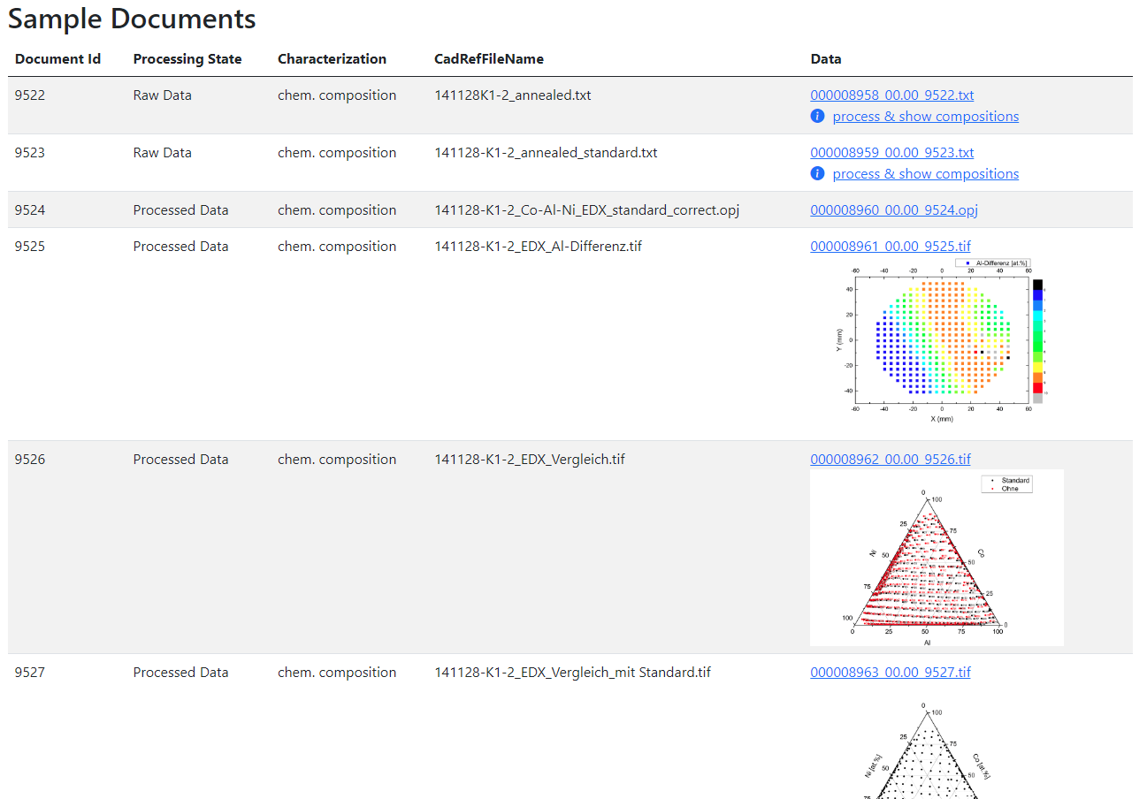
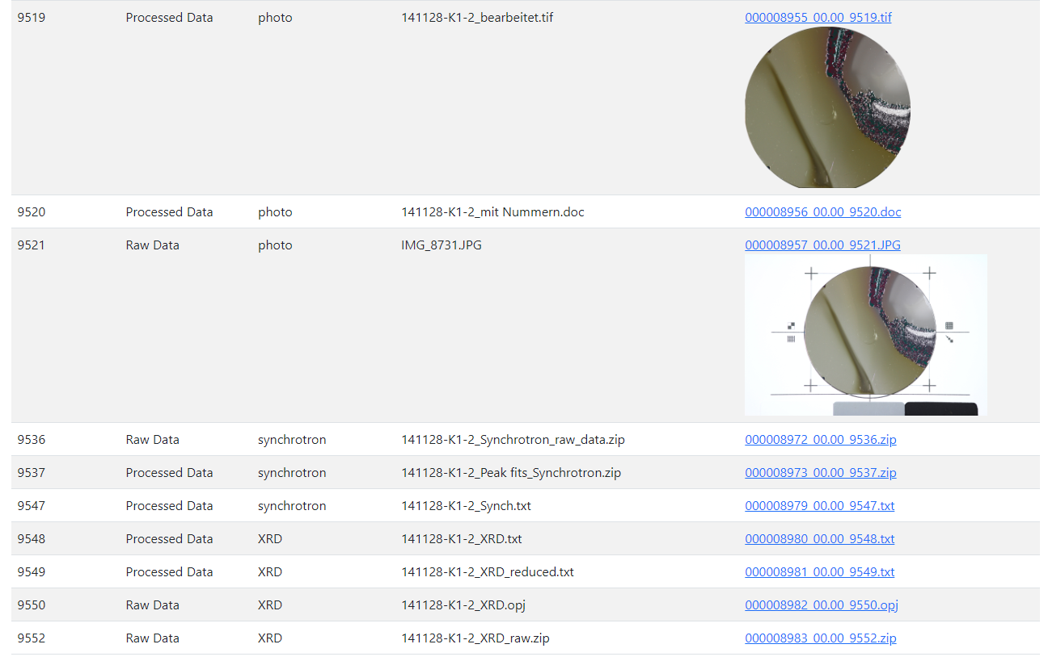
WebCompact Search
Al-Ni-Co (TIFF + JPG + no tree): /sample/samplebyid/1471

Slide 5
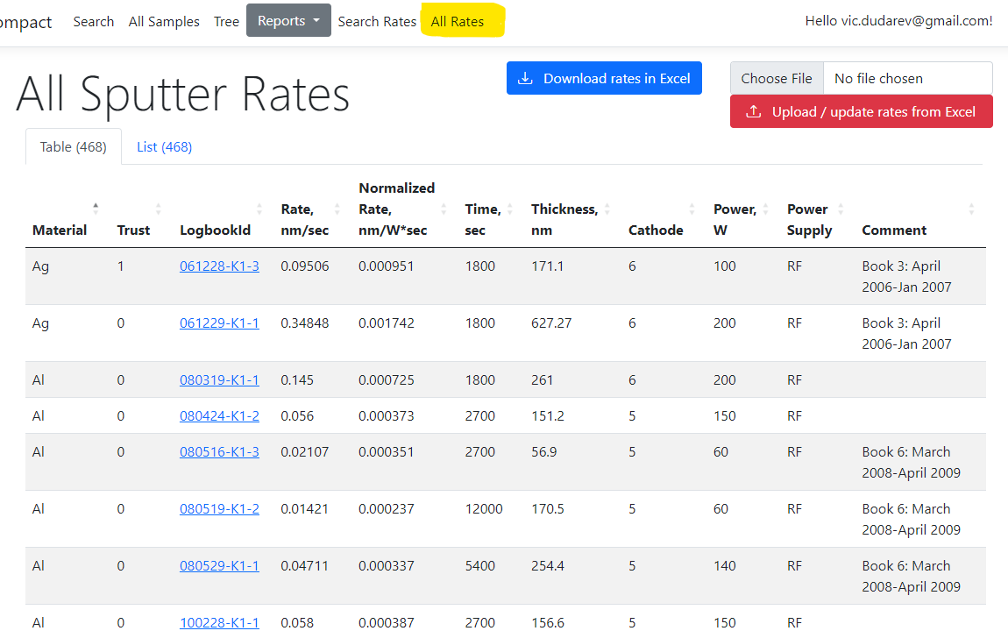
WebCompact: Sputter Rates
List of digitalized sputter rates
(User group access)
Download (export) data
(Administrator group or user with
_SputterRate.read claim)
Upload (import) data
(Administrator group or user with
_SputterRate.write claim)
Person in charge:
Alan Savan
Hints: LogbookId – primary key; Trust = -1000 – delete record on upload.
https://webcompact.wdm.ruhr-uni-bochum.de/sputterrate/allrates

Slide 6
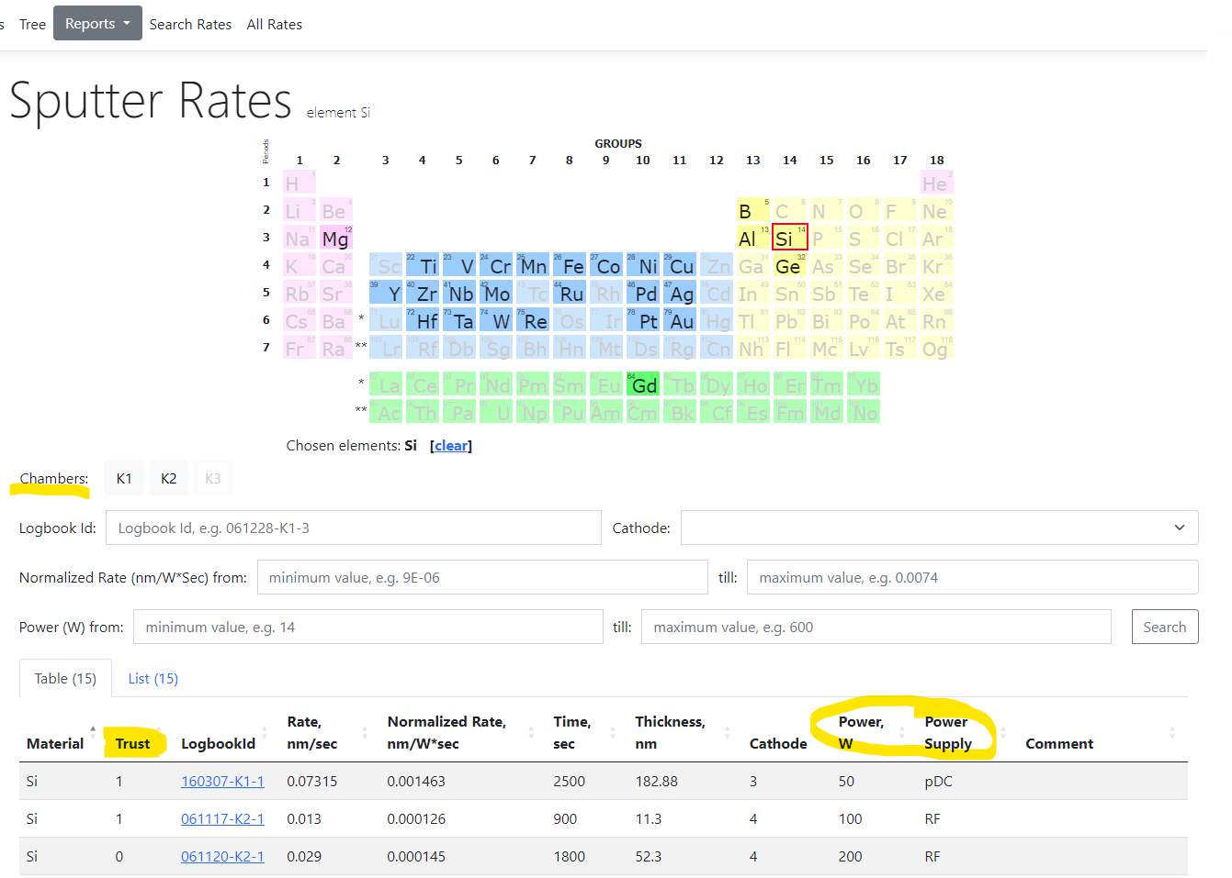
WebCompact: Search for Sputter Rates
Search on (+ sort results):
Elements
Cathode
Chambers
LogbookId (Date-Chamber-N)
Rate range
Power range
It provides a good “starting point” to
suggest sputtering mode settings and time to achieve desired thickness.
https://webcompact.wdm.ruhr-uni-bochum.de/sputterrate/

Slide 7
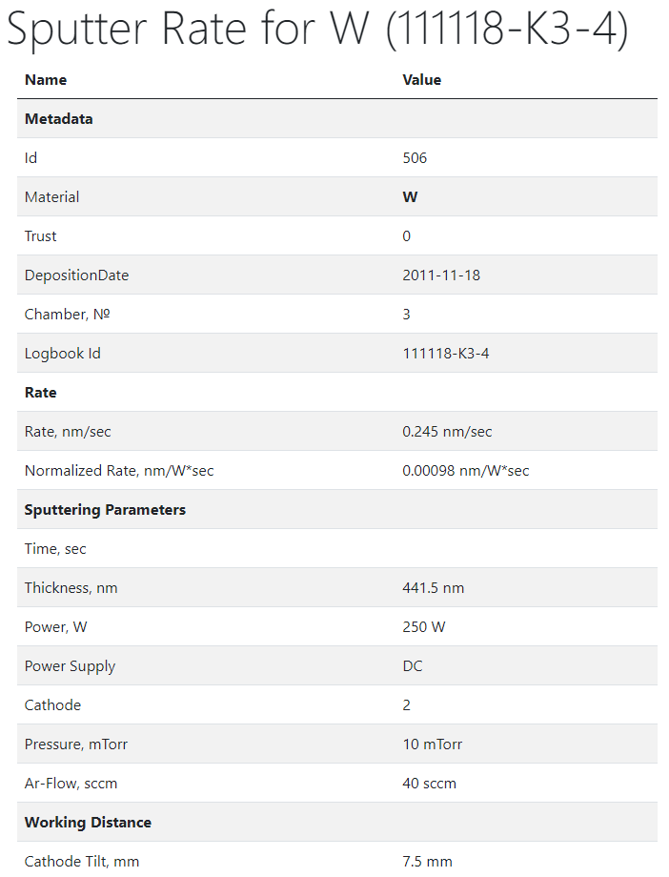
Detailed Information
Id
Material
Trust
Deposition Date
Chamber, №
Logbook Id
Rate, nm/sec
Normalized Rate, nm/W*sec
Time, sec
Thickness, nm
Power, W
Power Supply
Cathode
Pressure, mTorr
Ar-Flow, sccm
Cathode Tilt, mm
Table Height, mm
Comment
https://webcompact.wdm.ruhr-uni-bochum.de/sputterrate/ratebyid/506

Slide 8
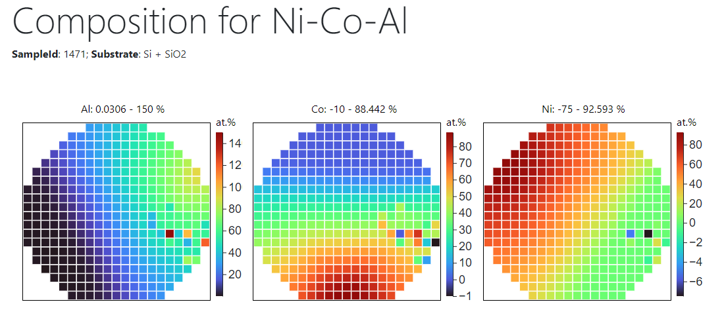
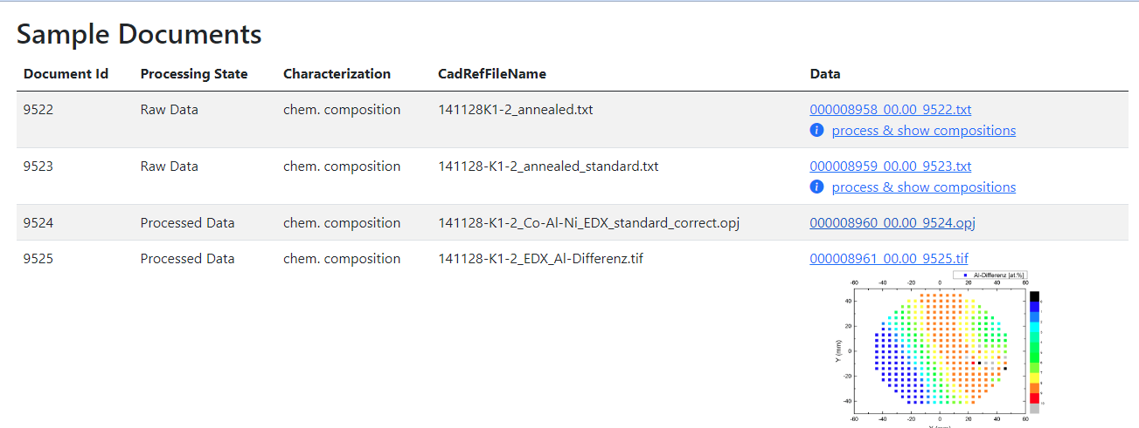
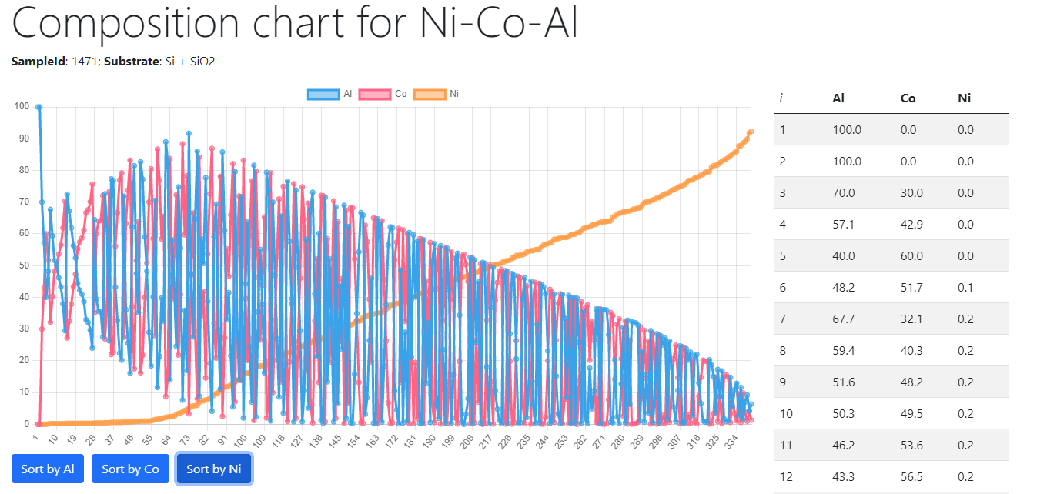
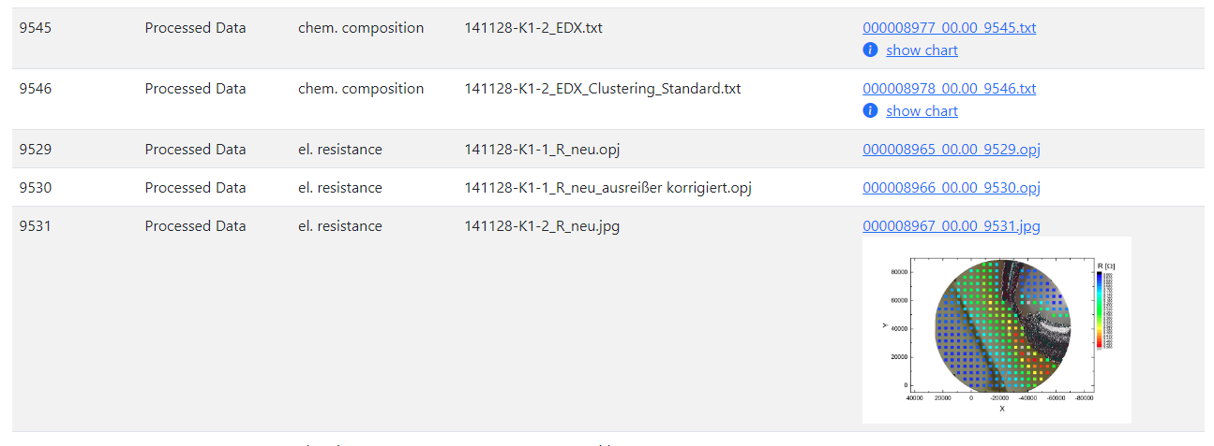
WebCompact and Data Visualization
Data processing with external software (written in Python) + visualization
Simple composition visualization (Chart.js)
https://webcompact.wdm.ruhr-uni-bochum.de/sample/samplebyid/1471

Slide 9
RDMS in Chemistry-related Domains: Requirements
Priorities (SFS): Security + Flexibility + Scalability
Requirements (functional capabilities):
Support for multiple Tenants;
Implement User Registration (including e-mail verification) and Authorization;
Implement Administrative Interface to Control Users and Groups;
Establish Predefined Roles (Administrator / PowerUser / User) with corresponding permissions;
Ensure Data Access Policy (public / protected / private) for all stored objects based on Object Access Level;
Adjust Functionality of RDMS according to authorized user role (Administrator / PowerUser / User);
Upload and Store Objects (documents) with minimalistic mandatory metadata;
Provide Flexible Tree Classification for stored documents (projects / organizational structure);
Provide means to Support Chemical Entities data types: systems, compositions, crystal structures;
Enable to Interlink Objects manually (associative objects) and show the resulting reverse associations;
Flexibility: implement Extended Properties for Objects and support search on them;
Import and Export object table properties from/to Excel; support table properties templates;
Provide Search Interface on chemical entities and objects with respect to user access level;
Flexibility: enable to easily Introduce Additional Object Types with predefined mandatory fields set*;
To be done:
Provide Reports / Charts / Diagrams on stored data in various aspects;
API to upload data from measurement devices (Bandgap, Resistance, etc…);
known object types Bulk Import from CSV files (with CSV-schema validation).
RDMS: Research Data Management System
* - depending on object type complexity may require programming (extra tables introduction in DB)

Slide 10
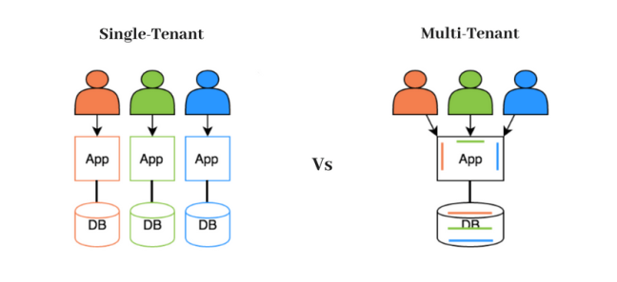
RDMS: Multiple Tenant Support
What is Tenant?
Short answer:
Tenant – separate (distinct) instance of a software application that
is used by a single organization or group of users.
Long answer:
Tenant is a customer account that has its own set of users, data, and configuration settings, and is isolated from other tenants in the same software application. This concept is commonly used in Software as a Service (SaaS) applications, where a single software application is hosted in the cloud and is made available to multiple customers as separate tenants. This allows each customer to have their own instance of the application, with their own data, settings, and customizations, while still sharing the underlying infrastructure and resources of the application
Conclusion:
Tenants are useful for separate SFB projects / workgroups / materials data repositories. For example:
          https://demo.mdi.ruhr-uni-bochum.de/
          https://inf.mdi.ruhr-uni-bochum.de/
          https://crc247.mdi.ruhr-uni-bochum.de/
Every tenant must have a unique URL!
https://en.wikipedia.org/wiki/Multitenancy

Slide 11
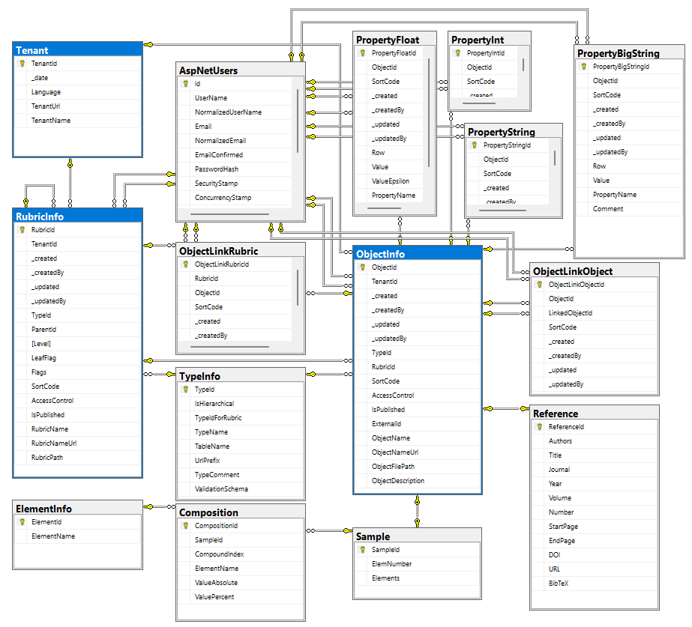
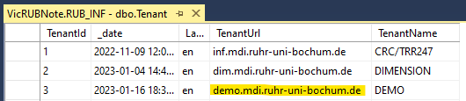
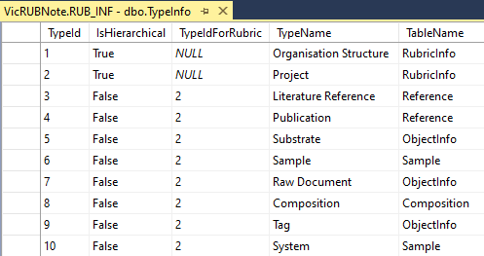
RDMS Database
Tenants (independent systems):
Every tenant must have a unique URL!
Data Types (can be shared among tenants):

Slide 12
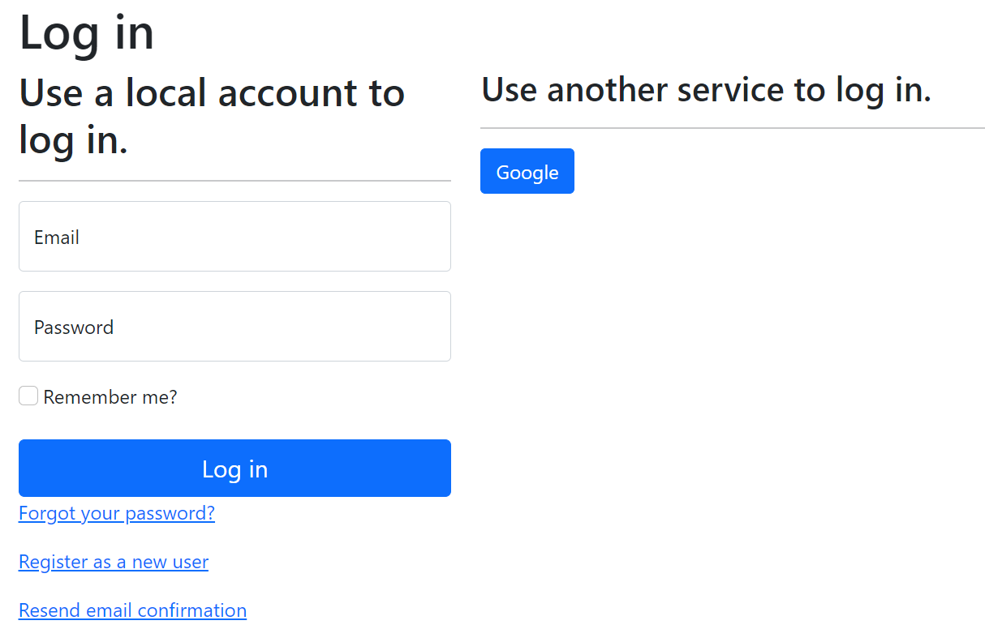
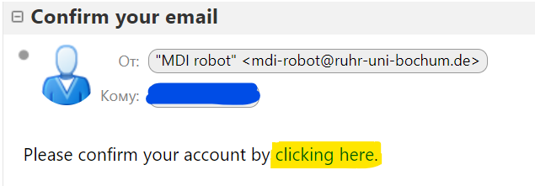
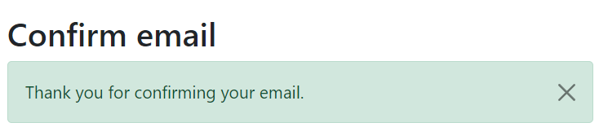
RDMS: Registration and Authorization
Application access level is determined by the current user context.
Two-way registration (choose any):
using external provider (OpenID Connect), e.g. Google (external authentication authority is used, no credentials are stored locally).
using local account (credentials are stored internally);
In both cases, an e-mail address is required, and its successful verification is a prerequisite for access.
After e-mail confirmation, the user is considered active, but does not have an assigned user group.
https://openid.net
https://en.wikipedia.org/wiki/Authentication
https://en.wikipedia.org/wiki/Authorization

Slide 13
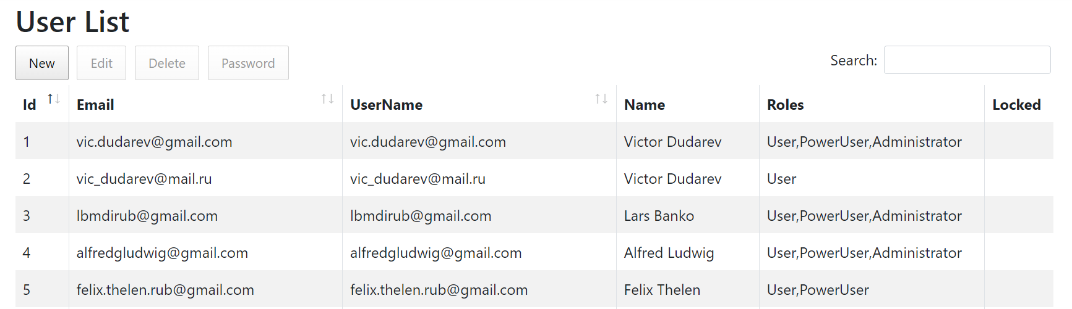
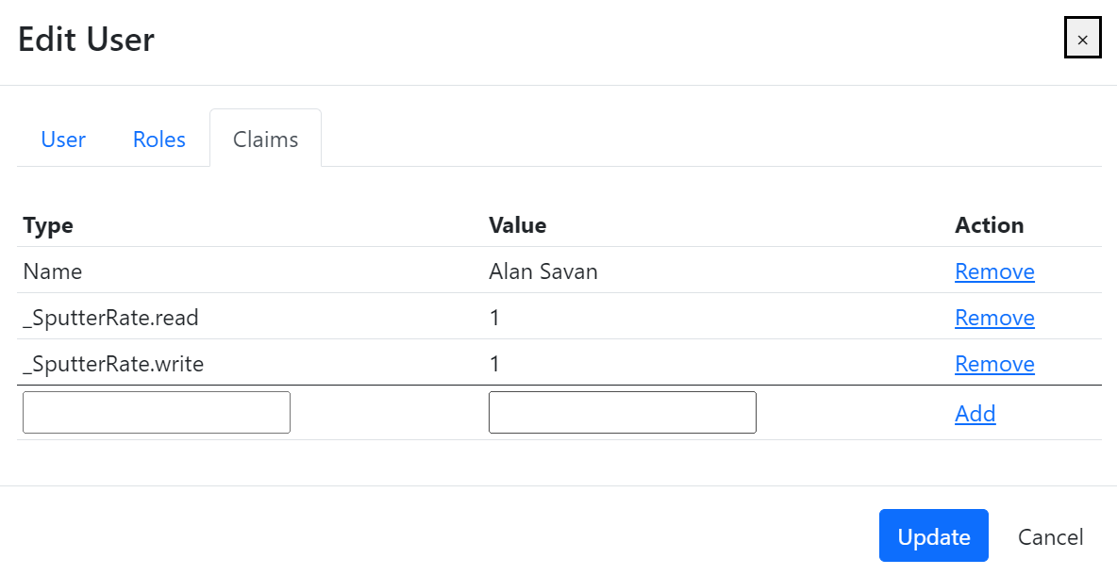
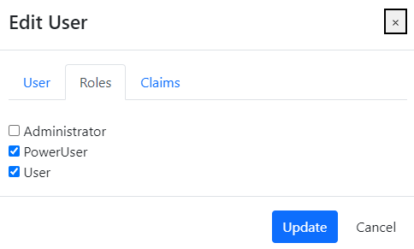
RDMS: Identity User Control Interface
Features:
Registered users management
Roles management
Claims management
Claim is a piece of information (key-value pair) that describes a user. Claims are stored in a user's identity and can be used to determine what actions a user is authorized to perform, such as accessing certain pages or resources.
https://learn.microsoft.com/en-us/aspnet/core/security/authentication/identity

Slide 14
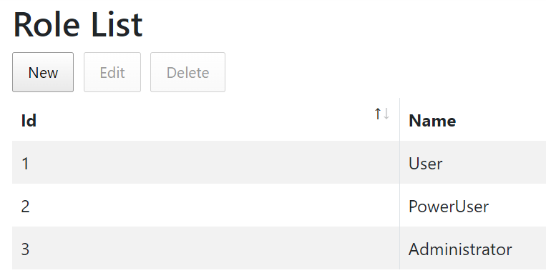
RDMS: Predefined Roles
Roles:
User:
    - read-only access to public and protected data
PowerUser:
- read-only access to public and protected data (+ private data, created by the current user)
- add data (+ write access to data, created by the current user)
Administrator:
- full access to all data (CRUD)
- user management
Anonymous (== registered user with no roles assigned):
- read-only access to public data only (be aware: internet search engines will index public data)
https://en.wikipedia.org/wiki/Role-based_access_control

Slide 15
RDMS: Setting the Object Access Level
What is an Object?
Object (=document) is a data entry within RDMS that has user-defined access level and reflects an object of the real world (e.g. sample) or its model. Ultimately, object has it’s unique Web page (with unique URL address).
To establish data access policy Data Access Levels are introduced in RDMS.
Three Access Levels:
Public (default, we are doing open science, FAIR, aren’t we?):
    objects are available to everybody regardless of authorization (visible to internet search engines);
Protected (visible to the community only):
- objects are visible to the community (available to authorized users with at least User role assigned);
Private (person’s secret, but open for Administrators):
- objects are visible to the user-creator (at least PowerUser role assigned);
- objects are visible to all users of Administrator role.

Slide 16
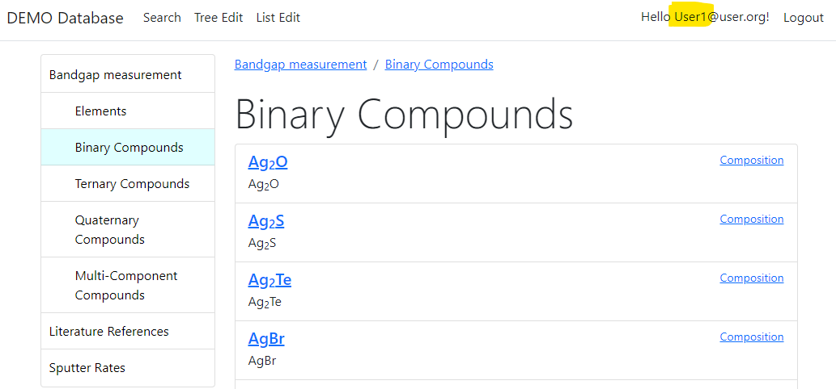
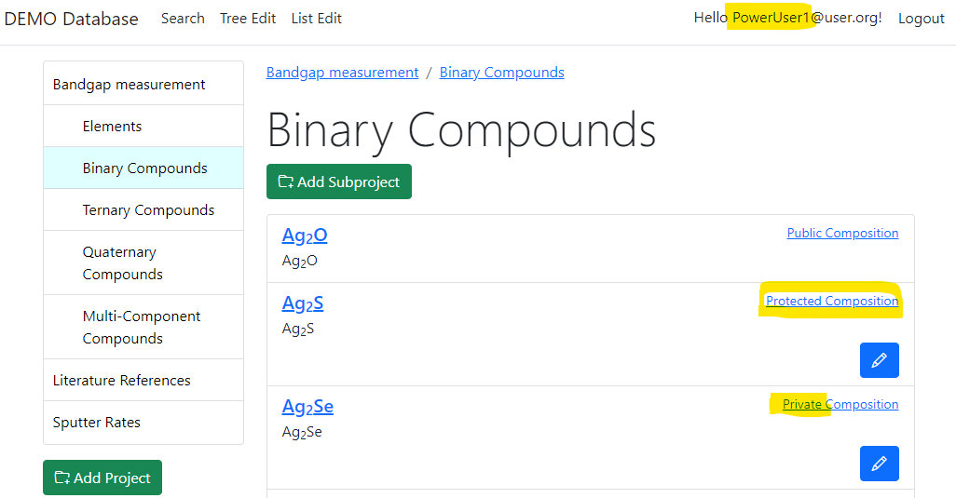
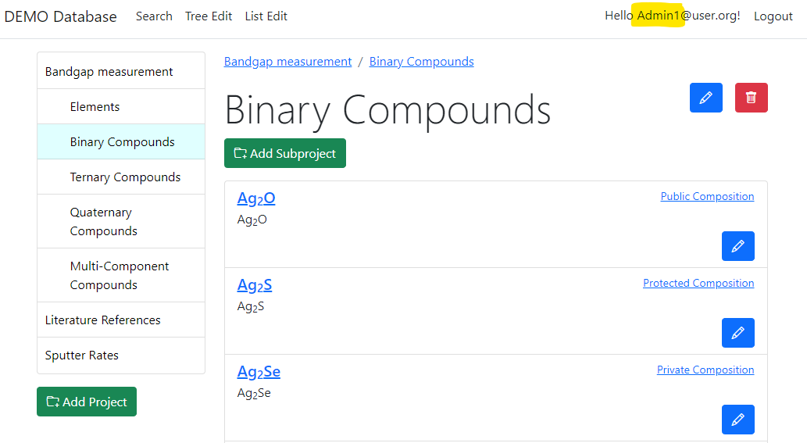
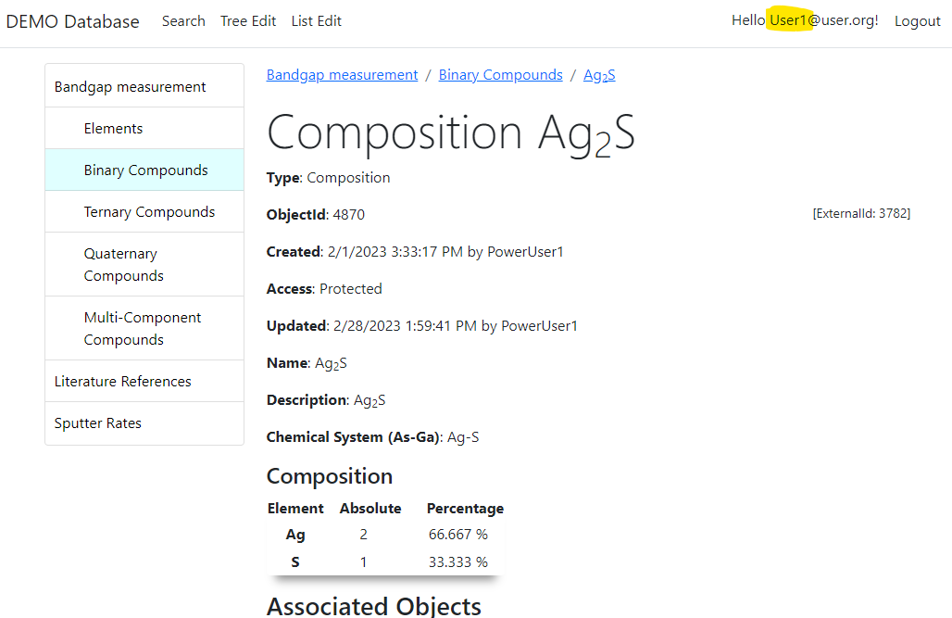
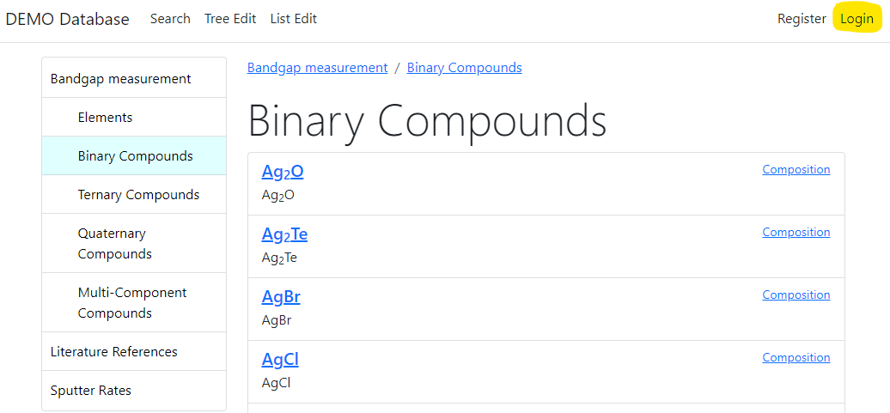

RDMS: Adjust Functionality According to User Permissions
User credentials (role) affects user interface: https://demo.mdi.ruhr-uni-bochum.de/rubric/binary-compounds
User1 (User role) PowerUser1 (PowerUser role) Admin1 (Administrator role)
Authorized CRC Community
User (no role) = Anonymous (search engine)
Preconditions:
Ag₂O created (public) by Admin1
Ag₂S created (protected) by PowerUser1
Ag₂Se created (private) by PowerUser1
Accessible (visible)
Denied (hidden)
Visit
https://demo.mdi.ruhr-uni-bochum.de/object/ag2s-4870
User => access granted
Anonymous => access denied

Slide 17
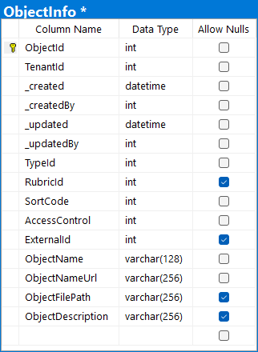
RDMS: Upload and Store Documents (with minimalistic mandatory metadata)
Unique Object Identifier (assigned automatically), primary key
Tenant Identifier (assigned automatically based on URL address)
User who created the object and date with time (automatically)
User who modified the object and modification date and time (auto)
Object type reference (determined by user on object creation)
Project (tree-structure) reference (can specified by user on object creation)
Code to define a certain order in list of objects (auto, can be changed)
One of predefined Object Access Levels: public def / protected / private
Name of the object (must be specified)
Relative URL for page to access object (auto formed; can be changed)
Reference to Data File uploaded to system (uploading by choice)
Object Description (can be empty, as all nullable attributes above)

Slide 18
RDMS: Data Types (hierarchies and lists)
Data Types
IsHierarchical = True
IsHierarchical = False
Hierarchical
(tree types)
List
(list types)
All types are extendable (stored in TypeInfo)
Rubrics (RubricInfo table) types:
Project
Organisation Structure
++ (extendable)
Objects (ObjectInfo table) and all derived (non-hierarchical) types:
Reference
Sample
Composition
++ (extendable)

Slide 19
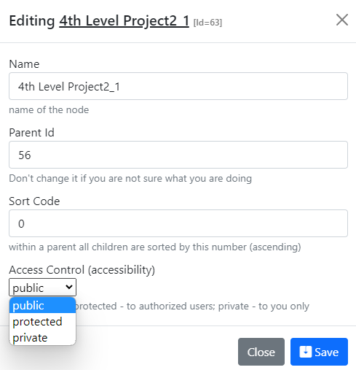
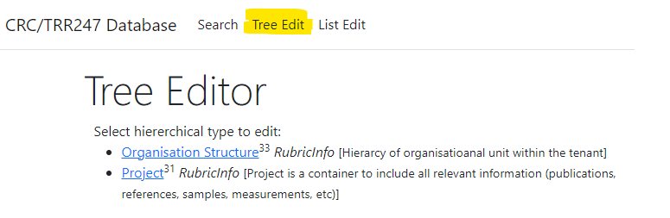
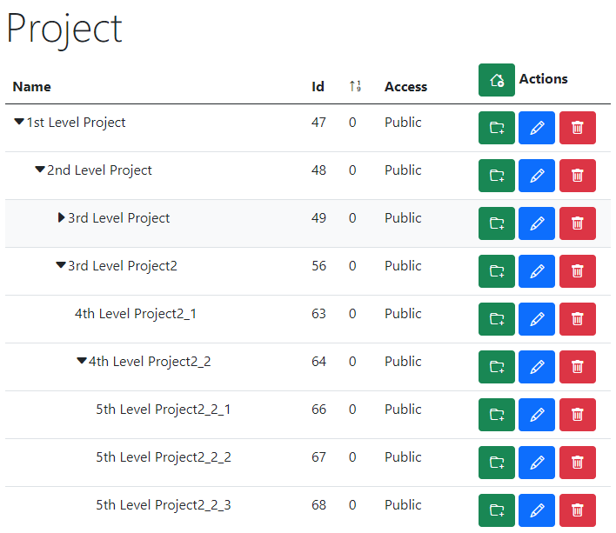
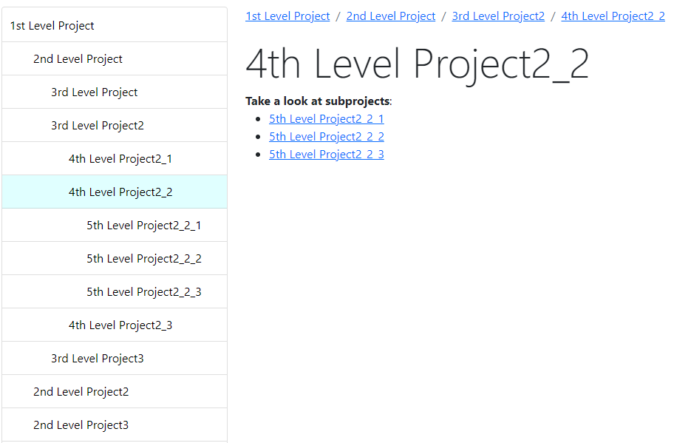
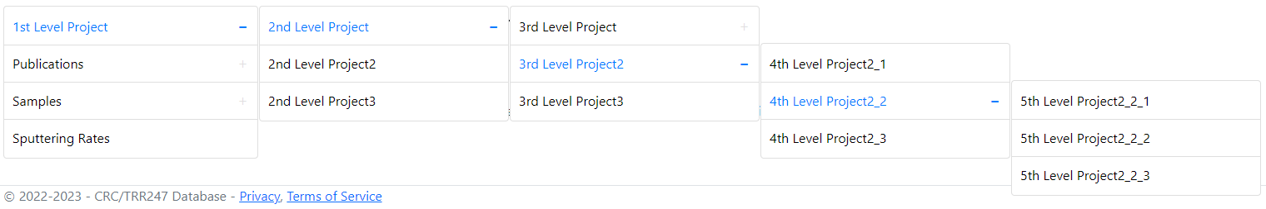
RDMS Tree Types: control and display
Display for users in Web Application
Control (admin):
Name
Parent Id
Sort Code
Access
https://demo.mdi.ruhr-uni-bochum.de/

Slide 20
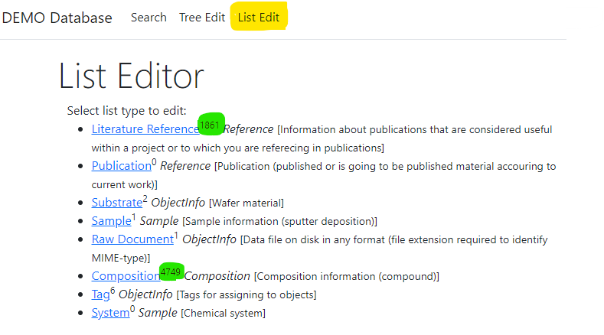
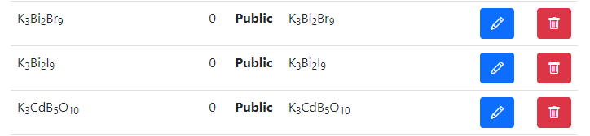
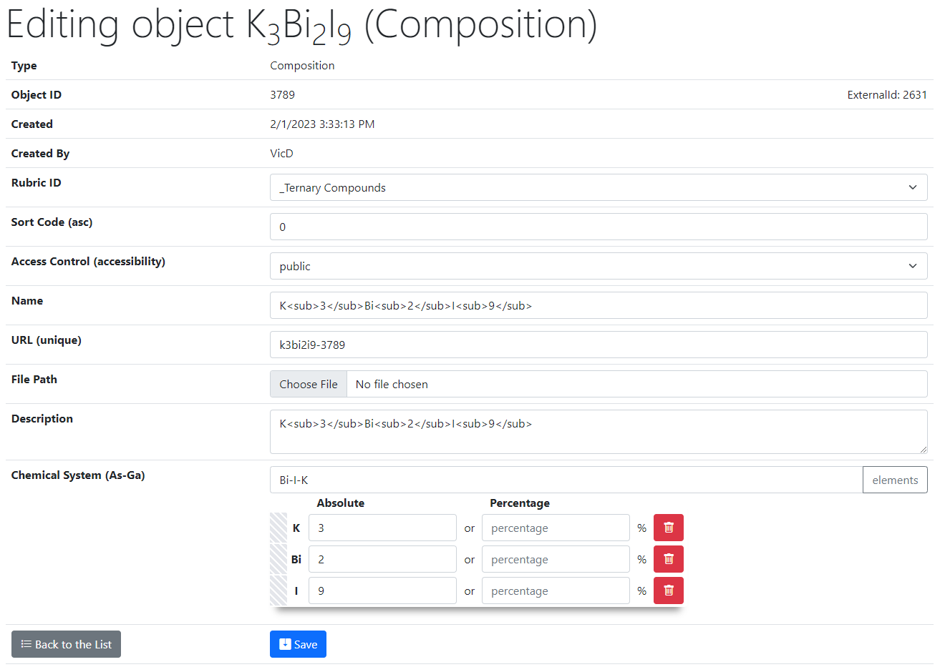
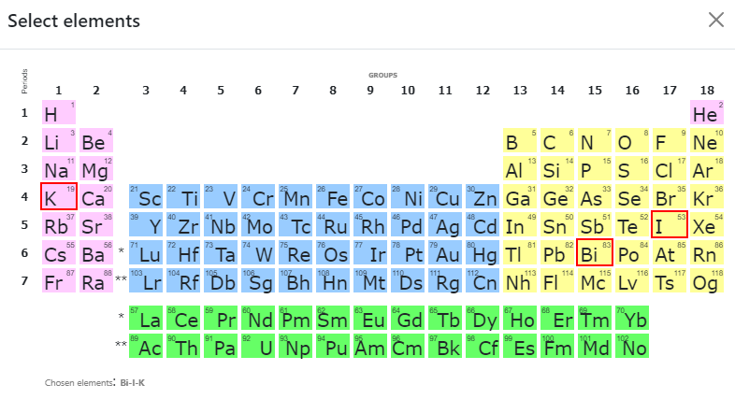
RDMS List Types: control
List of all objects (of type Composition):
Control (common to all objects):
Rubric Id;
Sort Code;
Access;
Name;
URL (adjustable*);
Attach File (document);
Description.
2
Type specific control (e.g. Composition):
Chemical System;
Composition (elements containment).
1
https://demo.mdi.ruhr-uni-bochum.de/

Slide 21
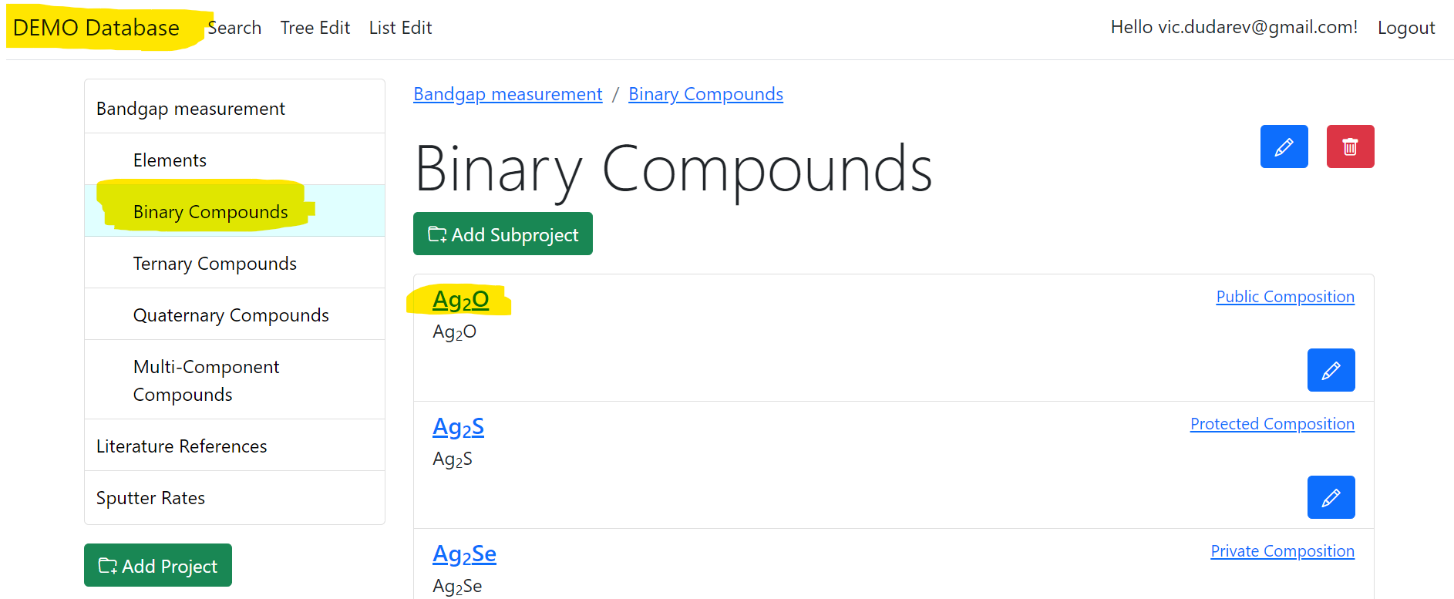
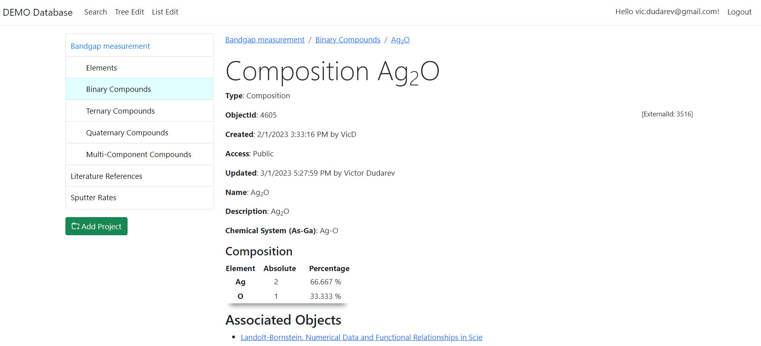
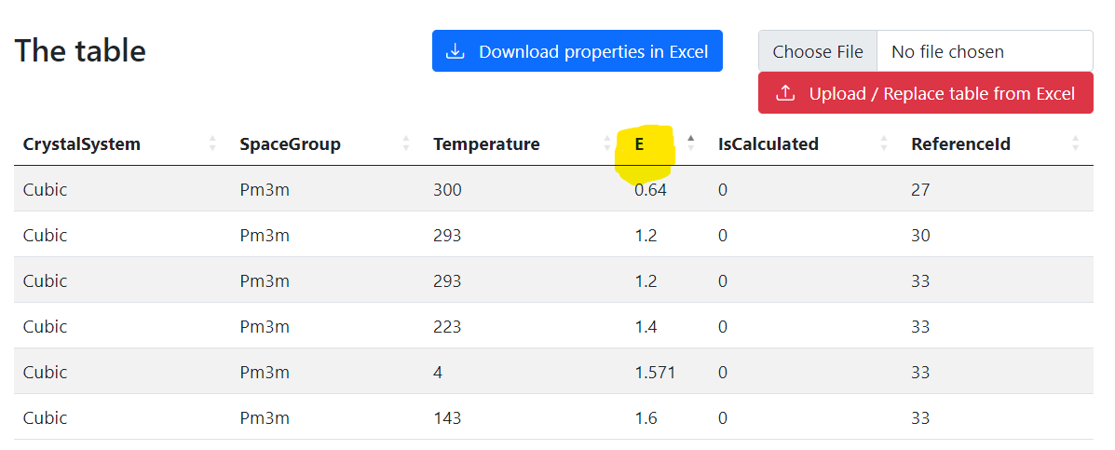
RDMS List Types: display
Visibility depends on user privileges
UI Experience:
Select project (rubric with objects)
Select object of interest
Follow the link and explore object data and properties
https://demo.mdi.ruhr-uni-bochum.de/object/ag2o-4605

Slide 22
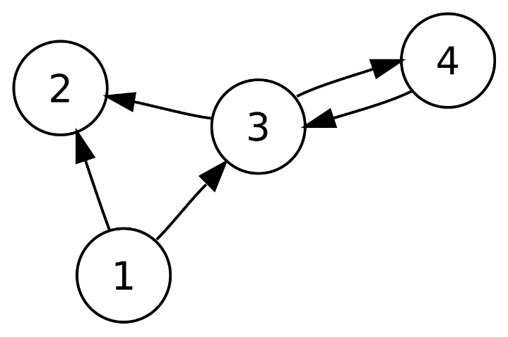
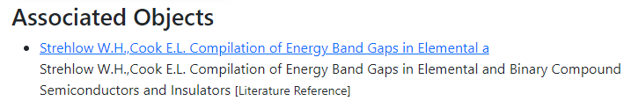
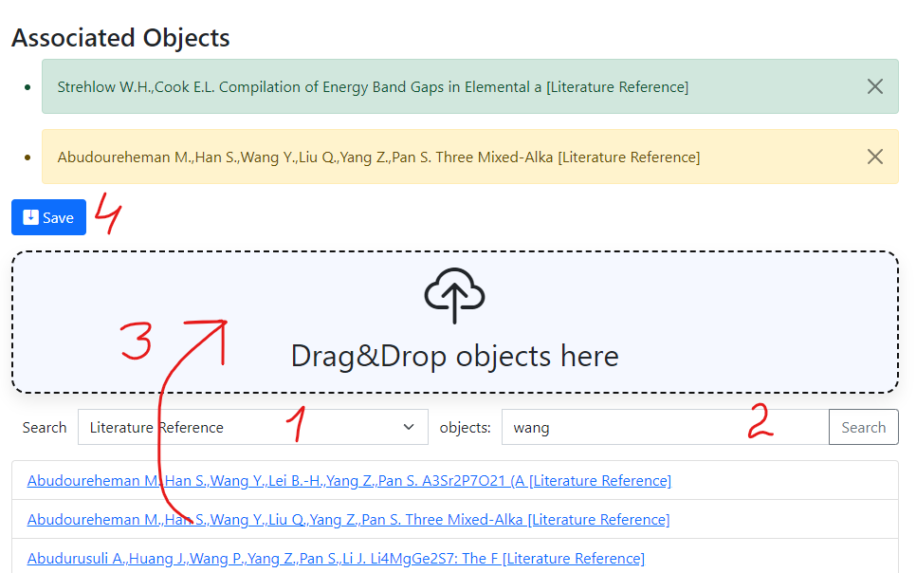
RDMS: Interlink Objects
Example: literature reference for published data on composition:
To add associated objects:
0) Go to “List edit” or select object to edit
1) Select associated object type (optional filter)
2) Input search phrase, contained in the Name of desired object to be associated
3) Drag & Drop desired object(s) from search result list to the area / adjust list
4) Save changes
Important: Reverse associations allow to browse reverse- directional associations, such as finding all compounds mentioned in a particular literature reference.
User view: https://demo.mdi.ruhr-uni-bochum.de/object/ag2s-4870
Admin view: https://demo.mdi.ruhr-uni-bochum.de/adminobject/edititem/4870

Slide 23
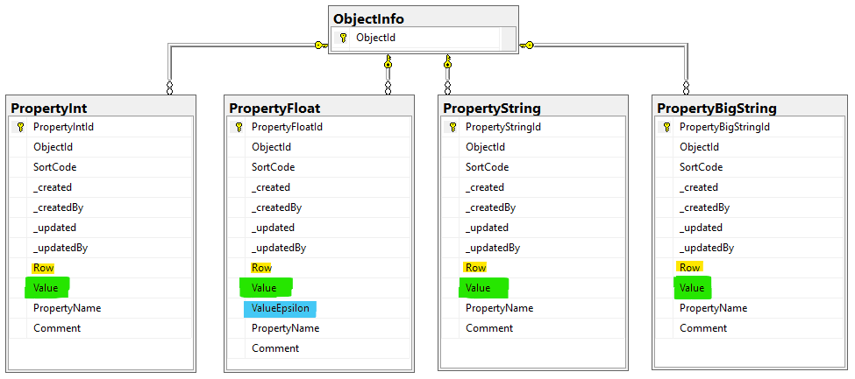
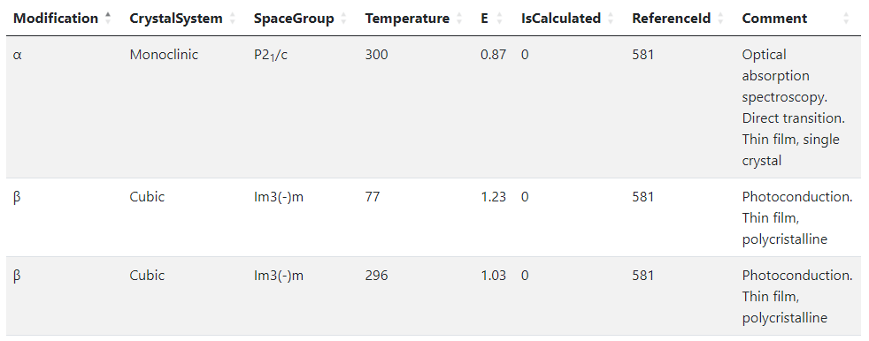
RDMS Object‘s Flexibility: Extended Properties
Use case: add additional properties values (or even a table) to object and afterwards make search on them.
OR
When the existing fields set is not enough…
Task: associate table with object
Row=1
Row=2
Row=3
String x3
Float x2
Int x2
String
Solution: Decompose the table so, that each cell value is stored in Property* table according to cell value type.
Important attributes:
PropertyName – contains column name
Value – contains cell value
Row – contains row number (1, 2, 3, …). If no row number specified – value is threated as object’s property
User view: https://demo.mdi.ruhr-uni-bochum.de/object/ag2s-4870
Admin view: https://demo.mdi.ruhr-uni-bochum.de/adminobject/edititem/4870

Slide 24
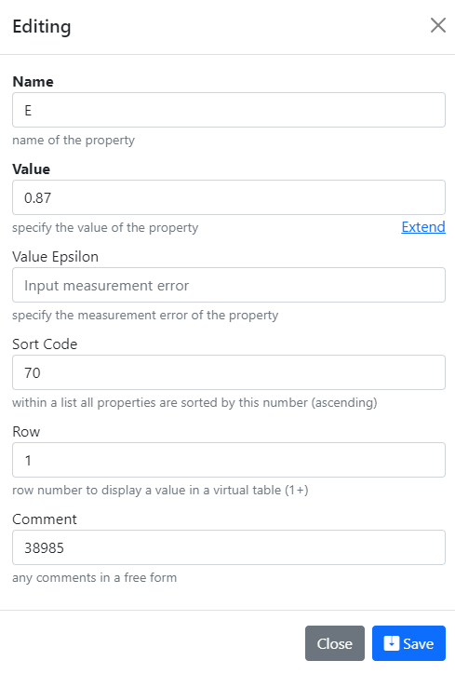



RDMS Extended Properties Control
Extended Properties Control for object is available according to the object access managements in administration panel for objects.
User view: https://demo.mdi.ruhr-uni-bochum.de/object/ag2s-4870
Admin view: https://demo.mdi.ruhr-uni-bochum.de/adminobject/edititem/4870

Slide 25


RDMS Extended Properties: Export and Import
Task: make properties modification easy
Steps:
Download data
Open in Excel and edit
Upload changed data back to the RDMS
Import
(requires permissions)
https://demo.mdi.ruhr-uni-bochum.de/object/ag2s-4870
Export
https://demo.mdi.ruhr-uni-bochum.de/object/ag2s-4870

Slide 26

RDMS: Search
Search on:
Chemical system
Composition
Object type
Phrase in object’s Name or Description
Properties values (all available within tenant)
Person created
Creation date
Important feature:
persistent URL on search (share search results easily by URL*).
* - respecting current security context
Task: make properties modification easy
https://demo.mdi.ruhr-uni-bochum.de/search/
https://demo.mdi.ruhr-uni-bochum.de/search/?system=As-Ga&Aspctmin=30&Aspctmax=50&Gaabsmin=1&Gaabsmax=3&pr0name=E&pr0type=Float&pr0min=1.5&pr0max=2&pr1name=Comment&pr1type=String&pr1max=3&pr1str=solution&prcnt=2
https://demo.mdi.ruhr-uni-bochum.de/search/?system=As-Ga&Aspctmin=30&Aspctmax=50&Gaabsmin=1&Gaabsmax=3&pr0name=E&pr0type=Float&pr0min=1.5&pr0max=2&prcnt=1

Slide 27
RDMS Extensibility: Additional Object Types
Task: introduce new object types
New Data Type
Based on existing tables
(hierarchical and non-hierarchical)
New Data Structures
(new table & code to fit particular requirements)
Add new type to TypeInfo table
To be done manually
Approximate time: 3 minutes
Just add a new table row with object specification required ))
To be done manually
Approximate time: 1 week
Tasks: develop and add new table; define read / write logic with respect to mandatory (or optional) fields and types; reflect to OOP model and provide consistency check (validators); develop import / export and search facilities, etc.
Question: It seems that all can be done with extended properties.
Why to use new data structures?
Short Answer: Performance (especially if number of new type objects is expected to exceed 10K)

Slide 28


RDMS Extended Properties: Templates for data types
Task: define Template for properties with respect to particular type
Steps:
After creating a data type (e.g. based on existing table) create a “_Template” object of given type: https://demo.mdi.ruhr-uni-bochum.de/adminobject/list/11
Add Columns of desired table to corresponding Properties (w.r.t. data type: Float / Int / String / BigString) with Row=-1 – predefined template:
https://demo.mdi.ruhr-uni-bochum.de/adminobject/edititem/6650
Create a new object and in UI press “Download properties in Excel” button: https://demo.mdi.ruhr-uni-bochum.de/object/all-sputter-rates-for-test-6651 to get template in Excel
Modify template in Excel file and upload the data: https://demo.mdi.ruhr-uni-bochum.de/object/all-sputter-rates-for-test-6651 (test passed: 16 columns and 468 rows)
https://demo.mdi.ruhr-uni-bochum.de/object/all-sputter-rates-for-test-6651

Slide 29


RDMS Demonstration: Bandgap Data
Task: check RDMS on Bandgap data from bg.imet-db.ru to test functionality and features.
Source data in numbers:
Substances: 4748
Bandgap records: 10264
Literature references: 1861
Objects in RDMS
Projects structure:
Bandgap values (~10K) are stored in extended properties tables:
BigString: 0 records
String: 28992 records
Int: 20527 records
Float: 15149 records
Total: 71 277 records in demo tenant for bandgap data.
https://demo.mdi.ruhr-uni-bochum.de/
Source data: https://bg.imet-db.ru/

Slide 30


RDMS: the Next Steps
Tasks (to be done in spring 2023):
refine UI for PowerUsers, incorporated in regular (end-user) interface + UI w.r.t. data types
API to upload data from measurement devices (Bandgap, Resistance)
Implement Reports / Charts / Diagrams on stored data in various aspects (like in WebCompact)
Existing object types Bulk Import from CSV files (with CSV-schema validation) and Export

Slide 31


Source Control (GitLab)
Everybody’s welcome!
Core INF project:
https://gitlab.ruhr-uni-bochum.de/vic/infproject
Web Compact:
https://gitlab.ruhr-uni-bochum.de/vic/WebCompact
Shared projects (INF & WebCompact):
1) Administration User Interface (Identity Manager UI):
https://gitlab.ruhr-uni-bochum.de/vic/identitymanagerui
2) Web Application General Library (WebUtilsLib):
https://gitlab.ruhr-uni-bochum.de/vic/webutilslib
https://gitlab.ruhr-uni-bochum.de

Slide 32


RDMS Playground
https://demo.mdi.ruhr-uni-bochum.de/ https://inf.mdi.ruhr-uni-bochum.de/
Playground to test RDMS (multiple tenants with shared users list):
https://demo.mdi.ruhr-uni-bochum.de/
https://inf.mdi.ruhr-uni-bochum.de/
Credentials are specified in protected presentation version
https://demo.mdi.ruhr-uni-bochum.de/
https://inf.mdi.ruhr-uni-bochum.de/
Notes:
https://qr.io/

Slide 33

RDMS in Production
Production mode (https://crc247.mdi.ruhr-uni-bochum.de/):
You need to register with Google account or create your own account (email/password) and confirm e-mail (warning: user created with no role assigned).
In case of any questions write me: Victor.Dudarev@rub.de
https://crc247.mdi.ruhr-uni-bochum.de/
Everything runs 24x7 on a dedicated VM within a new server (INF funding)
Notes:
https://qr.io/

Slide 34
Thanks for your kind attention
Demonstration
Q&A
Victor Dudarev
Victor.Dudarev@rub.de
https://vdudarev.ru

