Slide 1
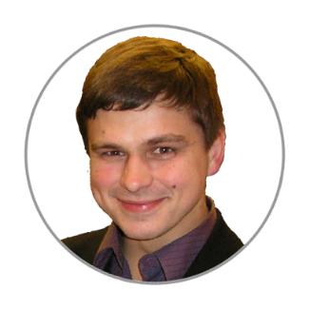
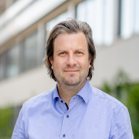
Project INF:
“Data Management –
Status report”
Dr.
V. Dudarev
Prof. Dr.
A. Ludwig
Victor Dudarev, Alfred Ludwig

Slide 2
Agenda
    Hardware INFrastructure
    Funding Period 1 Data: Recovery Completed
    Workflows (idea, request for synthesis)
    Oriented graph (objects interlinking)
    API & SQL access
    Documentation
    Invisible improvements
    Current database status
    Future plans
    Q&A
EDX - Energy-Dispersive X-ray spectroscopy

Slide 3
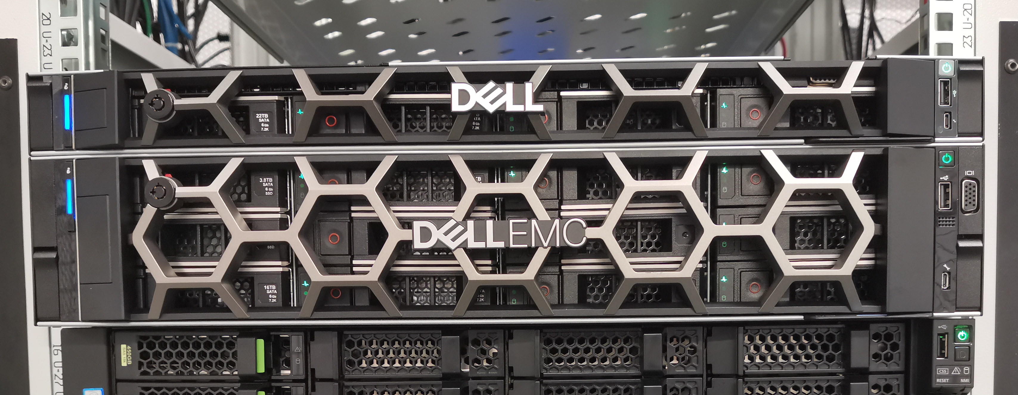
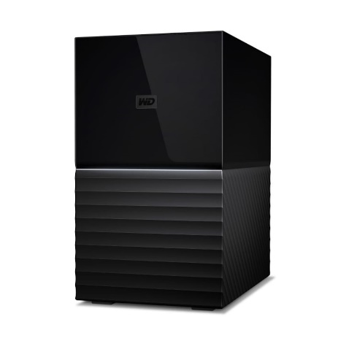
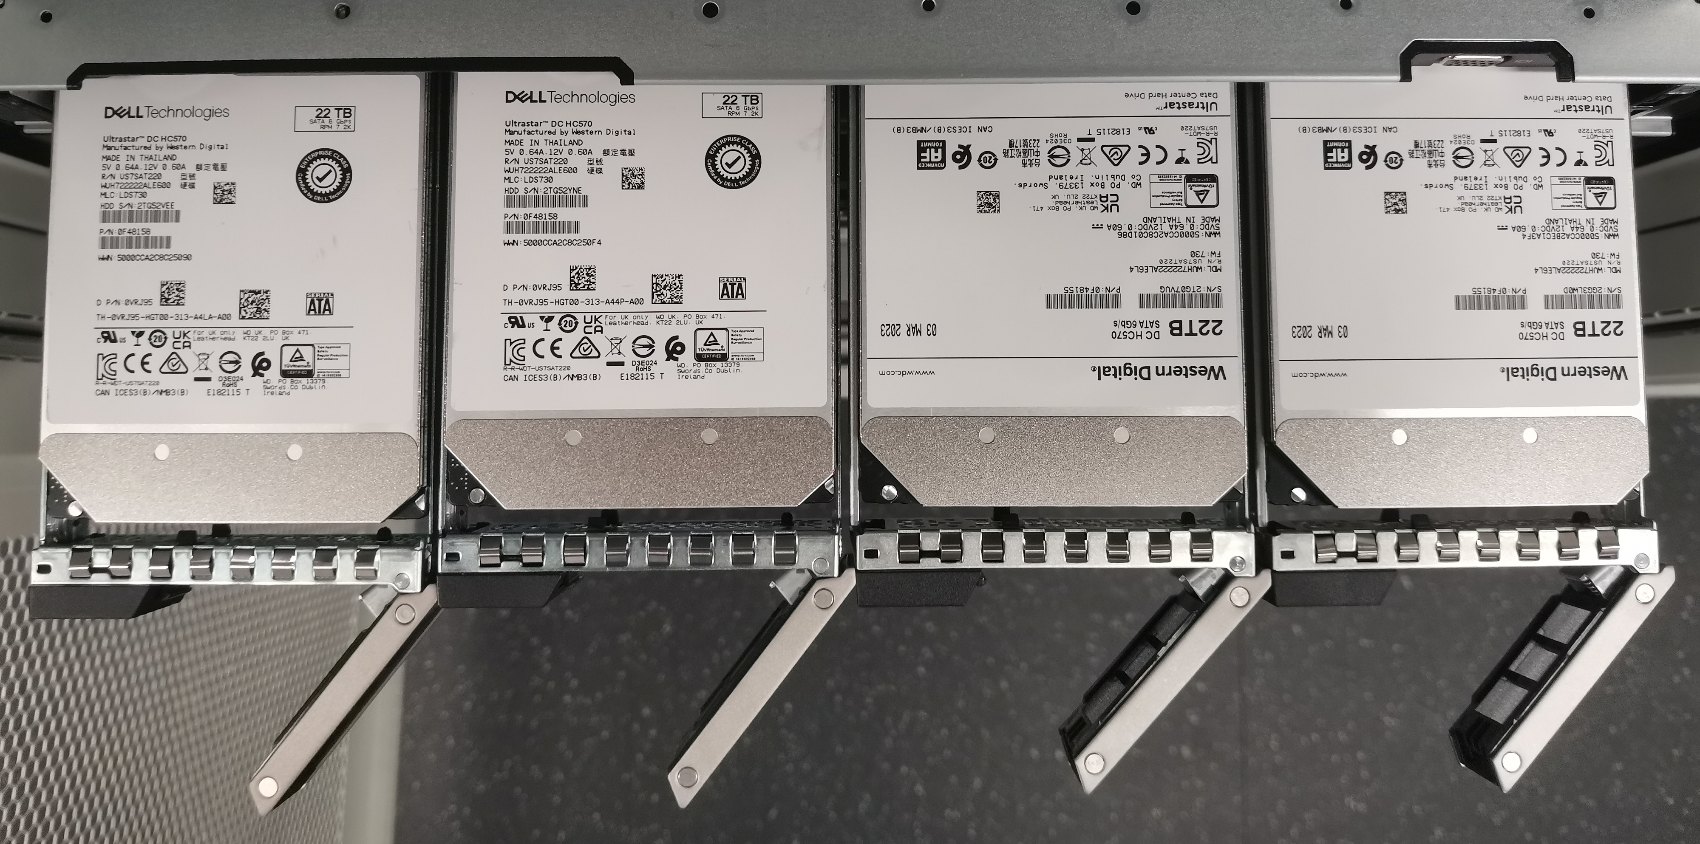
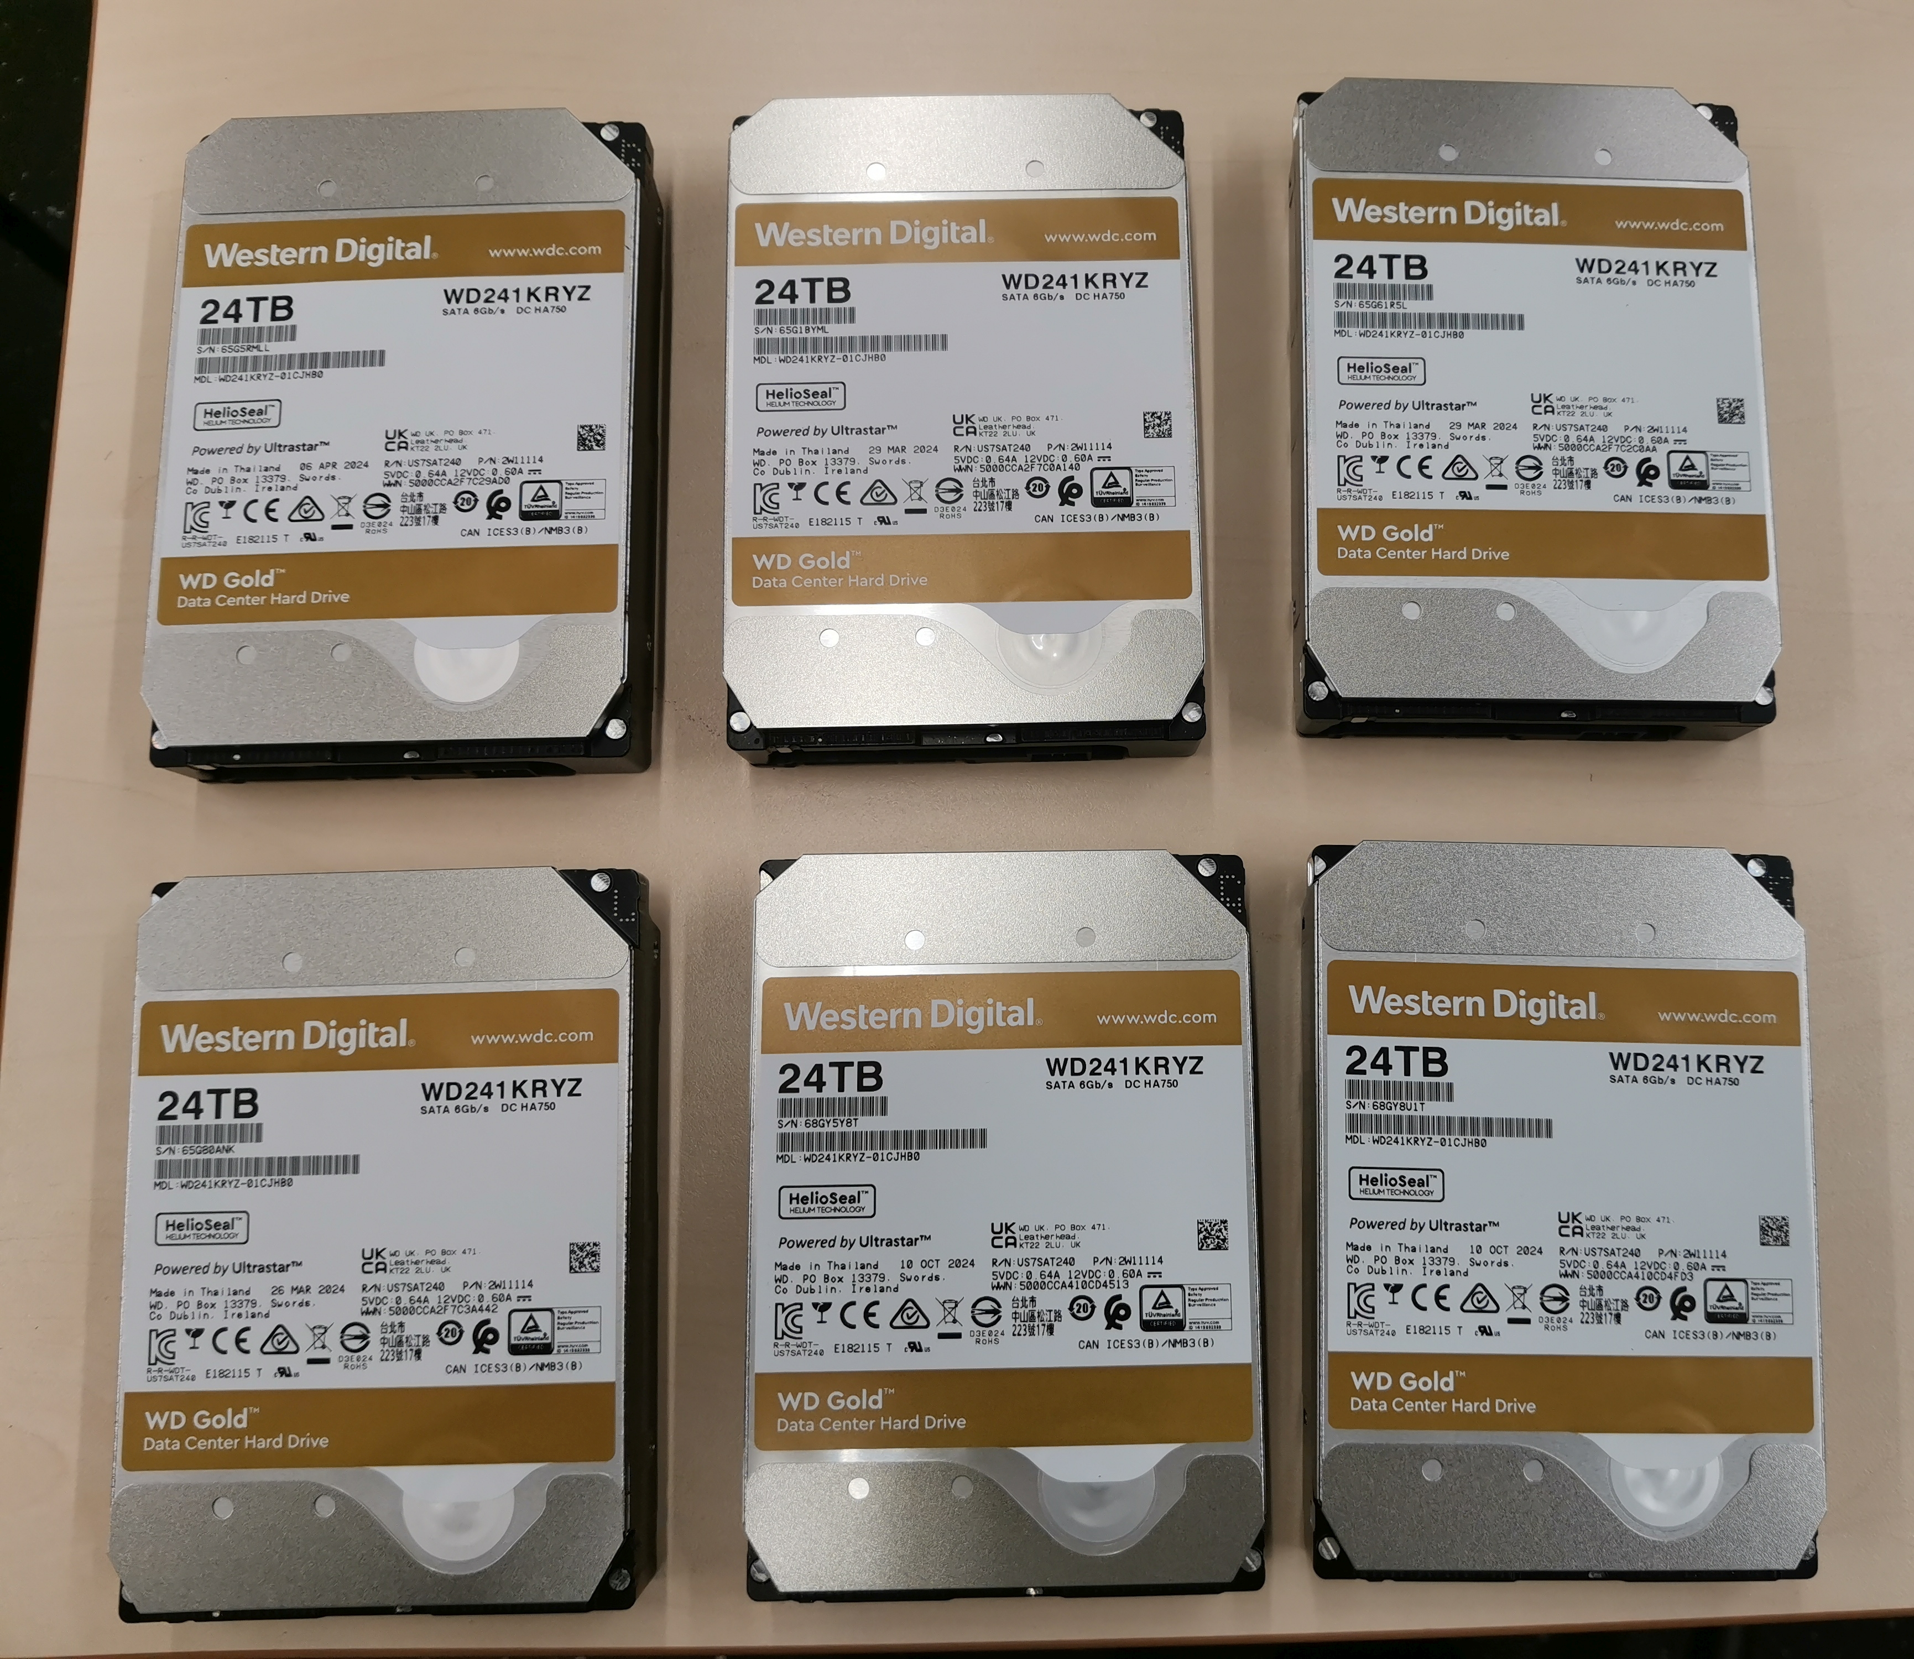
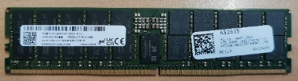
IT Infrastructure: Hardware Upgrade
Our own CRC/TRR 247 IT infrastructure (from 2022):
1U Dell PowerEdge R6615 (backup server)
  Upgraded storage: added 2 HDD (> RAID 5: 60 Tb)
  Upgraded memory: added 4 RAM (+256 Gb)
2U Dell PowerEdge R750 (main server: 42 Tb RAID 5)
  Upgraded storage: added 6 HDD (RAID 5: 100+ Tb)
External Backup: WD My Book Duo (21 Tb)
Currently used (CRC/TRR 247): 9 Gb of 42 Tb
INFrastructure plans:
Upgrade for Jupyter & ML applications (GPU)…
+
Everything runs 24x7 on a dedicated VM within a dedicated server (INF funding).
All data are backed up weekly on a dedicated external backup device + backup server.
https://www.delltechnologies.com/asset/en-iq/products/servers/briefs-summaries/poweredge-server-gpu-matrix.pdf

Slide 4
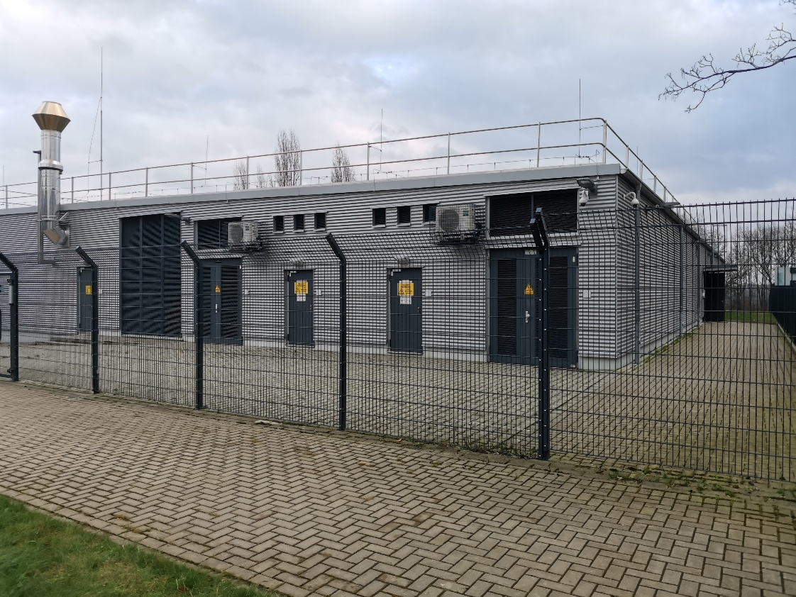
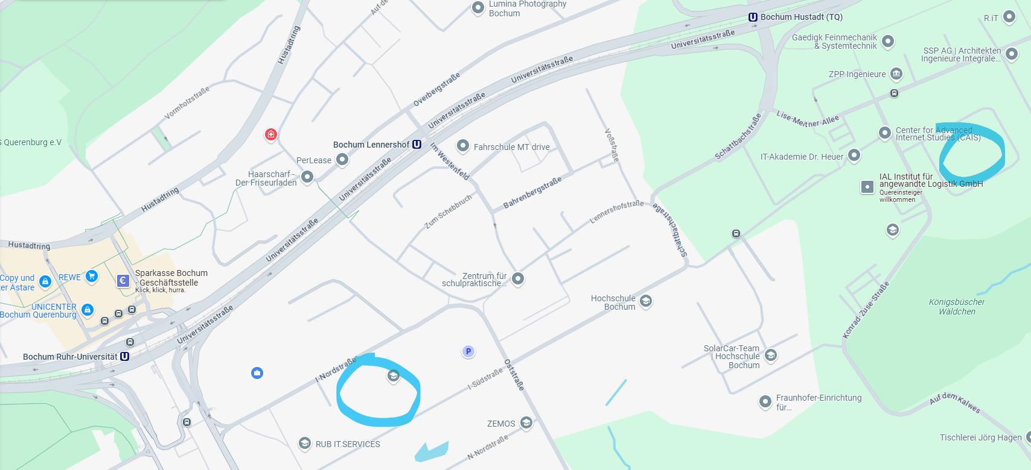
IT Infrastructure Disaster Tolerance
1U Dell PowerEdge R6615 (backup server)
moved to RUB DataCenter last Friday
(VK3/SK3/GN3 (DIN EN 50600)) + Another VLAN
Now the INFrastructure is catastrophe-tolerant
DC (RUB-Datacenter)
IC East Server room
Everything runs 24x7 on a dedicated VM within a dedicated server (INF funding).
All data are backed up weekly on a dedicated external backup device + backup server.
https://www.it-services.ruhr-uni-bochum.de/services/issi/server-housing.html.de

Slide 5
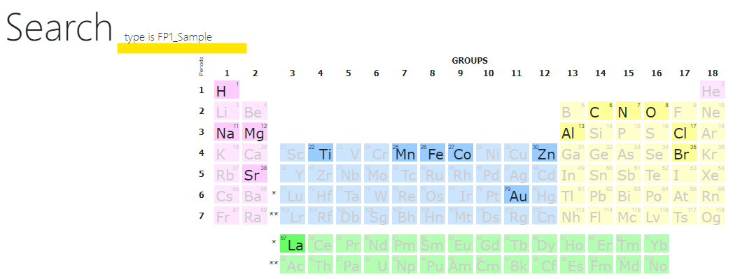
Funding Period 1 Data: Recovery Competed
Current status: 100% of data are recovered and available in the current RDMS:
3 types of entities from FP1 database (Samples, Experiments and Documents) are mapped to 21 new object types:
https://crc247.mdi.ruhr-uni-bochum.de/rubric/funding-period-1
FP1 in numbers:
77 inactive users (persistent authorship);
22060 objects (20284 files) including:
  743 samples,
  595 experiments,
  141 documents;
25972 links (between objects) of 4 types.
Examples (highly interconnected objects):
Multiple-typed links per object (3): https://crc247.mdi.ruhr-uni-bochum.de/object/exp_e201220_gp2os2
1968 referenced objects: https://crc247.mdi.ruhr-uni-bochum.de/object/exp_d211022_grcdsp
9 types of referenced objects: https://crc247.mdi.ruhr-uni-bochum.de/object/exp_e190214_reex
Elements from FP1 samples
FP1 – Funding Period 1
https://crc247.mdi.ruhr-uni-bochum.de/rubric/funding-period-1

Slide 6
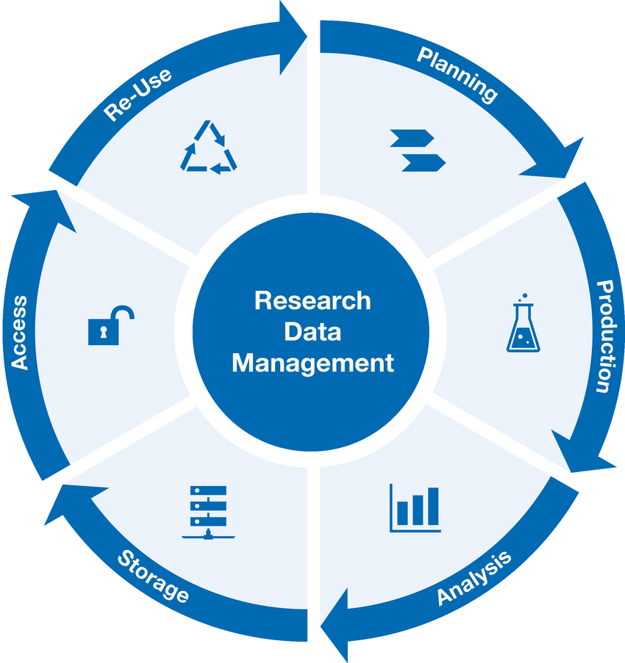
Research Workflow
and RDMS Object Types Interconnection
Research workflow support in RDMS
Defines characterizations
Provides report on samples & measurements
Idea or Plan
Calculation / Compu-tational Composition
Sample
Treatment:
annealing,
oxidation,
polishing, …
Sample_2
Report
Request for Synthesis
Characterisation:
EDX, XRD, Resistance, Bandgap, …
Characterisation:
EDX, XRD, Resistance, Bandgap, …
EDX – Energy-Dispersive X-ray spectroscopy (to determine composition)
XRD – X-Ray Diffraction (to determine crystallographic structure)
RDM Image source: Yazdi, M., Politze, M. and Müller, M. (2024) ‘A Novel Approach to Outlining Research Data Management Life Cycle: A Case Study’, Research gate, accessed 15.05.2024

Slide 7
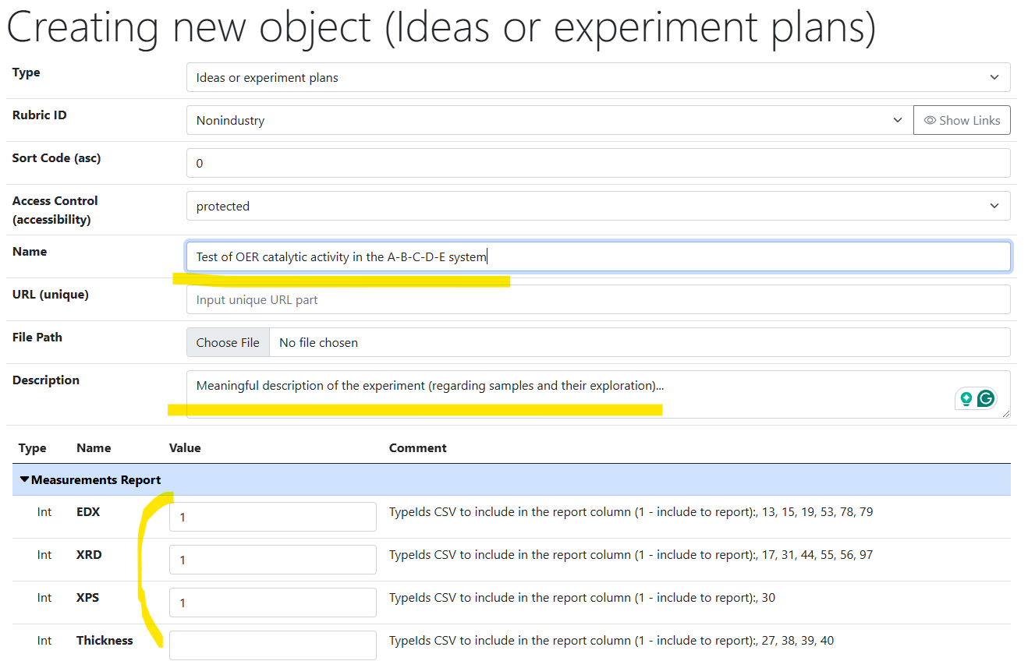
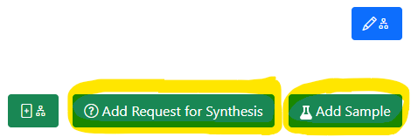
Idea or Experiment Plan
Motivation:
set up the workflow
by defining characterisation
for the experiment
(batch of samples)
Linked objects
https://mdi.matinf.pro/properties/edititem/103066
https://mdi.matinf.pro/object/standard-screening-crc-aka-tobias-report-103066

Slide 8
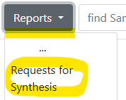
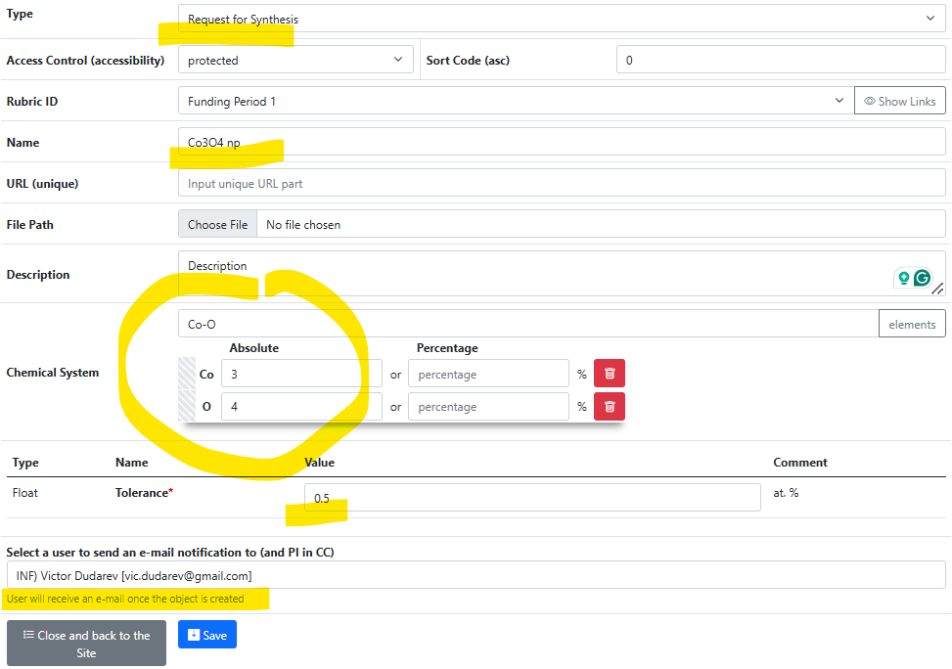
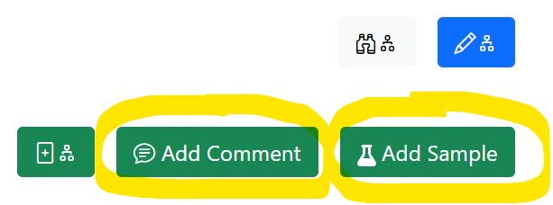
Request for Synthesis
Motivation:
Provide a technical task
by defining composition for sample synthesis
(batch of samples)
Linked objects

Slide 9
Data Integration: enriching composition data
{
"CompositionsForSampleUpdate": [
{
"Predicate": {
"Properties": [
{
"Type": 2,
"Name": "Measurement Area",
"Value": 1
}
]
},
"DeletePreviousProperties": false,
"Properties": [
{
"PropertyId": 0,
"Type": 1,
"Name": "R",
"Value": 34143346,
"ValueEpsilon": null,
"SortCode": 10,
"Row": null,
"Comment": "Resistance (Room Temperature) for Measurement Area 1"
}
]
},
...
],
"DeletePreviousProperties": true,
"Properties": [
{
"PropertyId": 0,
"Type": 1,
"Name": "R",
"Value": 97692.43229,
"ValueEpsilon": null,
"SortCode": 10,
"Row": 1,
"Comment": "Minimal Resistance (Room Temperature) of Materials Library (of all 342 MAs)"
},
{
"PropertyId": 0,
"Type": 1,
"Name": "R",
"Value": 34143346,
"ValueEpsilon": null,
"SortCode": 10,
"Row": 2,
"Comment": "Maximal Resistance (Room Temperature) of Materials Library (of all 342 MAs)"
}
]
}
Use case: adding characterization data after EDX is done.
Resistance for MA 1
Sample
EDX
composition
R
Resistance
x 342
Resistance range for object (whole ML)
Data import:
Locate parent sample object.
Find the collection of measurement areas.
Find a certain Measurement Area (corresponding to a predicate, e.g. MA index).
Add properties values to a composition corresponding to a measurement area index.
MA – Measurement Area
http://htts.matinf.pro/

Slide 10
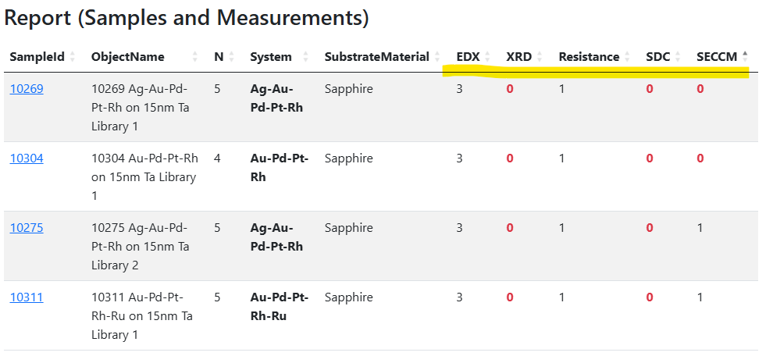
Report provided by “Idea or Experiment Plan”
Live monitoring: how well measurement workflows follow to the plan
Measurements according to the “Idea or Experiment Plan” object
Number of objects/documents according to measurement types
0 – no measurements done
https://mdi.matinf.pro/object/standard-screening-crc-aka-tobias-report-103066

Slide 11
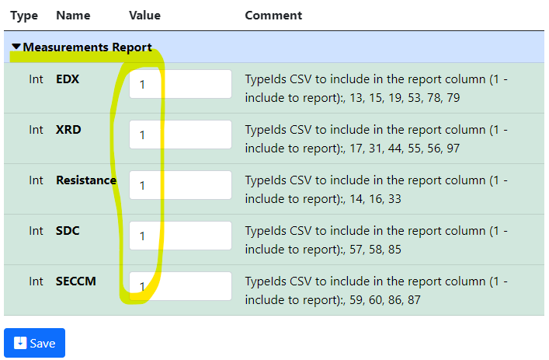
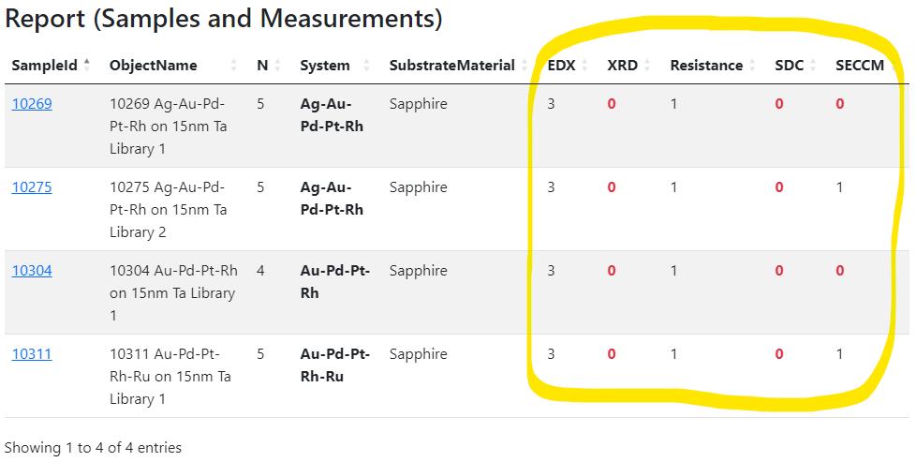
Idea or Experiment Plan: summary
Motivation: set up the workflow by defining characterisation for the experiment (idea or plan)
and track the progress.
Idea or Plan
1) Create “plan” object
2) Define characterisations
3) Add samples and
measurements…
4) Monitor workflows via reports in the “plan” object
https://mdi.matinf.pro/properties/edititem/103066
https://mdi.matinf.pro/object/standard-screening-crc-aka-tobias-report-103066

Slide 12
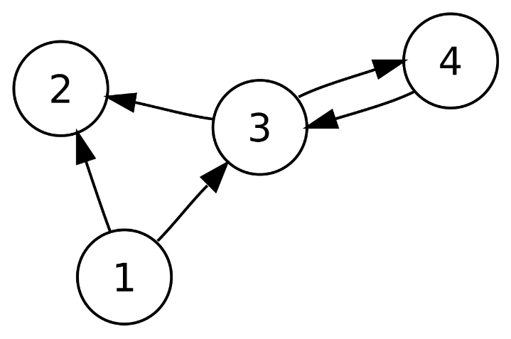
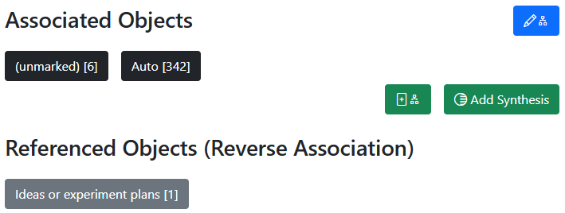
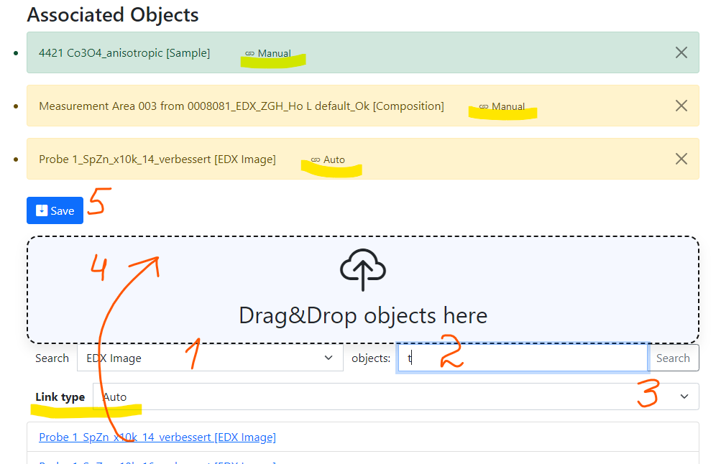
RDMS: Advanced Interlink Objects
a
a
c
Example: establishing graph above objects
b
directed graph
To add associated objects:
0) Go to “List edit” or select object to edit
1) Select associated object type (optional filter)
2) Input search phrase, contained in the Name of the desired object to be associated
3) Select (if required) link/association type object.
4) Drag & Drop desired object(s) from search result list to the area / adjust list
5) Save changes
Important: Reverse associations allow to browse reverse- directional associations.
User view: https://demo.mdi.ruhr-uni-bochum.de/object/ag2s-4870
Admin view: https://demo.mdi.ruhr-uni-bochum.de/adminobject/edititem/4870

Slide 13
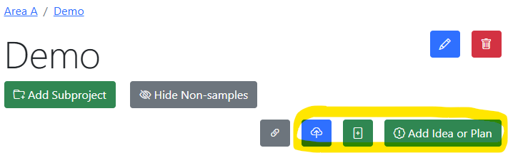
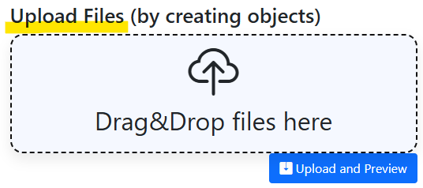
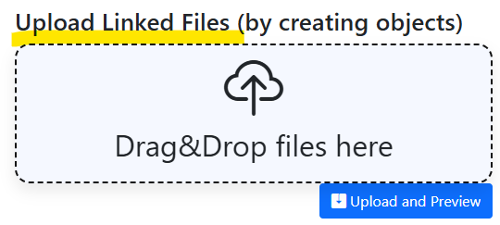
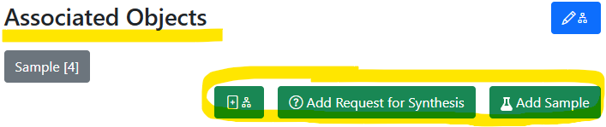
Graph: always think about object connections
In Project: add unlinked objects.
https://mdi.matinf.pro/rubric/industry
Add “top level” objects
Add “children/dependent” objects
In Object (under associated objects): add linked objects.
https://mdi.matinf.pro/object/standard-screening-crc-aka-tobias-report-103066
https://mdi.matinf.pro/rubric/industry
https://mdi.matinf.pro/object/standard-screening-crc-aka-tobias-report-103066

Slide 14
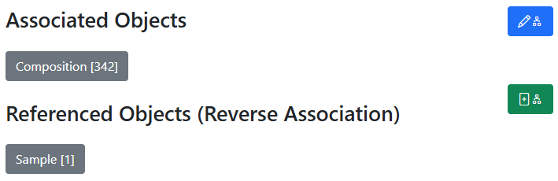
Oriented Graph: interlink & don’t mess up with directions
In all objects:
Control associated objects (children)
Child objects
Add a new (child) object + association
Parent objects
Idea or Plan
Sample
Synthesis
Request for Synthesis
Characterisations:
EDX, XRD, Resistance, Bandgap, …
342
x
Compositions

Slide 15
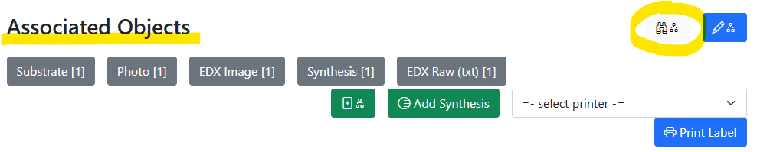
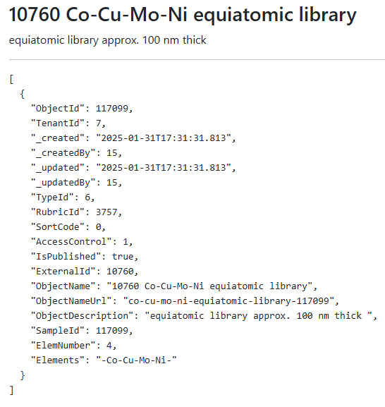
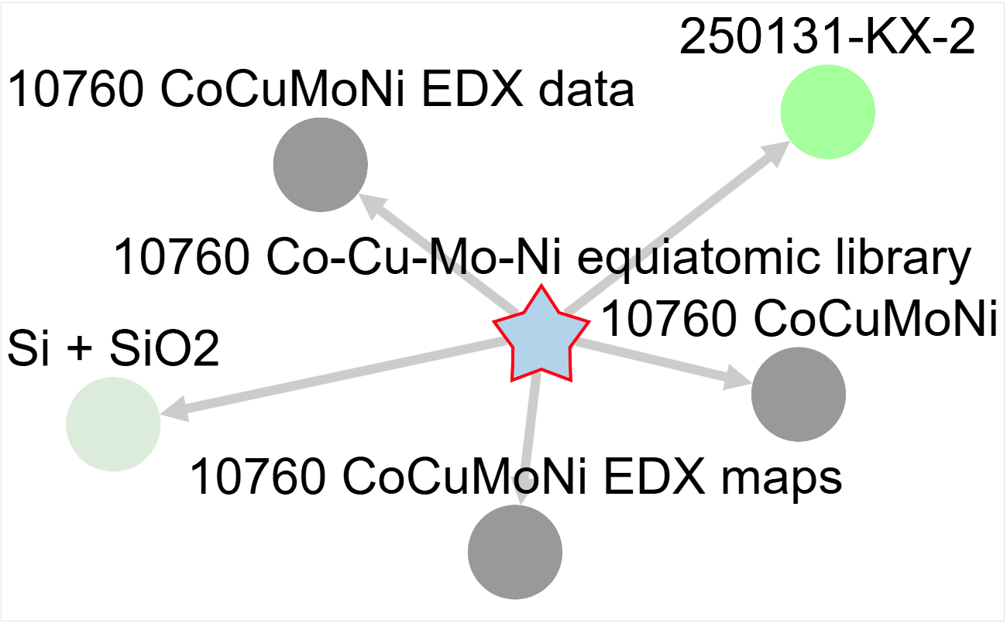
Graph visualisation
Motivation: understand relationship between objects
JSON description
Interactive graph
JSON
https://mdi.matinf.pro/object/co-cu-mo-ni-equiatomic-library-117099
https://mdi.matinf.pro/object/graph/co-cu-mo-ni-equiatomic-library-117099

Slide 16
Documentation
The link is in the footer on every page:
Documentation content:
User manual
  Many thanks to: Irina Roslyakova, Felix Thelen, Alan Savan, Tobias Piotrowiak, Jill Fortmann, Ellen Suhr, Sabrina Baha, Florian Lourens, Valerie Strotkötter, Rico Zehl, Patrick Marx, Aurelija Mockute, Elaheh Akbarnejad, Sigurd Thienhaus
Presentations, videos
Database structure description (tables and views)
User-defined type (UDT) system:
  Object type configuration
  UDT support API (validation, data extraction, visualization)
  UDT: supported formats (EDX, Resistance, Thickness)
System settings
Tenant settings
API
Source code
https://crc247.mdi.ruhr-uni-bochum.de/home/doc

Slide 17

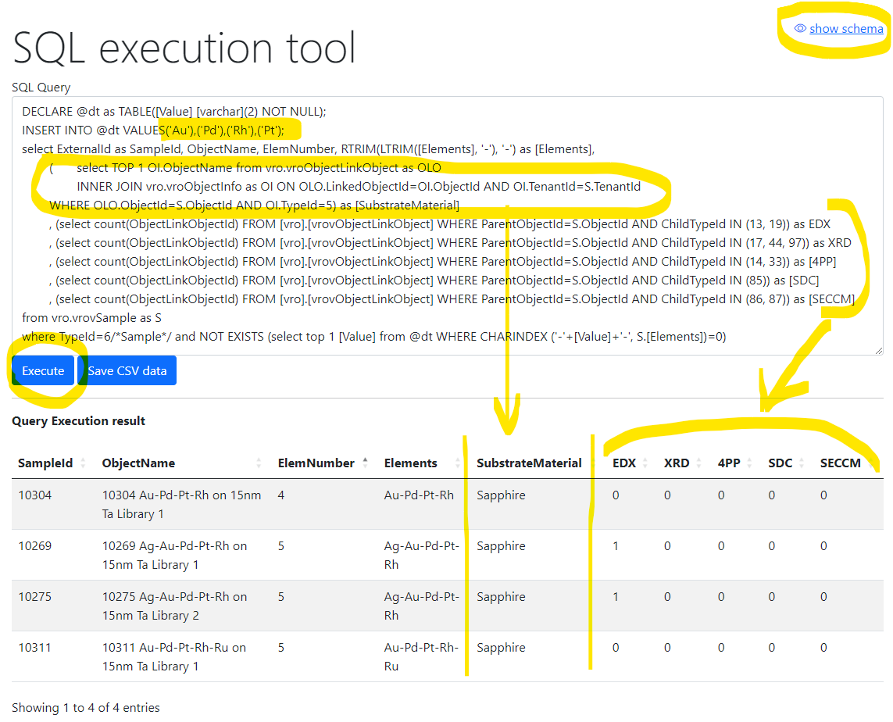
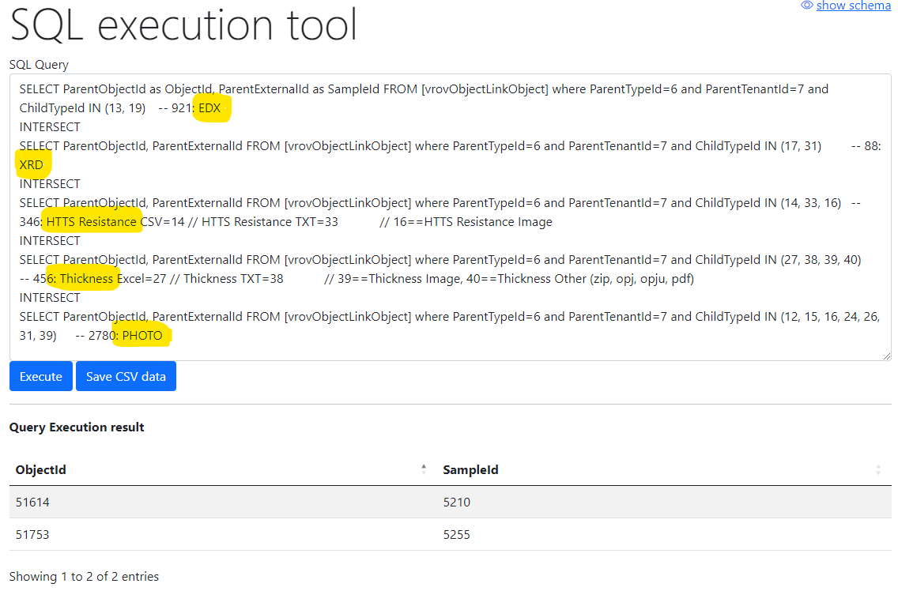
Flexible data queries for advances users
Database schema documentation:
https://mdi.matinf.pro/home/doc
Ex.1) Show samples having Au-Pd-Rh-Pt and how many characterisation documents for them we have (EDX, XRD, 4PP, SDC, SECCM)
Ex.2) Show samples (identifiers) that have all enlisted characterisations: EDX, XRD, Resistance, Thickness, Photo
https://mdi.matinf.pro/vroui
https://docs.google.com/document/d/1TDtHwtjP4RSXJw6m7jBvtmlSZ4qUBqWD/edit?usp=sharing&ouid=117346421118620353373&rtpof=true&sd=true
EDX - Energy-Dispersive X-ray spectroscopy; XRD - X-ray diffraction; 4PP – 4 Points Measurement (Resistance);
SDC - Scanning Droplet Cell; SECCM - Scanning ElectroChemical Cell Microscopy

Slide 18
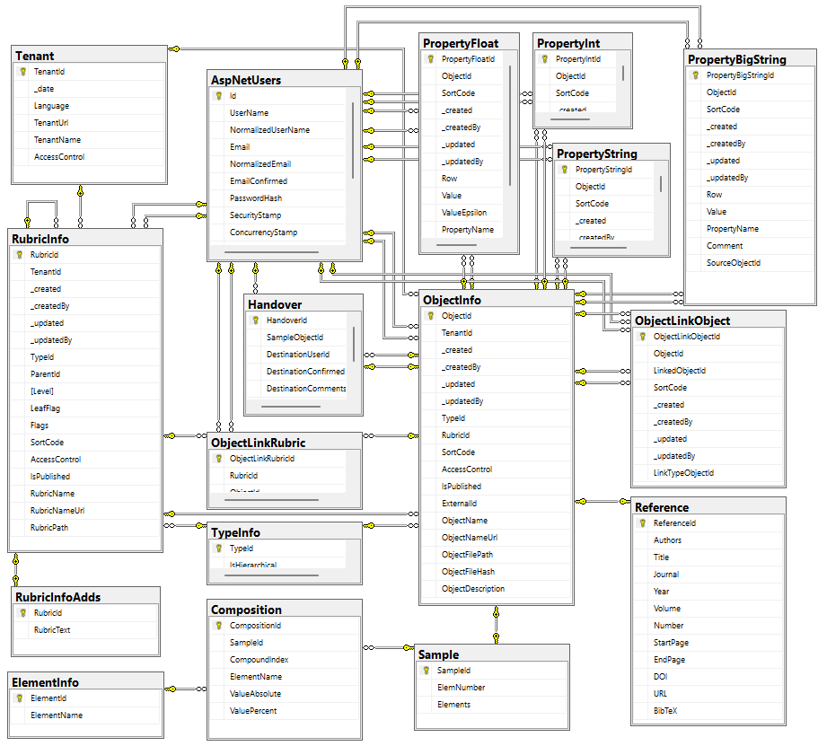
Data acquisition API
Two architectural implementation opportunities:
Provide a set of methods to deal with each table
Develop read-only views and let user introduce queries over them
POST /vroapi/v1/execute
Executes SQL statement and returns dataset (in JSON)
GET /vroapi/v1/download
Downloads document by specified identifier (ObjectId)
Database schema documentation:
https://mdi.matinf.pro/home/doc
https://mdi.matinf.pro/home/doc
https://docs.google.com/document/d/1TDtHwtjP4RSXJw6m7jBvtmlSZ4qUBqWD/edit?usp=sharing&ouid=117346421118620353373&rtpof=true&sd=true

Slide 19
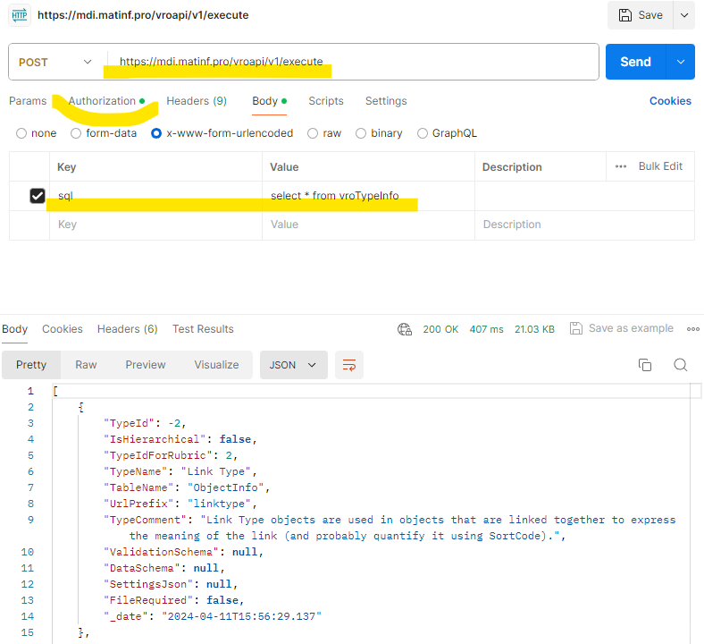
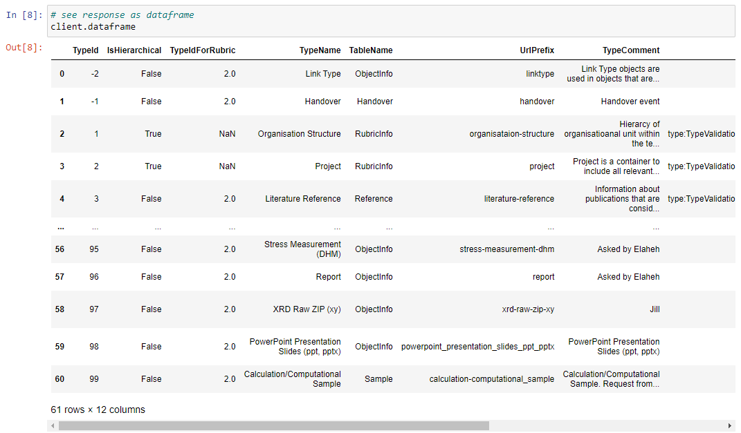
API for running arbitrary read-only queries
POST /vroapi/v1/execute
Executes SQL statement and returns dataset (in JSON)
Python wrapper to use API:
# 1. Specify tenant URL (since numerous tenants exist)
service_url = "https://mdi.matinf.pro" # tenant URL
# 2. Specify API Key ("VroApi" user claim)
api_key = "<api-key>" # your api_key here
# 3. Create a client object
client = MatInfWebApiClient(service_url, api_key)
# 4. Execute SQL and get result
result = client.execute("select * from vroTypeInfo")
# result – contains JSON
# client.dataframe – contains pandas.DataFrame
https://www.postman.com/downloads/

Slide 20
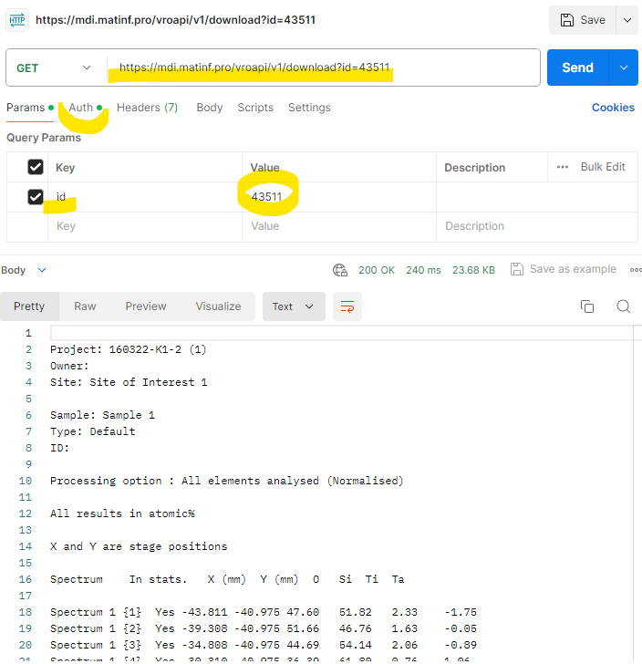

API for downloading documents
GET /vroapi/v1/download
Downloads document by specified identifier (ObjectId)
Python wrapper to use API:
# 1. Specify tenant URL (since numerous tenants exist)
service_url = "https://mdi.matinf.pro" # tenant URL
# 2. Specify API Key ("VroApi" user claim)
api_key = "<api-key>" # your api_key here
# 3. Create a client object
client = MatInfWebApiClient(service_url, api_key)
# 4. Download object file by ObjectId
result = client.download(43511)# ObjectId
# result – contains HTTP response
# result.content – contains file data
# client.file_name – contains the file name
https://www.postman.com/downloads/

Slide 21
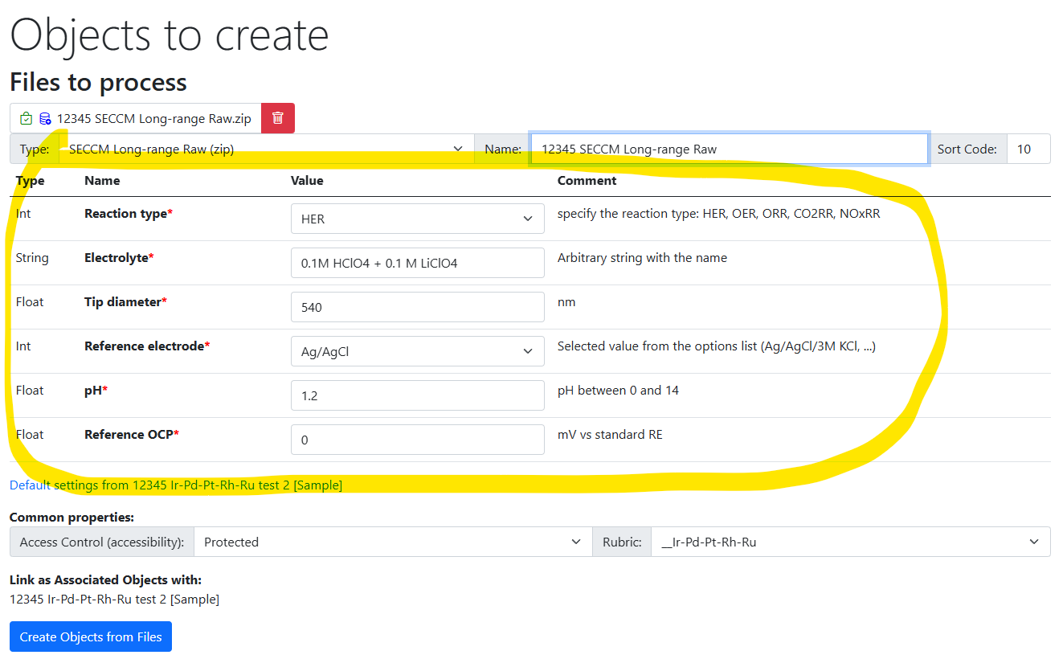
“Invisible” Improvements
RDMS Core Improvements:
Enhanced templates:
  required properties
  properties-based validation
  properties forms on object creation / file upload
  properties with a controlled drop-down list
New Access Level: ProtectedNDA
Search results improvement (enrich with properties)
SQL / read only API
Advanced object linking: “link type” object to characterize edge in the graph
UDT Web Service Template in C# and Python
Documentation

Slide 22
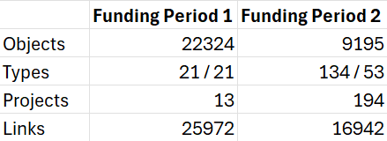
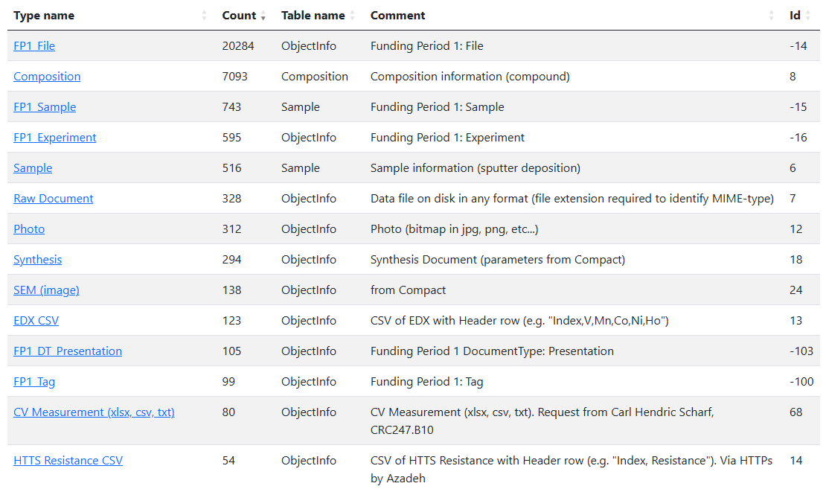
Current Data Status: overview
Funding Period 1 (<11.2022):
Objects: 22324
Types: 21 / 21
Projects: 13
Links: 25972
Funding Period 2 (≥11.2022):
Objects: 9195
Types: 134 / 53
Projects: 194
Links: 16942

Slide 23
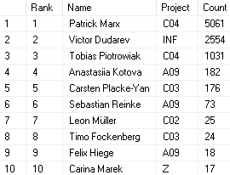
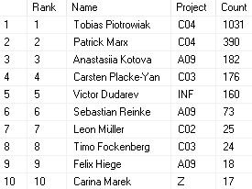

Current Data Status (FP2 only): personal contributions
Unfair: with x342 compositions per sample
Fair: x342 compositions are not considered
https://crc247.mdi.ruhr-uni-bochum.de/report/usersstatistics

Slide 24
Future plans
Data management workshop (online)
13.03.2025 Thursday 14:00-16:00
Core improvements:
  Integrated dataset generation for a sample / group of samples
  Data pagination / lazy load (performance)
  Data write API (direct connection for external devices to RDMS)
User data formats integration (XRD (ICSD / Pearsons integration), SDC, SECCM)…
Integration with Jupyter Hub (data processing scripts / calculations / ML)
Integration with NFDI (NOMAD by FAIRmat)
External workflow support agent (notifications, TO DO lists, Slack integration)
… your wishes - feel free to suggest

Slide 25
Thanks for your kind attention
Q&A
Victor Dudarev
Victor.Dudarev@rub.de
https://vdudarev.ru

Slide 26


Awards for data contribution
Awards from INF (the winner is…):
The most productive data creator in FP2 award (area/project/person)
The people’s choice award: project subtree clarity
The citation / popularity award

Slide 27
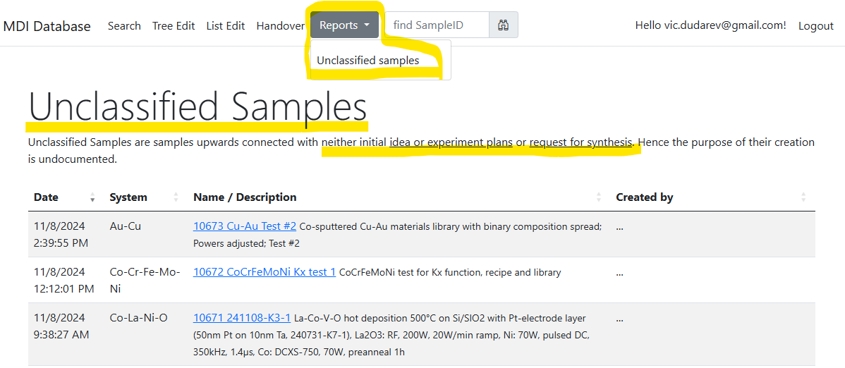
Unclassified samples: these should not exist anymore…
Goal: all samples should have a parent “Idea or Experiment Plan” / “Request for synthesis”
https://mdi.matinf.pro/report/unclassifiedsamples

