Slide 1

Overview of RDMS Infrastructure for CRC/TRR 247
Victor Dudarev
Victor Dudarev

Slide 2
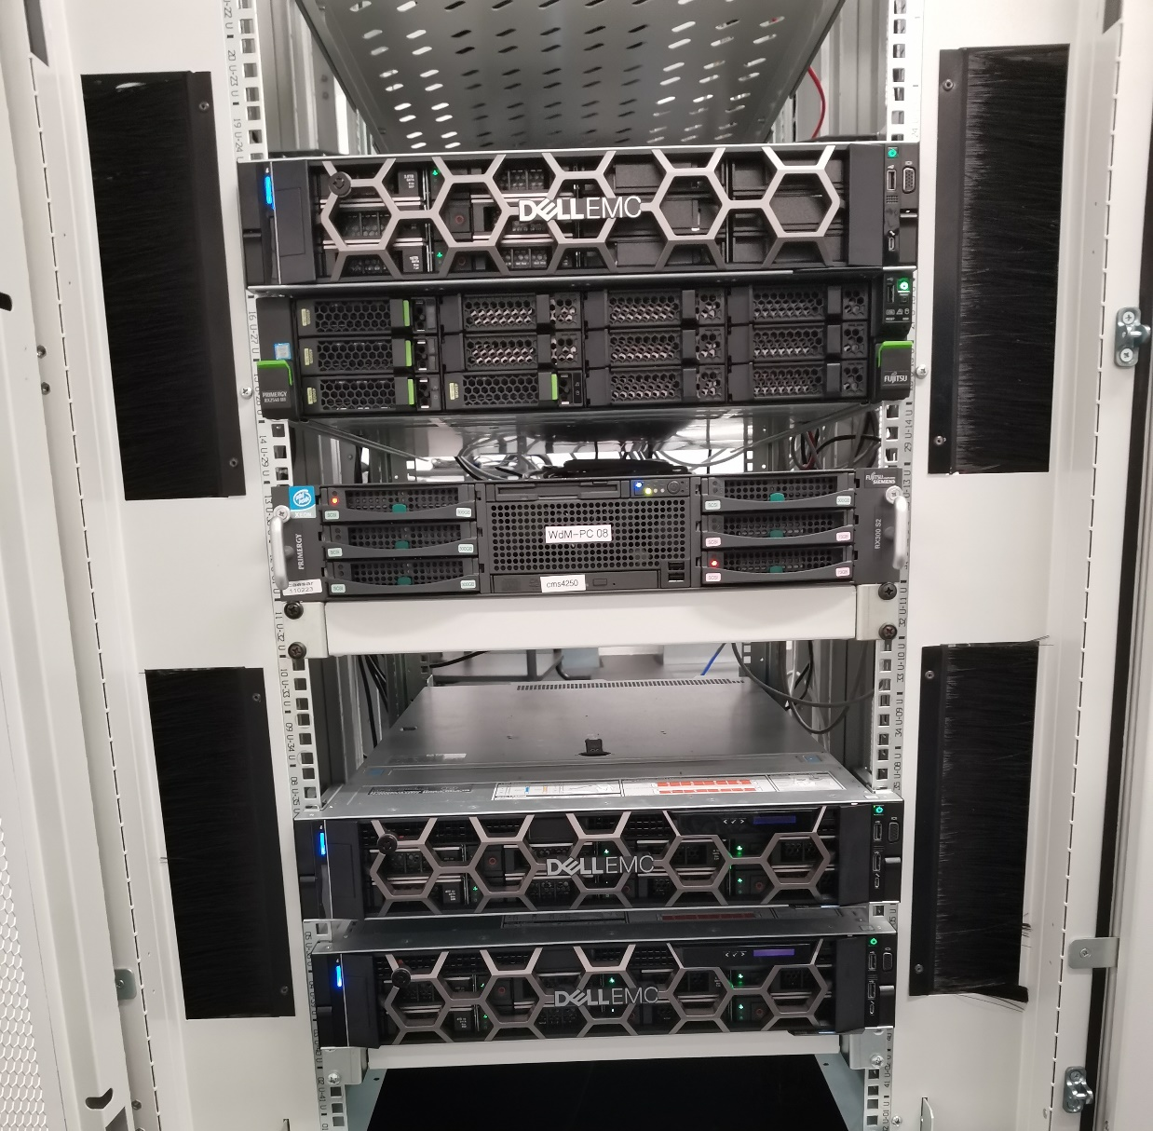


IT Infrastructure
Our own CRC/TRR 247 IT infrastructure:
2U Dell PowerEdge R750 (42 Tb RAID 5)
External Backup: WD My Book Duo (21 Tb)
Currently used (CRC/TRR 247): 9 Gb of 42 Tb
In plans this year (backup server: disaster tolerance):
1U Dell PowerEdge R6515 (22 Tb RAID 1 + ext.)
Everything runs 24x7 on a dedicated VM within a new server (INF funding).
All data are backed up weekly on a dedicated external backup device.
No disaster tolerance: all devices are physically in a single server room.

Slide 3




Motivation
Develop a Research Data Management System framework with a focus on materials science
Electronic Lab Notebooks & Wiki:
No support for materials science entities
(chemical systems, compositions)

Slide 4
RDMS in Chemistry-related Domains: Requirements
Priorities (SFS): Security + Flexibility + Scalability
Requirements (functional capabilities):
Support for multiple Tenants;
Implement User Registration (including e-mail verification) and Authorization;
Implement Administrative Interface to Control Users and Groups;
Establish Predefined Roles (Administrator / PowerUser / User) with corresponding permissions;
Ensure Data Access Policy (public / protected / protectedNDA / private) for all stored objects based on Object Access Level;
Adjust Functionality of RDMS according to authorized user role (Administrator / PowerUser / User);
Provide Flexible Tree Classification for stored documents (projects / organizational structure);
Upload and Store Objects (documents) with minimalistic mandatory metadata;
Provide means to Support Chemical Entities data types: systems, compositions, crystal structures;
Enable to Interlink Objects manually (associative objects) and show the resulting reverse associations;
Flexibility: implement Extended Properties for Objects and support search on them;
Import and Export object table properties from/to Excel; support table properties templates & properties templates;
Provide Search Interface on chemical entities and objects with respect to user access level;
Known object types Bulk Import from data files (w.r.t. schema validation, data extraction);
Flexibility: enable to easily Introduce Additional Object Types with predefined mandatory fields set*;
Provide Reports / Charts / Diagrams on stored data in various aspects;
API to upload data from measurement devices (Bandgap, Resistance, etc…).
RDMS: Research Data Management System
* - depending on object type complexity / performance requirements may require programming (extra tables introduction in DB)

Slide 5

RDMS Core Features
Support for multiple Tenants;
Flexible Project Tree;
User-defined Object Type support:
  Properties Templates
  Table Templates
  Document Validation
  Data Extraction
  Data Visualization
Batch Import of Documents
UI Customization (with HTML/JS/CSS injection)
Materials science orientation
System
(qualitative composition)
Co-O
Substance
(quantitative composition)
Co₃O₄
Modification
(crystal structure type)
β-Co₃O₄
…
RDMS: Research Data Management System

Slide 6
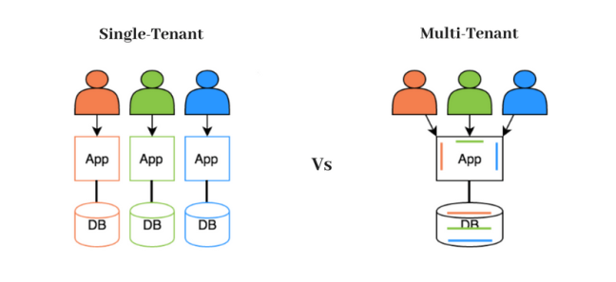
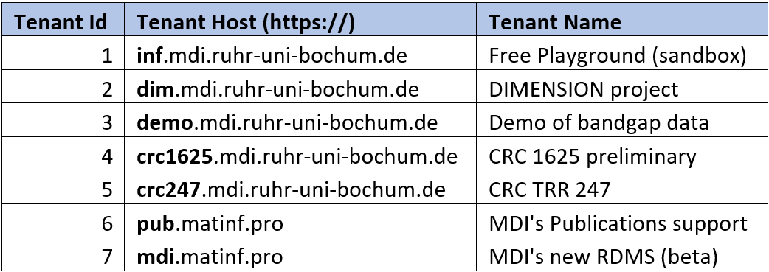
RDMS: Multiple Tenant Support
What is Tenant?
Short answer:
Tenant – separate (distinct) instance of a software application that
is used by a single organization or group of users.
Long answer:
Tenant is a customer account that has its own set of users, data, and configuration settings, and is isolated from other tenants in the same software application. This concept is commonly used in Software as a Service (SaaS) applications, where a single software application is hosted in the cloud and is made available to multiple customers as separate tenants. This allows each customer to have their own instance of the application, with their own data, settings, and customizations, while still sharing the underlying infrastructure and resources of the application.
Active tenants:
Every tenant must have a unique URL!
Conclusion:
Tenants are useful for separate projects / workgroups /
materials data repositories.
https://en.wikipedia.org/wiki/Multitenancy

Slide 7
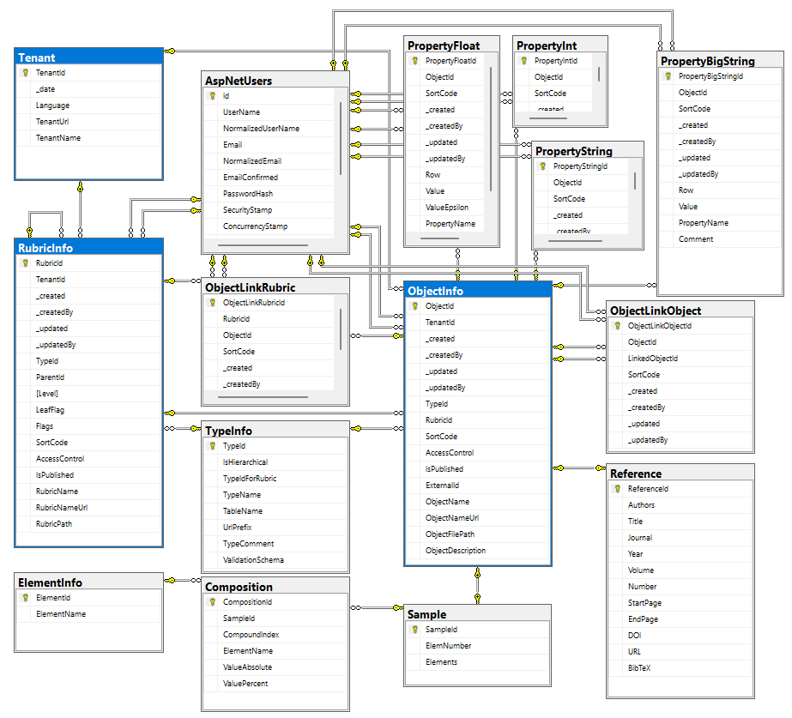
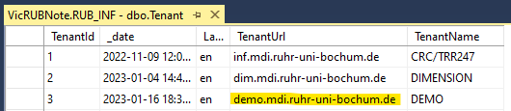
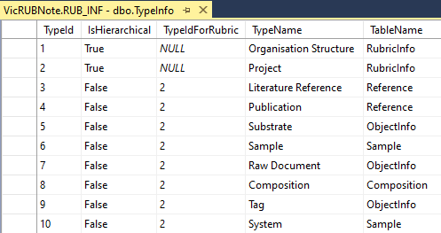
RDMS Database
Tenants (independent systems):
Every tenant must have a unique URL!
Data Types (can be shared among tenants):

Slide 8
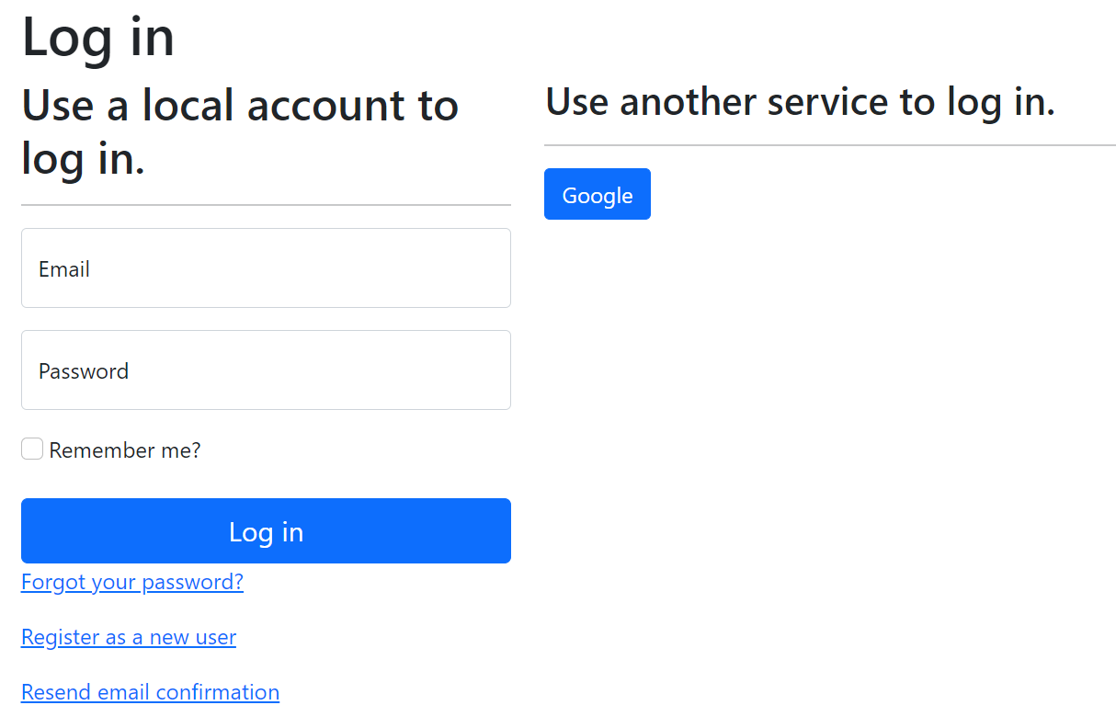
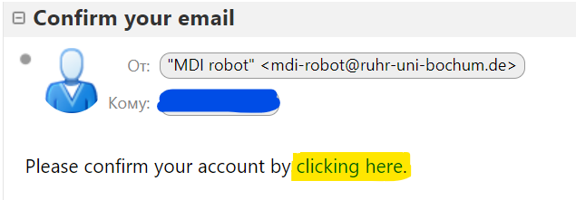

RDMS: Registration and Authorization
Application access level is determined by the current user context.
Two-way registration (choose any):
using external provider (OpenID Connect), e.g. Google (external authentication authority is used, no credentials are stored locally).
using local account (credentials are stored internally);
In both cases, an e-mail address is required, and its successful verification is a prerequisite for access.
After e-mail confirmation, the user is considered active, but does not have an assigned user group.
https://openid.net
https://en.wikipedia.org/wiki/Authentication
https://en.wikipedia.org/wiki/Authorization

Slide 9
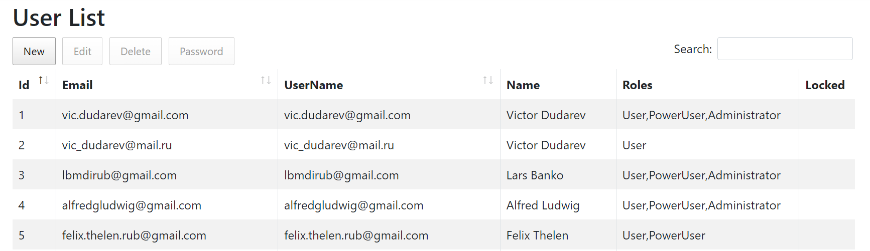
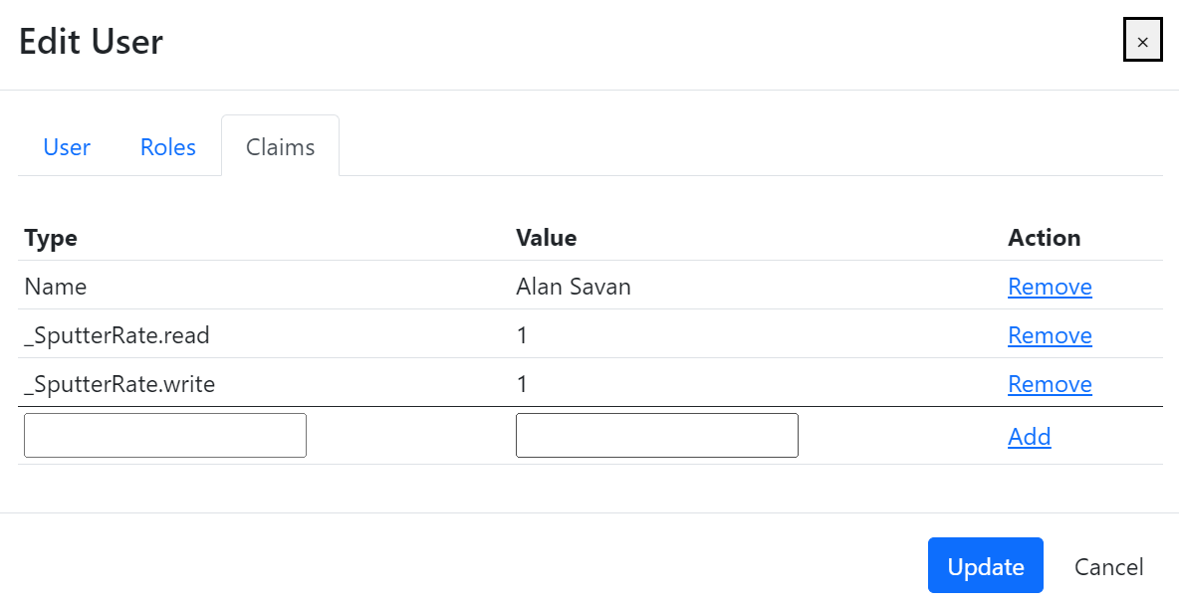
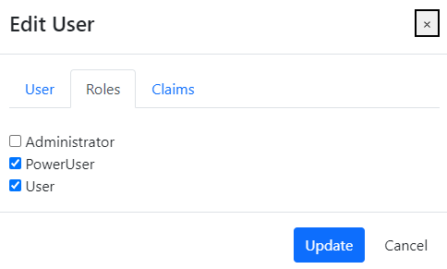
RDMS: Identity User Control Interface
Features:
Registered users management
Roles management
Claims management
Claim is a piece of information (key-value pair) that describes a user. Claims are stored in a user's identity and can be used to determine what actions a user is authorized to perform, such as accessing certain pages or resources.
https://learn.microsoft.com/en-us/aspnet/core/security/authentication/identity

Slide 10
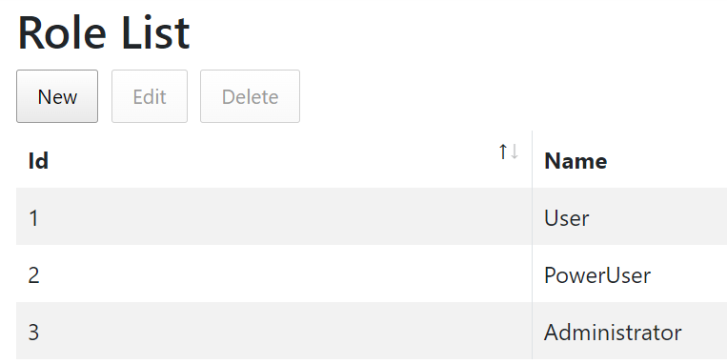
RDMS: Predefined Roles
Roles:
User:
    - read-only access to public and protected data
PowerUser:
- read-only access to public and protected data (+ private data, created by the current user)
- add data (+ write access to data, created by the current user)
Administrator:
- full access to all data (CRUD)
- user management
Anonymous (== registered user with no roles assigned):
- read-only access to public data only (be aware: internet search engines will index public data)
https://en.wikipedia.org/wiki/Role-based_access_control

Slide 11
RDMS: Setting the Object Access Level
What is an Object?
Object (=document) is a data entry within RDMS that has user-defined access level and reflects an object of the real world (e.g. sample) or its model. Ultimately, object has it’s unique Web page (with unique URL address).
To establish data access policy Data Access Levels are introduced in RDMS.
Four Access Levels:
Public (default, we are doing open science, FAIR, aren’t we?):
    objects are available to everybody regardless of authorization (visible to internet search engines);
Protected (visible to the community only):
- objects are visible to the community (available to authorized users with at least User role assigned);
ProtectedNDA (visible to the community only):
- objects are visible to the restricted community (see protected + user should have NDA claim set to 1);
Private (person’s secret, but open for Administrators):
- objects are visible to the user-creator (at least PowerUser role assigned);
- objects are visible to all users of Administrator role.

Slide 12
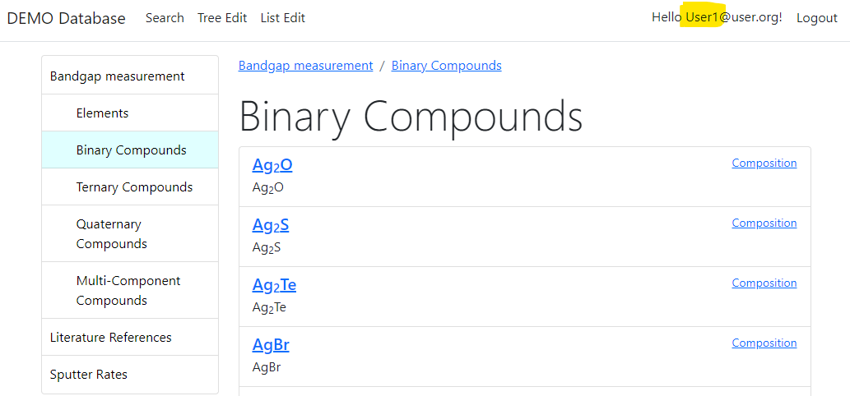
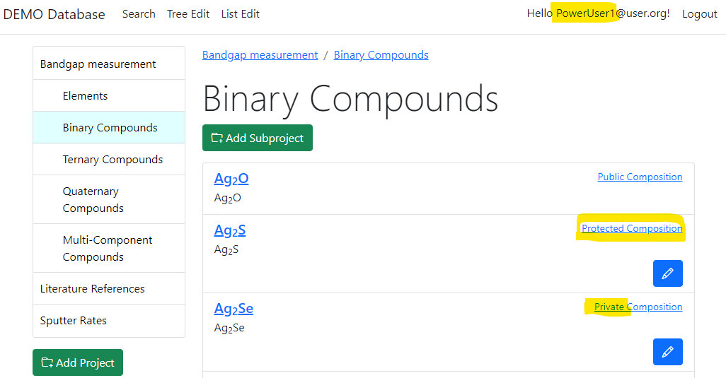
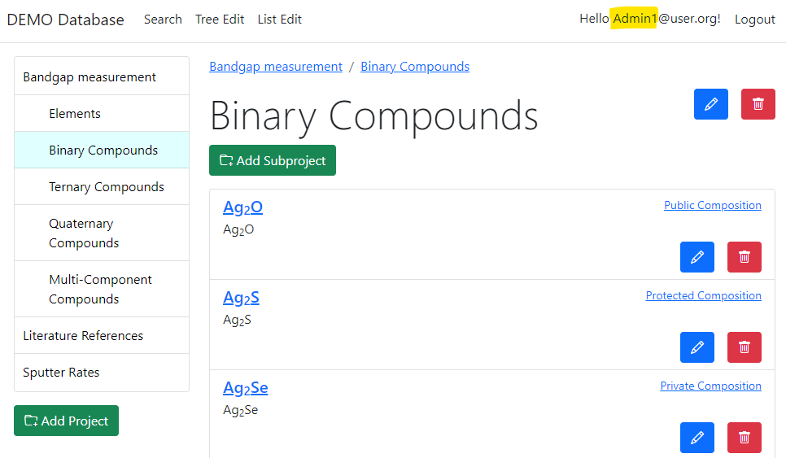
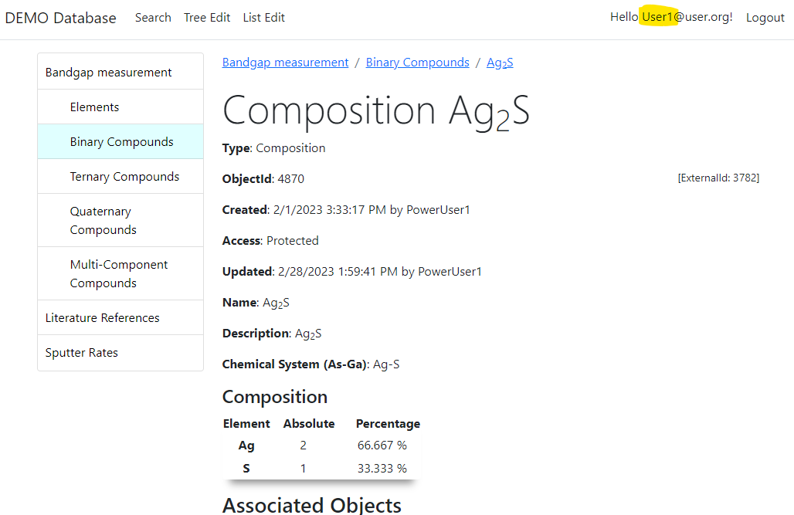
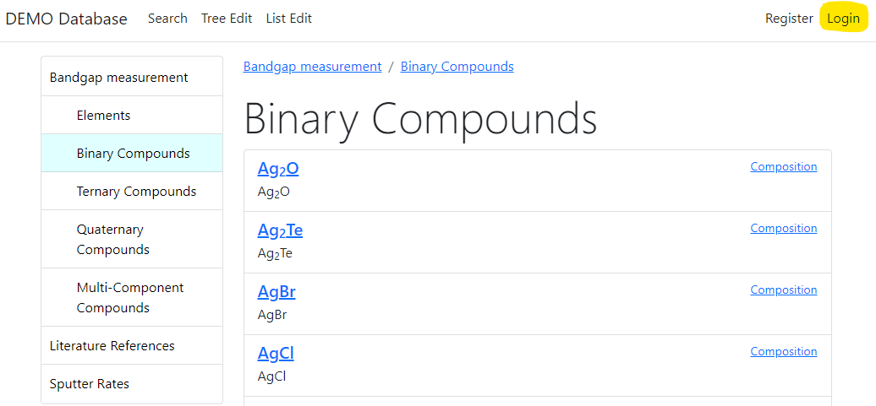

RDMS: Adjust Functionality According to User Permissions
User credentials (role) affects user interface: https://demo.mdi.ruhr-uni-bochum.de/rubric/binary-compounds
User1 (User role) PowerUser1 (PowerUser role) Admin1 (Administrator role)
Authorized CRC Community
User (no role) = Anonymous (search engine)
Preconditions:
Ag₂O created (public) by Admin1
Ag₂S created (protected) by PowerUser1
Ag₂Se created (private) by PowerUser1
Accessible (visible)
Denied (hidden)
Visit
https://demo.mdi.ruhr-uni-bochum.de/object/ag2s-4870
User => access granted
Anonymous => access denied
Login and Password (User): User1@user.org
Login and Password (PowerUser): PowerUser1@user.org
Login and Password (Administrator): Admin1@user.org

Slide 13
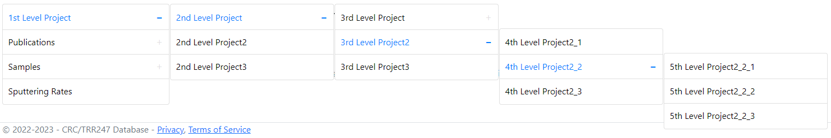
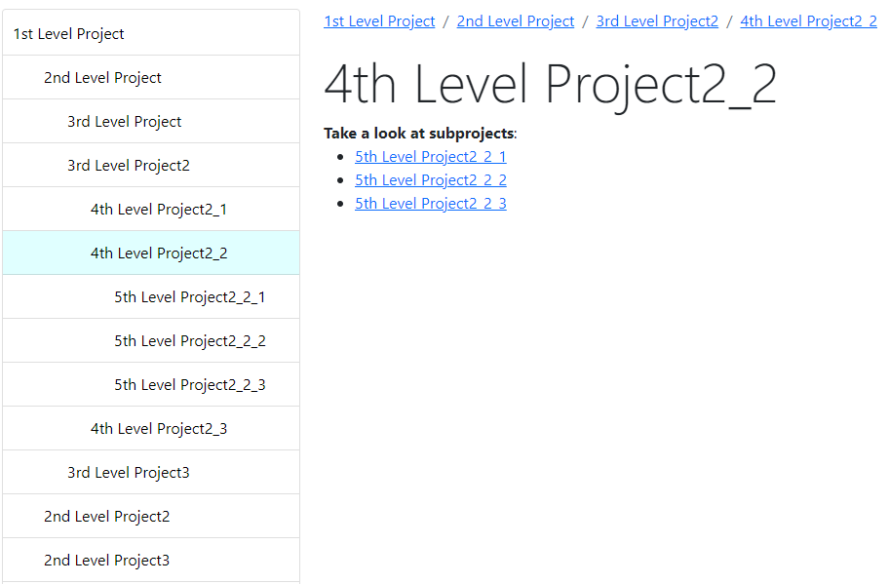
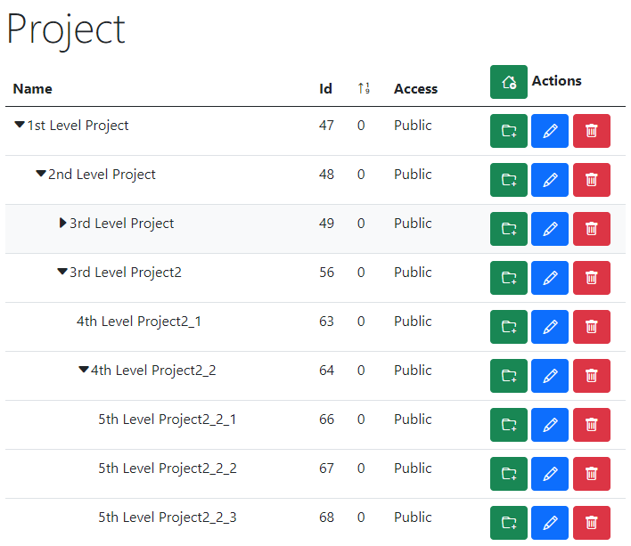
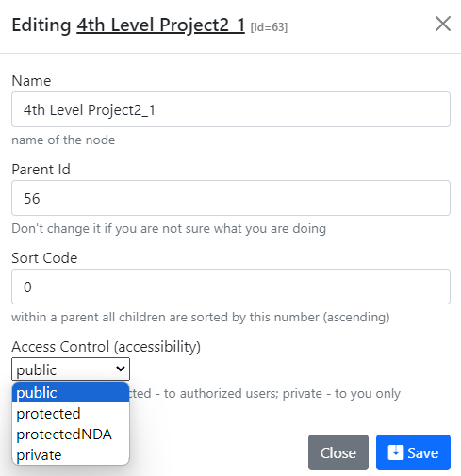
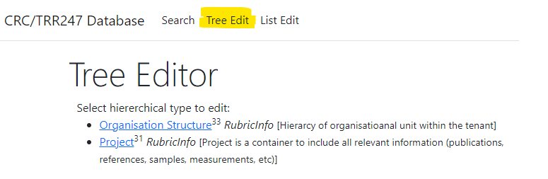
RDMS Tree Types: control and display
Display for users in Web Application
Control (admin):
Name
Parent Id
Sort Code
Access
https://demo.mdi.ruhr-uni-bochum.de/

Slide 14
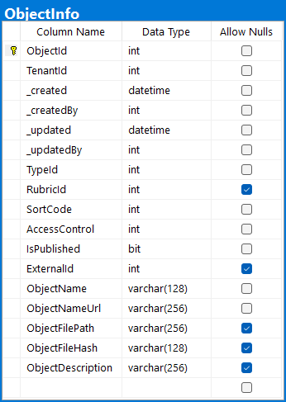
RDMS: Upload and Store Documents (with minimalistic mandatory metadata)
Unique Object Identifier (assigned automatically), primary key
Tenant Identifier (assigned automatically based on URL address)
User who created the object and date with time (automatically)
User who modified the object and modification date and time (auto)
Object type reference (determined by user on object creation)
Project (tree-structure) reference (can specified by user on object creation)
Code to define a certain order in list of objects (auto, can be changed)
One of predefined Object Access Levels: public / protected / protectedNDA / private
Name of the object (must be specified), unique within object type in tenant
Relative URL for page to access object (auto formed; can be changed)
Reference to Data File uploaded to system (uploading by choice)
SHA-256 file hash (must be unique within every tenant)
Object Description (can be empty, as all nullable attributes above)

Slide 15
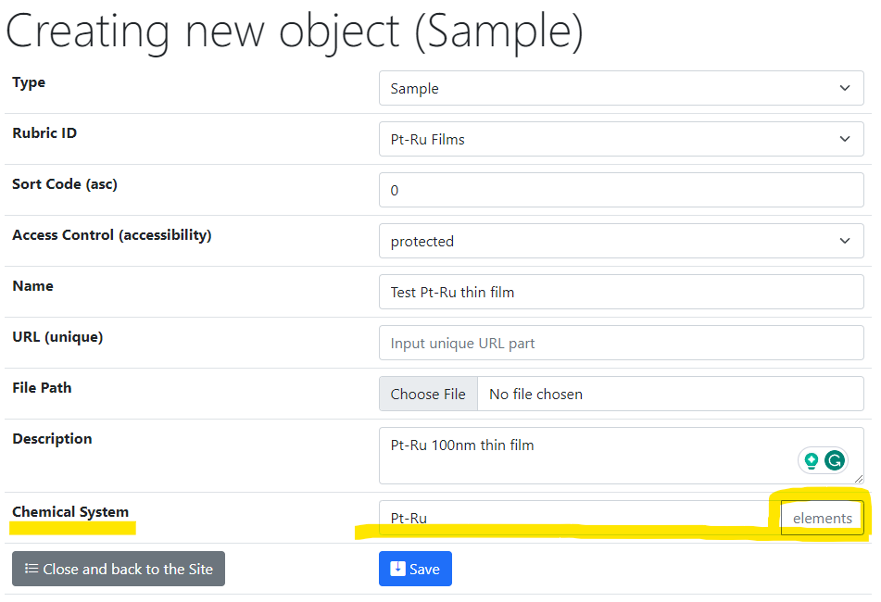
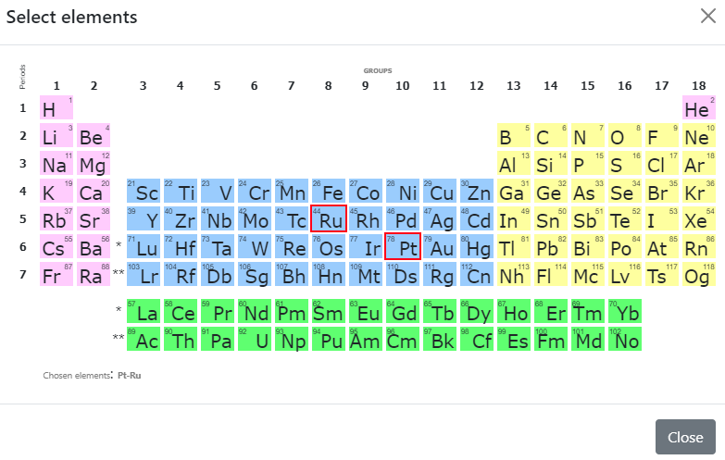
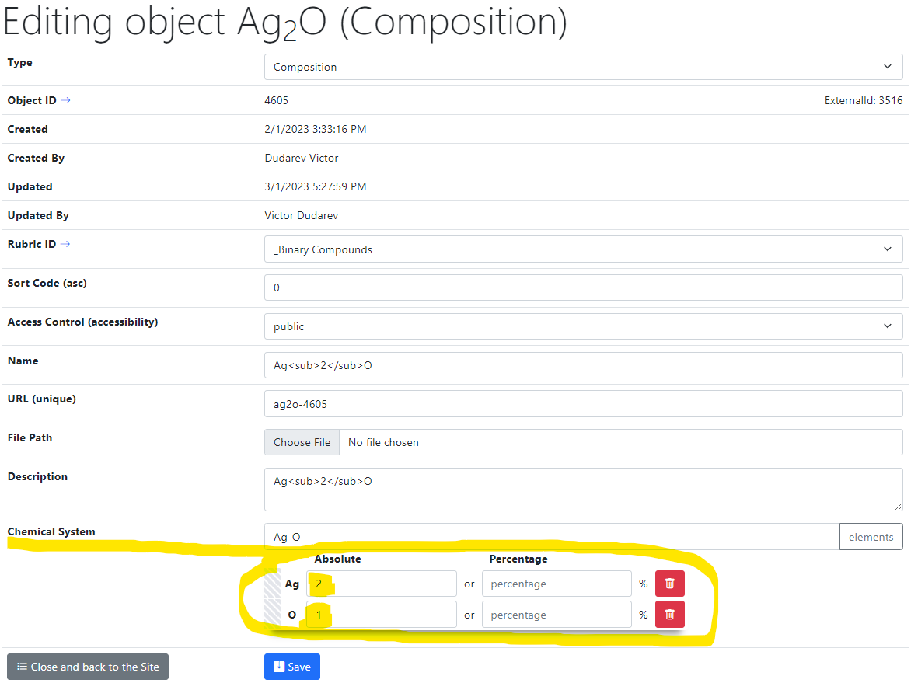
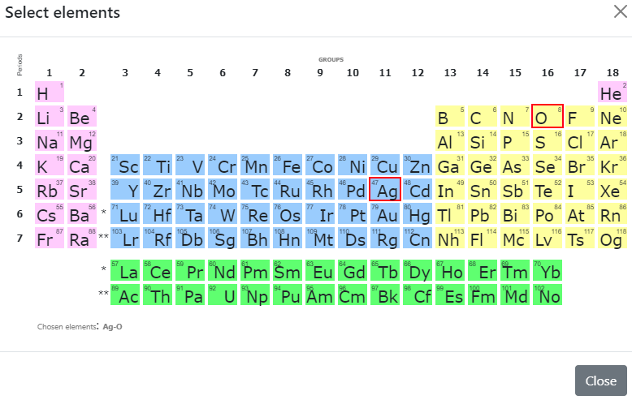
RDMS: Support for Chemical Entities
Metadata
+
chemical elements
System
(qualitative composition)
Co-O
Substance
(quantitative composition)
Metadata
+
chemical elements with indices
Co₃O₄

Slide 16
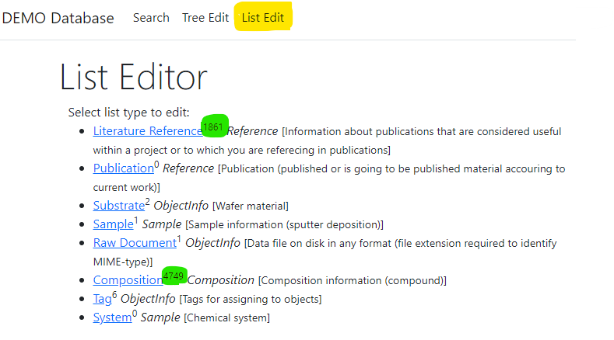
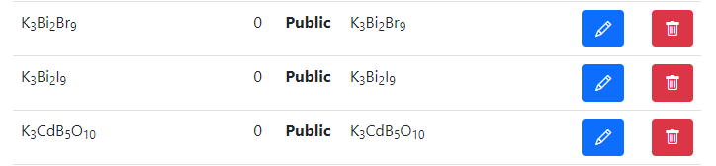
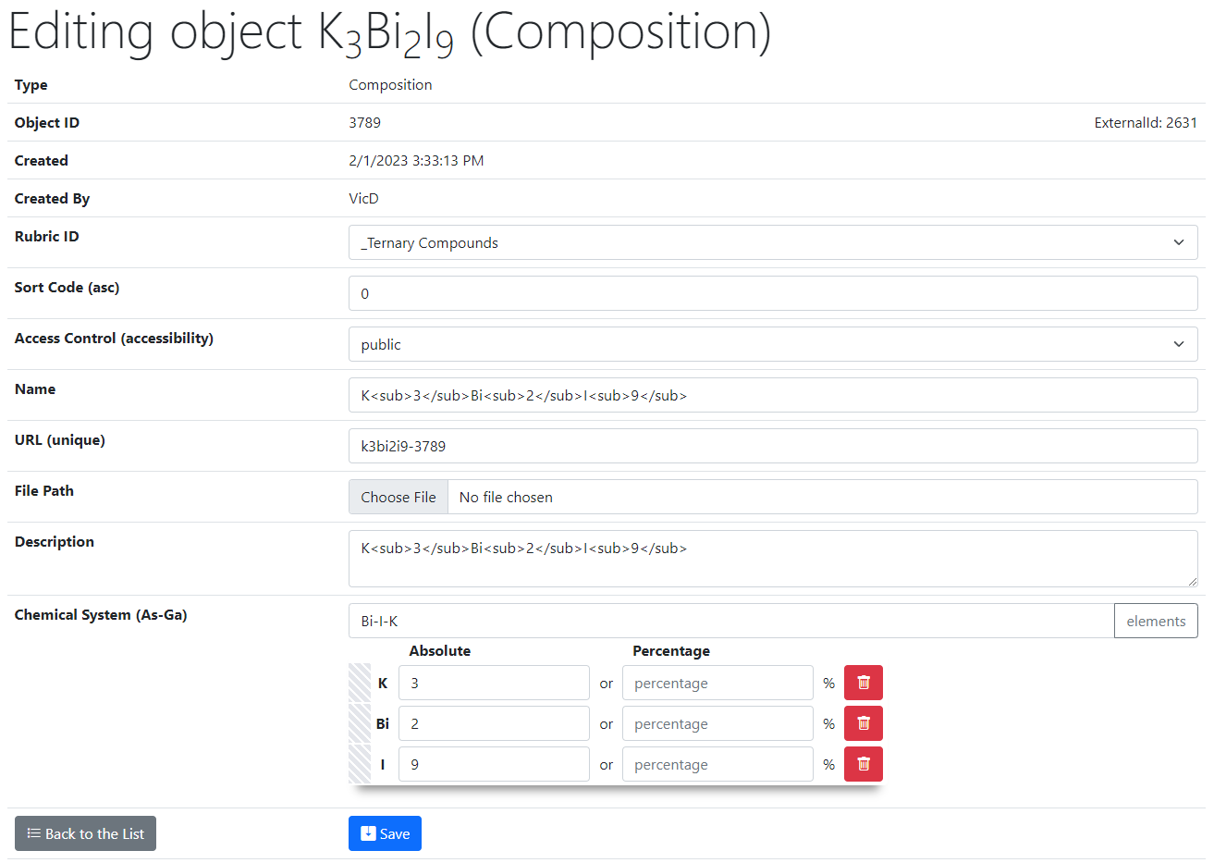
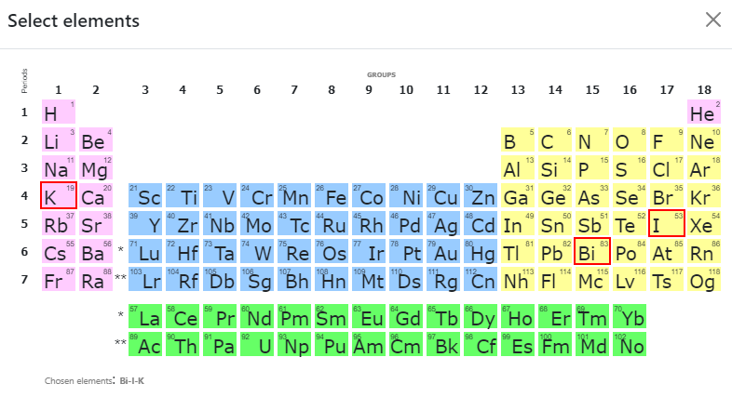
RDMS List Types: add composition
List of all objects (of type Composition):
Control (common to all objects):
Rubric Id;
Sort Code;
Access;
Name;
URL (adjustable*);
Attach File (document);
Description.
2
Type specific control (e.g. Composition):
Chemical System;
Composition (elements containment).
1
https://demo.mdi.ruhr-uni-bochum.de/object/k3bi2i9-3789
https://demo.mdi.ruhr-uni-bochum.de/adminobject/edititem/3789

Slide 17
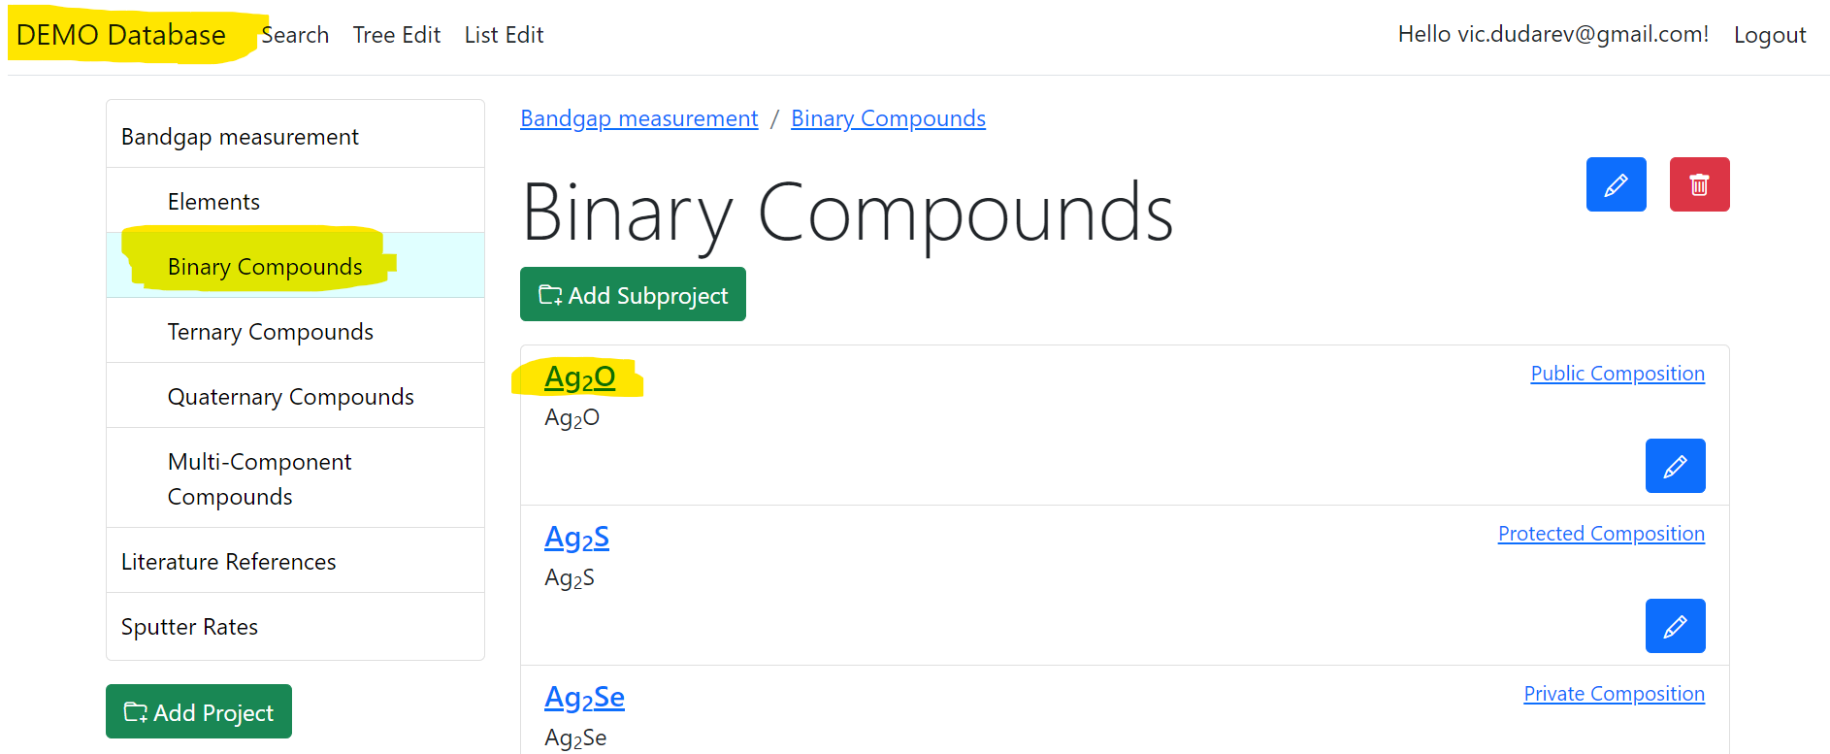
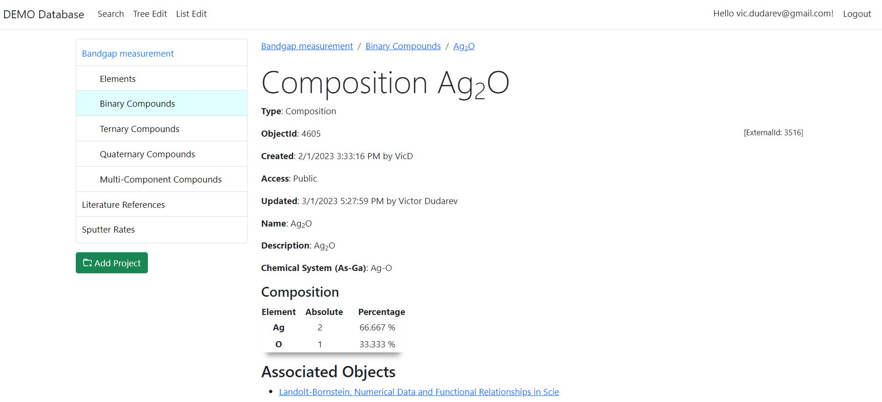
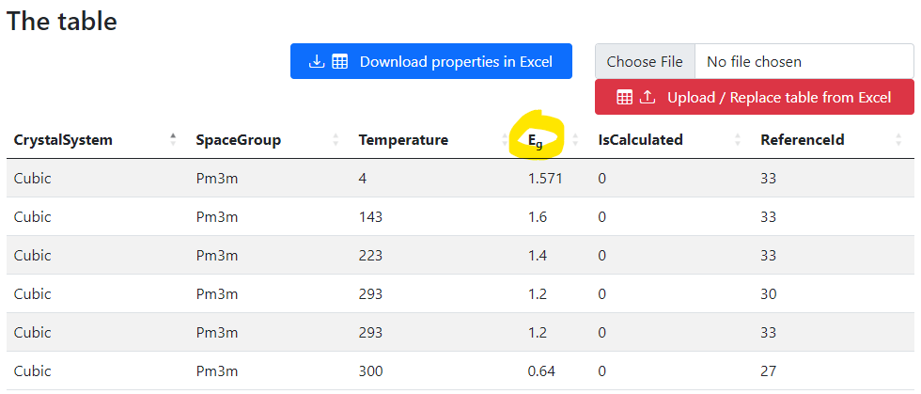
RDMS List Types: display composition
Visibility depends on user privileges
UI Experience:
Select project (rubric with objects)
Select object of interest
Follow the link and explore object data and properties
https://demo.mdi.ruhr-uni-bochum.de/object/ag2o-4605
https://demo.mdi.ruhr-uni-bochum.de/object/ag2o-4605

Slide 18
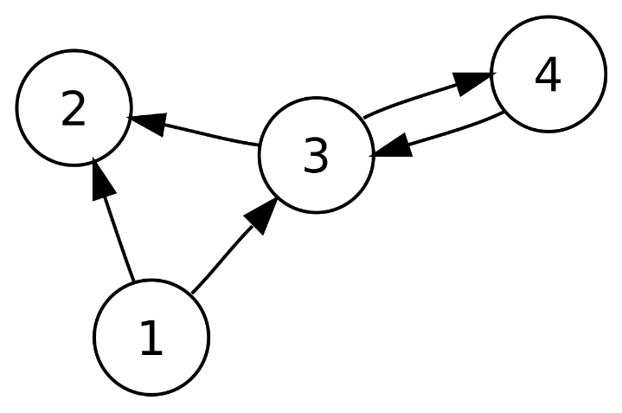
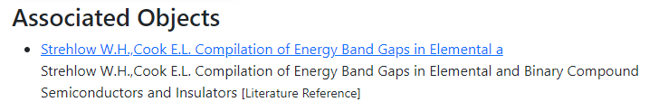
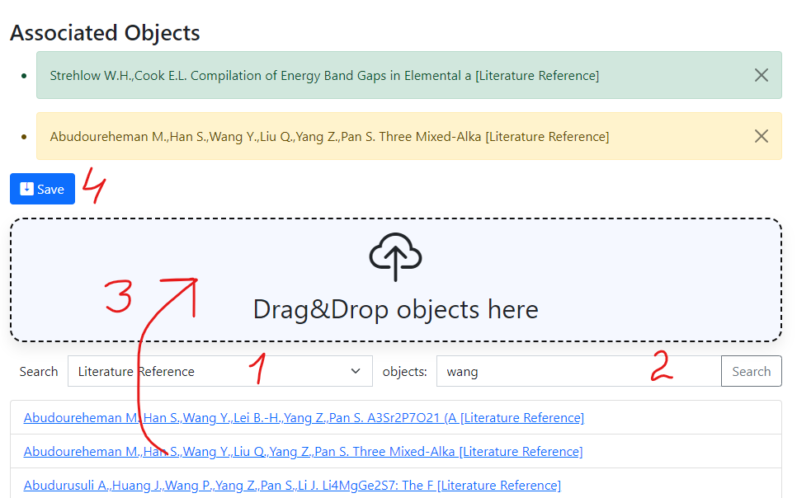
RDMS: Interlink Objects
Example: literature reference for published data on composition:
To add associated objects:
0) Go to “List edit” or select object to edit
1) Select associated object type (optional filter)
2) Input search phrase, contained in the Name of desired object to be associated
3) Drag & Drop desired object(s) from search result list to the area / adjust list
4) Save changes
Important: Reverse associations allow to browse reverse- directional associations, such as finding all compounds mentioned in a particular literature reference.
User view: https://demo.mdi.ruhr-uni-bochum.de/object/ag2s-4870
Admin view: https://demo.mdi.ruhr-uni-bochum.de/adminobject/edititem/4870

Slide 19
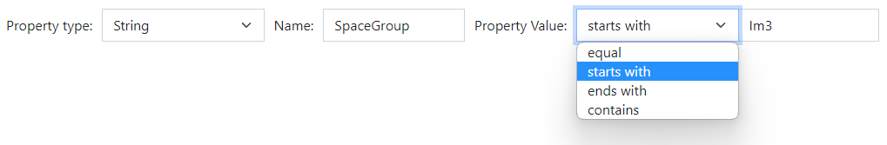
RDMS: Extended Properties (the basics)
All values are to be stored using appropriate data types!
DEFINITION: Data type is a collection or grouping of data values, usually specified by a set of possible values, a set of allowed operations on these values, and/or a representation of these values as machine types.
Supported data types (and their visualization in the search form):
Int – integer values (64-bit signed integer) in range [-9 223 372 036 854 775 808; 9 223 372 036 854 775 807].
Float – double-precision floating-point (8 bytes, IEEE-754), ±5.0×10⁻³²⁴ to ±1.7 × 10³⁰⁸.
String – any characters sequence no longer than 4096 symbols.
BigString – any characters sequence no longer than 2 147 483 647 symbols (2 Gb).
https://en.wikipedia.org/wiki/Data_type

Slide 20
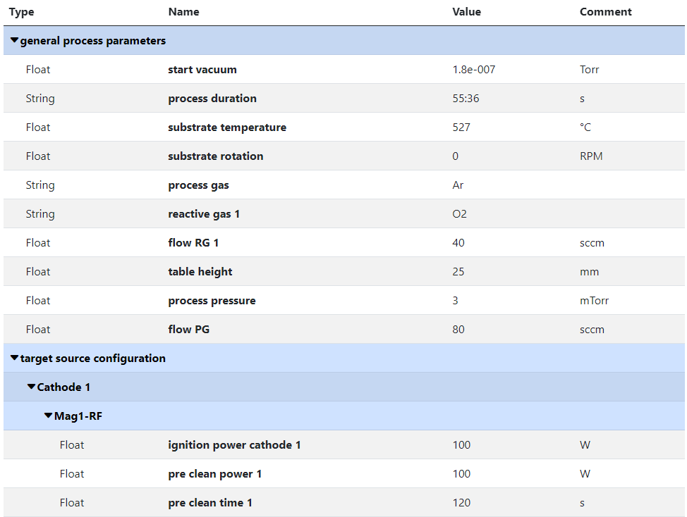
RDMS Object‘s Flexibility: Extended Properties with Separators
Measurement Units
Use case: add additional properties values to object and afterward make search on them.
Task: associate typed properties with object Synthesis parameters
Values Types
Separators
(logical blocks)
SortCode
https://crc247.mdi.ruhr-uni-bochum.de/object/synthesis-for-sample-8220-co-deposition-221111-k3-3-1922

Slide 21
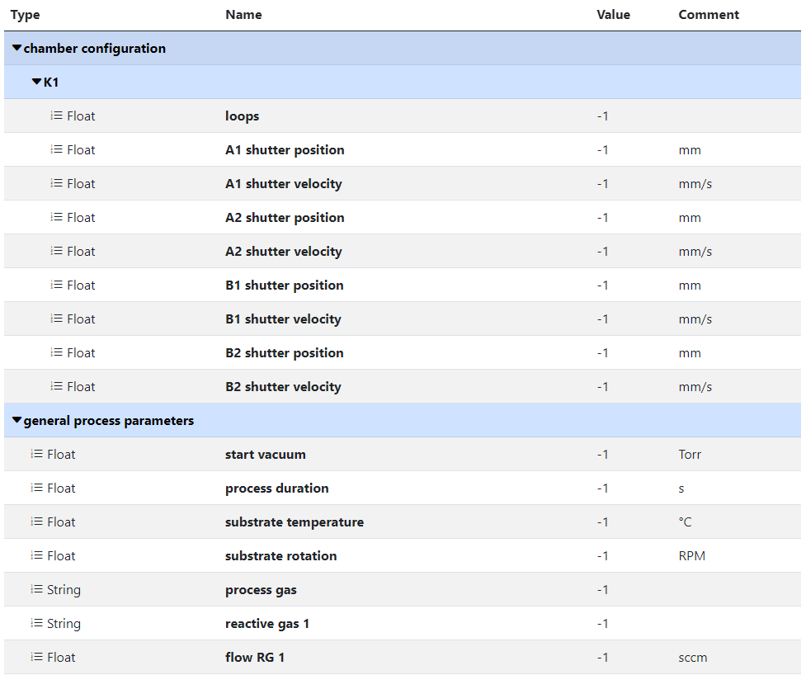
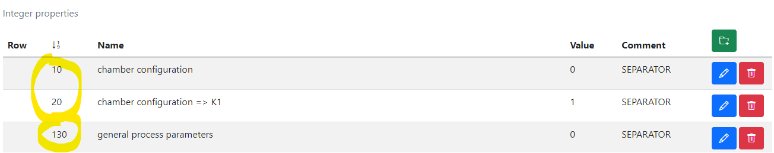
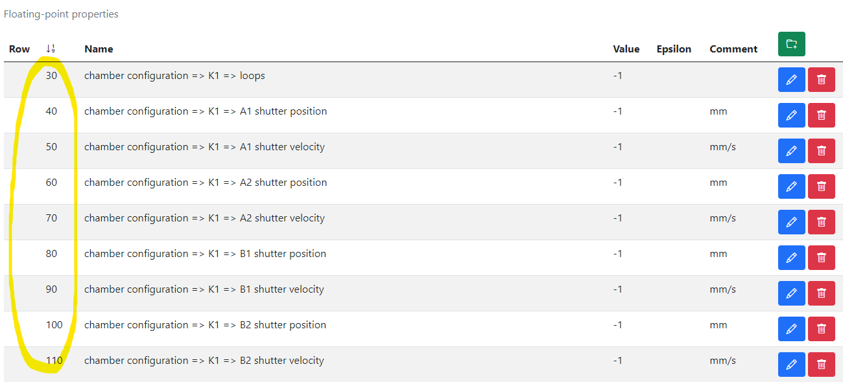
RDMS Extended Properties: Defining a Template
Measurement Units
Use case: to facilitated data edit we need to template extended properties for specified.
Task: create template for synthesis parameters => create object with “_Template” name.
1) Create separators, blue captions to create named sections (if required)
2) Create placeholders (float, int, string)
https://crc247.mdi.ruhr-uni-bochum.de/adminobject/edititem/1956/?returl=%2Fobject%2F_template-1956
https://crc247.mdi.ruhr-uni-bochum.de/object/_template-1956

Slide 22
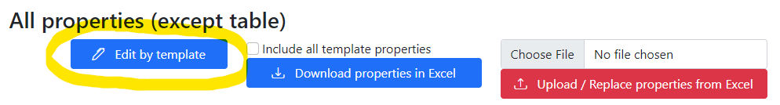
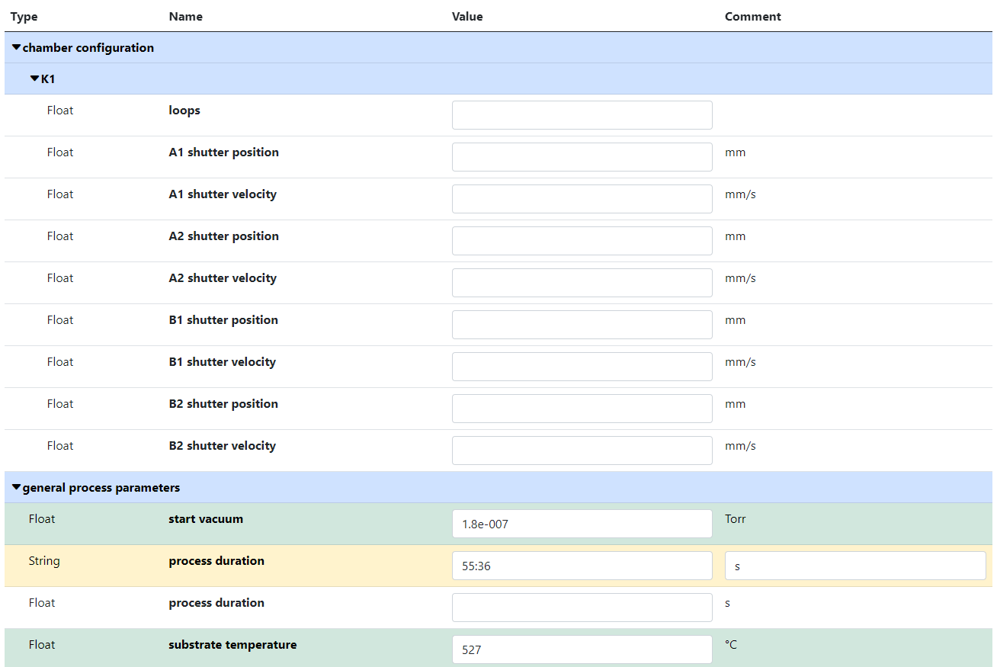
RDMS Extended Properties: Using Template to fill in data
Use case: take advantage of created template during data input.
Task: edit synthesis properties.
Empty values
(white)
Values Types
SortCode
Separators
(logical blocks)
Filled values
(green)
Out of template values
(yellow)
https://crc247.mdi.ruhr-uni-bochum.de/object/synthesis-for-sample-8220-co-deposition-221111-k3-3-1922
https://crc247.mdi.ruhr-uni-bochum.de/properties/edititem/1922

Slide 23
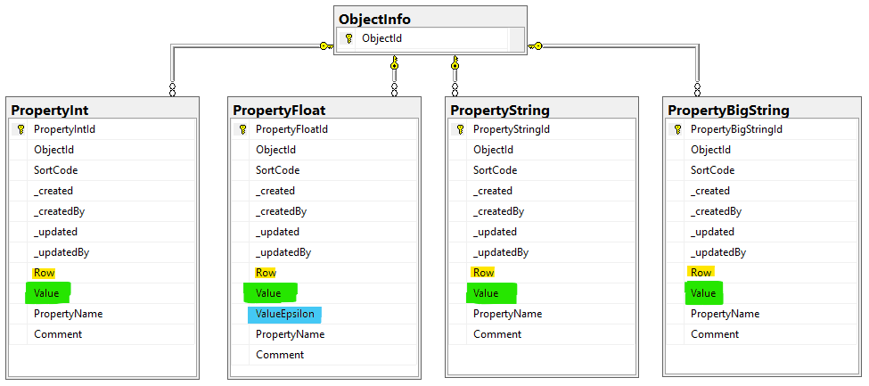
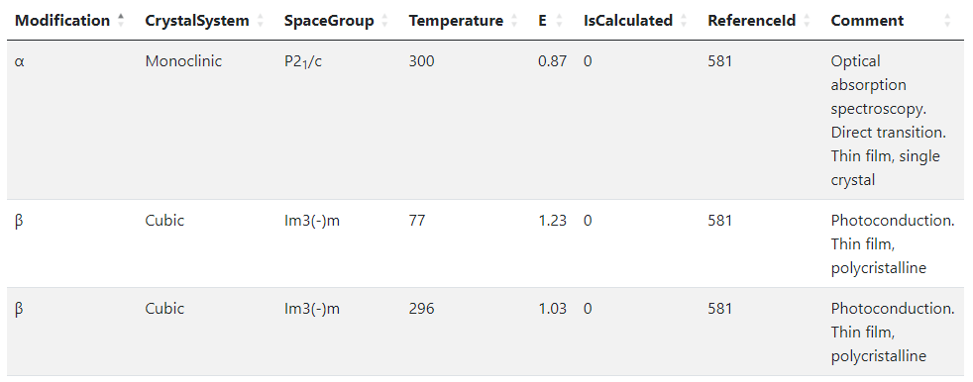
RDMS Object‘s Flexibility: Extended Properties (table data)
Use case: add additional properties values (or even a table) to object and afterward make search on them.
OR
When the existing fields set is not enough…
Task: associate table with object
Row=1
Row=2
Row=3
String x3
Float x2
Int x2
String
Solution: Decompose the table so, that each cell value is stored in Property* table according to cell value type.
Important attributes:
PropertyName – contains column name
Value – contains cell value
Row – contains row number (1, 2, 3, …). If no row number specified – value is threated as object’s property
User view: https://demo.mdi.ruhr-uni-bochum.de/object/ag2s-4870
Admin view: https://demo.mdi.ruhr-uni-bochum.de/adminobject/edititem/4870

Slide 24
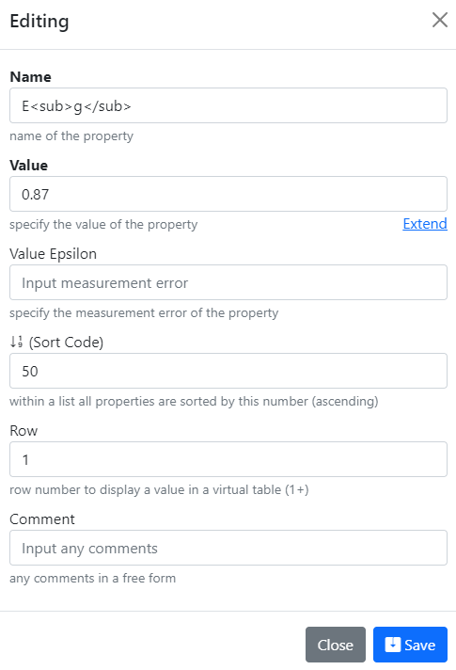
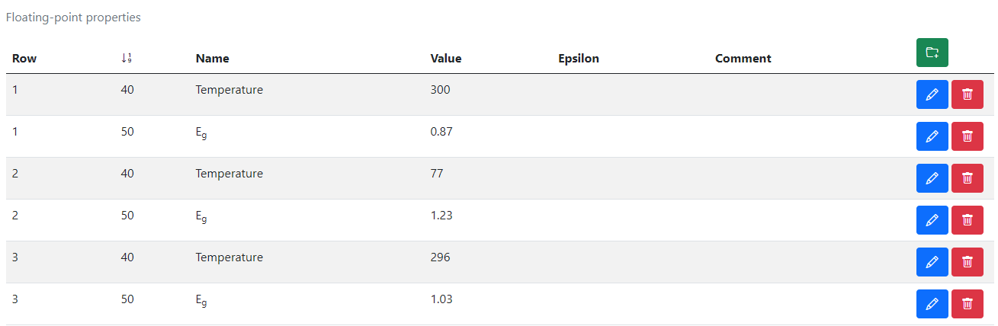
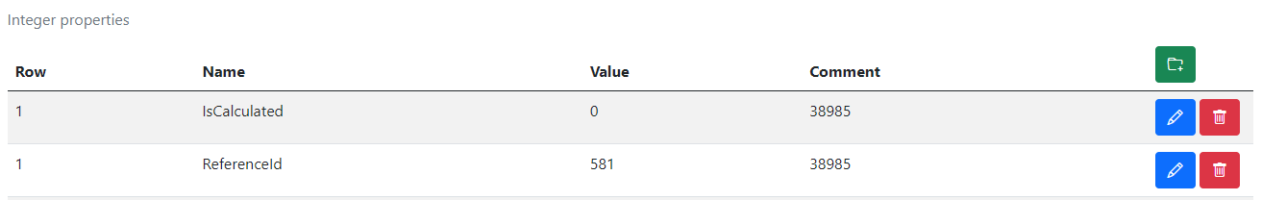
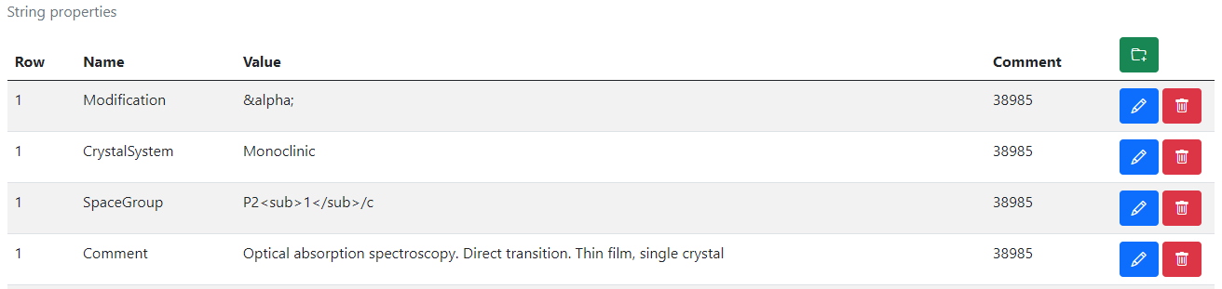
RDMS Extended Properties Control
Extended Properties Control for object is available according to the object access managements in administration panel for objects.
User view: https://demo.mdi.ruhr-uni-bochum.de/object/ag2s-4870
Admin view: https://demo.mdi.ruhr-uni-bochum.de/adminobject/edititem/4870

Slide 25


RDMS Extended Properties: Export and Import
Task: make properties modification easy
Steps:
Download data
Open in Excel and edit
Upload changed data back to the RDMS
Import
(requires permissions)
https://demo.mdi.ruhr-uni-bochum.de/object/ag2s-4870
Export
https://demo.mdi.ruhr-uni-bochum.de/object/ag2s-4870

Slide 26
RDMS: Data Types (hierarchies and lists)
Data Types
IsHierarchical = True
IsHierarchical = False
Hierarchical
(tree types)
List
(list types)
All types are extendable (stored in TypeInfo)
Rubrics (RubricInfo table) types:
Project
Organization Structure
++ (extendable)
Objects (ObjectInfo table) and all derived (non-hierarchical) types:
Reference
Sample
Composition
++ (extendable)

Slide 27
RDMS Extensibility: User-defined Object Types
Task: introduce new object types
New Data Type
Based on existing tables
(hierarchical and non-hierarchical)
New Data Structures
(new table & code to fit particular requirements)
Add new type to TypeInfo table
Added by admin (UI)
Approximate time: 3 minutes
Just add a new table row with object specification required (assign validator; data extractor; data visualizer, etc…)
To be done manually
Approximate time: 1 week
Tasks: develop and add new table; define read / write logic with respect to mandatory (or optional) fields and types; reflect to OOP model and provide consistency check (validators); develop import / export and search facilities, etc.
Question: It seems that all can be done with extended properties.
Why to use new data structures?
Short Answer: Performance (especially if number of new type objects is expected to exceed 10K)

Slide 28

What is an Object Type?
The most important attributes
Type Name – user-defined type name
Core Object Type:
ObjectInfo – the simplest (bare) object
Sample – chemical system (set of chemical elements), for example Co-O
Composition – chemical composition (set of elements and quantities), for example Co₃O₄
Reference – literature reference (Authors, Title, Year, DOI, etc.)
Validation & Data Schema – only if you have external Web Services ready to validate & extract data from files
Settings (JSON) – customization of type for RDMS
{ "CustomEditPath": "/custom/editsample",
"UrlPostVisualizer": "https://abc.de/VisualizeRT" }
File Required – sets the file mandatory
Description – comments for type designation

Slide 29





Validation Principle on Document Upload
Well-formed document to database
Some other “data” to trash bin
Validator

Slide 30

Document Validation from RDMS perspective: API
Provide a validator for every object type in configuration:
type: built-in type (object instantiated by class name);
https: URL to a REST Service (OpenAPI specification).
{
"Code": 0,
"Message": null,
"Warning": null
}
type:TypeValidationLibrary.TypeValidator_EDX_CSV (interface IFileValidator)
https://validation.matinf.pro/edx/validation
valid
Validation result
via external API call
External service decision
invalid
type
{
"Code": 500,
"Message": "error text",
"Warning": null
}
API – Application Programming Interface
URL – Uniform Resource Locator
REST – REpresentational State Transfer

Slide 31



Metadata extraction: external API
Provide a data extractor for every object type in configuration:
type: built-in type (object instantiated by class name);
https: URL to a REST Service (OpenAPI specification).
type:TypeValidationLibrary.TypeValidator_EDX_CSV (interface IDatabaseValuesGetter)
https://validation.matinf.pro/edx/data
{ "DeletePreviousProperties": true,
"Properties": [
{ "PropertyId": 0,
"Type": 1,
"Name": "V",
"Value": 0,
"ValueEpsilon": null,
"SortCode": 10,
"Row": 1,
"Comment": "Minimal V content"
},
{ "PropertyId": 0,
"Type": 1,
"Name": "V",
"Value": 36.400001525878906,
"ValueEpsilon": null,
"SortCode": 10,
"Row": 2,
"Comment": "Maximal V content"
}
]
}
Metadata for EDX (range values):
Administrative interface: Compositions
EDX - Energy-dispersive X-ray spectroscopy

Slide 32

All data extraction: external API
Provide a data extractor for every object type in configuration:
type: built-in type (object instantiated by class name);
https: URL to a REST Service (OpenAPI specification).
type:TypeValidationLibrary.TypeValidator_EDX_CSV (interface IDatabaseValuesGetter)
https://validation.matinf.pro/edx/data
Data from EDX (all values == 342 compositions):
{
"CompositionElements": [
{ "CompoundIndex": 0, "ElementName": "V", "ValueAbsolute": null, "ValuePercent": 31.299999237060547 },
{ "CompoundIndex": 10, "ElementName": "Mn", "ValueAbsolute": null, "ValuePercent": 2.700000047683716 },
{ "CompoundIndex": 20, "ElementName": "Co", "ValueAbsolute": null, "ValuePercent": 22.600000381469727 },
{ "CompoundIndex": 30, "ElementName": "Ni", "ValueAbsolute": null, "ValuePercent": 6 },
{ "CompoundIndex": 40, "ElementName": "Ho", "ValueAbsolute": null, "ValuePercent": 37.400001525878906 }
],
"DeletePreviousProperties": true,
"Properties": [
{
"PropertyId": 0, "Type": 2, "Name": "Measurement Area", "Value": 1, "ValueEpsilon": null,
"SortCode": 0, "Row": null, "Comment": null
}
]
}

Slide 33


EDX Data Visualization
After processing one can conclude with the final outcome
V: 18.3 %
Mn: 4.8 %
Co: 17.2 %
Ni: 6.8 %
Ho: 53 %
Measurement Area Index Chemical Elements
[1, 342]
Composition for the Measurement Area 3 (atomic %)
Measurement
Area 3
Composition
Data
Configurable XY-charts
https://dim.mdi.ruhr-uni-bochum.de/file/csv/6691

Slide 34

RDMS: Search
Search on:
Chemical system
Composition
Object type
Phrase in object’s Name or Description
Properties values (all available within a tenant)
Person created
Creation date
Important feature:
persistent URL on search (share search results easily by URL*).
* - respecting current security context
Task: make properties modification easy
https://demo.mdi.ruhr-uni-bochum.de/search/
https://demo.mdi.ruhr-uni-bochum.de/search/?system=As-Ga&typeid=8&Aspctmin=30&Aspctmax=50&Gaabsmin=1&Gaabsmax=3&pr0name=E%3Csub%3Eg%3C%2Fsub%3E&pr0type=Float&pr0min=1.5&pr0max=2&pr1name=Comment&pr1type=String&pr1max=3&pr1str=solution&prcnt=2
https://demo.mdi.ruhr-uni-bochum.de/search/?system=As-Ga&typeid=8&Aspctmin=30&Aspctmax=50&Gaabsmin=1&Gaabsmax=3&pr0name=E%3Csub%3Eg%3C%2Fsub%3E&pr0type=Float&pr0min=1.5&pr0max=2&prcnt=1

Slide 35


RDMS DropZone Tasks: Data Validation & Import
Task: validate documents & import data
Implemented Features:
Automatic type detection;
Uniqueness check;
Data validation (build-in + external);
Data import.

Slide 36




RDMS DropZone: Staged Files (before import)
Check for unique documents (based on SHA256 hash):
Check data to import:
Properties
(after import):
Workflow:
- validate every file;
- check/adjust all properties;
- Import files.

Slide 37


RDMS: Created Objects
After import:
- check all created objects (names, access level, etc…);
- share a link.
https://dim.mdi.ruhr-uni-bochum.de/rubric/p1project_ho-v-mn-co-ni-o_ho50_sample-id-0008081

Slide 38






Conclusion
Open-source RDMS framework in materials science:
Flexible project tree
Build-in support for basic chemical types
Extensible external object types support (via API):
  Validation
  Data extraction
  Visualization
Extended properties and templates
Flexible Search
UI Customization for tenants
Active tenants:
Playground to test RDMS (multiple tenants with shared users list):
https://inf.mdi.ruhr-uni-bochum.de/
Login and Password (User role): User1@user.org
Login and Password (PowerUser role): PowerUser1@user.org
Login and Password (Administrator role): Admin1@user.org
Bandgap data demo:
https://demo.mdi.ruhr-uni-bochum.de/
https://demo.mdi.ruhr-uni-bochum.de/
https://inf.mdi.ruhr-uni-bochum.de/
https://gitlab.ruhr-uni-bochum.de/vic/infproject
Notes:
https://qr.io/

Slide 39


Source Control (GitLab)
Everybody’s welcome!
Core INF project:
https://gitlab.ruhr-uni-bochum.de/vic/infproject
Shared projects (INF & WebCompact):
1) Administration User Interface (Identity Manager UI):
https://gitlab.ruhr-uni-bochum.de/vic/identitymanagerui
2) Web Application General Library (WebUtilsLib):
https://gitlab.ruhr-uni-bochum.de/vic/webutilslib
Web Compact:
https://gitlab.ruhr-uni-bochum.de/vic/WebCompact
https://gitlab.ruhr-uni-bochum.de

Slide 40
Thanks for your kind attention
Q&A
Victor Dudarev
Victor.Dudarev@rub.de
https://vdudarev.ru

Slide 41
Playgrounds
https://inf.mdi.ruhr-uni-bochum.de/ https://demo.mdi.ruhr-uni-bochum.de/
Playground Inf Playground Demo
Playground to test RDMS (multiple tenants with shared users list):
https://inf.mdi.ruhr-uni-bochum.de/
https://demo.mdi.ruhr-uni-bochum.de/
Login and Password (User role): User1@user.org
Login and Password (PowerUser role): PowerUser1@user.org
Login and Password (Administrator role): Admin1@user.org
https://inf.mdi.ruhr-uni-bochum.de/

