Slide 1

Overview of CRC/TRR 247
Database and Use Cases
Victor Dudarev
Victor Dudarev

Slide 2

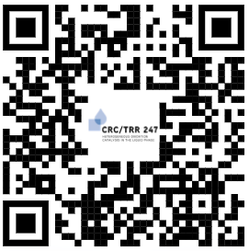
RDMS in Production
Production mode (https://crc247.mdi.ruhr-uni-bochum.de/):
You need to register with Google account or create your own account (email/password) and confirm e-mail (warning: user created with no role assigned).
Fill the access request form https://forms.gle/tkZeweU6kStRCoKp7, specifying your e-mail, used in registration, your name, project (e.g. C04) and optional comments.
Wait… After manual processing you will be assigned by default PowerUser role and you are in power of adding data ))
In case of any questions write me: Victor.Dudarev@rub.de
TO DO: Check current user list.
https://crc247.mdi.ruhr-uni-bochum.de/
2) https://forms.gle/tkZeweU6kStRCoKp7
Everything runs 24x7 on a dedicated VM within a new server (INF funding).
All data are backed up weekly on a dedicated external backup device.
No disaster tolerance: all devices are physically in a single server room.
Notes:
https://qr.io/

Slide 3
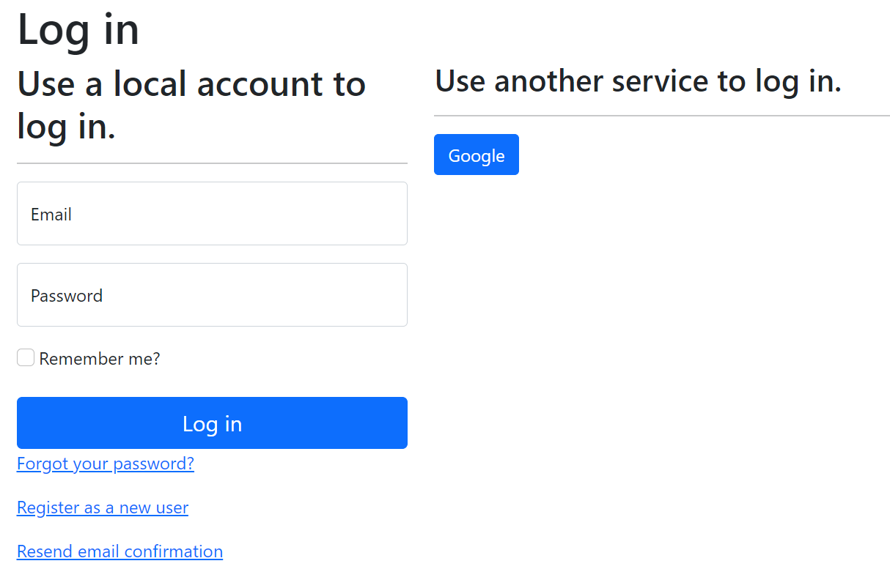
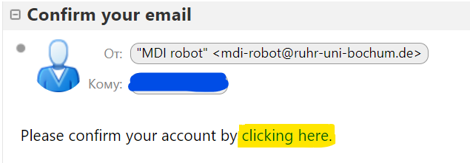
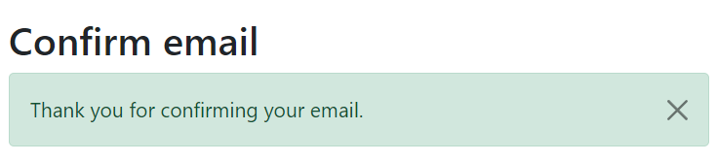
Registration and Authorization
Application access level is determined by the current user context.
Two-way registration (choose any):
using external provider (OpenID Connect), e.g. Google (external authentication authority is used, no credentials are stored locally).
using local account (credentials are stored internally);
In both cases, an e-mail address is required, and its successful verification is a prerequisite for access.
After e-mail confirmation, the user is considered active, but does not have an assigned user group.
https://openid.net
https://en.wikipedia.org/wiki/Authentication
https://en.wikipedia.org/wiki/Authorization

Slide 4
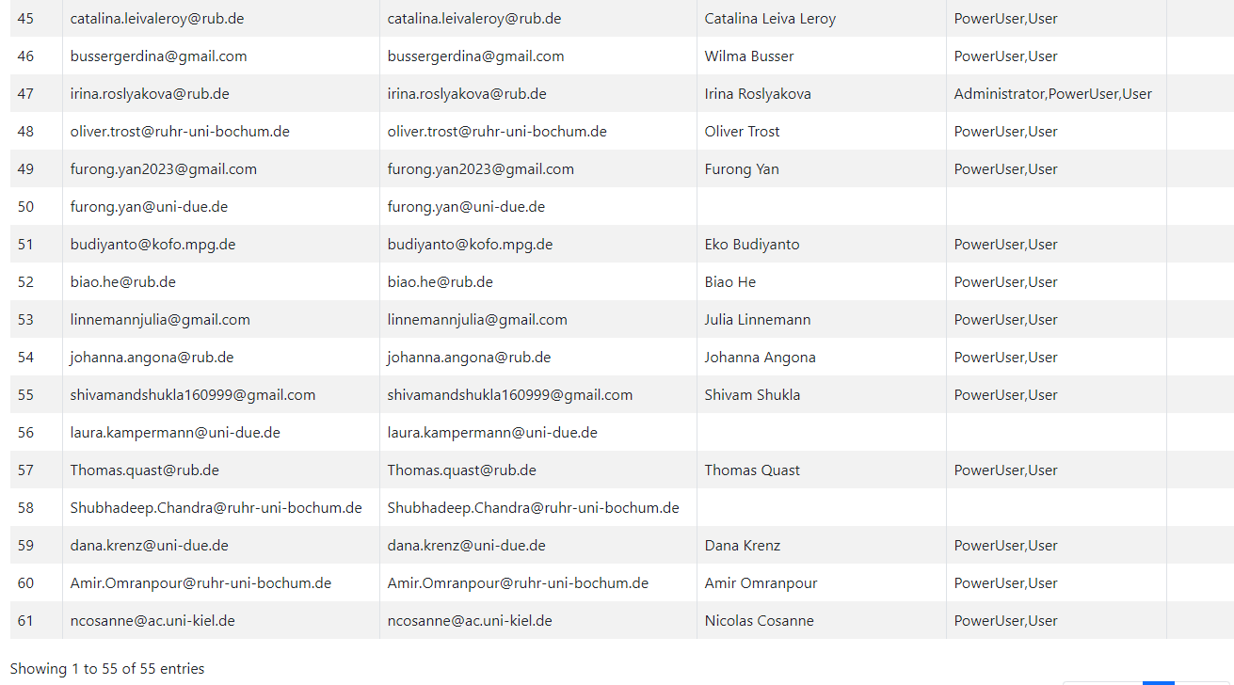
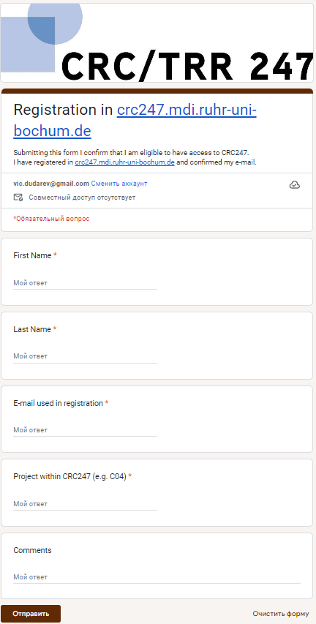
Current Users List
1) After registration
2) Fill out the form
https://crc247.mdi.ruhr-uni-bochum.de/identitymanager/home/users

Slide 5
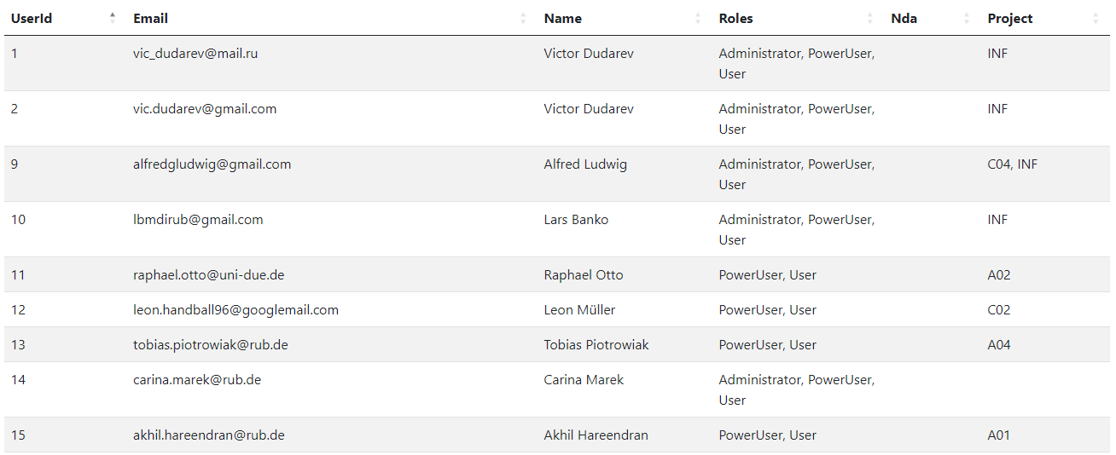
Users and Projects
Report for Users and projects
https://crc247.mdi.ruhr-uni-bochum.de/report/users/

Slide 6
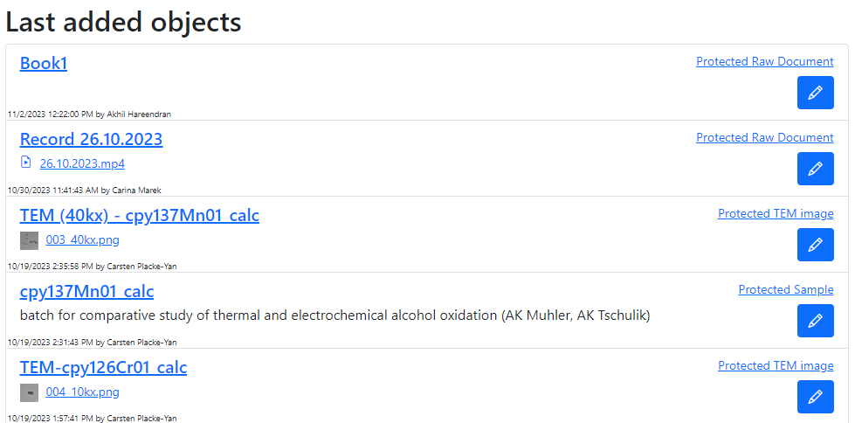
Last added objects (on the main page)
https://crc247.mdi.ruhr-uni-bochum.de

Slide 7
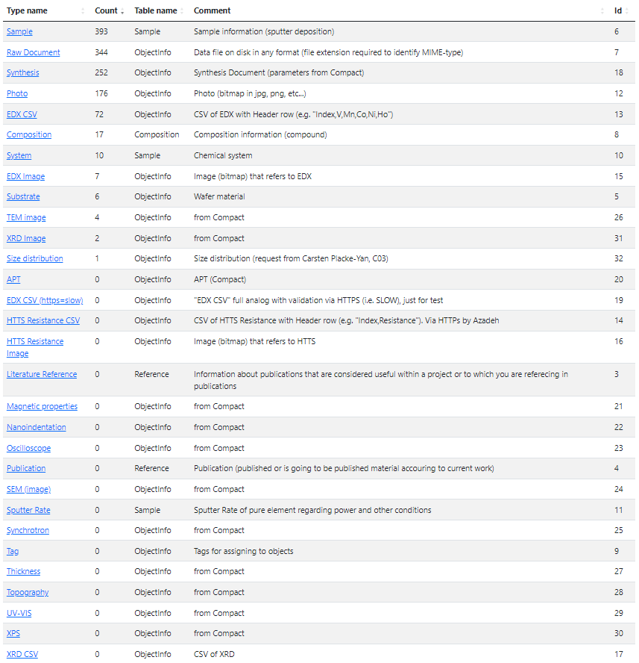
Types and Statistics
Top used types:
Sample (393)
Raw Document (344)
Synthesis (252)
Photo (176)
EDX CSV (72)
To do (suggestions to improve):
get rid of Raw Documents – create more descriptive types
recheck Photo objects (are there wrongly typed TEM images?)
https://crc247.mdi.ruhr-uni-bochum.de/adminobject

Slide 8

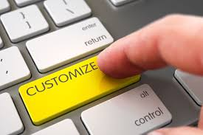
What about customization?
How to customise:
Simple (client side only)
  Page-code injection:
    HTML
    Javascript
    CSS
Complex (+ server side)
  INF-code adjust (Asp.Net Core App)
    C#
    SQL
    HTML/Javascript/CSS

Slide 9
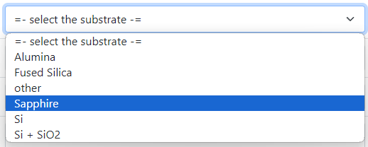

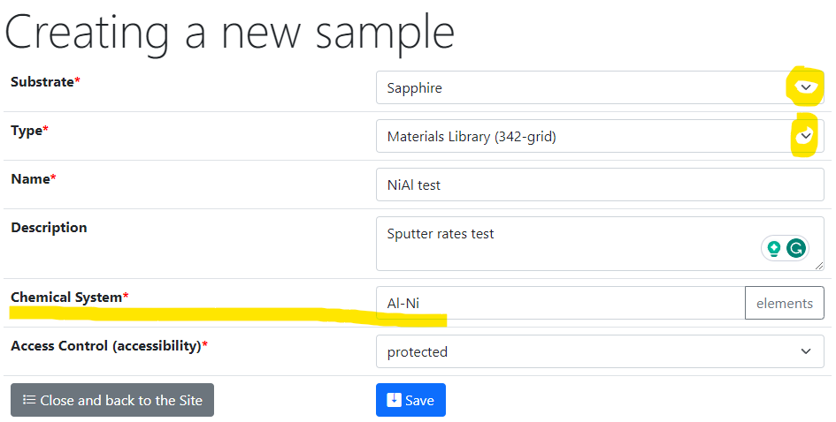
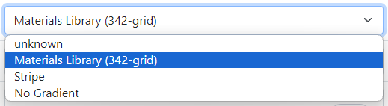
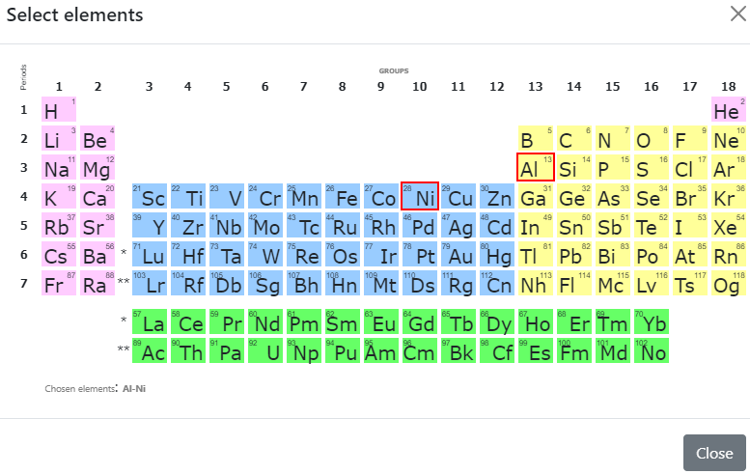
Sample Customised Form
List from subproject
- Customised sample input
List from JS-template
Standard chemical system
Customisation with UI form / JS
https://crc247.mdi.ruhr-uni-bochum.de/custom/editsample/0/?idr=179&returl=%2Frubric%2Farea-c_c04

Slide 10
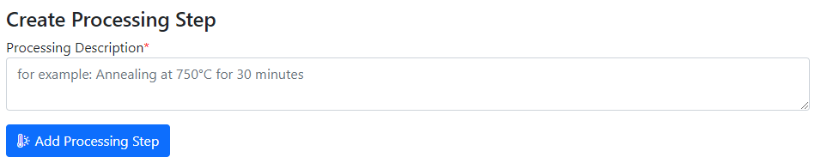
Create Processing State
Customised sample form on edit appendix
Sample_2a_2
(subsample 2a state 2)
polishing
documents
Sample_2a
(subsample 2a)
annealing
splitting
Sample_2b_2
(subsample 2b state 2)
Sample
(initial state)
Sample_2
(changed state 2)
oxidation
Sample_2b
(subsample 2b)
documents
documents
documents
https://mdi.matinf.pro/custom/editsample/43508/?idr=2748&returl=%252Frubric%252Ftest

Slide 11



Project-wide Statistics / Person-wide Statistics
To be implemented…
Questions:
How productive is project/person in terms of adding data (objects creation)?
Is project subtree clearly structured (for manual subprojects traversing)?
What is the most referenced / liked object?
Awards from INF (the winner is…):
The most productive data creator award project/person
The people’s choice award: project subtree clarity
The citation / popularity award
?

Slide 12
Thanks for your kind attention
Q&A
Victor Dudarev
Victor.Dudarev@rub.de
https://vdudarev.ru

