Slide 1

Object Type Support Request on example of C04:
Incorporating EDX Data in Research Data Management System
Project INF + C04:
Victor Dudarev
Victor Dudarev, Tobias Piotrowiak

Slide 2
Agenda
    Data format description
    Search requirements
    EDX object type in RDMS:
      Validation
      Metadata extraction (composition range)
      Data extraction (all compositions)
    Search demonstration:
      EDX document
      Composition (measurement area)
    Plan proposal for data presentation
    Q&A.
EDX - Energy-Dispersive X-ray spectroscopy

Slide 3
Material Characterisation: Chemical Entities Hierarchy
Chemical system
System
(qualitative composition)
Co-O
Solution
Compound
Heterogeneous mixture
Material
(quantitative composition)
Co₃O₄
Crystal
modification
Crystal
modification
Crystal
modification
Modification
(crystal structure type)
β-Co₃O₄
…
…
…
…

Slide 4
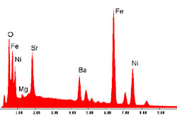
Motivation: EDX as a “must have” characterisation
known from synthesis
System
(qualitative composition)
Co-O
Material
(quantitative composition)
EDX
Co₃O₄
Modification
(crystal structure type)
Energy-dispersive X-ray spectroscopy (EDX)
Analytical technique used
for the elemental analysis
or chemical characterization
of a sample
XRD
β-Co₃O₄
…
X-ray diffraction analysis (XRD)
technique used in to determine the crystallographic structure of a material (other story…)

Slide 5
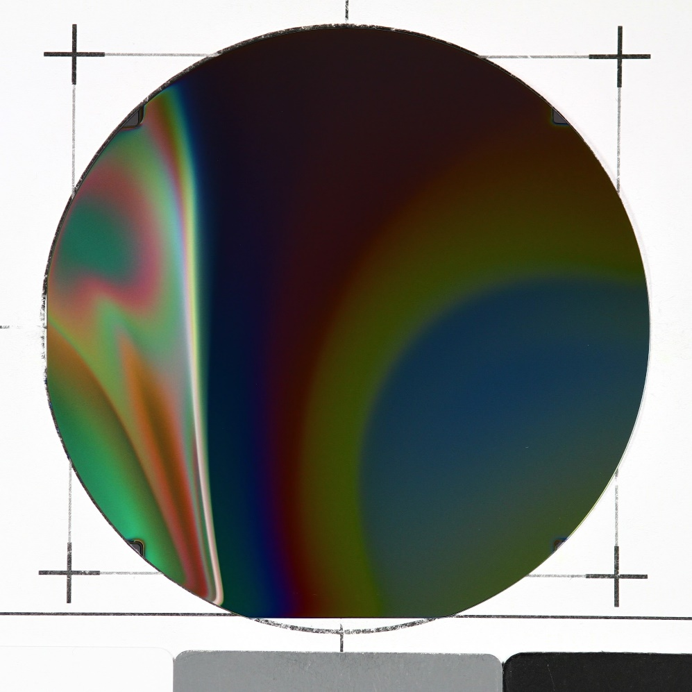
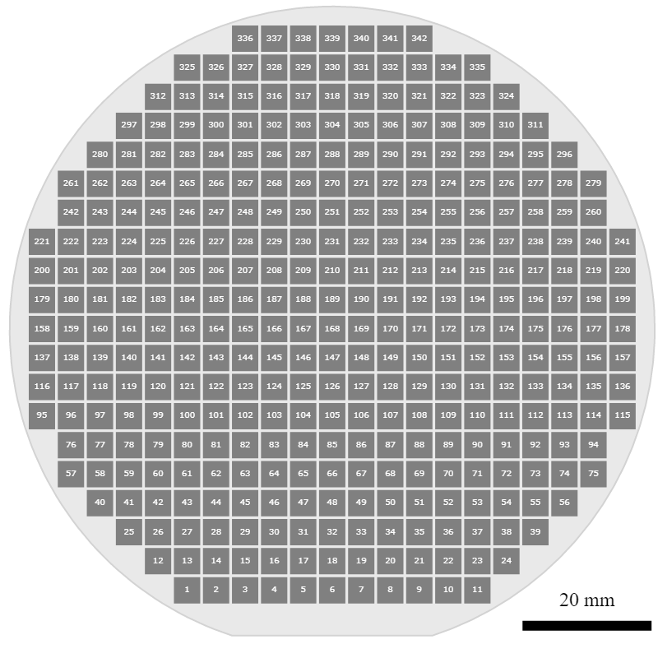
Combinatorial Materials Library: basic agreements
I X Y
1 27000 4500
2 31500 4500
3 36000 4500
…
11 72000 4500
12 22500 9000
13 27000 9000
...
341 58500 90000
342 63000 90000
Materials Library Measurement Areas
342 Measurement Areas (4.5 mm x 4.5 mm)
(x; y) coordinates on the surface

Slide 6
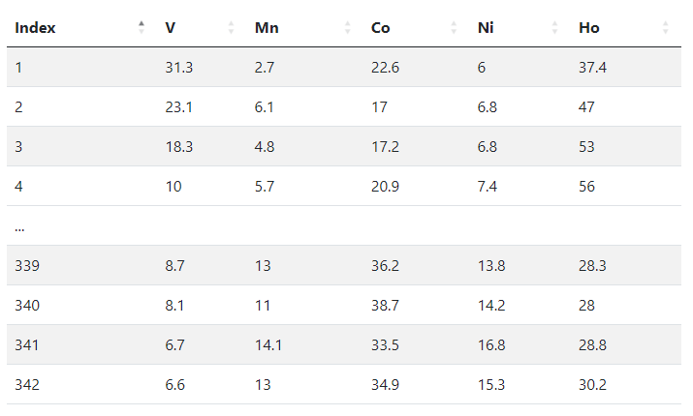
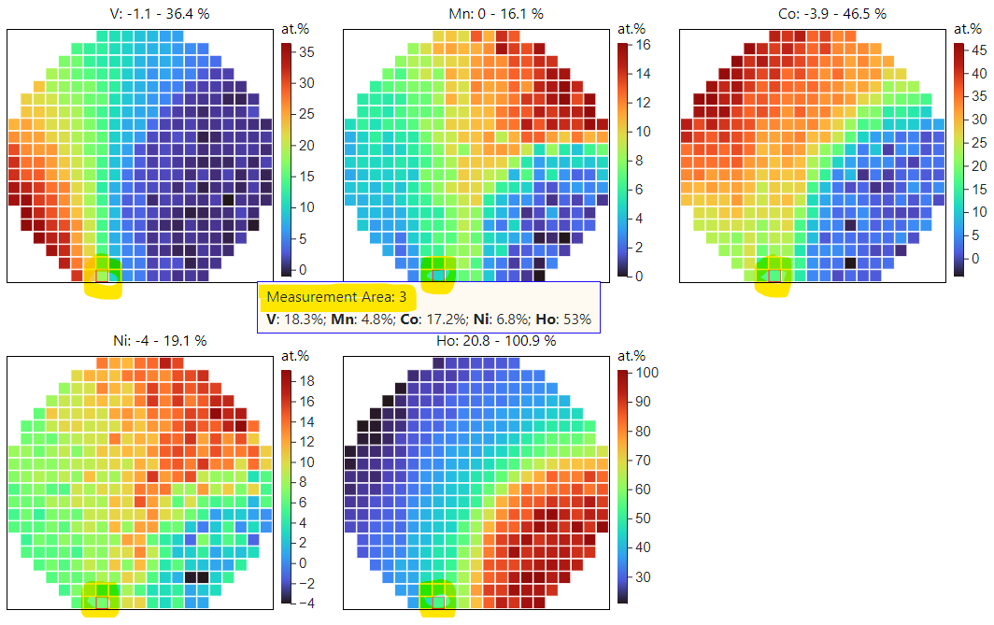
EDX Measurement Outcome (Processed Data): the Table
After processing one can conclude with the final outcome
V: 18.3 %
Mn: 4.8 %
Co: 17.2 %
Ni: 6.8 %
Ho: 53 %
Measurement Area Index Chemical Elements
[1, 342]
Composition for the Measurement Area 3 (atomic %)
Measurement
Area 3
Composition
Data
https://dim.mdi.ruhr-uni-bochum.de/file/csv/6691

Slide 7

Raw EDX data format (parseable text file)
Project: 0008081_EDXmapping ZGH (1)
Owner:
Site: Site of Interest 1
Sample: Sample 1
Type: Default
ID:
Processing option : All elements analysed
All results in atomic%
X and Y are stage positions
Spectrum In stats. X (mm) Y (mm) C O Si V Mn Co Ni Ho
Spektrum 1 {1} Yes -44.600 -40.300 80.36562 17.7799 0.331076 -0.3328189 9.434319E-02 1.12593 1.070188 -0.4342265
Spektrum 1 {2} Yes -40.100 -40.300 80.1367 23.03086 0.2024186 -4.792345E-02 -0.2482219 -3.621299 0.6450471 -9.758038E-02
Spektrum 1 {3} Yes -35.600 -40.300 83.67403 14.34433 0.2835474 -6.302138E-02 -7.115601E-02 1.043958 1.091217 -0.3029233
- … - … - … - … - … - … - … - … - … - … - … - …
Spektrum 1 {418} Yes 36.400 45.200 81.8801 12.53673 0.5853955 -1.528375E-02 4.889345E-02 -1.36448 6.783489 -0.4548477
Spektrum 1 {419} Yes 40.900 45.200 80.46669 12.32581 0.2078687 0.27237 -0.2769422 -7.077376 12.81309 1.268483
Spektrum 1 {420} Yes 45.400 45.200 83.68153 15.48148 0.0646082 0.2312067 -0.1969592 -2.165317 2.769571 0.1338789
Mean 43.79094 18.89702 29.09091 0.7714614 0.4576146 1.19483 3.057466 2.739753
Std. deviation 21.38218 7.121112 11.38863 0.9768385 0.3503809 20.70591 9.166298 3.695945
Max. 321.3774 82.92272 36.86385 3.61815 1.213754 225.3098 62.29993 5.617296
Min. -93.34522 -33.35334 -1.881486 -0.7680827 -0.4307786 -309.4584 -2.63329 -66.55944
Header (could be skipped)
Data we need (TAB separated). Almost, but:
420 measurement areas (instead of 342), need to filter;
Other elements (from substrate, need to filter: C, O, Si).
Footer
(to skip)

Slide 8
Processed EDX data (good to go)
Good CSV document (processed)
Measurement Area Index Chemical Elements
[1, 342]
Index,V,Mn,Co,Ni,Ho
1,31.3,2.7,22.6,6,37.4
2,23.1,6.1,17,6.8,47
3,18.3,4.8,17.2,6.8,53
4,10,5.7,20.9,7.4,56
...
339,8.7,13,36.2,13.8,28.3
340,8.1,11,38.7,14.2,28
341,6.7,14.1,33.5,16.8,28.8
342,6.6,13,34.9,15.3,30.2
Even more open questions:
How to validate EDX data (raw&processed)?
What metadata for EDX should we store in RDMS?
How we would like to find our EDX data in RDMS?

Slide 9





Validation Principle and Importance
Index,V,Mn,Co,Ni,Ho
1,31.3,2.7,22.6,6,37.4
2,23.1,6.1,17,6.8,47
3,18.3,4.8,17.2,6.8,53
4,10,5.7,20.9,7.4,56
...
339,8.7,13,36.2,13.8,28.3
340,8.1,11,38.7,14.2,28
341,6.7,14.1,33.5,16.8,28.8
342,6.6,13,34.9,15.3,30.2
Processed EDX CSV data
1
to Database
Project: 0008081_EDXmapping ZGH (1)
Owner:
Site: Site of Interest 1
Sample: Sample 1
Type: Default
ID:
Processing option : All elements analysed
All results in atomic%
X and Y are stage positions
Spectrum In stats. X (mm) Y (mm) C O Si V Mn Co Ni Ho
Spektrum 1 {1} Yes -44.600 -40.300 80.36562 17.7799 0.331076 -0.3328189 9.434319E-02 1.12593 1.070188 -0.4342265
Spektrum 1 {2} Yes -40.100 -40.300 80.1367 23.03086 0.2024186 -4.792345E-02 -0.2482219 -3.621299 0.6450471 -9.758038E-02
Spektrum 1 {3} Yes -35.600 -40.300 83.67403 14.34433 0.2835474 -6.302138E-02 -7.115601E-02 1.043958 1.091217 -0.3029233
- … - … - … - … - … - …
Spektrum 1 {418} Yes 36.400 45.200 81.8801 12.53673 0.5853955 -1.528375E-02 4.889345E-02 -1.36448 6.783489 -0.4548477
Spektrum 1 {419} Yes 40.900 45.200 80.46669 12.32581 0.2078687 0.27237 -0.2769422 -7.077376 12.81309 1.268483
Spektrum 1 {420} Yes 45.400 45.200 83.68153 15.48148 0.0646082 0.2312067 -0.1969592 -2.165317 2.769571 0.1338789
Mean 43.79094 18.89702 29.09091 0.7714614 0.4576146 1.19483 3.057466 2.739753
Std. deviation 21.38218 7.121112 11.38863 0.9768385 0.3503809 20.70591 9.166298 3.695945
Max. 321.3774 82.92272 36.86385 3.61815 1.213754 225.3098 62.29993 5.617296
Min. -93.34522 -33.35334 -1.881486 -0.7680827 -0.4307786 -309.4584 -2.63329 -66.55944
Raw EDX data
to Database
2
Trust me,
I’m cute!
Some other data
3
Validator

Slide 10
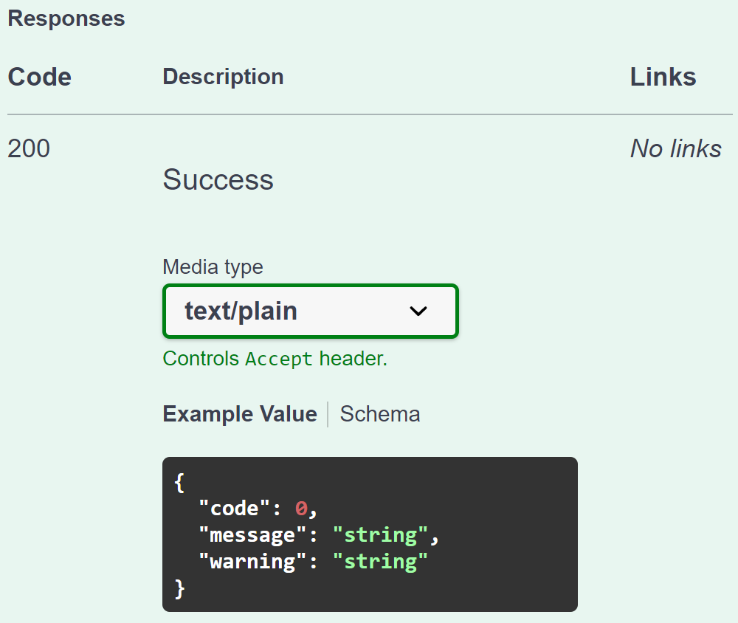
Validation from RDMS perspective: API makes it flexible for all
Provide a validator for every object type in configuration:
type: built-in type (object instantiated by class name);
https: URL to a REST Service (OpenAPI specification).
{
"Code": 0,
"Message": null,
"Warning": null
}
type:TypeValidationLibrary.TypeValidator_EDX_CSV (interface IFileValidator)
https://validation.matinf.pro/edx/validation
valid
Validation result
via external API call
External service decision
invalid
type
{
"Code": 500,
"Message": "error text",
"Warning": null
}
API – Application Programming Interface
URL – Uniform Resource Locator
REST – REpresentational State Transfer

Slide 11
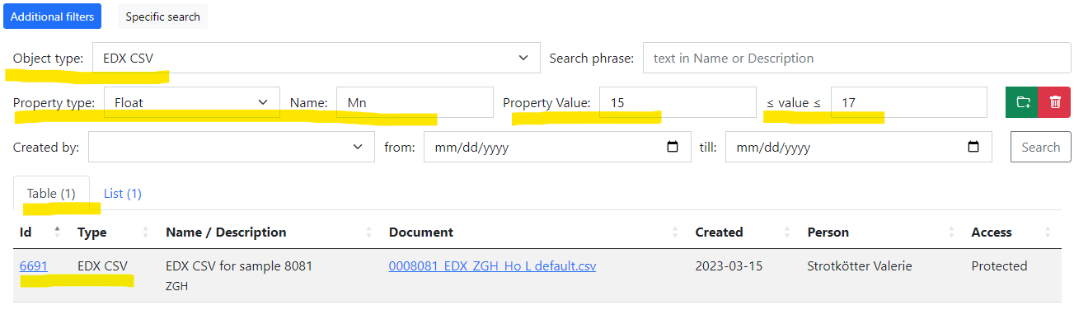
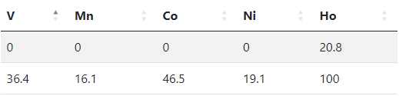
User perspective: how EDX should be findable?
Processed EDX CSV document should be findable by any chemical element concentration!
We need to store (Concentration_{MIN}; Concentration_{MAX}) for every element present in the sample:
Sample 8081 (V-Mn-Co-Ni-Ho): fill properties
 | V | Mn | Co | Ni | Ho
Min | 0 | 0 | 0 | 0 | 20.7
Max | 36.4 | 16.1 | 46.5 | 19.1 | 100
After authorization (User group member):
https://dim.mdi.ruhr-uni-bochum.de/search/?typeid=13&pr0name=Mn&pr0type=Float&pr0min=15&pr0max=17&prcnt=1
https://dim.mdi.ruhr-uni-bochum.de/object/edx-csv-for-sample-8081-6691

Slide 12
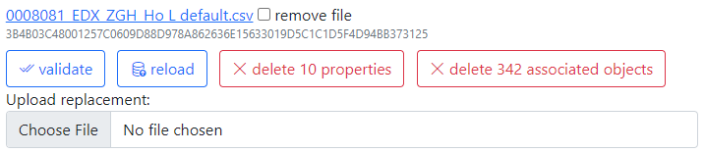
Metadata extraction: external API
Provide a data extractor for every object type in configuration:
type: built-in type (object instantiated by class name);
https: URL to a REST Service (OpenAPI specification).
type:TypeValidationLibrary.TypeValidator_EDX_CSV (interface IDatabaseValuesGetter)
https://validation.matinf.pro/edx/data
{ "DeletePreviousProperties": true,
"Properties": [
{ "PropertyId": 0,
"Type": 1,
"Name": "V",
"Value": 0,
"ValueEpsilon": null,
"SortCode": 10,
"Row": 1,
"Comment": "Minimal V content"
},
{ "PropertyId": 0,
"Type": 1,
"Name": "V",
"Value": 36.400001525878906,
"ValueEpsilon": null,
"SortCode": 10,
"Row": 2,
"Comment": "Maximal V content"
}
]
}
Metadata for EDX (range values):
Administrative interface: Compositions

Slide 13
All data extraction: external API
Provide a data extractor for every object type in configuration:
type: built-in type (object instantiated by class name);
https: URL to a REST Service (OpenAPI specification).
type:TypeValidationLibrary.TypeValidator_EDX_CSV (interface IDatabaseValuesGetter)
https://validation.matinf.pro/edx/data
Data from EDX (all values == 342 compositions):
{
"CompositionElements": [
{ "CompoundIndex": 0, "ElementName": "V", "ValueAbsolute": null, "ValuePercent": 31.299999237060547 },
{ "CompoundIndex": 10, "ElementName": "Mn", "ValueAbsolute": null, "ValuePercent": 2.700000047683716 },
{ "CompoundIndex": 20, "ElementName": "Co", "ValueAbsolute": null, "ValuePercent": 22.600000381469727 },
{ "CompoundIndex": 30, "ElementName": "Ni", "ValueAbsolute": null, "ValuePercent": 6 },
{ "CompoundIndex": 40, "ElementName": "Ho", "ValueAbsolute": null, "ValuePercent": 37.400001525878906 }
],
"DeletePreviousProperties": true,
"Properties": [
{
"PropertyId": 0, "Type": 2, "Name": "Measurement Area", "Value": 1, "ValueEpsilon": null,
"SortCode": 0, "Row": null, "Comment": null
}
]
}

Slide 14
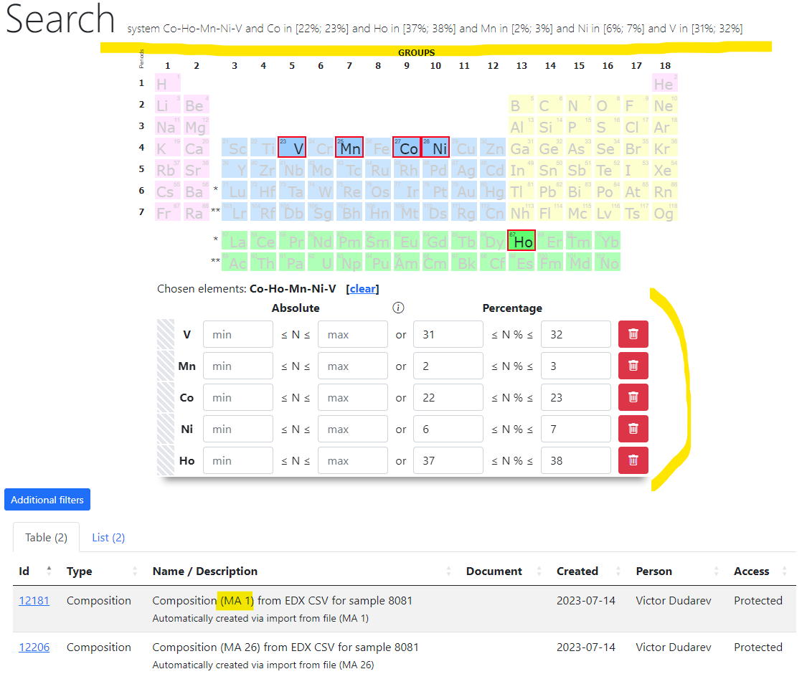
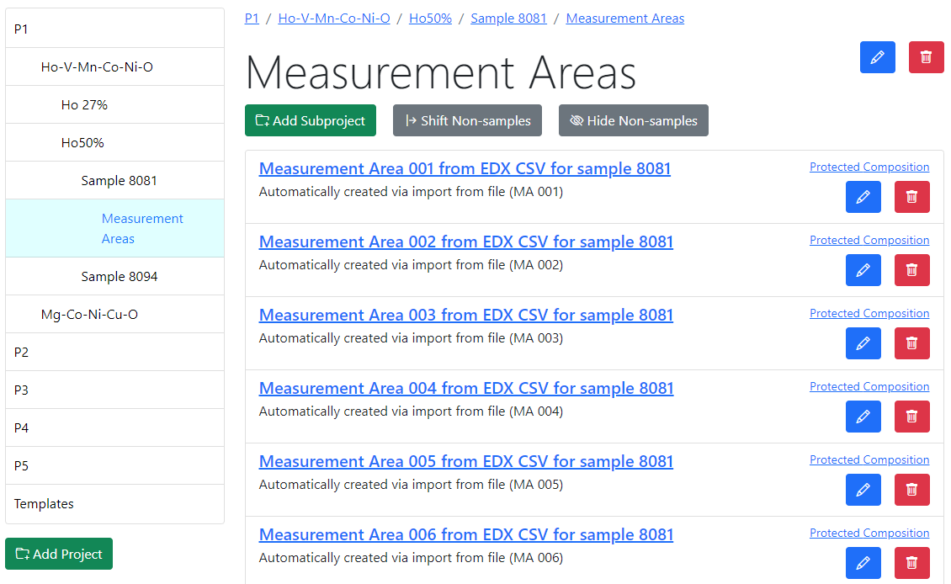
Search for Composition (obtained from EDX)
Rubric: https://dim.mdi.ruhr-uni-bochum.de/rubric/p1project_ho-v-mn-co-ni-o_ho50_sample-id-0008081_measurement-areas
2) Search: https://dim.mdi.ruhr-uni-bochum.de/search/?system=Co-Ho-Mn-Ni-V&Copctmin=22&Copctmax=23&Hopctmin=37&Hopctmax=38&Mnpctmin=2&Mnpctmax=3&Nipctmin=6&Nipctmax=7&Vpctmin=31&Vpctmax=32

Slide 15
Recommended plan for data presentation (for every project)
    Brief introduction to data / measurements
    Data format description
    Search requirements:
      How do you (partners) find your object among thousands of similar objects?
      What are essential parameters/properties?
    Proposal for object type in RDMS:
      File validation requirements (no validation -> formal schema)
      Metadata extraction or template proposal (enlist mandatory properties)
      Data extraction (if required, specify requirements)
    Q&A.

Slide 16
A Perfect “Object Type Support Request” from … project
    based on considered EDX example…
    comes from the next slide

Slide 17
Brief introduction to data / measurements: coordinate grid
I X Y
1 27000 4500
2 31500 4500
3 36000 4500
…
11 72000 4500
12 22500 9000
13 27000 9000
...
341 58500 90000
342 63000 90000
Materials Library Measurement Areas
342 Measurement Areas (4.5 mm x 4.5 mm)
(x; y) coordinates on the surface

Slide 18
Data format description: raw EDX data format
Project: 0008081_EDXmapping ZGH (1)
Owner:
Site: Site of Interest 1
Sample: Sample 1
Type: Default
ID:
Processing option : All elements analysed
All results in atomic%
X and Y are stage positions
Spectrum In stats. X (mm) Y (mm) C O Si V Mn Co Ni Ho
Spektrum 1 {1} Yes -44.600 -40.300 80.36562 17.7799 0.331076 -0.3328189 9.434319E-02 1.12593 1.070188 -0.4342265
Spektrum 1 {2} Yes -40.100 -40.300 80.1367 23.03086 0.2024186 -4.792345E-02 -0.2482219 -3.621299 0.6450471 -9.758038E-02
Spektrum 1 {3} Yes -35.600 -40.300 83.67403 14.34433 0.2835474 -6.302138E-02 -7.115601E-02 1.043958 1.091217 -0.3029233
- … - … - … - … - … - … - … - … - … - … - … - …
Spektrum 1 {418} Yes 36.400 45.200 81.8801 12.53673 0.5853955 -1.528375E-02 4.889345E-02 -1.36448 6.783489 -0.4548477
Spektrum 1 {419} Yes 40.900 45.200 80.46669 12.32581 0.2078687 0.27237 -0.2769422 -7.077376 12.81309 1.268483
Spektrum 1 {420} Yes 45.400 45.200 83.68153 15.48148 0.0646082 0.2312067 -0.1969592 -2.165317 2.769571 0.1338789
Mean 43.79094 18.89702 29.09091 0.7714614 0.4576146 1.19483 3.057466 2.739753
Std. deviation 21.38218 7.121112 11.38863 0.9768385 0.3503809 20.70591 9.166298 3.695945
Max. 321.3774 82.92272 36.86385 3.61815 1.213754 225.3098 62.29993 5.617296
Min. -93.34522 -33.35334 -1.881486 -0.7680827 -0.4307786 -309.4584 -2.63329 -66.55944
Header (could be skipped)
Data we need (TAB separated). Almost, but:
420 measurement areas (instead of 342), need to filter;
Other elements (from substrate, need to filter: C, O, Si).
Footer
(to skip)

Slide 19
EDX: what we need to extract (the Table)
After processing one can conclude with the final outcome
V: 18.3 %
Mn: 4.8 %
Co: 17.2 %
Ni: 6.8 %
Ho: 53 %
Measurement Area Index Chemical Elements
[1, 342]
Composition for the Measurement Area 3 (atomic %)
Measurement
Area 3
Composition
Data
https://dim.mdi.ruhr-uni-bochum.de/file/csv/6691

Slide 20
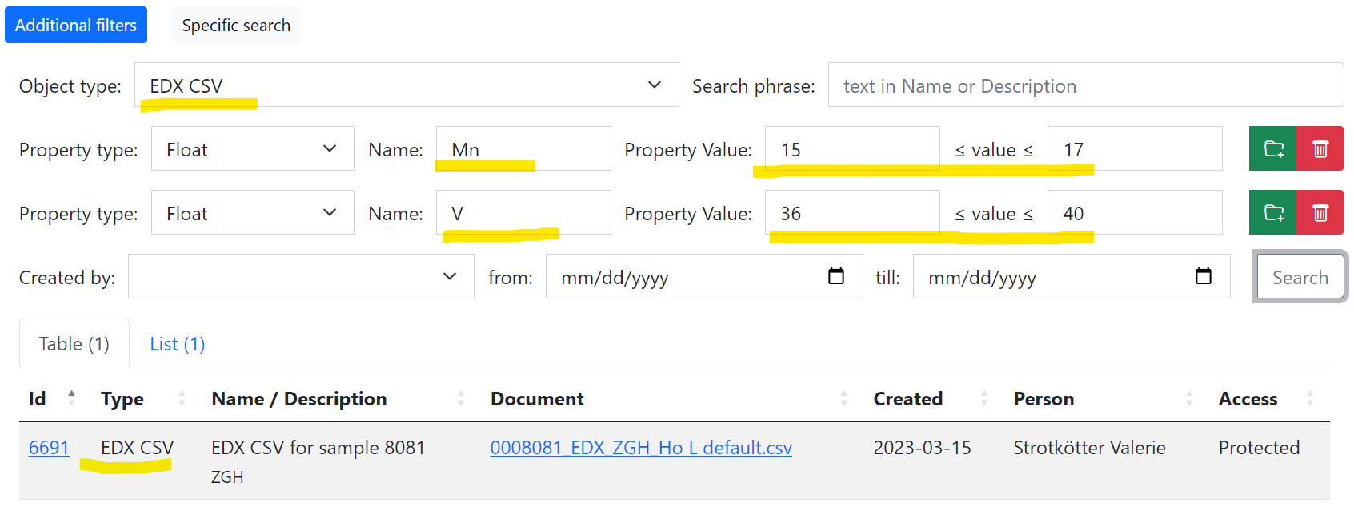
Search requirements: how EDX should be findable?
1) EDX document should be findable by chemical elements contents within a range in materials library
We need to store (Concentration_{MIN}; Concentration_{MAX}) for every element:
After authorization (User group member):
https://dim.mdi.ruhr-uni-bochum.de/search/?typeid=13&pr0name=Mn&pr0type=Float&pr0min=15&pr0max=17&pr1name=V&pr1type=Float&pr1min=36&pr1max=40&prcnt=2

Slide 21
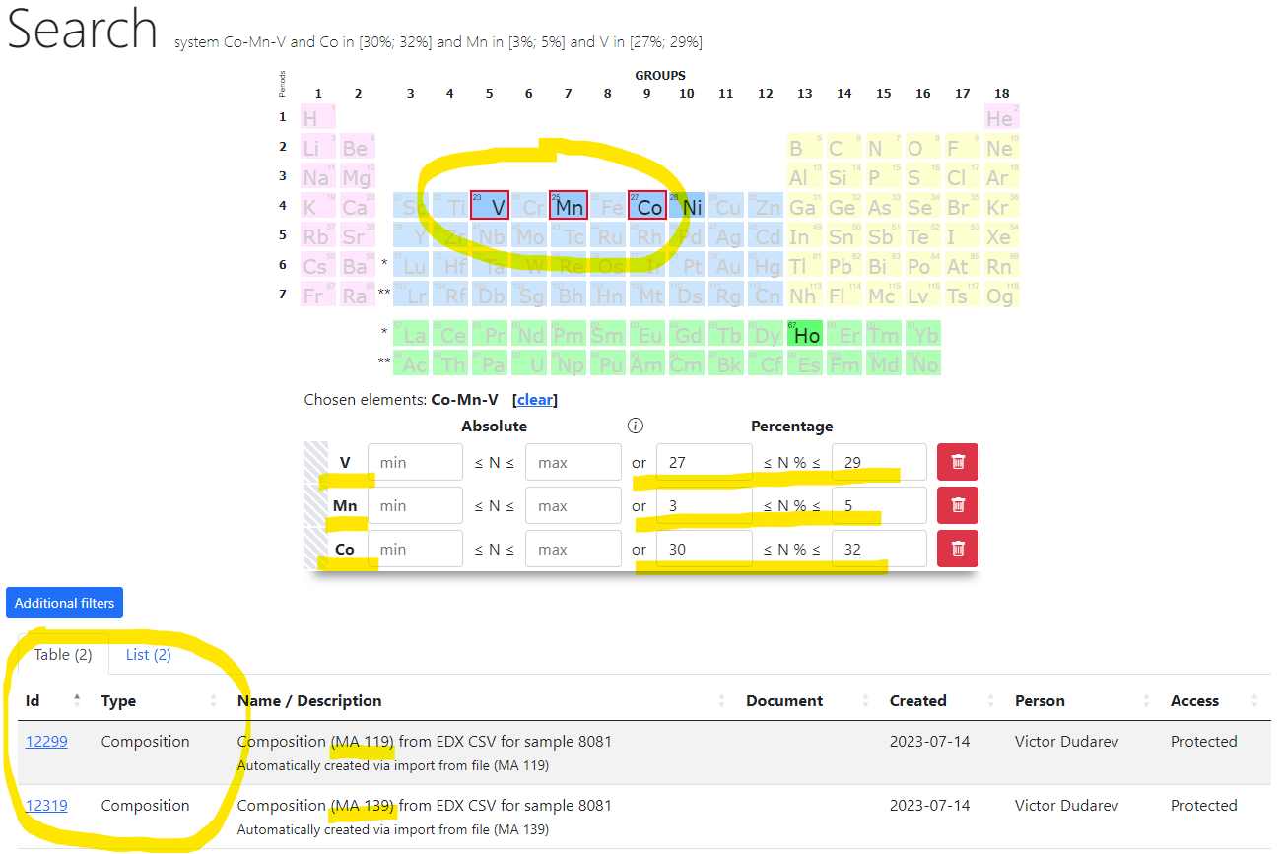
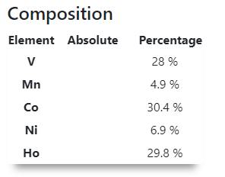
Search requirements: individual compositions findability
2) Compositions within measurements area should be findable
We need to create composition for every measurement area of materials library on basis of EDX data. For example:
Composition (MA 119) from EDX CSV for sample 8081
After authorization (User group member):
https://dim.mdi.ruhr-uni-bochum.de/search/?system=Co-Mn-V&Copctmin=30&Copctmax=32&Mnpctmin=3&Mnpctmax=5&Vpctmin=27&Vpctmax=29

Slide 22
Validation Requirements
Index,V,Mn,Co,Ni,Ho
1,31.3,2.7,22.6,6,37.4
2,23.1,6.1,17,6.8,47
3,18.3,4.8,17.2,6.8,53
4,10,5.7,20.9,7.4,56
...
339,8.7,13,36.2,13.8,28.3
340,8.1,11,38.7,14.2,28
341,6.7,14.1,33.5,16.8,28.8
342,6.6,13,34.9,15.3,30.2
Processed EDX CSV data
1
Project: 0008081_EDXmapping ZGH (1)
Owner:
Site: Site of Interest 1
Sample: Sample 1
Type: Default
ID:
Processing option : All elements analysed
All results in atomic%
X and Y are stage positions
Spectrum In stats. X (mm) Y (mm) C O Si V Mn Co Ni Ho
Spektrum 1 {1} Yes -44.600 -40.300 80.36562 17.7799 0.331076 -0.3328189 9.434319E-02 1.12593 1.070188 -0.4342265
Spektrum 1 {2} Yes -40.100 -40.300 80.1367 23.03086 0.2024186 -4.792345E-02 -0.2482219 -3.621299 0.6450471 -9.758038E-02
Spektrum 1 {3} Yes -35.600 -40.300 83.67403 14.34433 0.2835474 -6.302138E-02 -7.115601E-02 1.043958 1.091217 -0.3029233
- … - … - … - … - … - …
Spektrum 1 {418} Yes 36.400 45.200 81.8801 12.53673 0.5853955 -1.528375E-02 4.889345E-02 -1.36448 6.783489 -0.4548477
Spektrum 1 {419} Yes 40.900 45.200 80.46669 12.32581 0.2078687 0.27237 -0.2769422 -7.077376 12.81309 1.268483
Spektrum 1 {420} Yes 45.400 45.200 83.68153 15.48148 0.0646082 0.2312067 -0.1969592 -2.165317 2.769571 0.1338789
Mean 43.79094 18.89702 29.09091 0.7714614 0.4576146 1.19483 3.057466 2.739753
Std. deviation 21.38218 7.121112 11.38863 0.9768385 0.3503809 20.70591 9.166298 3.695945
Max. 321.3774 82.92272 36.86385 3.61815 1.213754 225.3098 62.29993 5.617296
Min. -93.34522 -33.35334 -1.881486 -0.7680827 -0.4307786 -309.4584 -2.63329 -66.55944
Raw EDX data
2

Slide 23
Metadata extraction
 | V | Mn | Co | Ni | Ho
Min | 0 | 0 | 0 | 0 | 20.7
Max | 36.4 | 16.1 | 46.5 | 19.1 | 100
Task: Metadata extraction or template proposal (enlist mandatory properties)
- No template or fixed properties list
- Property names are chemical elements that are in a sample
- For every element should be created two Float properties with minimal and maximal contents
(Concentration_{MIN}; Concentration_{MAX}) for every element

Slide 24
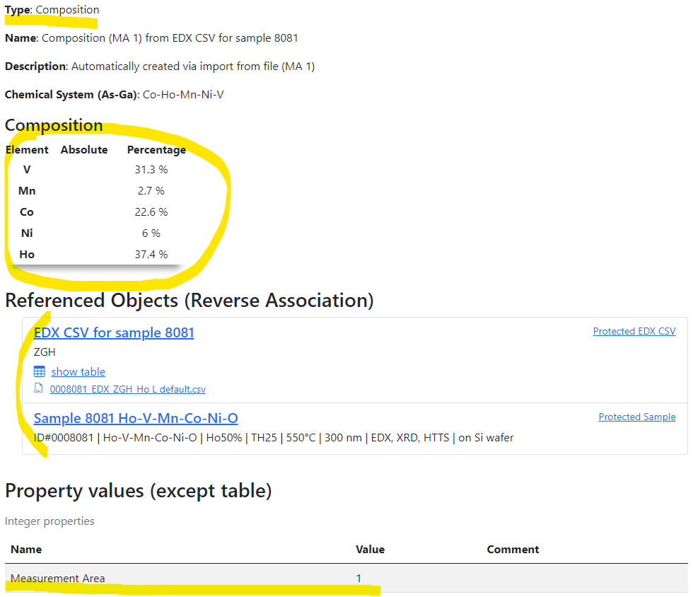
Data extraction
It’s required to create objects of Composition type for every measurement area (342)
For example
and these compositions should be connected with “parent” objects:
Source EDX CSV object
Source sample
https://dim.mdi.ruhr-uni-bochum.de/object/measurement-area-001-from-edx-csv-for-sample-8081-12866

Slide 25
Thanks for your kind attention
Q&A
Victor Dudarev
Victor.Dudarev@rub.de
https://vdudarev.ru

