Slide 1

CRC/TRR247 Research Data Management System
Use Case:
How To Manage Project Tree And Add Your Data
Dr.
V. Dudarev
Victor Dudarev

Slide 2
Agenda
    Project tree
      Tree concept in computer science
      Browsing project tree in RDMS
      Controlling project tree in RDMS
    Objects and data
      Object concept (document, piece of data)
      Create an object in RDMS
      Basic search
    Q&A

Slide 3
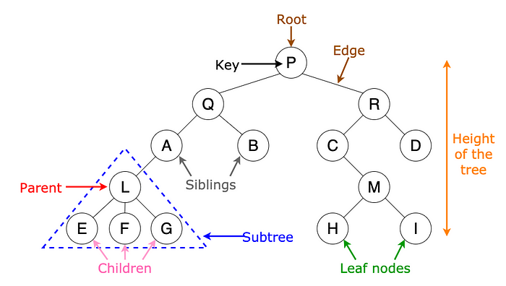
Tree concept (in computer science)
N-ary tree concept: https://towardsdatascience.com/8-useful-tree-data-structures-worth-knowing-8532c7231e8c

Slide 4
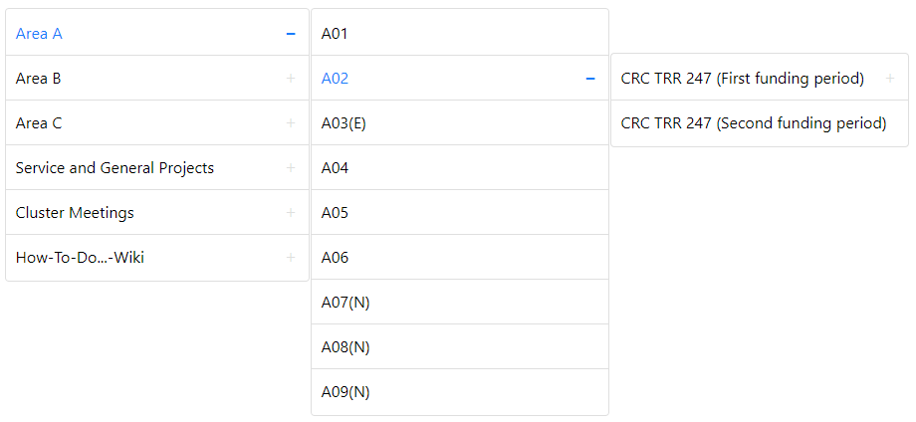
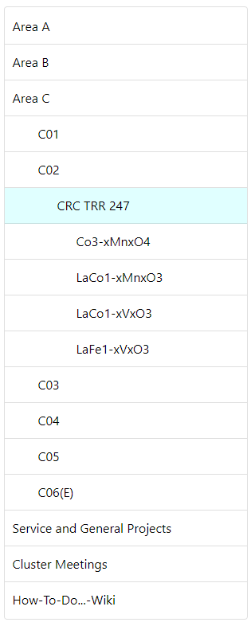
Project Tree In RDMS (page browsing)
Main Page (root):
Other Pages:
    Unlimited tree height (nesting level)
    No naming restrictions
    Access Level is honored (public, protected, etc…)
    Every rubric has unique URL.
https://crc247.mdi.ruhr-uni-bochum.de

Slide 5

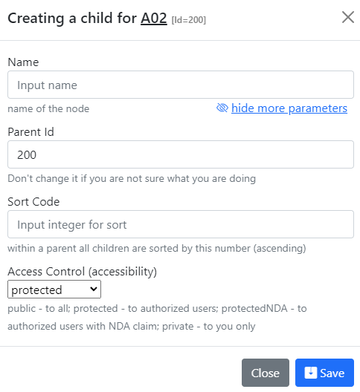

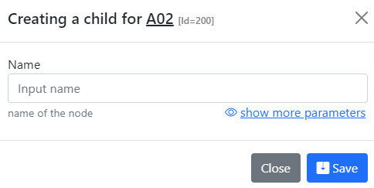
Controlling Project Tree
- add project to the top level
- add project as a child for the current project
Simple view
Advanced view
https://crc247.mdi.ruhr-uni-bochum.de

Slide 6
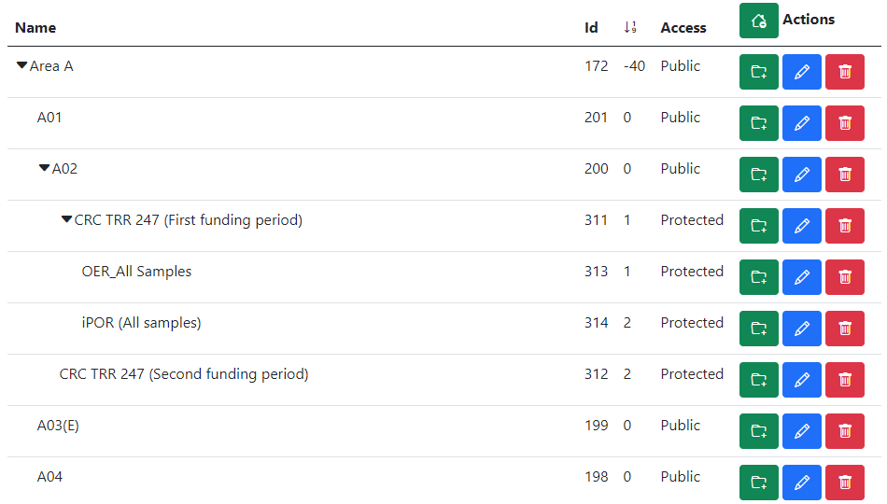
Controlling All Project Tree
add top-level project
Open / Collapse Subtree
add subproject
edit project
delete project
https://crc247.mdi.ruhr-uni-bochum.de

Slide 7
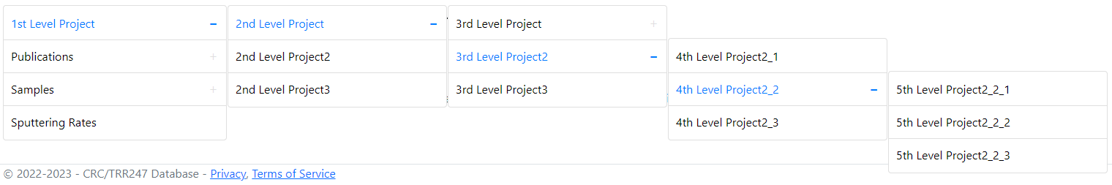
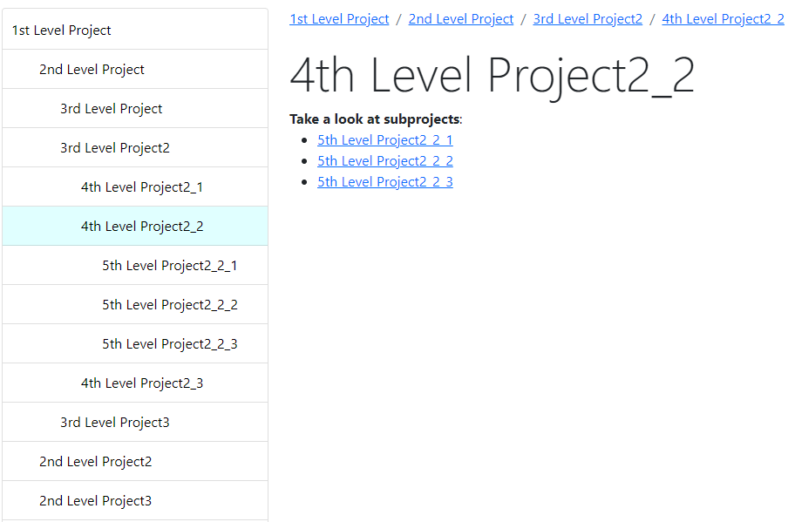
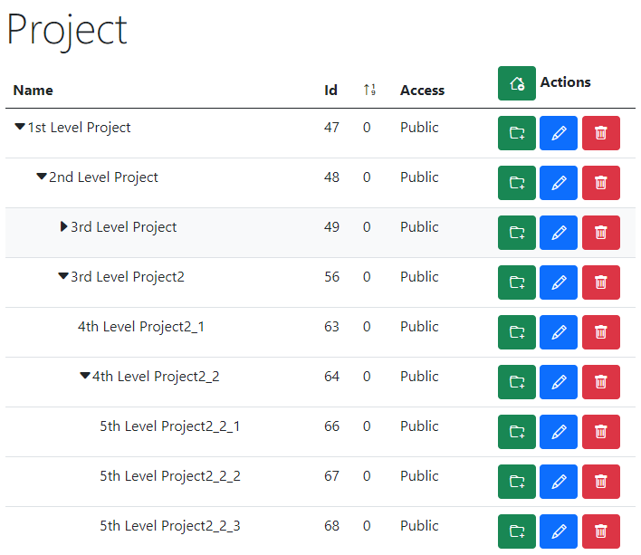
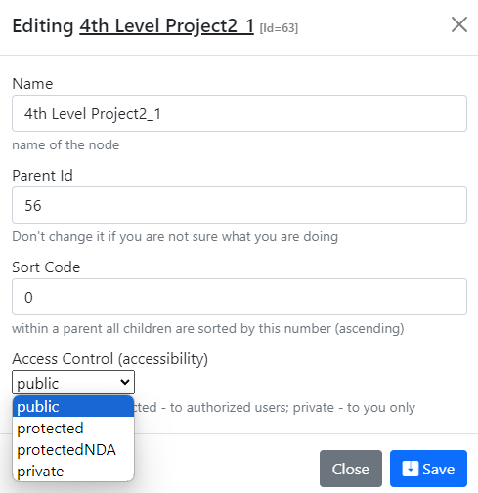
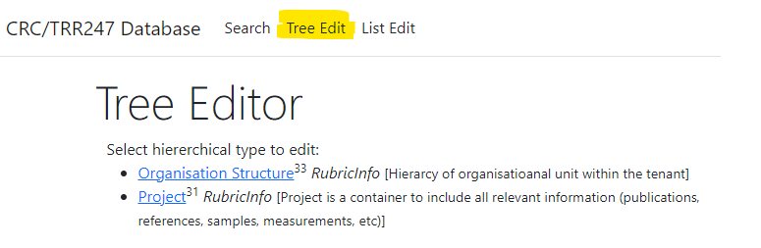
RDMS Tree Types Summary: control and display
Display for users in Web Application
Control (admin):
Name
Parent Id
Sort Code
Access
https://demo.mdi.ruhr-uni-bochum.de/

Slide 8


Playgrounds
https://inf.mdi.ruhr-uni-bochum.de/ https://demo.mdi.ruhr-uni-bochum.de/
Playground Inf Playground Demo
Playground to test RDMS (multiple tenants with shared users list):
https://inf.mdi.ruhr-uni-bochum.de/
https://demo.mdi.ruhr-uni-bochum.de/
Login and Password (User role): User1@user.org
Login and Password (PowerUser role): PowerUser1@user.org
Login and Password (Administrator role): Admin1@user.org
https://inf.mdi.ruhr-uni-bochum.de/

Slide 9
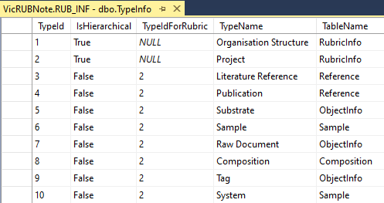
RDMS: Data Types (hierarchies and lists)
Data Types
IsHierarchical = True
IsHierarchical = False
Hierarchical
(tree types)
List
(list types)
All types are extendable (stored in TypeInfo)
Rubrics (RubricInfo table) types:
Project
Organization Structure
++ (extendable)
Objects (ObjectInfo table) and all derived (non-hierarchical) types:
Reference
Sample
Composition
++ (extendable)

Slide 10
Core Objects‘ Characteristics
Object characteristics:
Type Reference (specified by user on object creation / could be automatically suggested on file upload)
Name (must be specified), unique within type
Description (can be empty)
Reference to a Data File uploaded to system (uploading by choice)
Metadata:
Unique Object Identifier (assigned automatically), primary key
User who created the object and date with time (auto)
User who modified the object and modification date and time (auto)
Project (tree-structure) reference (can specified by user on object creation)
Code to define a certain sort order in a list of objects (auto, can be changed)
One of predefined Object Access Levels: public / protected / protectedNDA / private (auto)
Relative URL for page to access object (auto formed; must be unique; can be changed)
SHA-256 file hash (must be unique)
(!) All core data on objects are stored in ObjectsInfo table.

Slide 11
How to Choose a Type for an Object
Core Object Types:
ObjectInfo – the simplest (bare) object
Sample – chemical system (set of chemical elements), for example Co-O
Composition – chemical composition (set of elements and quantities), for example Co₃O₄
Reference – literature reference (Authors, Title, Year, DOI, etc.)
All other (user-defined) types are derived from the core object types and can enrich defined object specification by customized (templates!) properties (either in list or table form) of primitive types:
  Integer
  Float
  String / BigString

Slide 12
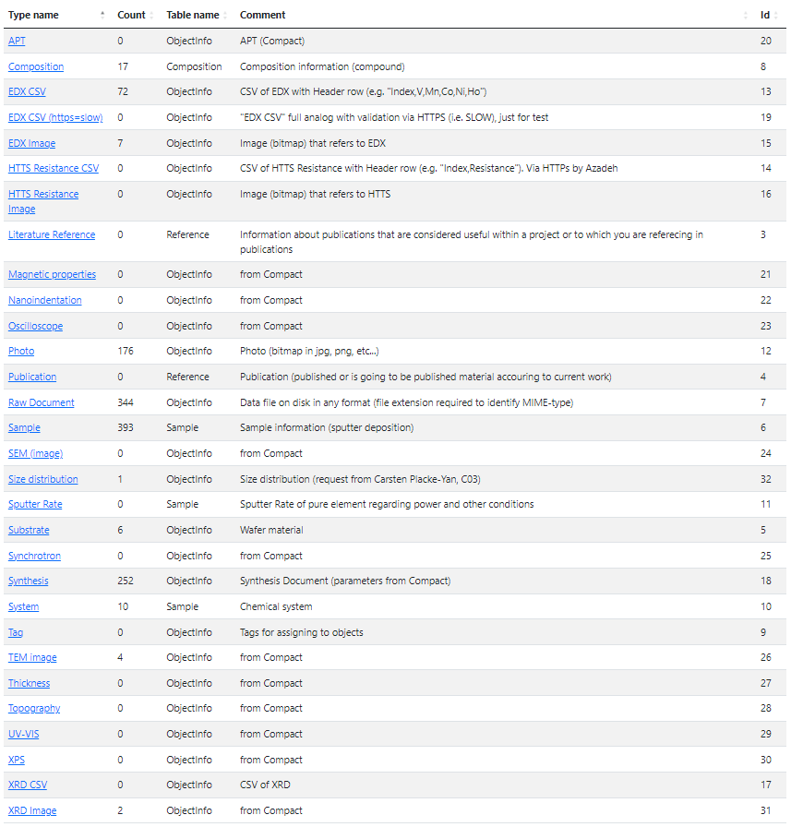


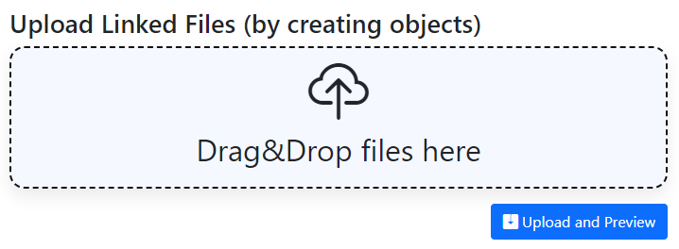
Available Types in CRC/TRR 247 tenant
UI Experience to add object:
1) Direct type selection
Add object Add Sample
2) File Drag&Drop zone (type is suggested based on file name/extension, user can adjust file type)
Types are to be extended
https://crc247.mdi.ruhr-uni-bochum.de/adminobject

Slide 13
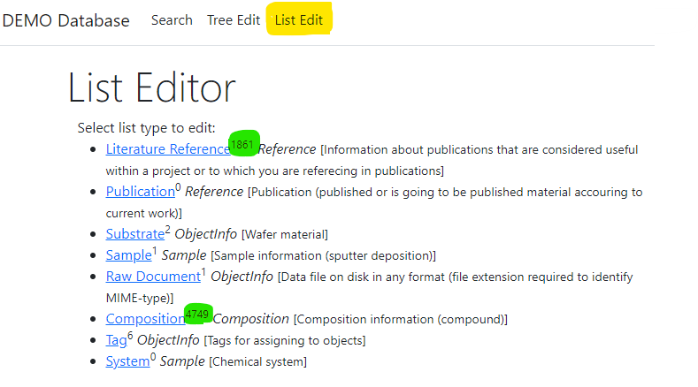
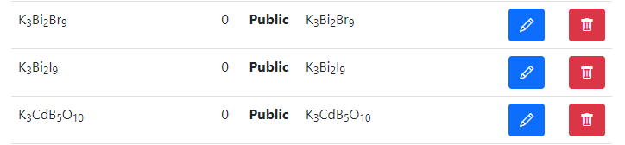
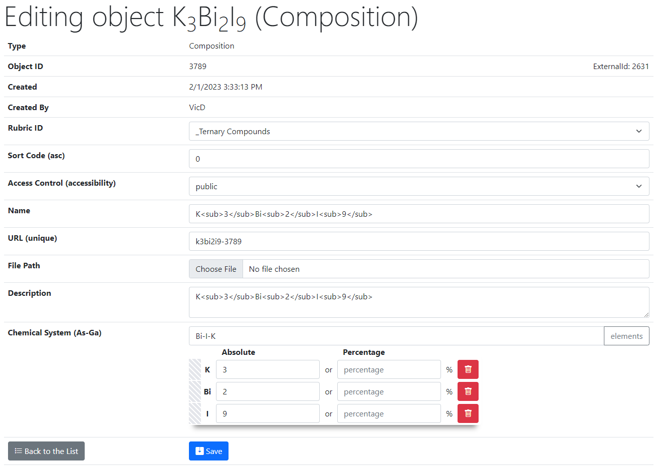
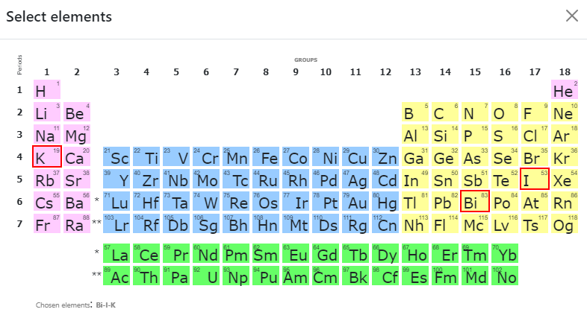
UI for a Composition type
List of all objects (of type Composition):
Control (common to all objects, from ObjectInfo):
Rubric Id;
Sort Code;
Access;
Name;
URL (adjustable*);
Attach File (document);
Description.
2
Type specific control (e.g. Composition):
Chemical System;
Composition (elements containment).
1
https://demo.mdi.ruhr-uni-bochum.de/object/k3bi2i9-3789
https://demo.mdi.ruhr-uni-bochum.de/adminobject/edititem/3789

Slide 14
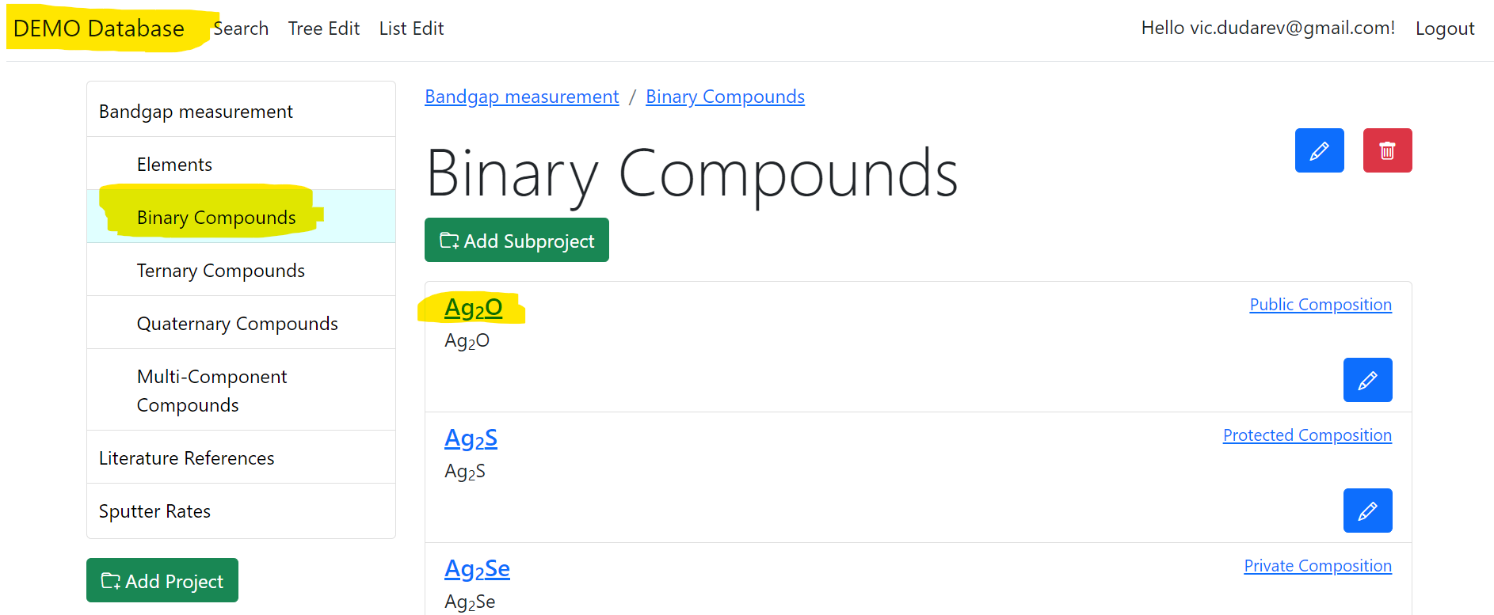
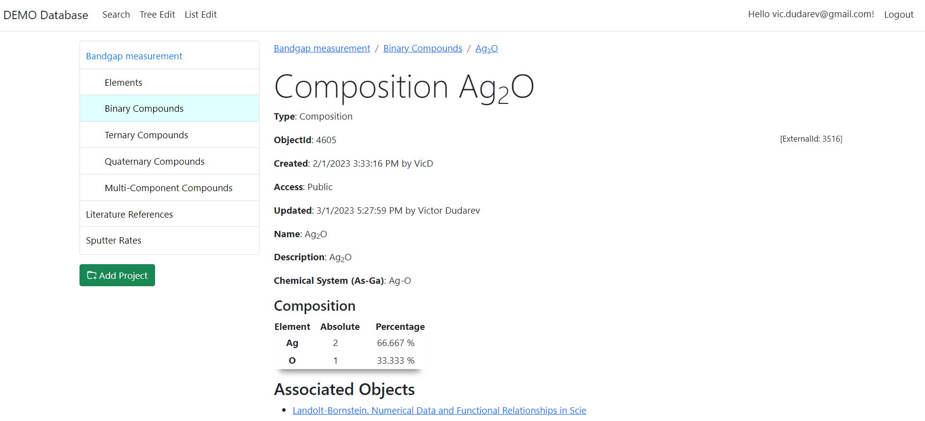
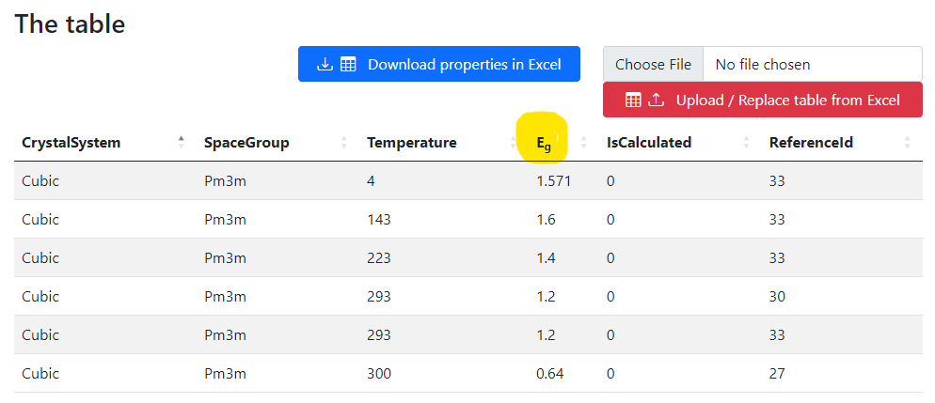
Composition Type: customisation with a table
Visibility depends on user privileges
UI Experience:
Select project (rubric with objects)
Select object of interest
Follow the link and explore object data and properties
https://demo.mdi.ruhr-uni-bochum.de/object/ag2o-4605
https://demo.mdi.ruhr-uni-bochum.de/object/ag2o-4605

Slide 15
Thanks for your kind attention
Q&A
Victor Dudarev
Victor.Dudarev@rub.de
https://vdudarev.ru

Slide 16
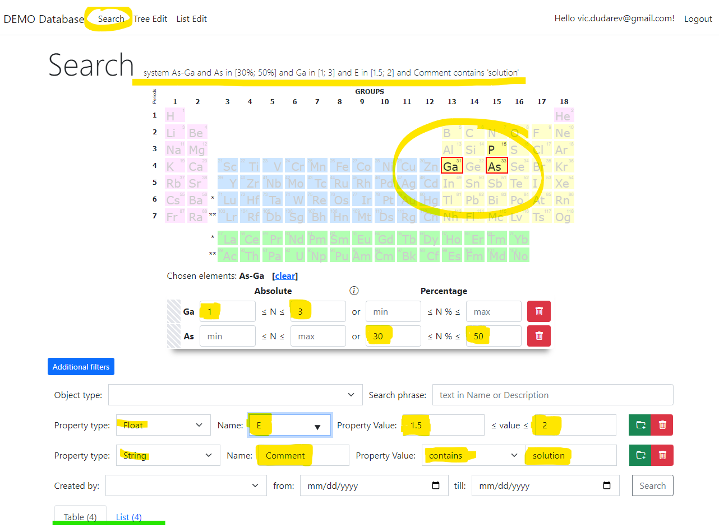
RDMS: Search
Search on:
Chemical system
Composition
Object type
Phrase in object’s Name or Description
Properties values (all available within tenant)
Person created
Creation date
Important feature:
persistent URL on search (share search results easily by URL*).
* - respecting current security context
Task: make properties modification easy
https://demo.mdi.ruhr-uni-bochum.de/search/
https://demo.mdi.ruhr-uni-bochum.de/search/?system=As-Ga&typeid=8&Aspctmin=30&Aspctmax=50&Gaabsmin=1&Gaabsmax=3&pr0name=E%3Csub%3Eg%3C%2Fsub%3E&pr0type=Float&pr0min=1.5&pr0max=2&pr1name=Comment&pr1type=String&pr1max=3&pr1str=solution&prcnt=2
https://demo.mdi.ruhr-uni-bochum.de/search/?system=As-Ga&typeid=8&Aspctmin=30&Aspctmax=50&Gaabsmin=1&Gaabsmax=3&pr0name=E%3Csub%3Eg%3C%2Fsub%3E&pr0type=Float&pr0min=1.5&pr0max=2&prcnt=1

Slide 17
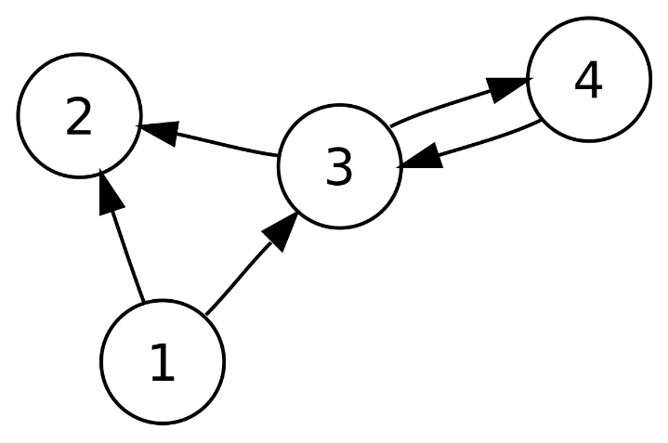
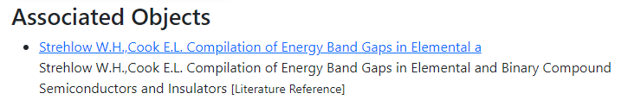
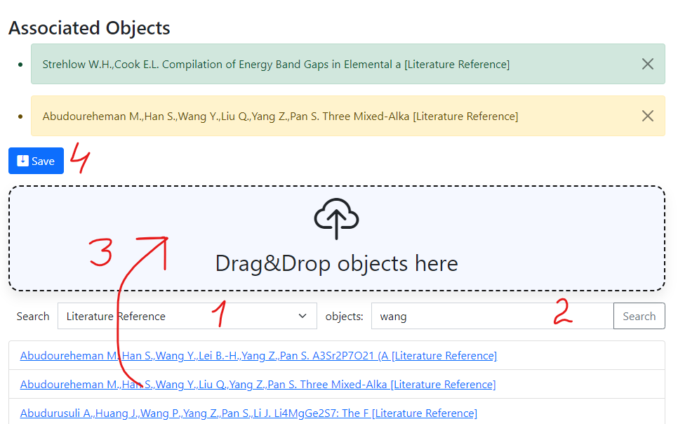
RDMS: Interlink Objects
Example: literature reference for published data on composition:
To add associated objects:
0) Go to “List edit” or select object to edit
1) Select associated object type (optional filter)
2) Input search phrase, contained in the Name of desired object to be associated
3) Drag & Drop desired object(s) from search result list to the area / adjust list
4) Save changes
Important: Reverse associations allow to browse reverse- directional associations, such as finding all compounds mentioned in a particular literature reference.
User view: https://demo.mdi.ruhr-uni-bochum.de/object/ag2s-4870
Admin view: https://demo.mdi.ruhr-uni-bochum.de/adminobject/edititem/4870

Slide 18
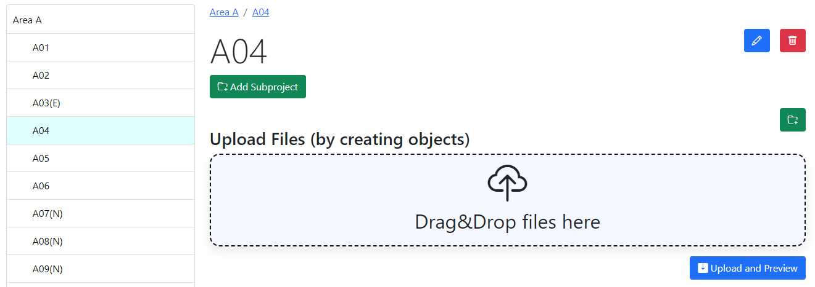
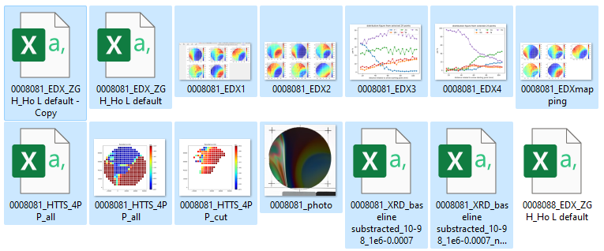
RDMS DropZone Tasks: Data Validation & Import
Task: validate documents & import data
Implemented Features:
Automatic type detection;
Uniqueness check;
Data validation (build-in + external);
Data import.

Slide 19
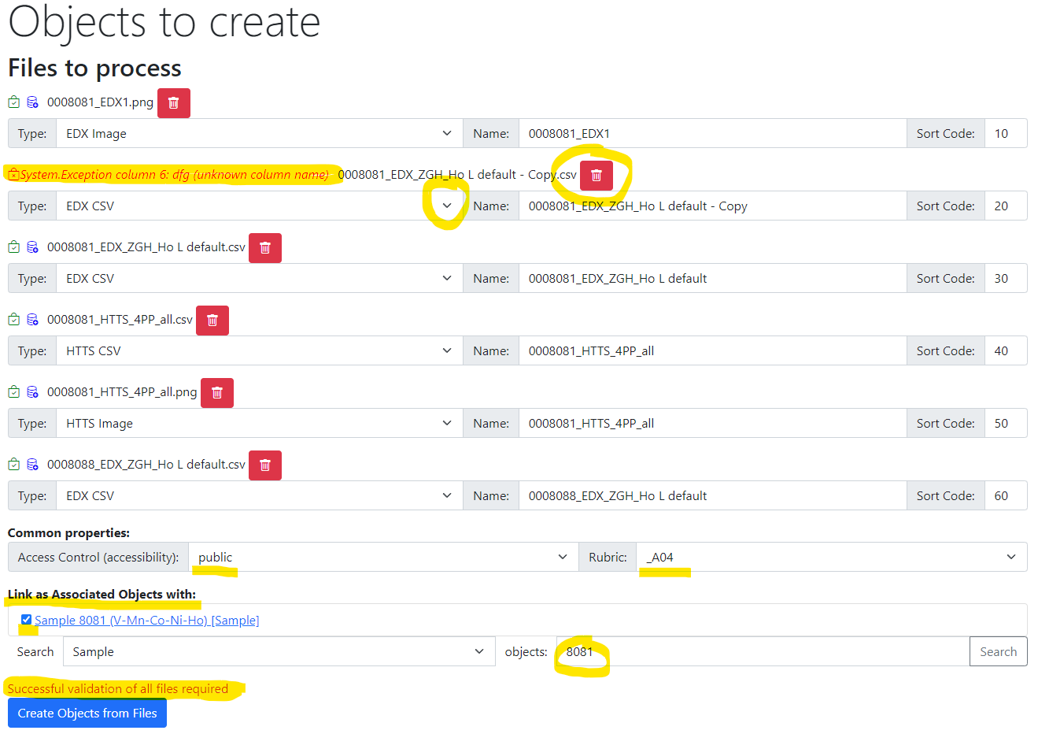
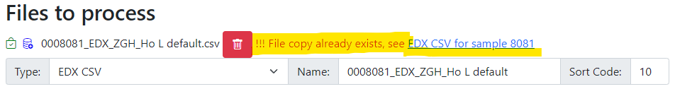
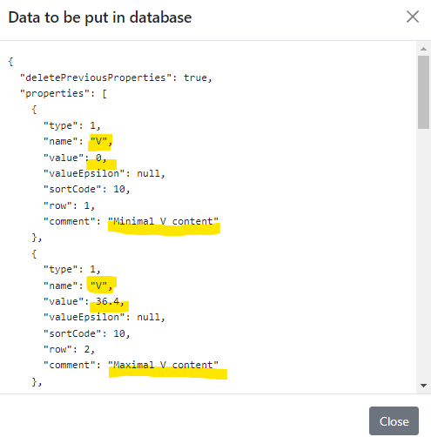
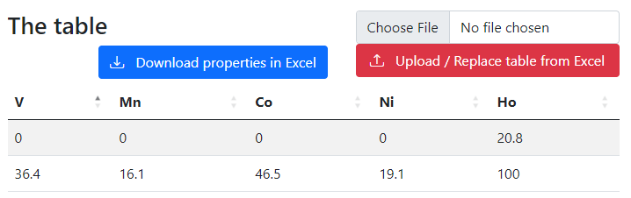
RDMS DropZone: Staged Files (before import)
Check for unique documents (based on SHA256 hash):
Check data to import:
Properties
(after import):
Workflow:
- validate every file;
- check/adjust all properties;
- Import files.

Slide 20
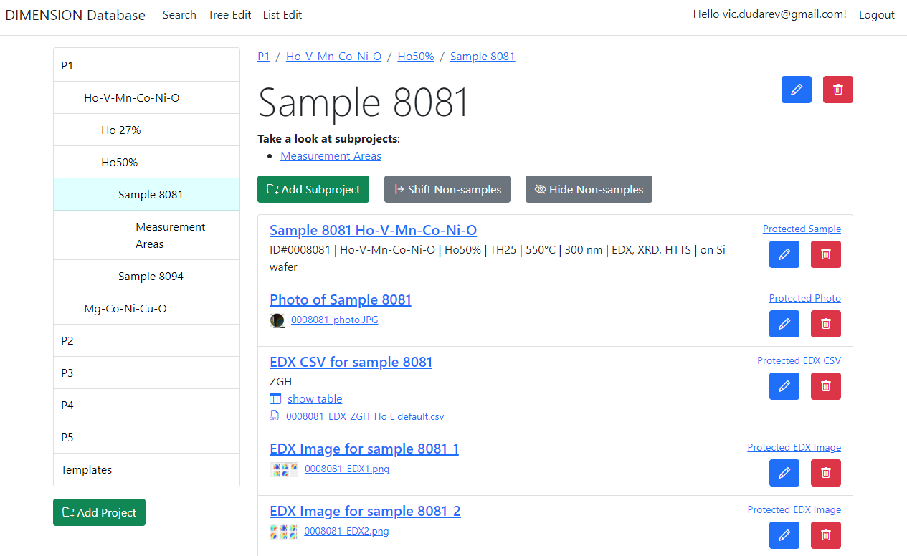

RDMS: Created Objects
After import:
- check all created objects (names, access level, etc…);
- share a link.

