Slide 1

CRC/TRR247 Research Data Management System
Use Case:
How To Create A User-defined Object Type
And Configure A Template
Dr.
V. Dudarev
Victor Dudarev

Slide 2
Agenda
    User-Defined types
      How to choose a base type
      UI to create a new type
    Properties Templates
      Types of Properties
      Setting Up a template for properties list
      Setting Up a template for a table
    Q&A

Slide 3
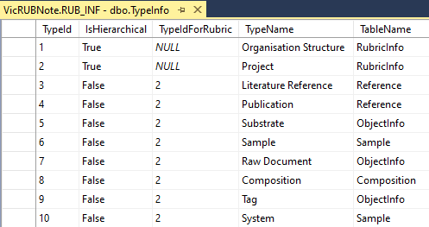
RDMS Extensibility: Additional Object Types
Task: introduce new object types
New Data Type
Based on existing tables
(hierarchical and non-hierarchical)
New Data Structures
(new table & code to fit requirements)
Add new type to TypeInfo table
Added by admin (UI)
Approximate time: 3 minutes
To be done manually
Approximate time: 1 week
Tasks: develop and add new table; define read / write logic with respect to mandatory (or optional) fields and types; reflect to OOP model and provide consistency check (validators); develop import / export and search facilities, etc.
Question: It seems that all can be done with extended properties.
Why to use new data structures?
Short Answer: Performance (especially if number of new type objects is expected to exceed 10K)

Slide 4
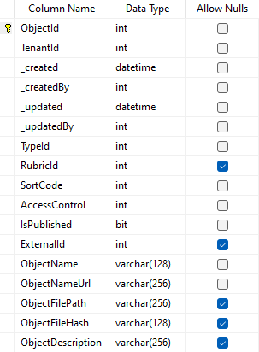
How to choose a Base Type
ObjectInfo
Core Object Types:
ObjectInfo – the simplest (bare) object
Sample – ObjectInfo + chemical system (set of chemical elements), for example Co-O
Composition – ObjectInfo + chemical composition (set of elements and quantities), for example Co₃O₄
Reference – ObjectInfo + literature reference (Authors, Title, Year, DOI, etc.)
All other (user-defined) types are derived from the core object types and can enrich defined object specification by customized (templates!) properties (either in list or table form) of primitive types:
  Integer
  Float
  String / BigString

Slide 5
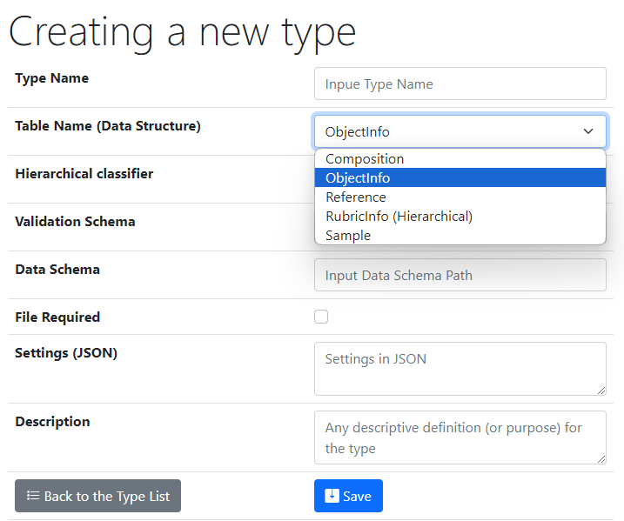
UI to create a new user-defined type
Type Name – user-defined type name
Core Object Types:
ObjectInfo – the simplest (bare) object
Sample – chemical system (set of chemical elements), for example Co-O
Composition – chemical composition (set of elements and quantities), for example Co₃O₄
Reference – literature reference (Authors, Title, Year, DOI, etc.)
Validation & Data Schema – only if you have external Web Services ready to validate & extract data from files
File Required – sets the file mandatory
Settings (JSON) – customization of type for RDMS
{ "CustomEditPath": "/custom/editsample",
"UrlPostVisualizer": "https://abc.de/VisualizeRT" }
Description – comments for type designation

Slide 6
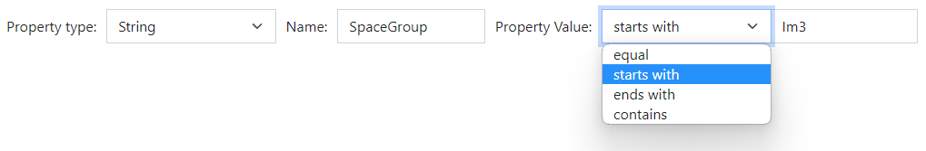
RDMS: Extended Properties (the basics)
All values are to be stored using appropriate data types!
DEFINITION: Data type is a collection or grouping of data values, usually specified by a set of possible values, a set of allowed operations on these values, and/or a representation of these values as machine types.
Supported data types (and their visualization in the search form):
Int – integer values (64-bit signed integer) in range [-9 223 372 036 854 775 808; 9 223 372 036 854 775 807].
Float – double-precision floating-point (8 bytes, IEEE-754), ±5.0×10⁻³²⁴ to ±1.7 × 10³⁰⁸.
String – any characters sequence no longer than 4096 symbols.
BigString – any characters sequence no longer than 2 147 483 647 symbols (2 Gb).
https://en.wikipedia.org/wiki/Data_type

Slide 7
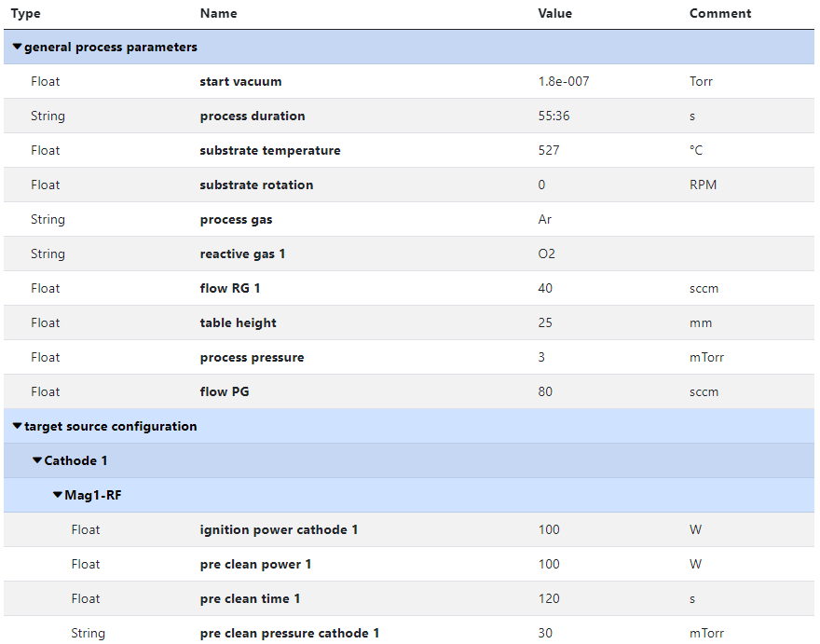
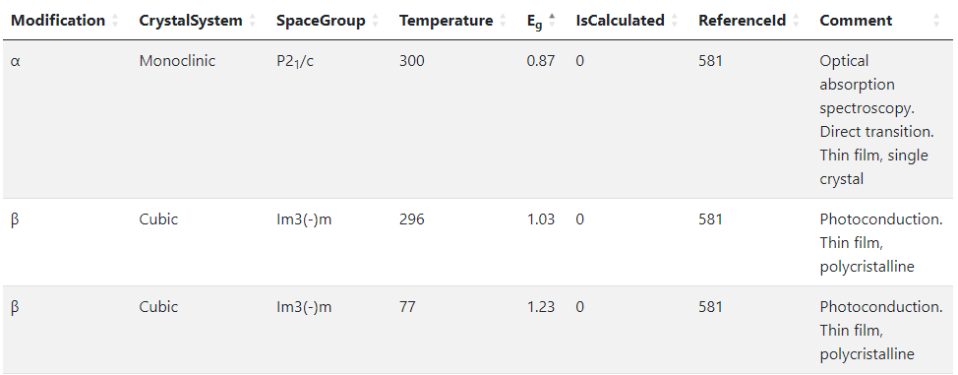
RDMS Templates for type
Template
List
(specify sorted properties list with separators)
Create an object with “_Template” name
Specify properties set
Table
(specify table structure: columns & types)
https://crc247.mdi.ruhr-uni-bochum.de/object/synthesis-for-sample-8220-co-deposition-221111-k3-3-1922
https://demo.mdi.ruhr-uni-bochum.de/object/ag2s-4870

Slide 8
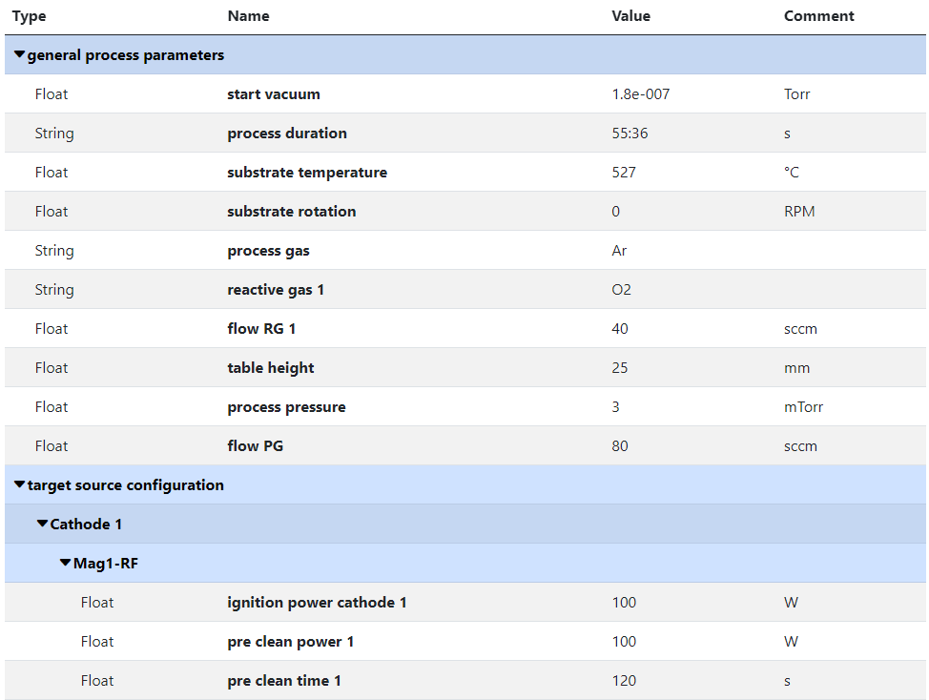
RDMS Object‘s Flexibility: Extended Properties
Measurement Units
Use case: add additional properties values to object and afterward make search on them.
Task: associate typed properties with object Synthesis parameters
Values Types
Separators
(logical blocks)
SortCode
https://crc247.mdi.ruhr-uni-bochum.de/object/synthesis-for-sample-8220-co-deposition-221111-k3-3-1922

Slide 9
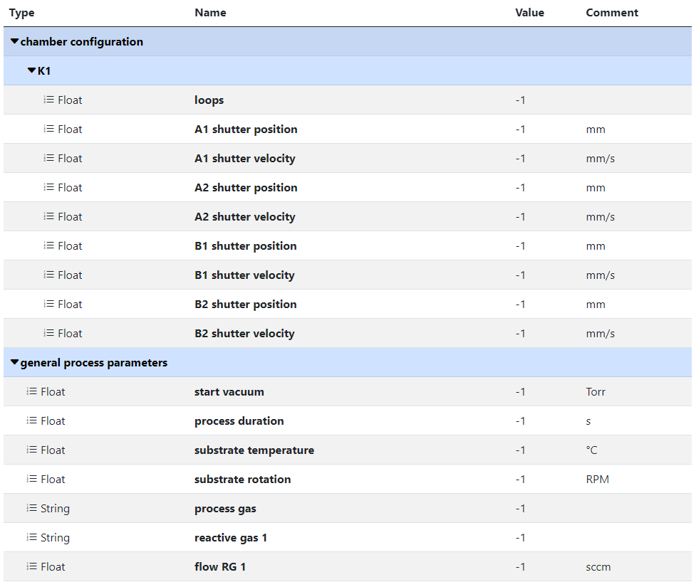
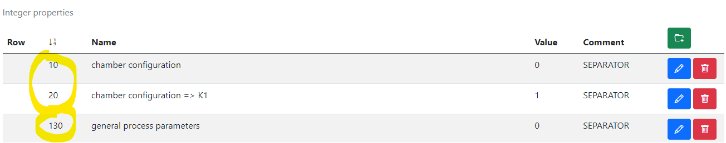
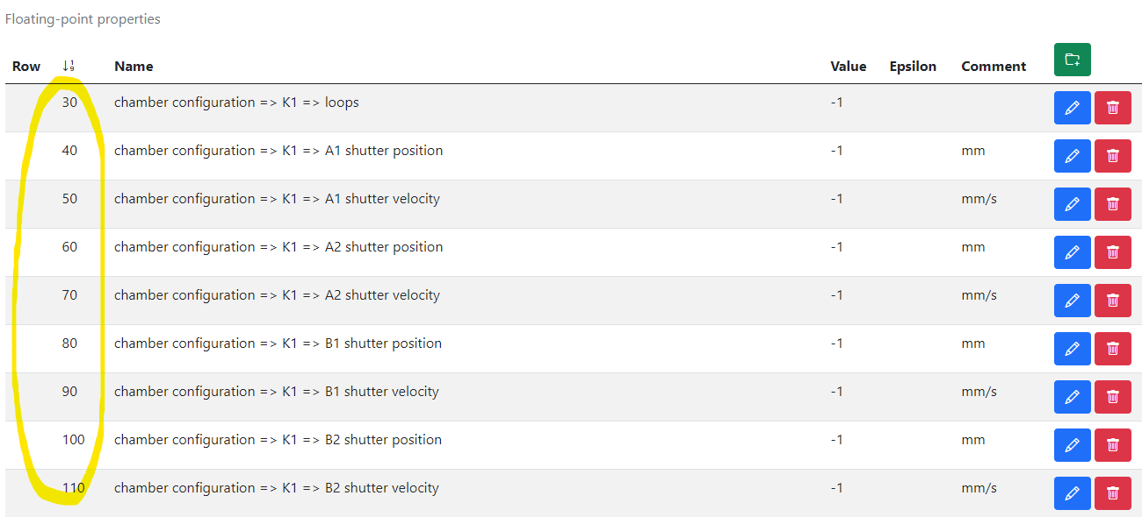
RDMS Extended Properties: Defining a Template
Measurement Units
Use case: to facilitated data edit we need to template extended properties for specified.
Task: create template for synthesis parameters => create object with “_Template” name.
1) Create separators, blue captions to create named sections (if required)
2) Create placeholders (float, int, string)
https://crc247.mdi.ruhr-uni-bochum.de/adminobject/edititem/1956/?returl=%2Fobject%2F_template-1956
https://crc247.mdi.ruhr-uni-bochum.de/object/_template-1956

Slide 10
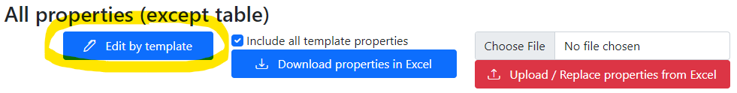
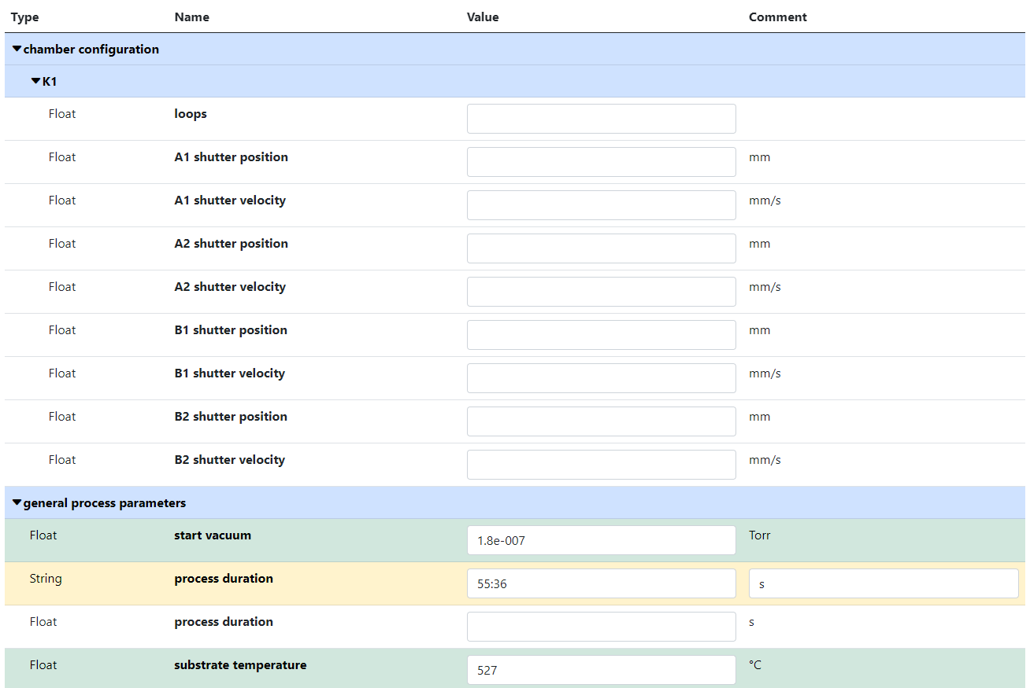
RDMS Extended Properties: Using Template to fill in data
Use case: take advantage of created template during data input.
Task: edit synthesis properties.
Empty values
(white)
Values Types
SortCode
Separators
(logical blocks)
Filled values
(green)
Out of template values
(yellow)
https://crc247.mdi.ruhr-uni-bochum.de/object/synthesis-for-sample-8220-co-deposition-221111-k3-3-1922
https://crc247.mdi.ruhr-uni-bochum.de/properties/edititem/1922

Slide 11
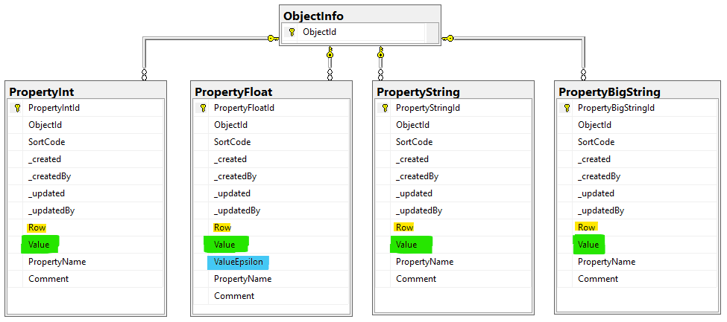
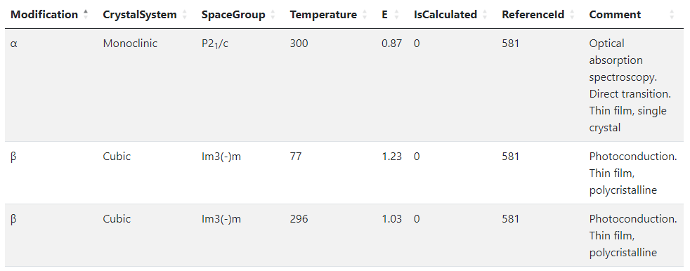
RDMS Object‘s Flexibility: Extended Properties (table data)
Use case: add additional properties values (or even a table) to object and afterward make search on them.
OR
When the existing fields set is not enough…
Task: associate table with object
Row=1
Row=2
Row=3
String x3
Float x2
Int x2
String
Solution: Decompose the table so, that each cell value is stored in Property* table according to cell value type.
Important attributes:
PropertyName – contains column name
Value – contains cell value
Row – contains row number (1, 2, 3, …). If no row number specified – value is threated as object’s property
User view: https://demo.mdi.ruhr-uni-bochum.de/object/ag2s-4870
Admin view: https://demo.mdi.ruhr-uni-bochum.de/adminobject/edititem/4870

Slide 12
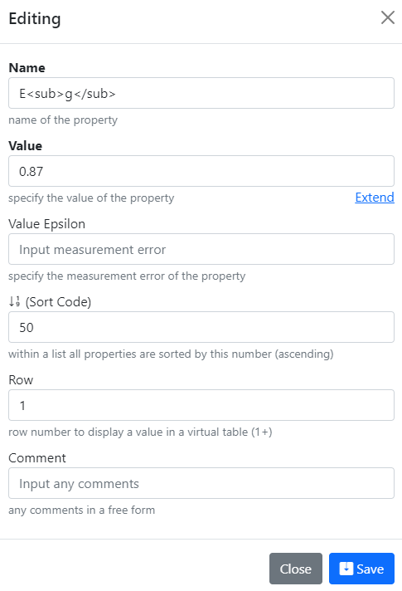
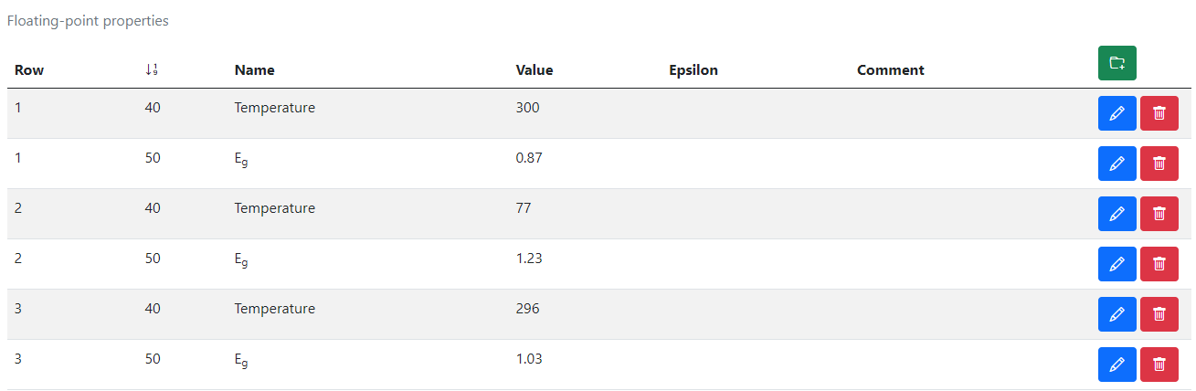
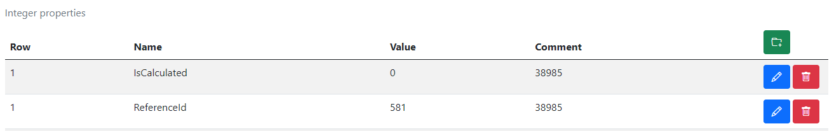
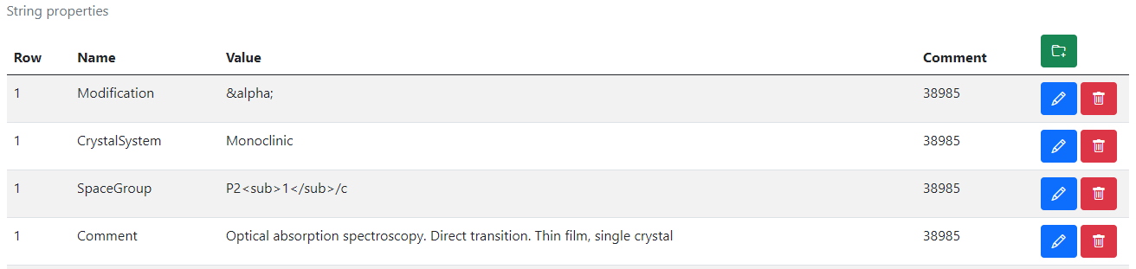
RDMS Extended Properties Control
Extended Properties Control for object is available according to the object access managements in administration panel for objects.
User view: https://demo.mdi.ruhr-uni-bochum.de/object/ag2s-4870
Admin view: https://demo.mdi.ruhr-uni-bochum.de/adminobject/edititem/4870

Slide 13
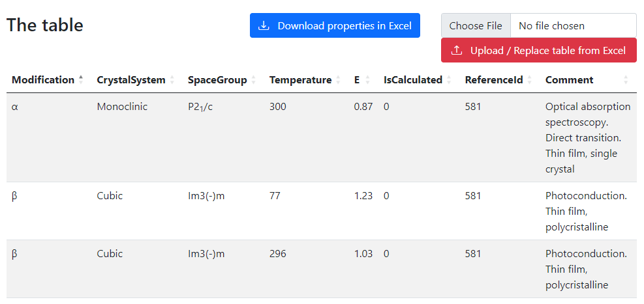
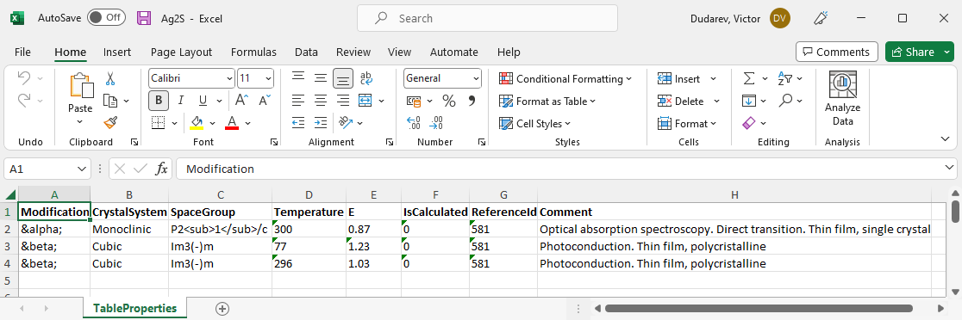
RDMS Extended Properties: Export and Import
Task: make properties modification easy
Steps:
Download data
Open in Excel and edit
Upload changed data back to the RDMS
Import
(requires permissions)
https://demo.mdi.ruhr-uni-bochum.de/object/ag2s-4870
Export
https://demo.mdi.ruhr-uni-bochum.de/object/ag2s-4870

Slide 14
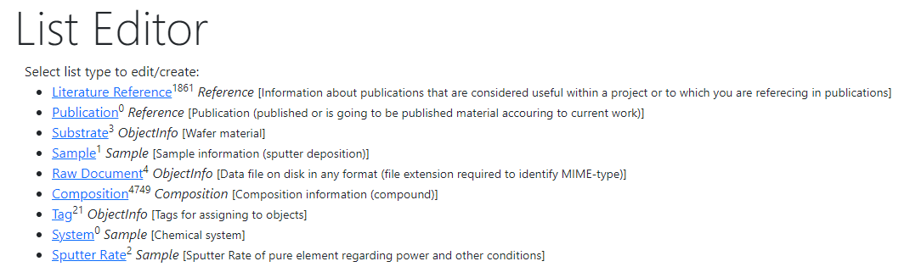
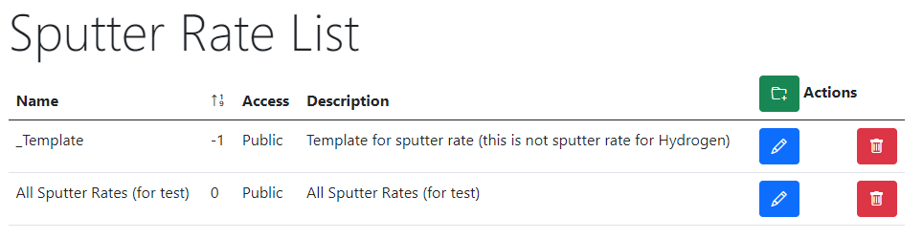


RDMS Extended Properties: Table Templates for data types
Task: define Table Template for properties
with respect to a particular type
Steps:
After creating a data type (e.g. based on existing table) create a “_Template” object of given type: https://demo.mdi.ruhr-uni-bochum.de/adminobject/list/11
Add Columns of desired table to corresponding Properties (w.r.t. data type: Float / Int / String / BigString) with Row=-1 – predefined template:
https://demo.mdi.ruhr-uni-bochum.de/adminobject/edititem/6650
Create a new object and press “Download properties in Excel” button: https://demo.mdi.ruhr-uni-bochum.de/object/all-sputter-rates-for-test-6651 to get a template in Excel
Modify template in Excel file and upload the data: https://demo.mdi.ruhr-uni-bochum.de/object/all-sputter-rates-for-test-6651 (test passed: 16 columns and 468 rows)
https://demo.mdi.ruhr-uni-bochum.de/object/all-sputter-rates-for-test-6651
https://demo.mdi.ruhr-uni-bochum.de/object/_templatesputterrate

Slide 15


Playgrounds
https://inf.mdi.ruhr-uni-bochum.de/ https://demo.mdi.ruhr-uni-bochum.de/
Playground Inf Playground Demo
Playground to test RDMS (multiple tenants with shared users list):
https://inf.mdi.ruhr-uni-bochum.de/
https://demo.mdi.ruhr-uni-bochum.de/
Login and Password (User role): User1@user.org
Login and Password (PowerUser role): PowerUser1@user.org
Login and Password (Administrator role): Admin1@user.org
https://inf.mdi.ruhr-uni-bochum.de/

Slide 16
Thanks for your kind attention
Q&A
Victor Dudarev
Victor.Dudarev@rub.de
https://vdudarev.ru

