Slide 1

CRC/TRR247 Research Data Management System
Use Case:
How To Create A User-defined Object Type
And Configure A Template
Dr.
V. Dudarev
Victor Dudarev

Slide 2
Agenda
    Understanding (list) templates (with synthesis documents)
    Understanding table templates (with sputter rates table)
    Add Object Type
    Create a Template (for table and scalar properties)
    Add Data by the Template
    Q&A

Slide 3
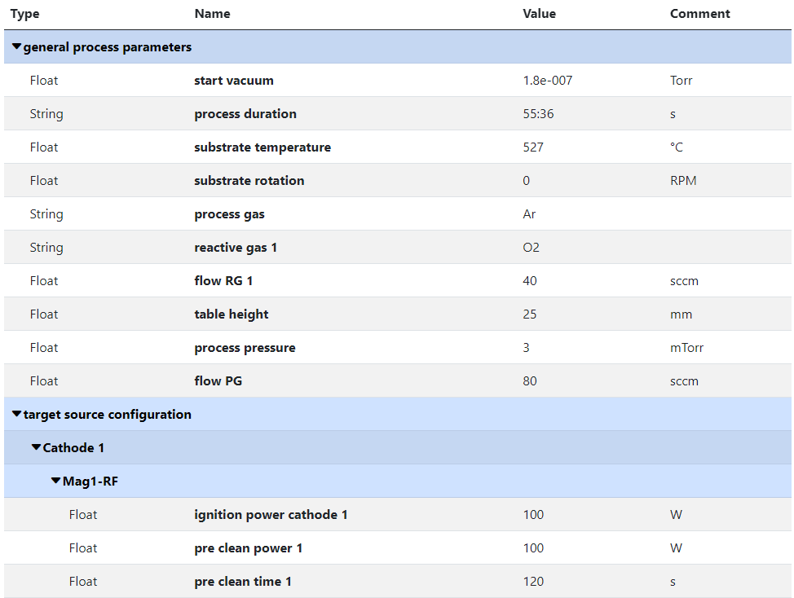
RDMS Object‘s Flexibility: Properties with Separators
Measurement Units
Use case: add additional properties values to object and afterward make search on them.
Task: associate typed properties with object Synthesis parameters
Values Types
Separators
(logical blocks)
SortCode
https://crc247.mdi.ruhr-uni-bochum.de/object/synthesis-for-sample-8220-co-deposition-221111-k3-3-1922

Slide 4
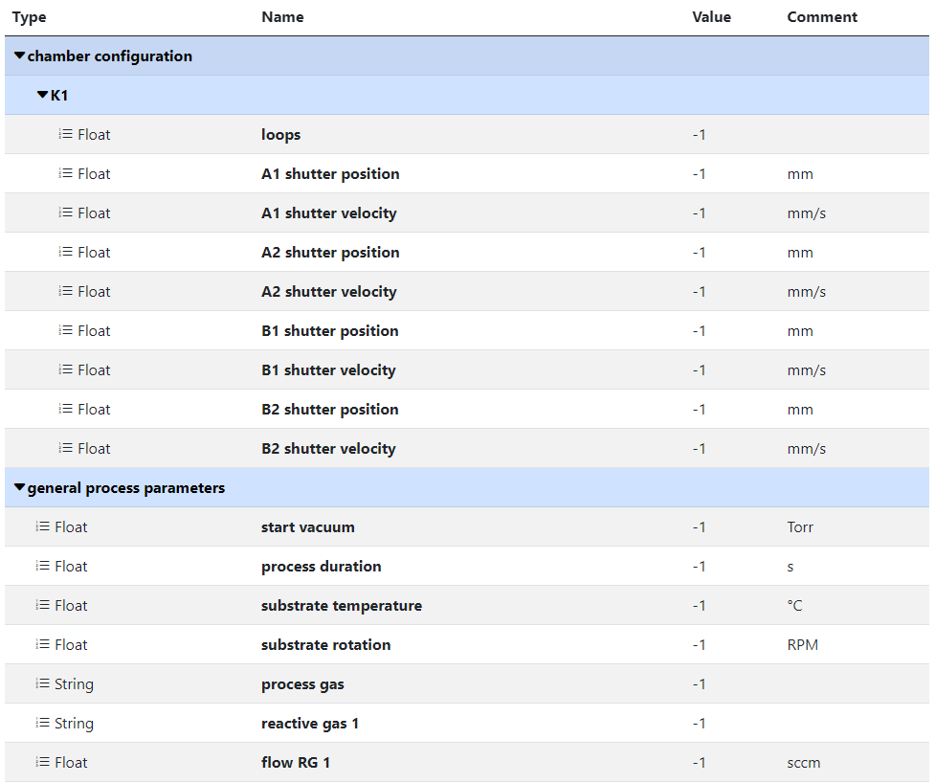
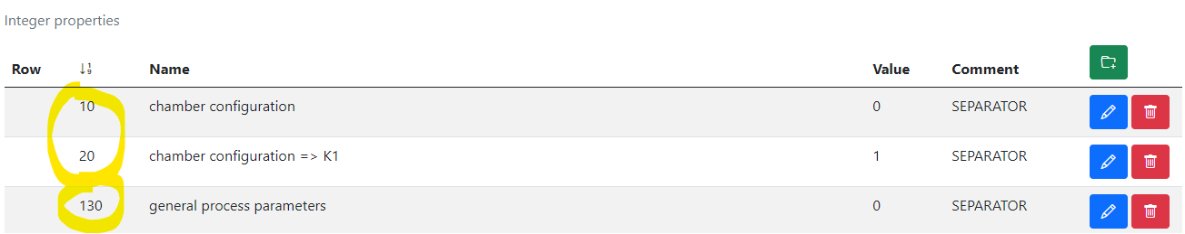
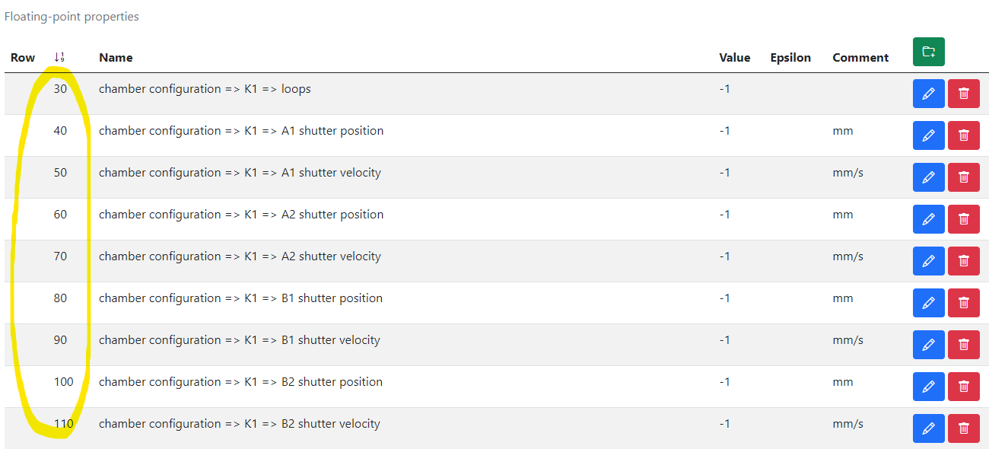
RDMS Extended Properties: Defining a Template
Measurement Units
Use case: to facilitated data edit we need to template extended properties for specified.
Task: create template for synthesis parameters => create object with “_Template” name.
1) Create separators, blue captions to create named sections (if required)
2) Create placeholders (float, int, string)
https://crc247.mdi.ruhr-uni-bochum.de/adminobject/edititem/1956/?returl=%2Fobject%2F_template-1956
https://crc247.mdi.ruhr-uni-bochum.de/object/_template-1956

Slide 5
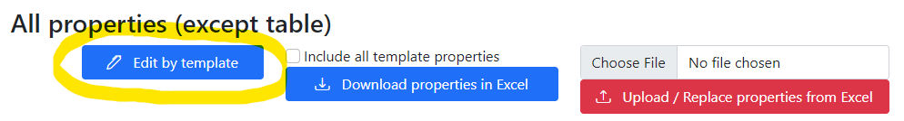
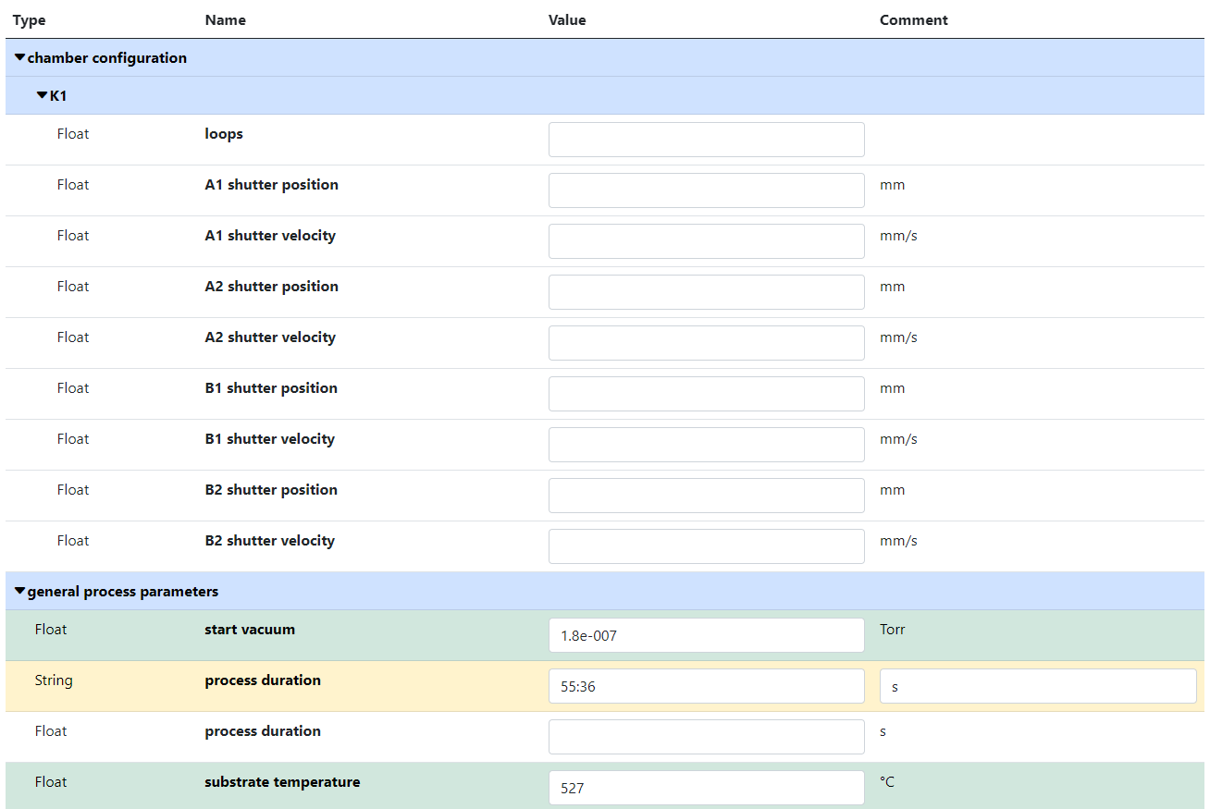
RDMS Extended Properties: Using Template to fill in data
Use case: take advantage of created template during data input.
Task: edit synthesis properties.
Empty values
(white)
Values Types
SortCode
Separators
(logical blocks)
Filled values
(green)
Out of template values
(yellow)
https://crc247.mdi.ruhr-uni-bochum.de/object/synthesis-for-sample-8220-co-deposition-221111-k3-3-1922
https://crc247.mdi.ruhr-uni-bochum.de/properties/edititem/1922

Slide 6
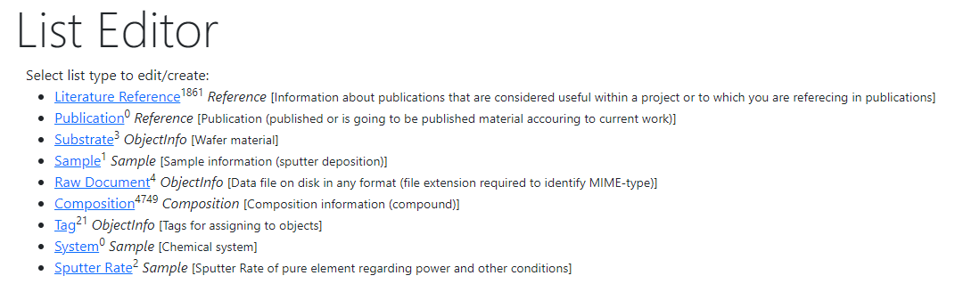
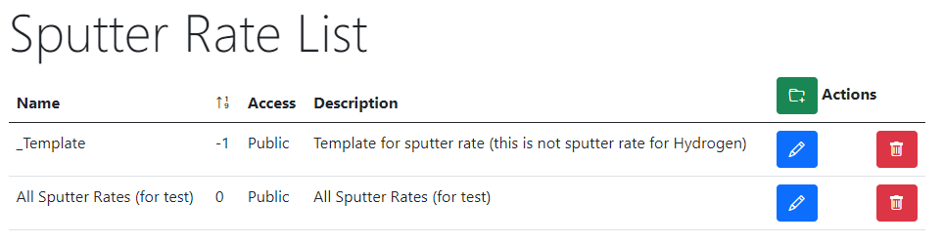


RDMS Extended Properties: Table Templates for data types
Task: define Table Template for properties
with respect to a particular type
Steps:
After creating a data type (e.g. based on existing table) create a “_Template” object of given type: https://demo.mdi.ruhr-uni-bochum.de/adminobject/list/11
Add Columns of desired table to corresponding Properties (w.r.t. data type: Float / Int / String / BigString) with Row=-1 – predefined template:
https://demo.mdi.ruhr-uni-bochum.de/adminobject/edititem/6650
Create a new object and press “Download properties in Excel” button: https://demo.mdi.ruhr-uni-bochum.de/object/all-sputter-rates-for-test-6651 to get a template in Excel
Modify template in Excel file and upload the data: https://demo.mdi.ruhr-uni-bochum.de/object/all-sputter-rates-for-test-6651 (test passed: 16 columns and 468 rows)
https://demo.mdi.ruhr-uni-bochum.de/object/all-sputter-rates-for-test-6651
https://demo.mdi.ruhr-uni-bochum.de/object/_templatesputterrate

Slide 7
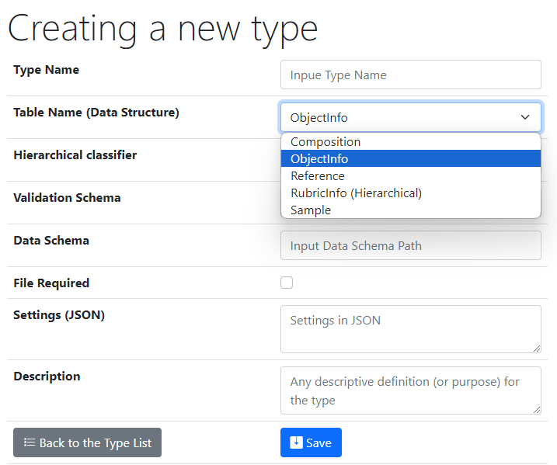
UI to create a new user-defined type
Type Name – user-defined type name
Core Object Types:
ObjectInfo – the simplest (bare) object
Sample – chemical system (set of chemical elements), for example Co-O
Composition – chemical composition (set of elements and quantities), for example Co₃O₄
Reference – literature reference (Authors, Title, Year, DOI, etc.)
Validation & Data Schema – only if you have external Web Services ready to validate & extract data from files
File Required - sets the file mandatory
Settings (JSON) – customization of type for RDMS
{ "CustomEditPath": "/custom/editsample",
"UrlPostVisualizer": "https://abc.de/VisualizeRT" }
Description – customization of type for RDMS

Slide 8
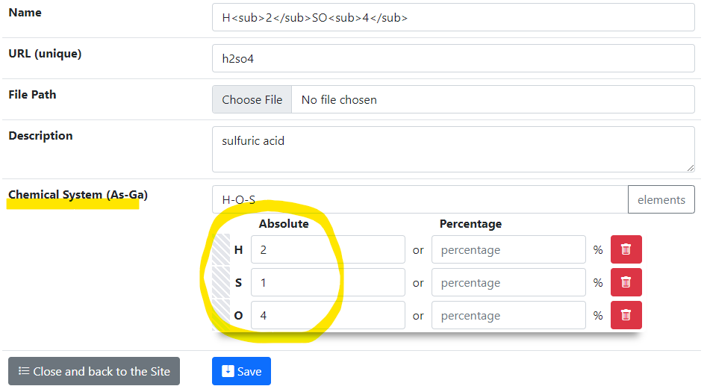
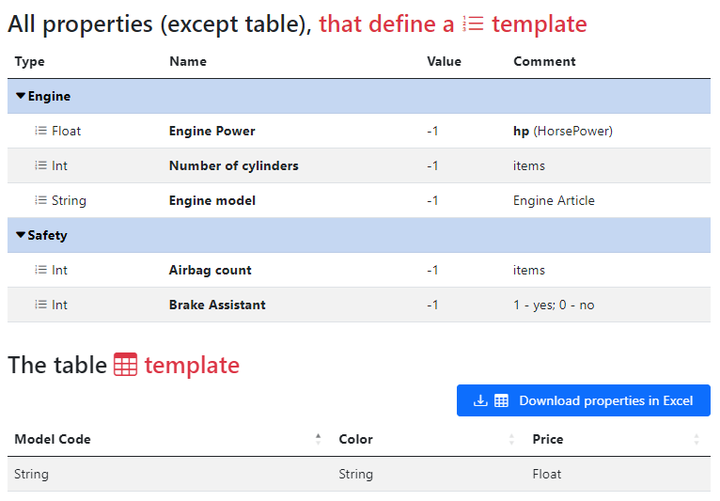
Demo_1 Goal: Create & Setup for Compositions
Task: Create type for Compositions with a template (for properties and tables)
Target interface: Templates specification:
List template
Table template
https://inf.mdi.ruhr-uni-bochum.de/object/_template-25413

Slide 9
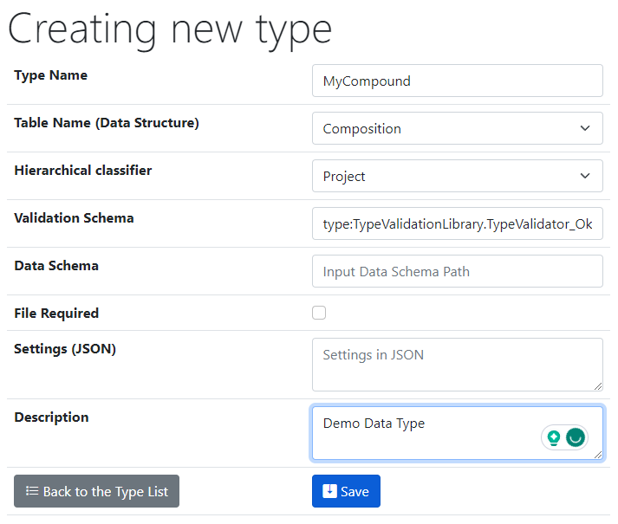
Demo_1: Creating a new type
Task: Create a new type (Administrator role): List Edit => Control Types
Base (inherited functionality)
Basic validator (ok)
https://inf.mdi.ruhr-uni-bochum.de/admintype/edititem/32

Slide 10
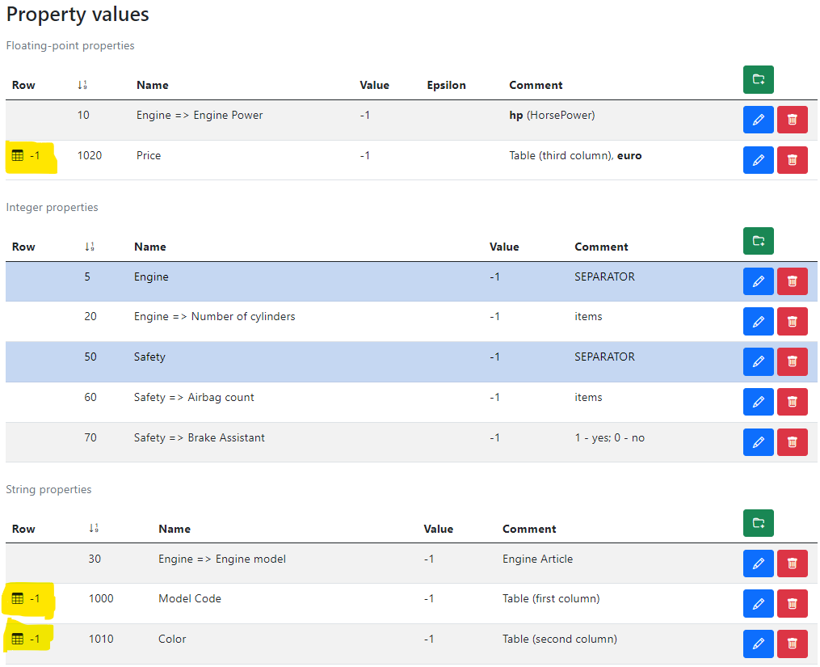
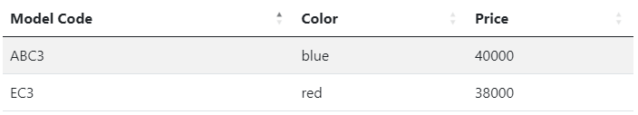
Demo_1: Hands on the labs!
Sort Code
Task: Repeat properties set: _Template
Table Properties
Other
(non-table)
properties
Separators
Table example (according to template)
https://inf.mdi.ruhr-uni-bochum.de/adminobject/edititem/25413/?returl=%2Fobject%2F_template-25413

Slide 11
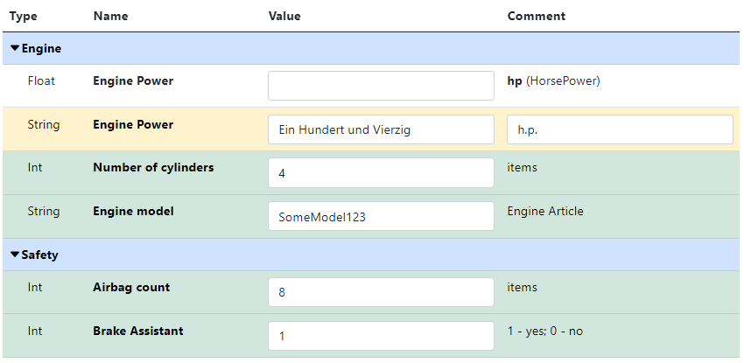
Demo_1: Edit form for properties
Task: Create a new object and edit properties according to the template
Separators
Missing value
Property (out of template)
Filled values (according to template)
https://inf.mdi.ruhr-uni-bochum.de/properties/edititem/25417

Slide 12
Thanks for your kind attention
Q&A
Victor Dudarev
Victor.Dudarev@rub.de
https://vdudarev.ru

