Slide 1

CRC/TRR247 Research Data Management System
Use Case:
Each Project Tries to Search for Data from Partner Projects
Dr.
V. Dudarev
Victor Dudarev

Slide 2
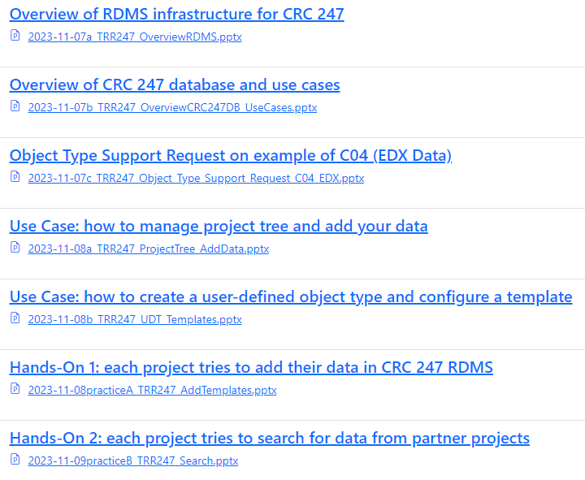
Presentations
All my presentations are available at:
https://crc247.mdi.ruhr-uni-bochum.de/rubric/how-to-do-wiki_workshop2023-inf

Slide 3
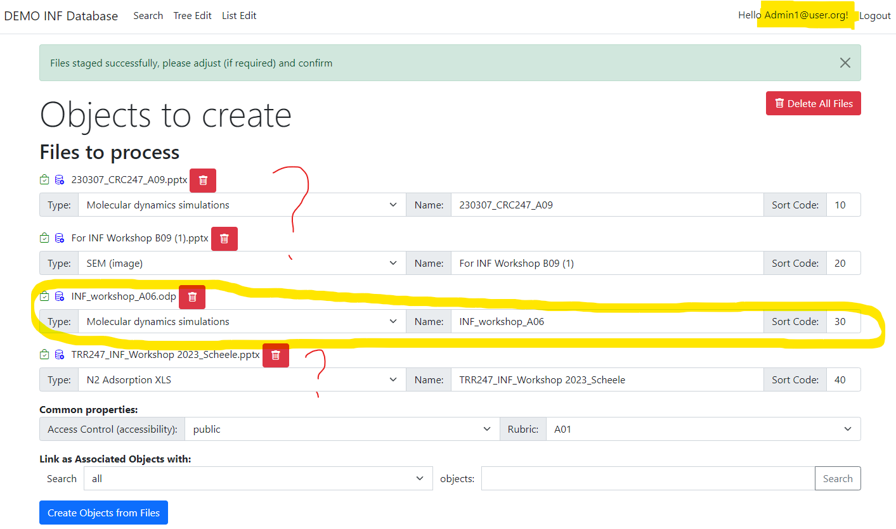
Staged files are user-bound
Stage zone is a temporary folder to store user files before objects creation.
Every user account has its own “staged zone”.
Consequence:
when several users use the same account simultaneously – staged zone becomes messy.

Slide 4
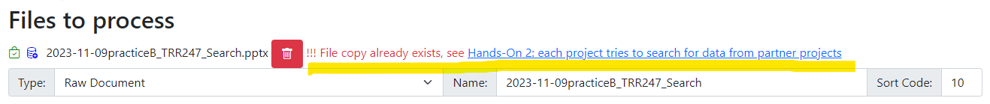
Files must be unique
When you are at “Staged files” zone while uploading some files:
https://inf.mdi.ruhr-uni-bochum.de/uploadfiles OR https://crc247.mdi.ruhr-uni-bochum.de/uploadfiles
you could observe
A file copy is already in a system
You are not allowed to upload the same data (even if file names are different)
Uniqueness is preserved using SHA-256 hash function (collisions are almost impossible).
Every tenant must have files with unique hash values.
https://en.wikipedia.org/wiki/Hash_function

Slide 5
Names of objects must be unique (within a type)
When you try to create objects with the same name:
You are not allowed to use the same names for different objects
Similar errors:
Error dataContext.SampleAddProcessingStep System.Data.SqlClient.SqlException: Cannot insert duplicate key row in object 'dbo.ObjectInfo' with unique index 'UIX-ObjectInfo_Tenant-Type-ObjectName'. The duplicate key value is (1, 6, 4422 LCFO_2).
TenantId TypeId Object Name

Slide 6
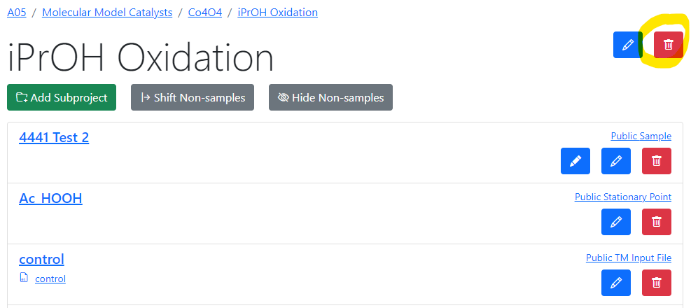
Administrator can‘t delete non-empty projects
When you try to delete (sub)project, that contains some objects
You will have a message:
Make sure that project is empty (before you delete it)

Slide 7
Some errors from the Log
Miracles with shared staged folder (not possible in production)
Error CreateObjectsFromStagedFiles System.Exception: Error validating custom model for file: (fail 404: file not found, WebUtilsLib.DBUtils+DatabaseValues) [Probe 1_SpZn_x10k_14_verbessert.png]
Template mismatch with Excel File structure:
Error UploadPropertiesExcel System.Exception: Excel file must contain first row with columns: "Type", "Name", "Value", "Epsilon", "Comment"
Can’t change essential type parameters when objects of given type are in the system:
Error dataContext.ObjectInfo_UpdateInsert System.Data.SqlClient.SqlException: Error (TypeInfo_UpdateInsert): Can not change TableName or IsHierarchical since there are already objects of given type [TableDB=Sample, IsHierarchicalDB=0, Table=ObjectInfo, IsHierarchical=0, TypeId=47]
Non-Excel file:
Error UploadPropertiesExcel System.IO.InvalidDataException: The file is not a valid Package file. If the file is encrypted, please supply the password in the constructor. [ at OfficeOpenXml.Packaging.ZipPackage..ctor(Stream stream)
Wrong data on input:
- Error UploadTablePropertiesExcel System.FormatException: Failed to convert parameter value from a String to a Double.
- Error UploadTablePropertiesExcel System.ArgumentException: Unable to find type for column "wave#". Please create within a tenant at least one property with this name manually to set up property type
- Error UploadTablePropertiesExcel System.ArgumentException: Column 1 should have a name

Slide 8
Lucky people (it was not your fault)
Miracles with shared staged folder / Concurrency errors (not possible in production)
Error CreateObjectsFromStagedFiles System.Exception: Error validating custom model for file: (fail 404: file not found, WebUtilsLib.DBUtils+DatabaseValues) [Probe 1_SpZn_x10k_14_verbessert.png]
Error CreateObjectsFromStagedFiles System.IO.IOException: The process cannot access the file because it is being used by another process.
Poor network connection:
An unhandled exception has occurred while executing the request. Microsoft.AspNetCore.Connections.ConnectionResetException: The client has disconnected
You are (un)lucky:
Error dataContext.RubricInfo_UpdateInsert System.Data.SqlClient.SqlException: Transaction (Process ID 56) was deadlocked on lock resources with another process and has been chosen as the deadlock victim. Rerun the transaction.

Slide 9
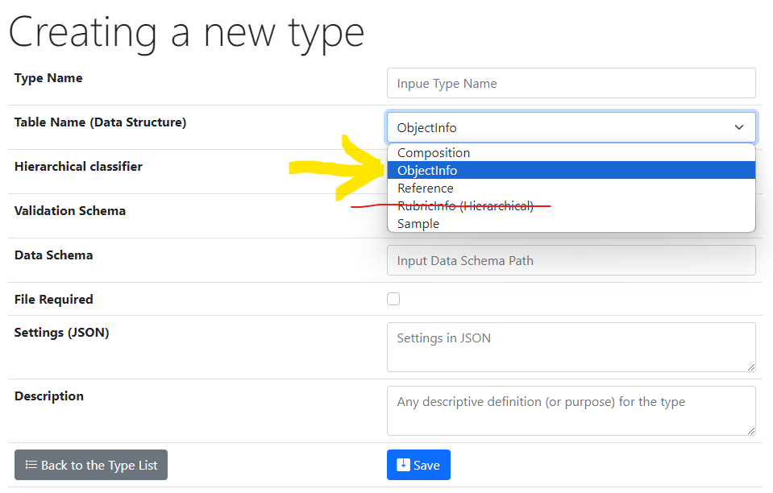
Be careful creating a new type
Good to know:
When selecting a value for Table Name:
1) Never select RubricInfo (Hierarchical)
2) ObjectInfo – is what you need in most cases (for all characterization documents)
3) For “sample” types use one of “chemical entities”:
Sample – for systems (Co-O)
Composition – for compounds (Co₃O₄)
4) Do not change Hierarchical classifier
(leave Project by default)
5) Provide meaningful type description (clear to all CRC members).
https://demo.mdi.ruhr-uni-bochum.de/search/
https://demo.mdi.ruhr-uni-bochum.de/search/?system=As-Ga&typeid=8&Aspctmin=30&Aspctmax=50&Gaabsmin=1&Gaabsmax=3&pr0name=E%3Csub%3Eg%3C%2Fsub%3E&pr0type=Float&pr0min=1.5&pr0max=2&pr1name=Comment&pr1type=String&pr1max=3&pr1str=solution&prcnt=2
https://demo.mdi.ruhr-uni-bochum.de/search/?system=As-Ga&typeid=8&Aspctmin=30&Aspctmax=50&Gaabsmin=1&Gaabsmax=3&pr0name=E%3Csub%3Eg%3C%2Fsub%3E&pr0type=Float&pr0min=1.5&pr0max=2&prcnt=1

Slide 10
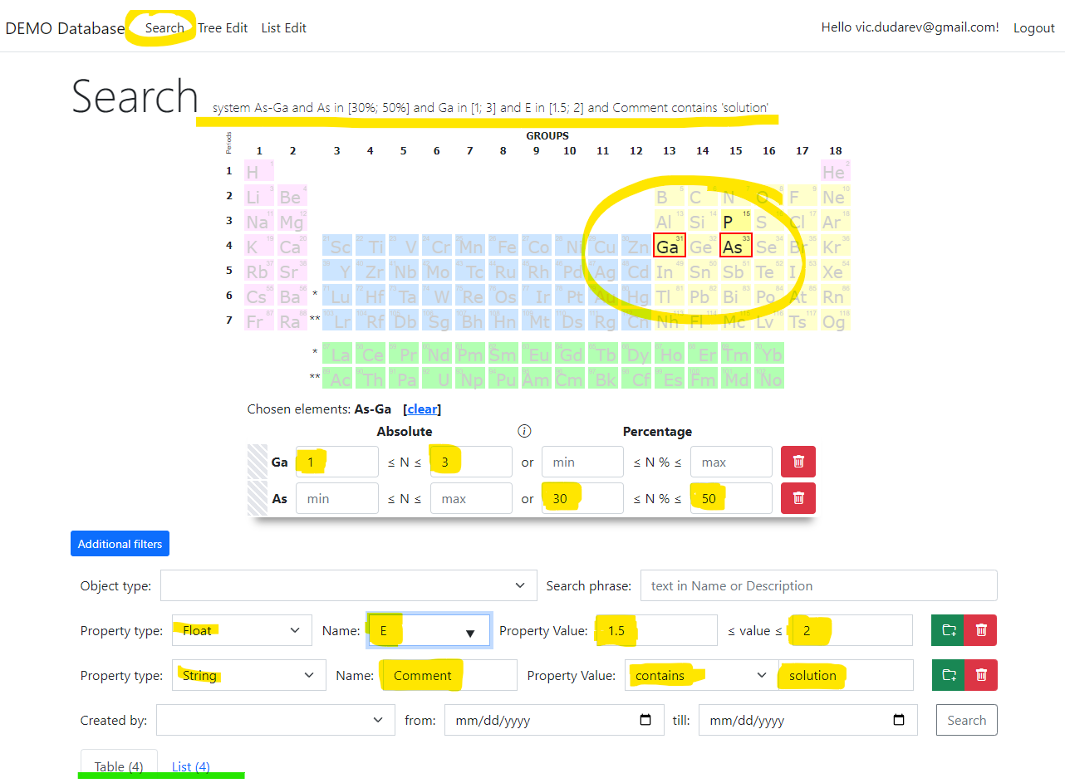
RDMS: Search
Search on:
Chemical system
Composition
Object type
Phrase in object’s Name or Description
Properties values (all available within tenant)
Person created
Creation date
Important feature:
persistent URL on search (share search results easily by URL*).
* - respecting current security context
Task: make properties modification easy
https://demo.mdi.ruhr-uni-bochum.de/search/
https://demo.mdi.ruhr-uni-bochum.de/search/?system=As-Ga&typeid=8&Aspctmin=30&Aspctmax=50&Gaabsmin=1&Gaabsmax=3&pr0name=E%3Csub%3Eg%3C%2Fsub%3E&pr0type=Float&pr0min=1.5&pr0max=2&pr1name=Comment&pr1type=String&pr1max=3&pr1str=solution&prcnt=2
https://demo.mdi.ruhr-uni-bochum.de/search/?system=As-Ga&typeid=8&Aspctmin=30&Aspctmax=50&Gaabsmin=1&Gaabsmax=3&pr0name=E%3Csub%3Eg%3C%2Fsub%3E&pr0type=Float&pr0min=1.5&pr0max=2&prcnt=1

Slide 11
Thanks for your kind attention
Q&A
Victor Dudarev
Victor.Dudarev@rub.de
https://vdudarev.ru

