Slide 1




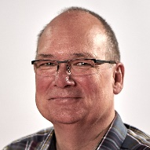
Project B06
“Correlative and multi-modal quasi in situ and operando spectroscopy and microscopy”
Prof.
S. DeBeer,
Co-PI
Dr. A. Schnegg
Dr. O. Rüdiger
PD Dr. T. Lunkenbein,
Co-PI
Dr. A. Knop-Gericke
Principle Investigators: Serena DeBeer, Thomas Lunkenbein

Slide 2
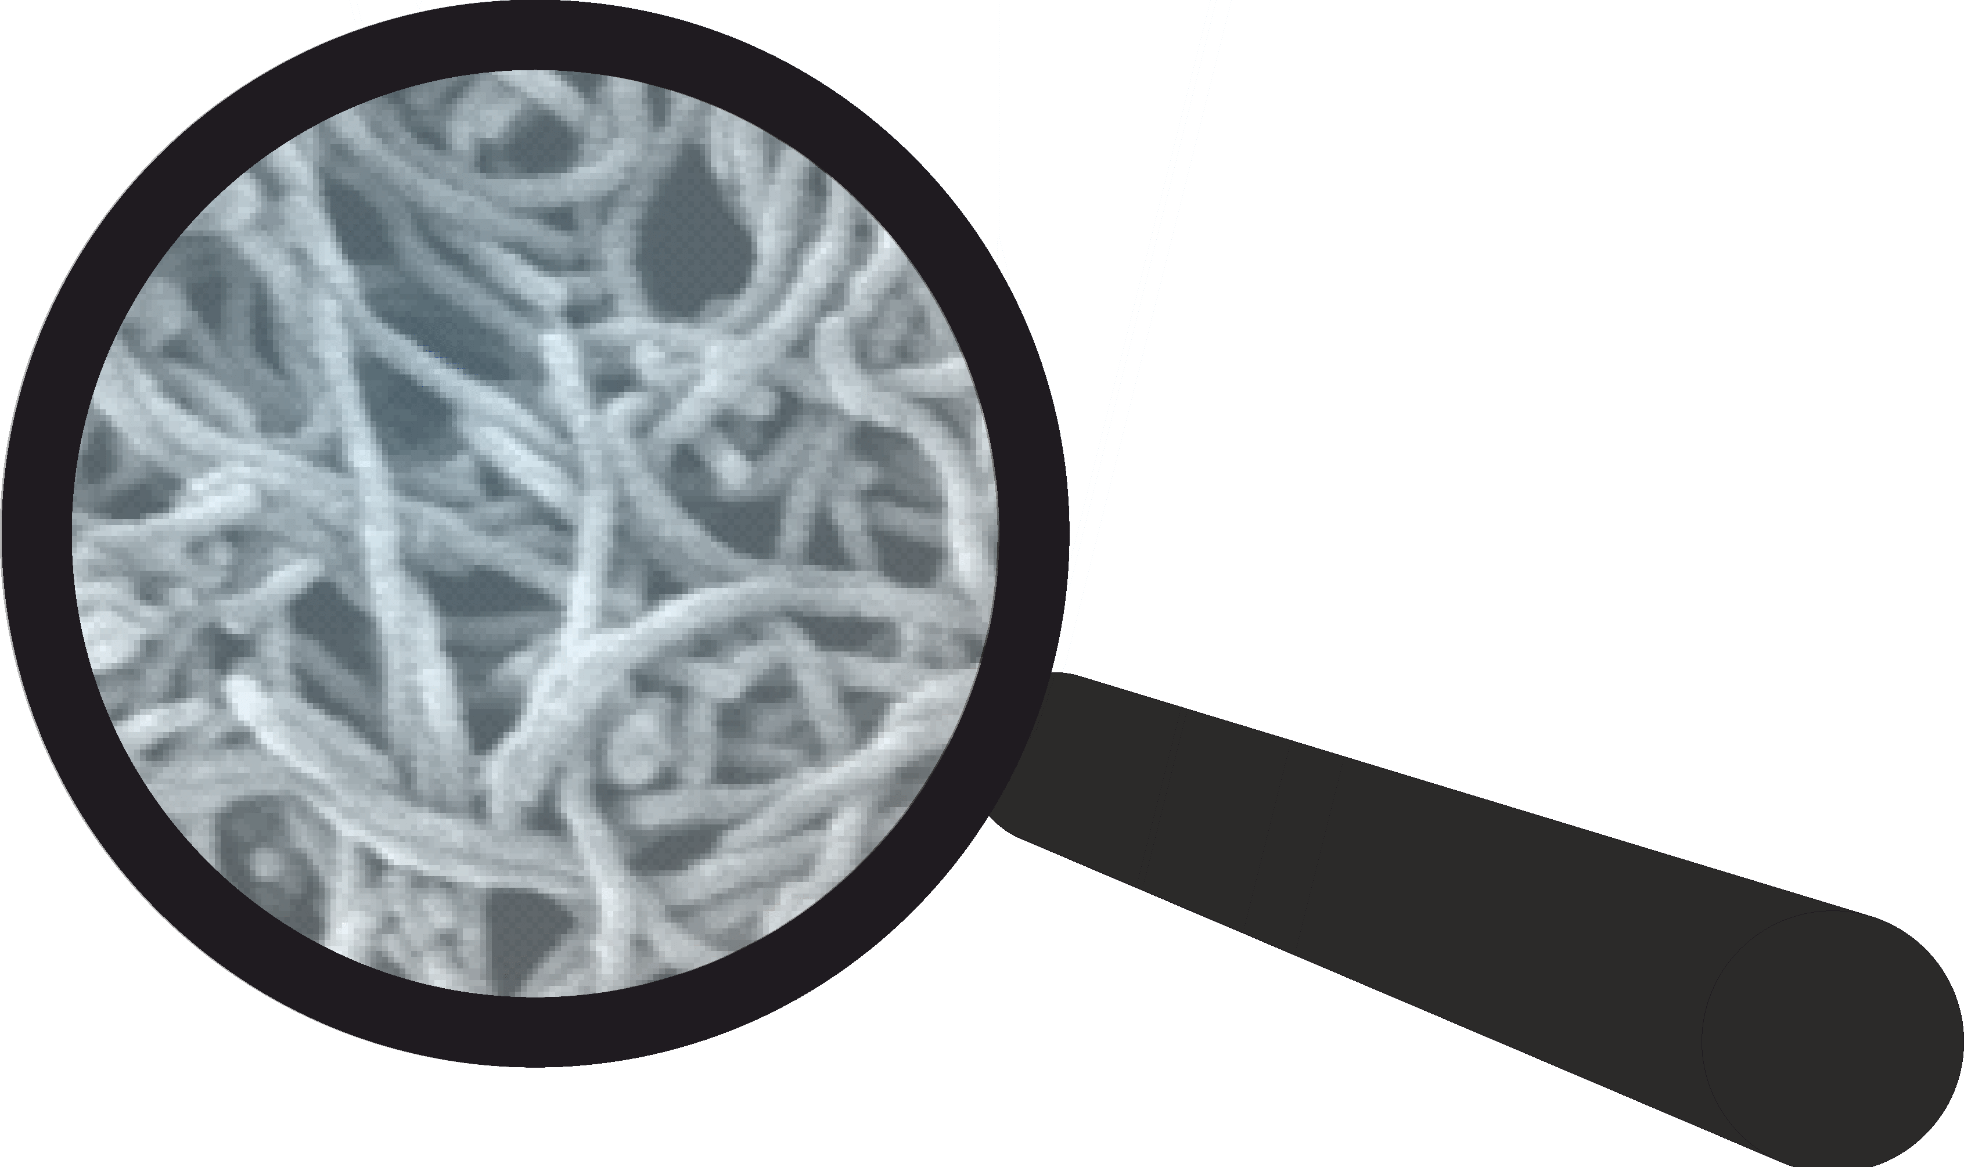
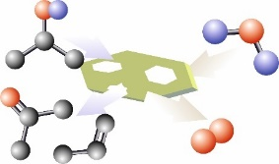
Our project
electron
X-ray
Introduction to our data / measurements
SEM (image + EDX, average ratio, elemental mapping)
TEM (STEM), (image + EDX, EELS, point spectrum, line scan, mapping)
spectroscopy
spectromicroscopy
microscopy
magnetic resonance
TEM
(Operando) geometric and electronic structure; atomic and nanoscale information;
correlative to TXM
STXM
(operando) geometric +
electronic structure (K- and L-edges)
Data | Raw format | Converted format
TEM image STEM image (HAADF+DF4+DF2+BF) | emd. dm3./dm4. | tif., bmp…
EDX | emd. | tif, csv
EELS | dm3./dm4 | tif, csv
GC | env. exp. scn. | csv
EPR | - | binary files
Synchrotron data | Depending on experimental details and synchrotron facility | h5 files
Operando/ in situ | all | videos, data series…
XPS/XAS
Operando;
information depth;
electronic structure;
correlative to ESEM
Quasi in situ TEM
Conversion detection;
geometric and electronic structural changes
atomic resolution
VtC XES
protonation state;
geometry changes
Correlative and multi-modal operando spectroscopy and microscopy
ESEM
operando;
meso- and macroscale geometric structure;
correlative to XPS/XAS
1s3p, 2p3d,
VtC RIXS/RXES
2D experiments;
selectivity enhancement;
detailed electronic and geometric insights
EPR in situ radical trapping
Intermediates during oxidation reactions
EPR SEC
0-6 T Q-band;
oxidation states;
even spin systems

Slide 3
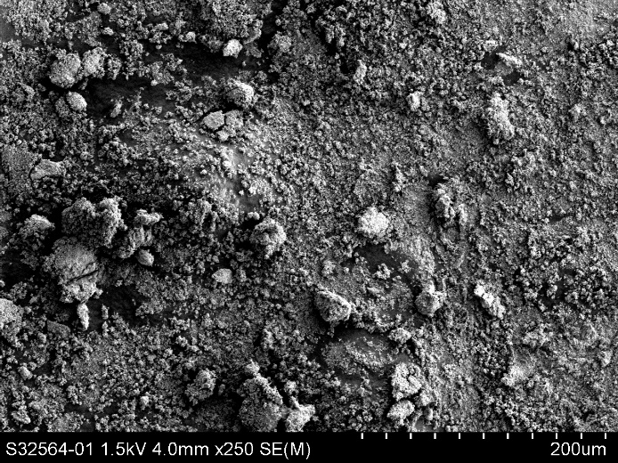
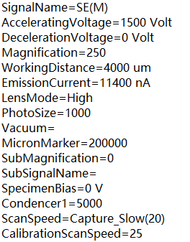
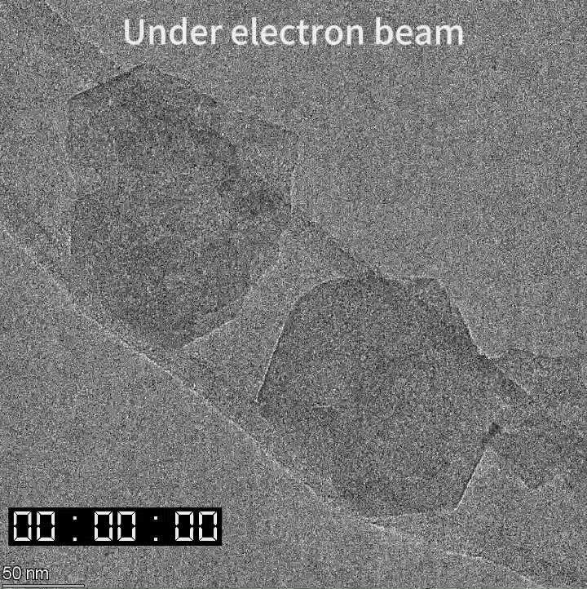

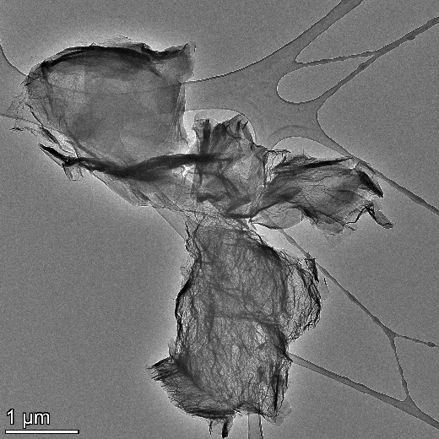
Example of data formats
SEM image: (tif.) + information file (txt.)
Operando/in situ experiments (videos)
TEM image: (raw format: emd on Talos, dm3 on Jeol, can be converted into tif.bmp or other image files）
STEM image
HAADF
BF

Slide 4
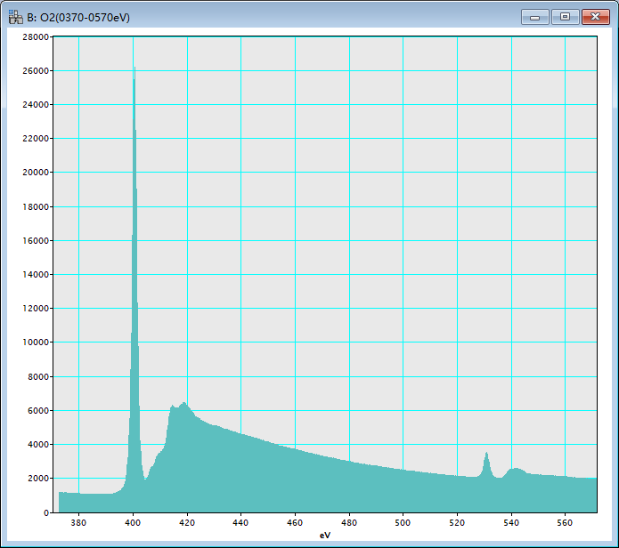
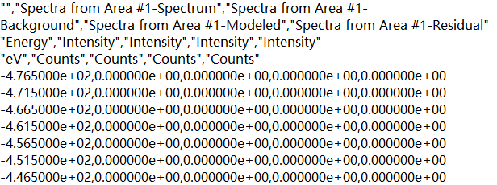
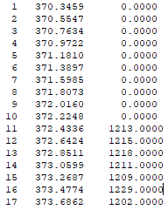
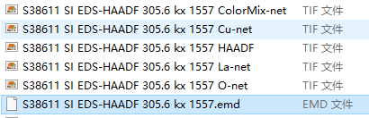
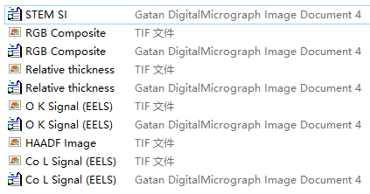
EDX + EELS data: point average spectra, liner scan, mapping
EELS spectra: converted into txt file
EDX spectra: converted into CSV file
raw + converted tif files
Mapping: raw + converted tif files
Mapping: raw + converted tif files
HAADF
Co + O

Slide 5
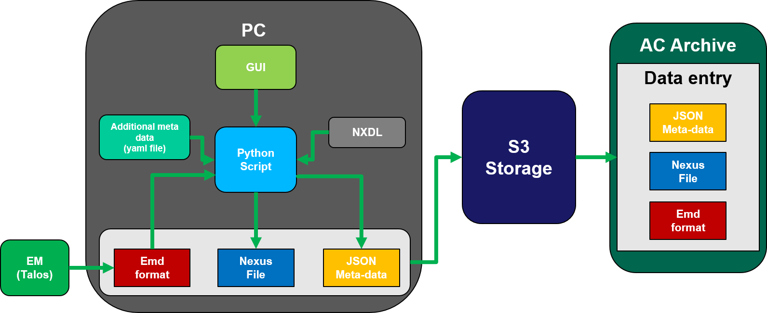
Example: Automated data conversion and storage of electron microscopy data
Automated upload of data and metadata: Workflow for automatically converting the emd file format of a commercial instrument (TalosTM, ThermoFisher) to the hdf5 open source file format following a NeXus* application definition
*Konnecke, M., et al., Journal of Applied Crystallography 2015, 48, 301.

Slide 6
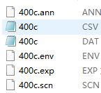
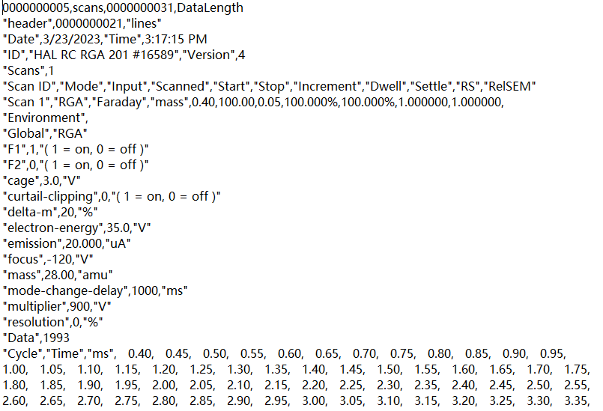
MS data
raw files
converted file: CSV
interpreted data

Slide 7
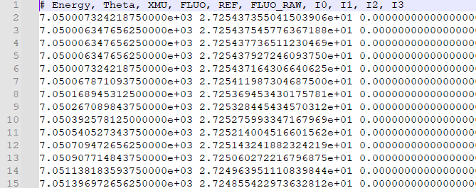
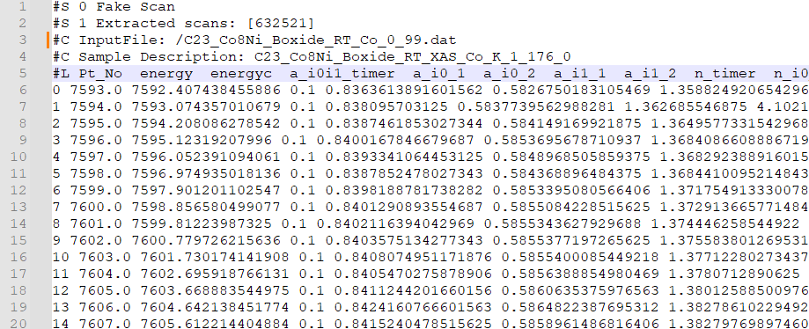
X-ray Data management workflow
Synchrotron data contains varied amount of data in header depending on source
Readability
  Depending on experimental details and synchrotron facility, only certain pieces of data are used (for instance, the Energy and FLUO columns, in the ESRF example)
  Some files need to be preprocessed to be directly readable (e.g. .h5 files)
ESRF
Data formats:
.txt / .dat / .mca / .h5
ALBA
Readable with
text editor
Must be
processed first
Data accessibility
It would be desirable to be able to search a database based on:
  Element
  Synchrotron and beamline where data was taken

Slide 8
Concerns and ideas
Challenges with data formats
Operando experiments:
  Large number of devices included in experiment
    e.g. spectrometer, potentiostat, mass spec, GC, …
  At times data is not easily accessible (GC)
  Different file formats for each device
  most can be exported to CSV, ASCII or similar files
  Metadata usually just includes device information, not experimental conditions
  Challenges with raw data: operando X-ray spectroscopy at BESSY II
  Spectra not easy to interpret
  Data pre-treatment not straight-forward
  ‚Context‘ missing, especially for operando measurements:
  history of the sample etc.
  Can easily lead to misinterpretation of the results
  Synchronization between different experiments difficult
  What is more useful?
  Short presentation of main results
  Better overview, key results
  Interpretation done by experts in the techniques who did the experiments and know about the protocol of the operando experiments
  4. What we want to see
  See what has happened to the sample previously
  What techniques were done already? Can we contribute with complementary experiments?
  What was the preparation protocol?
  Basic characterization (phase purity, elemental composition)

Slide 9
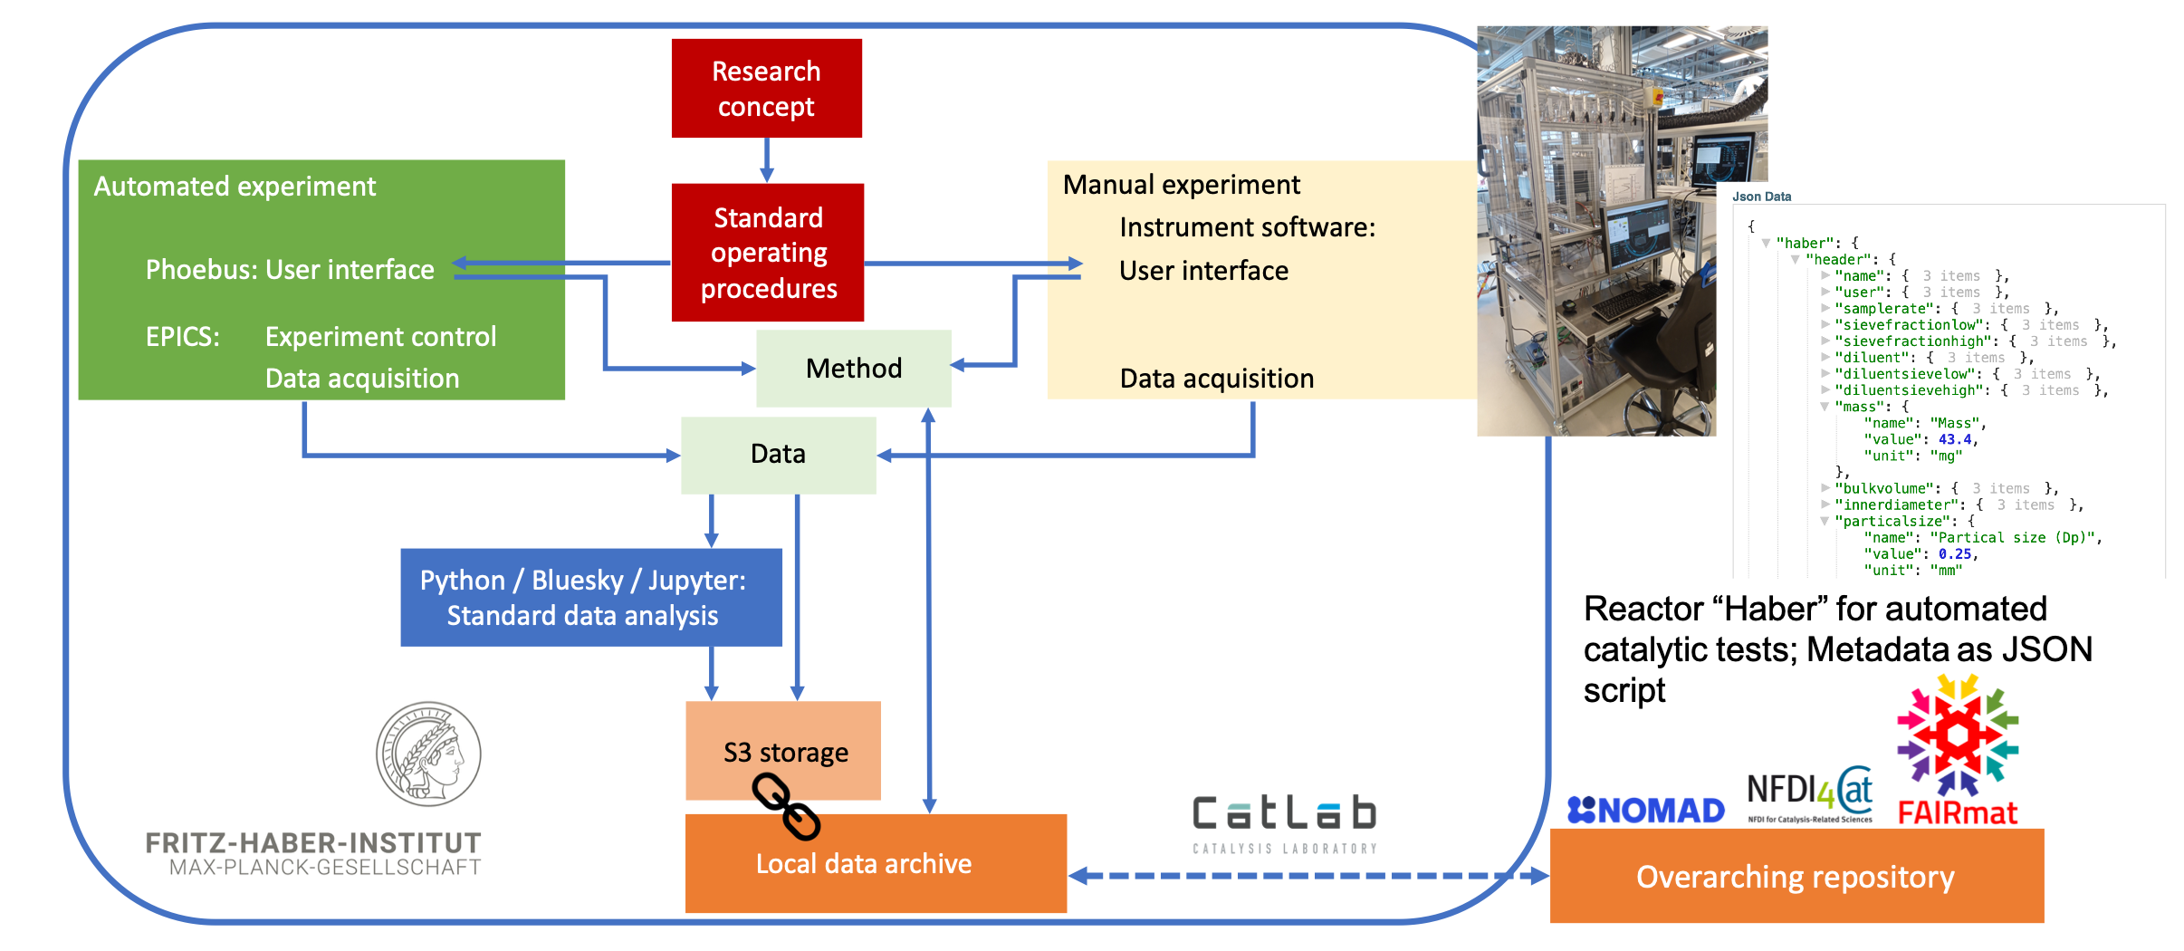
Our concept for a Local and Community Shared Data Infrastructure in Catalysis
Example for fully automated experiment: https://gitlab.fhi.mpg.de/fhi-ac/haber
https://github.com/schumannj/nomad-schema-plugin-fhi-catalysis

Slide 10
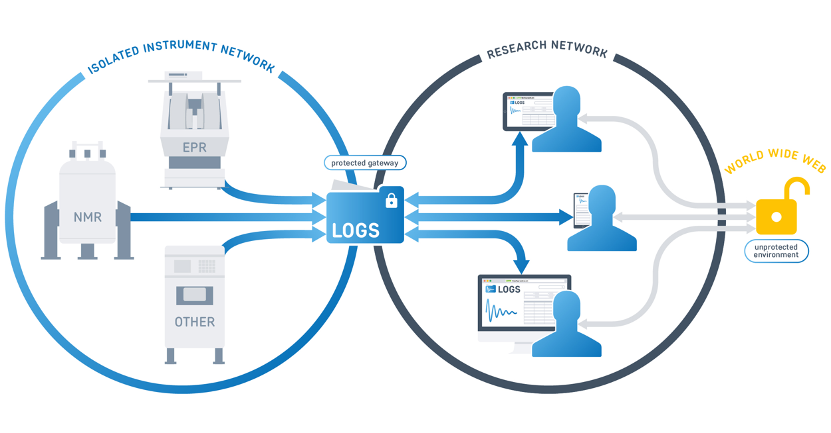
Archiving of EPR data @ MPI CEC
Connection to external partners
Sharing of data with external partners is possible via projects in LOGS.
  ➔ Requires definition and establishment of a safe and robust interface to pull/push data.
EPR Measurements
EPR spectra are recorded at local and mobile spectrometers.
Spectra and measurement parameters are saved as binary files.
Additional information (sample prep etc.) is recorded in an electronic lab book (Labstep)
Data archiving
Data archiving system (LOGS) pulls experimental data every 10 min from EPR spectrometers.
LOGS is operated on a server at MPI CEC.
In LOGS data is claimed by users and associated with a project, a sample and a spectrometer
LOGS is connected to the electronic lab book Labstep where EPR spectra and secondary data can be viewed.

Slide 11
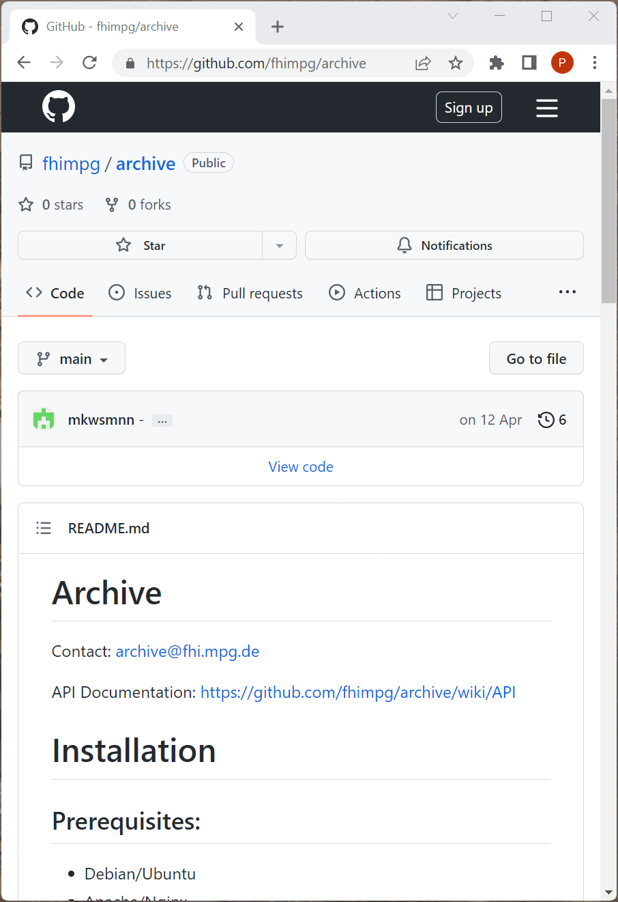
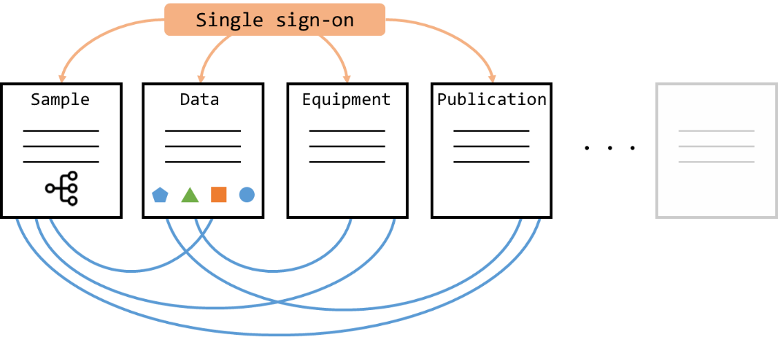
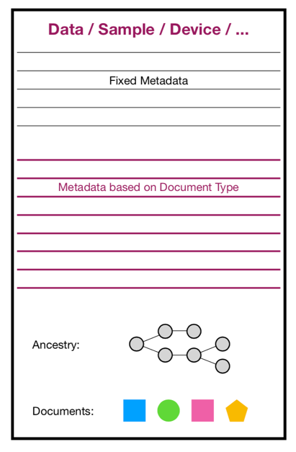
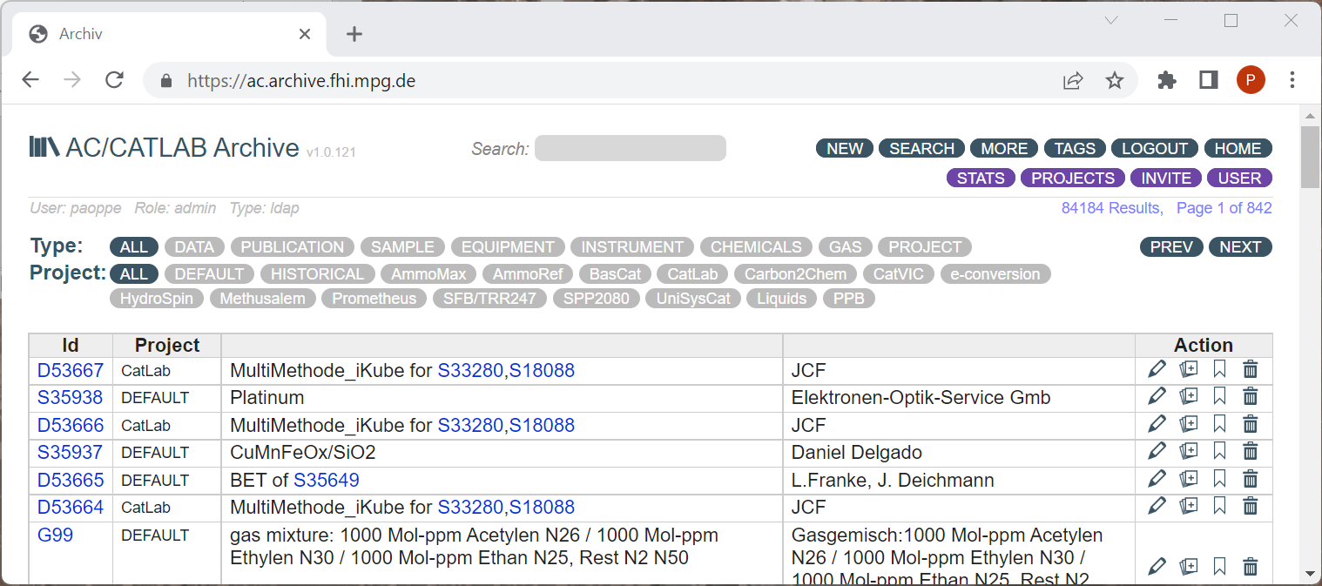
Data Archive
Michael Wesemann
Electronic Laboratory Notebook optimally adapted to the needs of catalysis research
Regulated access rights
Flexible and expandable structure (data types, projects)
Each entry can be linked to any other entry
Minimum number of field in data types → storage of metadata in form of Json scripts
Application Programming Interface (API) for data exchange
Manual and automated upload
IT contact: Michael Wesemann, FHI:
mike@fhi-berlin.mpg.de
Scientific contact: Annette Trunschke, FHI:
trunschke@fhi-berlin.mpg.de
Documentation: https://github.com/fhimpg/archive

