Slide 1


CRC247 INF Workshop
Research Data Management System
Dr.
V. Dudarev
Prof. Dr.
A. Ludwig
Victor Dudarev, Alfred Ludwig

Slide 2
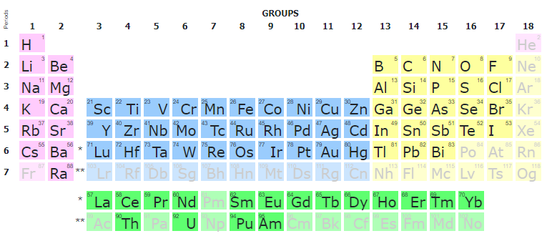

RDMS Overview
Support for multiple Tenants;
Custom Project Tree & Objects Management
Batch Import of Documents
Extensible object Properties;
User-defined Object Type support:
  Document Validation
  Data Extraction
  Data Visualization
  Properties Templates
  Table Templates
Handover
Reporting
UI Customization
System
(qualitative composition)
Co-O
Substance
(quantitative composition)
Co₃O₄
Modification
(crystal structure type)
β-Co₃O₄
…
RDMS: Research Data Management System

Slide 3
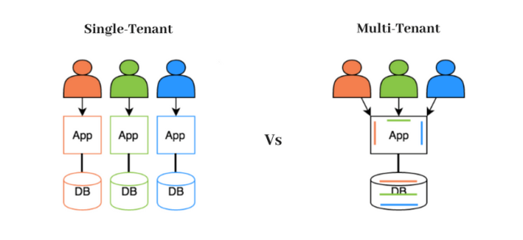
RDMS: Multiple Tenant Support
What is a Tenant?
Short answer:
Tenant – separate (distinct) instance of a software application that
is used by an organization / group of users / consortia.
Long answer:
Tenant is a customer account that has its own set of users, data, and configuration settings, and is isolated from other tenants in the same software application. This concept is commonly used in Software as a Service (SaaS) applications, where a single software application is hosted in the cloud and is made available to multiple customers as separate tenants. This allows each customer to have their own instance of the application, with their own data, settings, and customizations, while still sharing the underlying infrastructure and resources of the application.
Conclusion:
Tenants are useful for separate SFB projects / workgroups / materials data repositories. For example:
          MDI: https://mdi.matinf.pro
          CRC 247: https://crc247.mdi.ruhr-uni-bochum.de
          CRC 1625: https://crc1625.mdi.ruhr-uni-bochum.de
Every tenant must have a unique URL!
https://matinf.pro/
https://en.wikipedia.org/wiki/Multitenancy

Slide 4
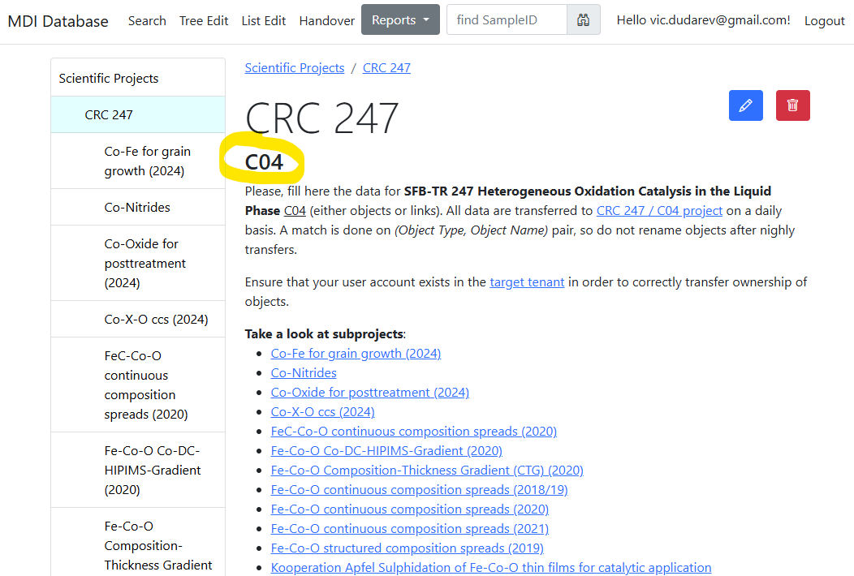
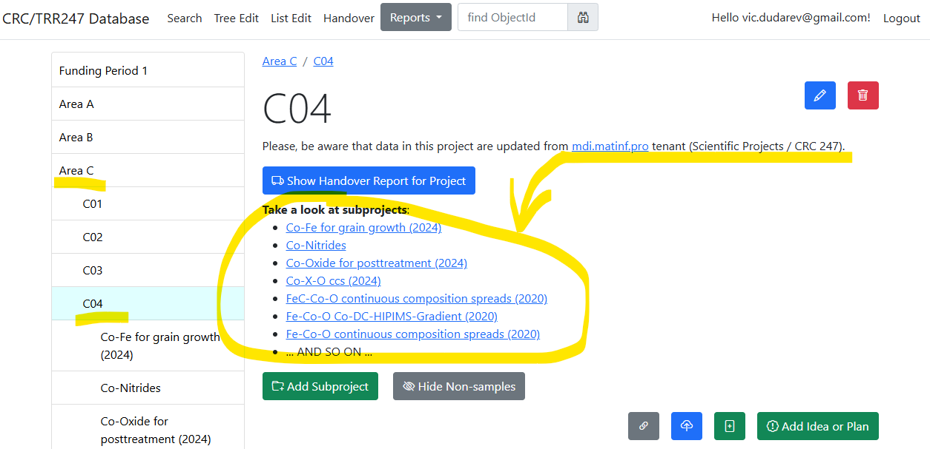
RDMS: Data transfer between tenants
Data from MDI tenant
(Scietific Projects / CRC 247 project) transferred to CRC 247 tenant
(Area C / C04)
Automatic Data Transfer (on a daily basis)
Consequence: data can be put into CRC247 RDMS from your data source (ELN/RDMS, i.e. integration is possible)!

Slide 5
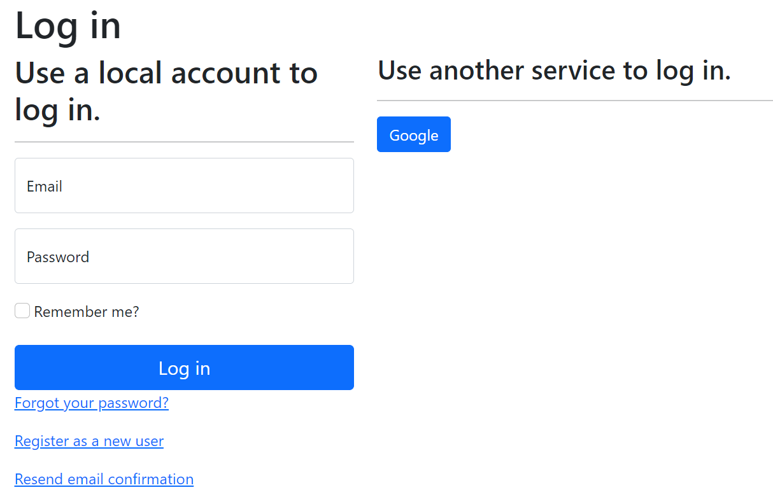
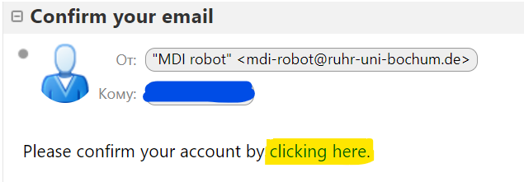
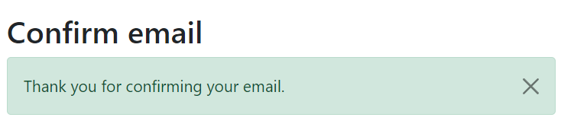
RDMS: Registration and Authorization
https://crc247.mdi.ruhr-uni-bochum.de
Application access level is determined by the current user context.
Two-way registration (choose any):
using external provider (OpenID Connect), e.g. Google (external authentication authority is used, no credentials are stored locally).
using local account (credentials are stored internally);
In both cases, an e-mail address is required, and its successful verification is a prerequisite for access.
After e-mail confirmation, the user is considered active, but does not have an assigned user group.
https://openid.net
https://en.wikipedia.org/wiki/Authentication
https://en.wikipedia.org/wiki/Authorization

Slide 6
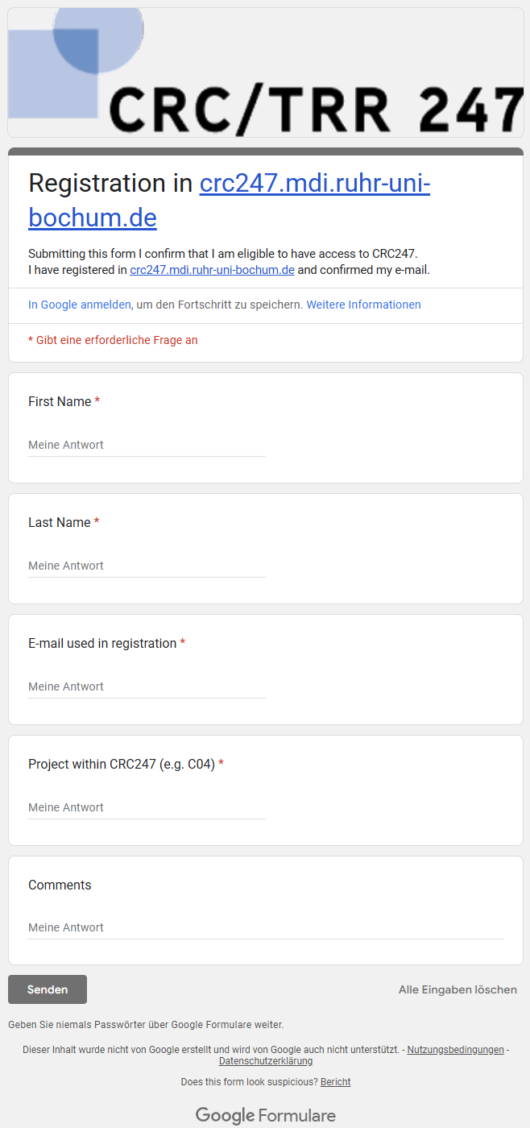
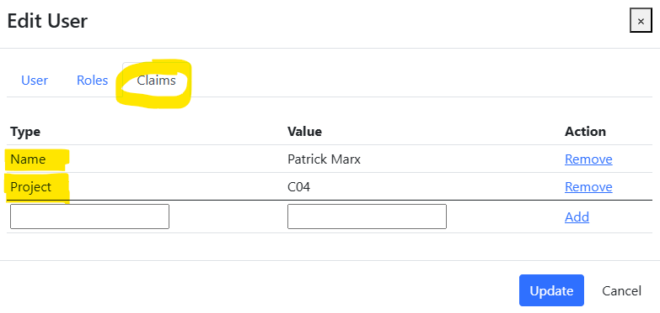
RDMS: how to register
Production (https://crc247.mdi.ruhr-uni-bochum.de):
You need to register with Google account or create your own account (email/password) and confirm e-mail (warning: user created with no role assigned).
Fill the access request form https://forms.gle/tkZeweU6kStRCoKp7, specifying your e-mail, used in registration, your name, project (e.g. A02) and optional comments.
Wait… After manual processing you will be assigned by default a PowerUser role and you are in power of adding data ))
Important for Administrators!
Please, assign the following claims:
Name
Project
Administrators:
Victor Dudarev,
Carina Marek,
Lars Banko,
Alfred Ludwig
Notes:
https://qr.io/

Slide 7
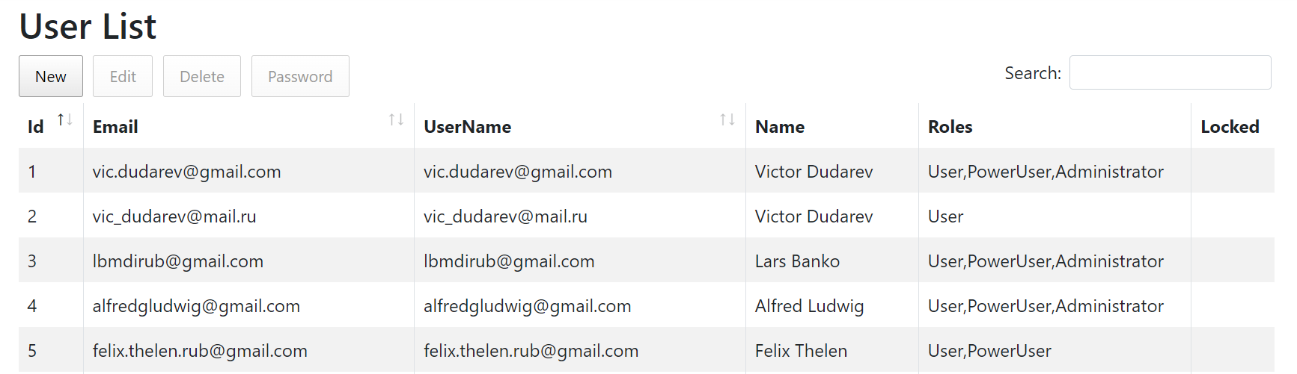
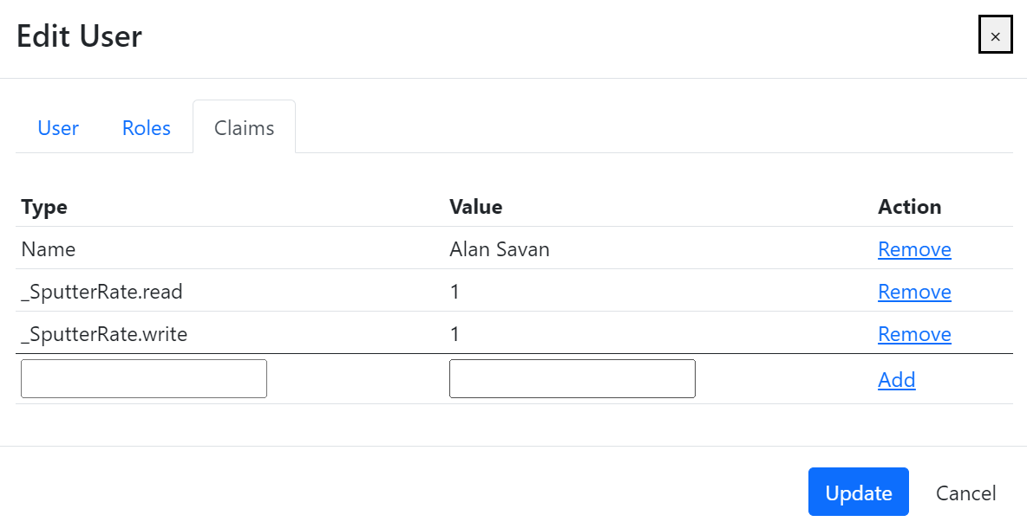
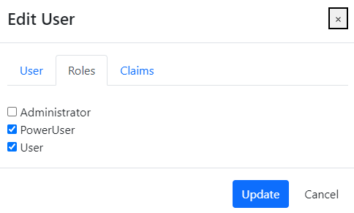
RDMS: Identity User Control Interface
Features:
Registered users management
Roles management
Claims management
Claim is a piece of information (key-value pair) that describes a user. Claims are stored in a user's identity and can be used to determine what actions a user is authorized to perform, such as accessing certain pages or resources.
https://learn.microsoft.com/en-us/aspnet/core/security/authentication/identity

Slide 8
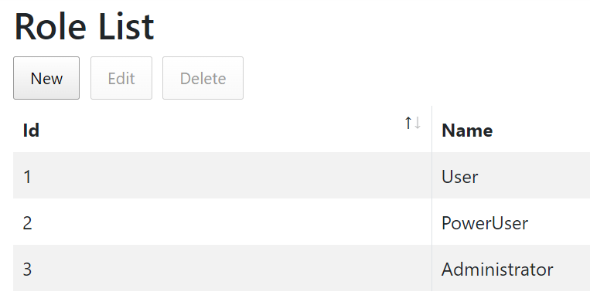
RDMS: Predefined Roles
Roles:
User:
    - read-only access to public and protected data
PowerUser:
- read-only access to public and protected data (+ private data, created by the current user)
- add data (+ write access to data, created by the current user)
Administrator:
- full access to all data (CRUD)
- user management
Anonymous (== registered user with no roles assigned):
- read-only access to public data only (be aware: internet search engines will index public data)
https://en.wikipedia.org/wiki/Role-based_access_control

Slide 9
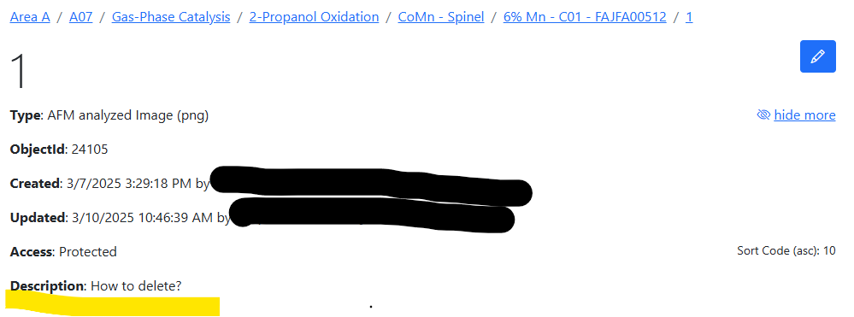
Popular Question: how to delete an object / objects
Q: Who can delete objects?
A: Administrator
It was decided that PowerUsers can only add and update their own data (no deletion is possible).
If you want to delete the objects, but can not (because of permissions), please do the following:
Change the name of the object by inserting “_delete_” prefix (for example: “_delete_1”)
Another alternative: if not exist, create a “Trash Bin” project at the top level and put/move the objects to be deleted there.
https://crc247.mdi.ruhr-uni-bochum.de/object/1

Slide 10
RDMS: Setting the Object Access Level
What is an Object?
Object (=document) is a data entry within RDMS that has user-defined access level and reflects an object of the real world (e.g. sample) or its model. Ultimately, object has it’s unique Web page (with unique URL address).
To establish data access policy Data Access Levels are introduced in RDMS.
Four Access Levels:
Public (for anonymous users, search engines):
    objects are available to everybody regardless of authorization (visible to internet search engines);
Protected (by default, visible to the community only):
- objects are visible to the community (available to authorized users with at least User role assigned);
ProtectedNDA (restricted visiblility):
- objects are visible to the authorized users with NDA claim set OR to Administrators;
Private (person’s secret, but open for Administrators):
- objects are visible to the user-creator (at least PowerUser role assigned);
- objects are visible to all users of Administrator role.
Protected is default in CRC 247
NDA - Non-Disclosure Agreement

Slide 11
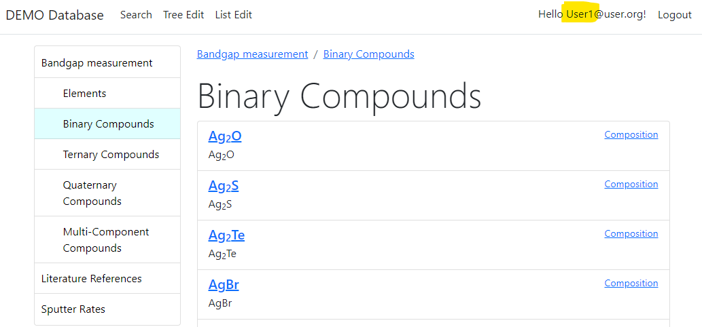
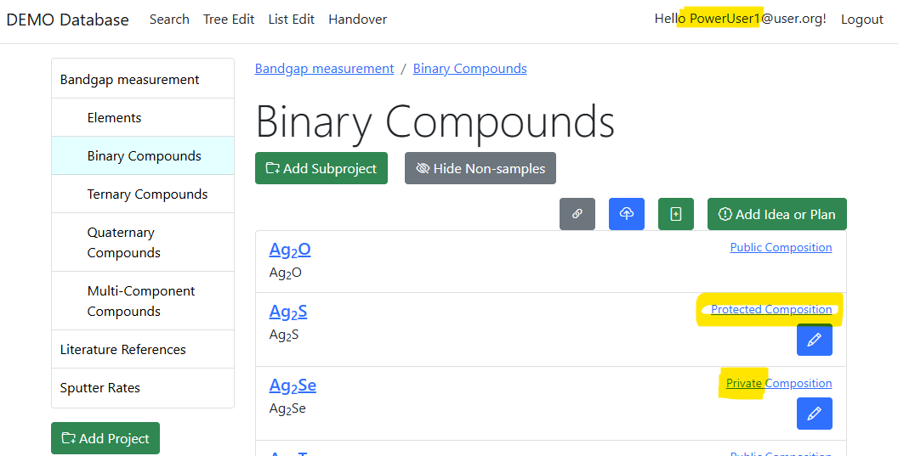
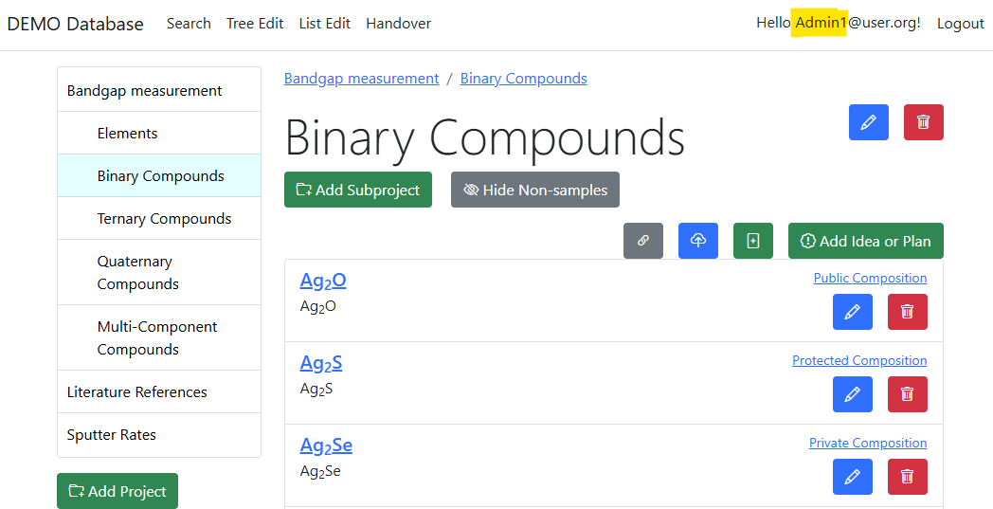
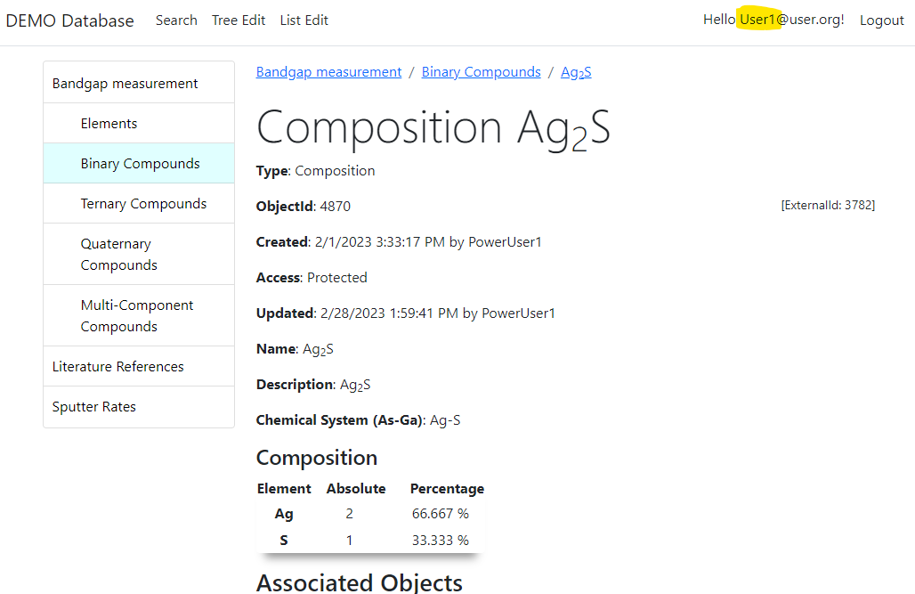
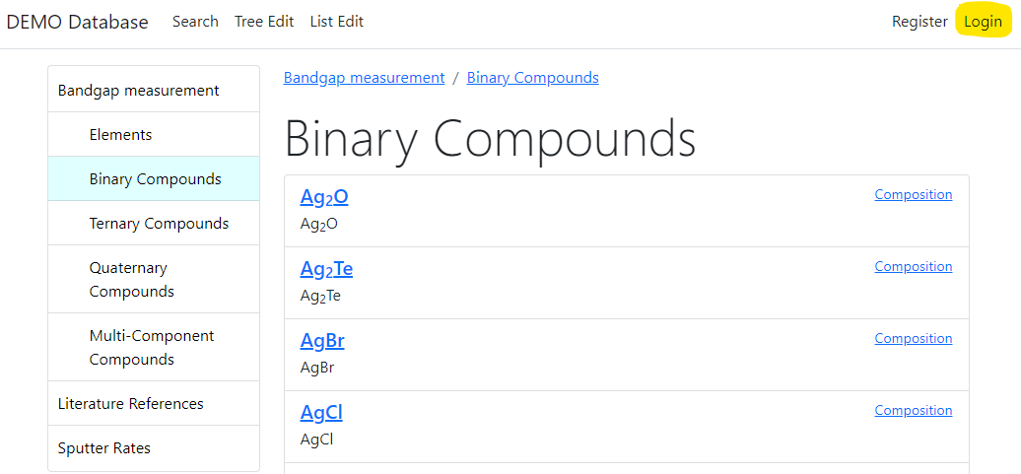

RDMS: Adjust Functionality According to User Permissions
User credentials (role) affects user interface: https://demo.mdi.ruhr-uni-bochum.de/rubric/binary-compounds
User1 (User role) PowerUser1 (PowerUser role) Admin1 (Administrator role)
Authorized CRC Community
Preconditions:
Ag₂O created (public) by Admin1
Ag₂S created (protected) by PowerUser1
Ag₂Se created (private) by PowerUser1
Accessible (visible)
Denied (hidden)
User (no role) = Anonymous (search engine)
Visit
https://demo.mdi.ruhr-uni-bochum.de/object/ag2s-4870
User => access granted
Anonymous => access denied
https://demo.mdi.ruhr-uni-bochum.de

Slide 12
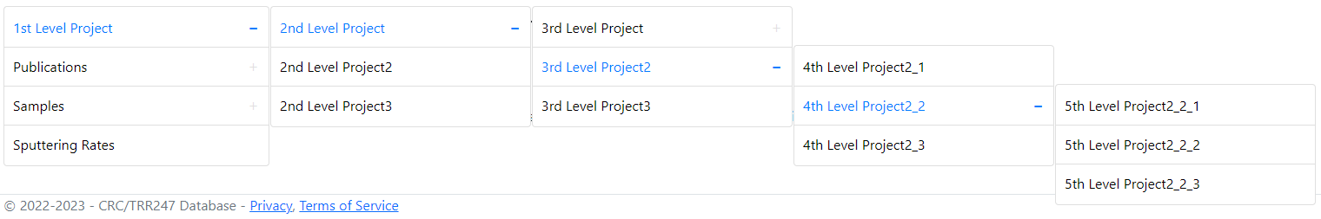
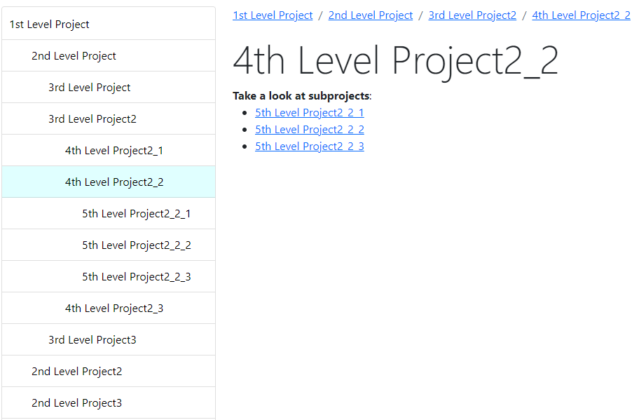
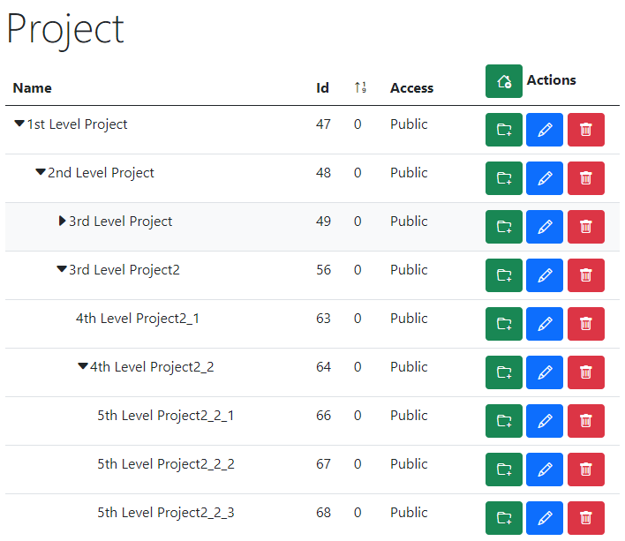
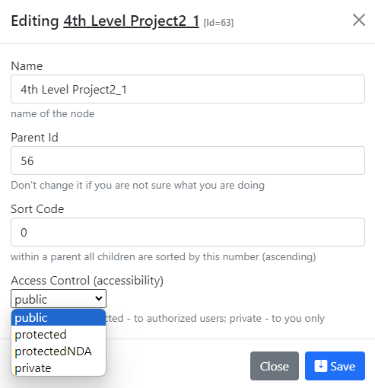
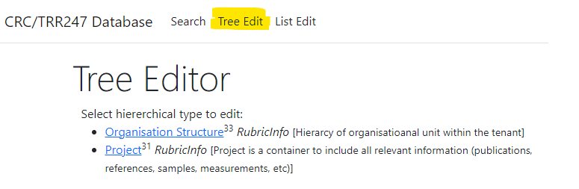
RDMS Project Tree: control and display
Control (CRUD):
Name
Parent Id
Sort Code
Access
Text (HTML)
https://demo.mdi.ruhr-uni-bochum.de/

Slide 13
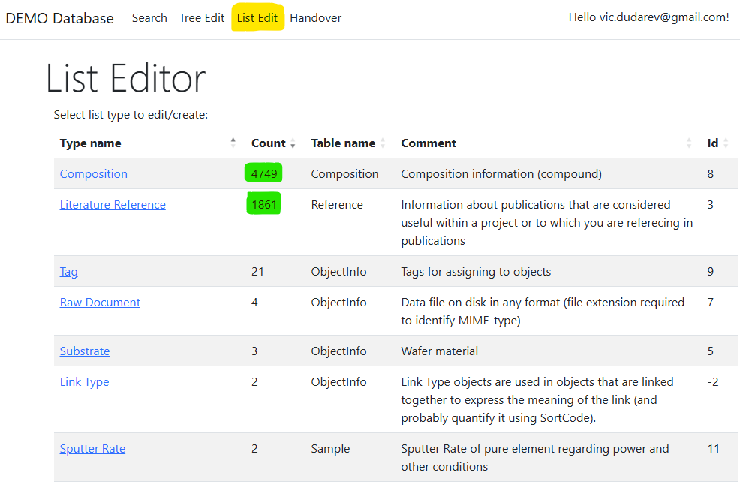
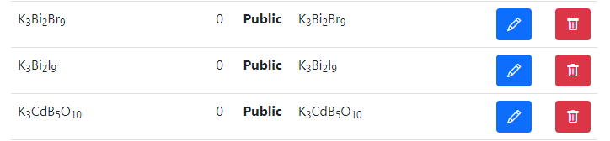
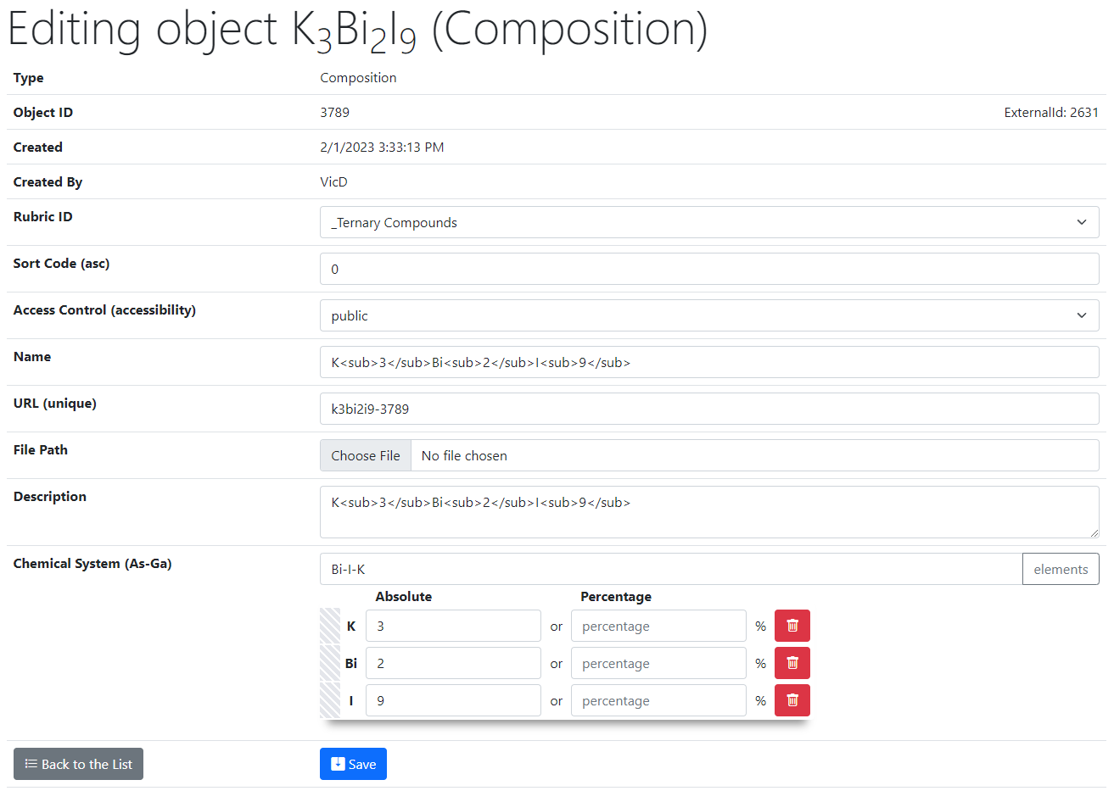
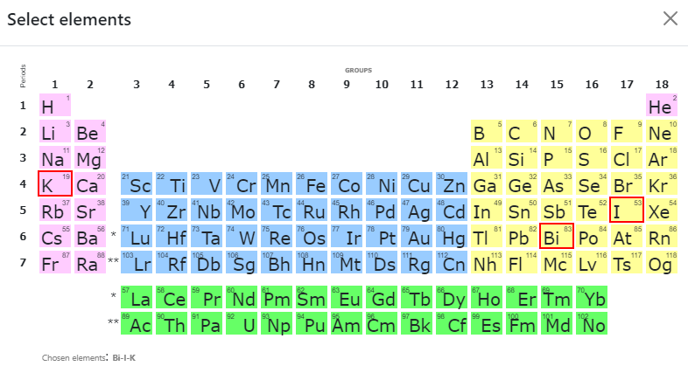
RDMS List Types: control
List of all objects (of type Composition):
Control (common to all objects):
Rubric Id;
Sort Code;
Access;
Name;
URL (adjustable*);
Attach File (document);
Description.
2
Type specific control (e.g. Composition):
Chemical System;
Composition (elements containment).
1
https://demo.mdi.ruhr-uni-bochum.de/
https://demo.mdi.ruhr-uni-bochum.de/adminobject/edititem/3789

Slide 14
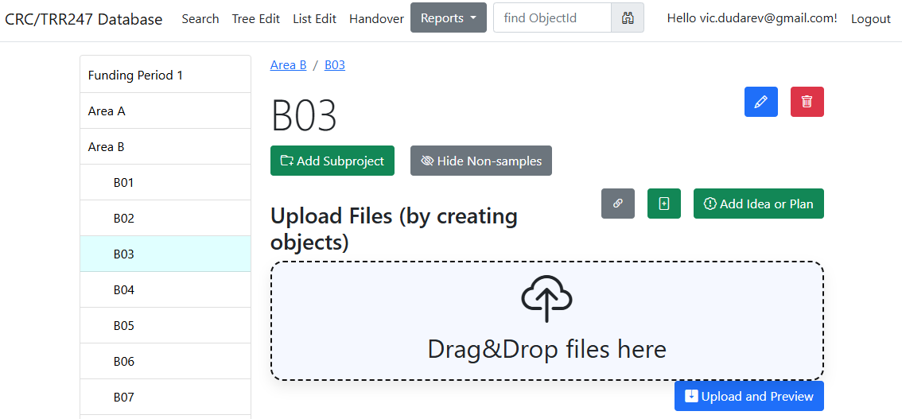

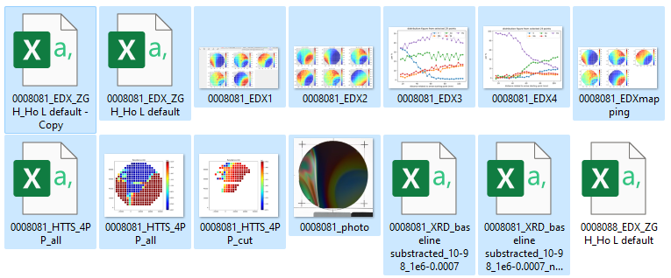
RDMS DropZone Tasks: Batch Data Validation & Import
Task: validate documents & import data
Implemented Features:
Automatic type detection (by file name)*;
  Type name and file name are split into words:
  10 points for each complete word match
  1 point for every substring match to
  Highest score type wins!
Uniqueness check (object name + file);
Data validation (build-in + external);
Data import.
Every name (type name and file name) is split into words using non-alphabetical characters as delimiters, and then the score is calculated:
- If the word matches completely, then we add 10 points to the score
- If the word in the file name is a substring of the word in the type name (or vice versa), then we add 1 point to the score.

Slide 15
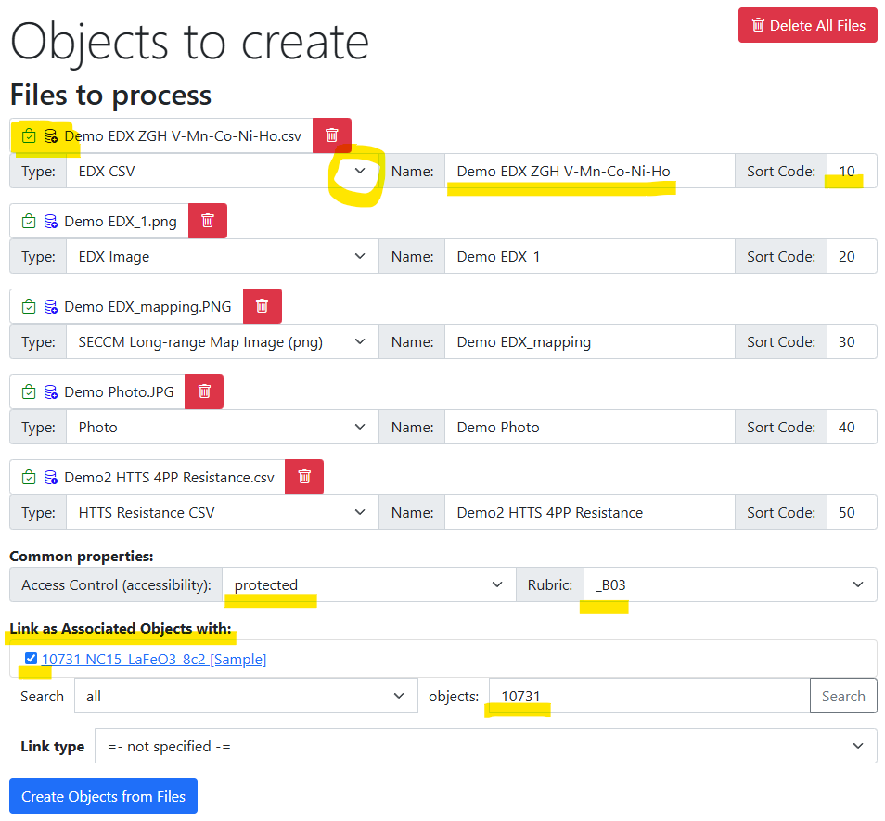
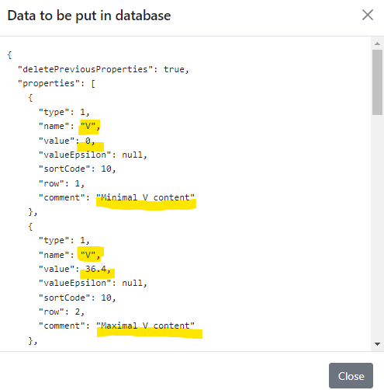
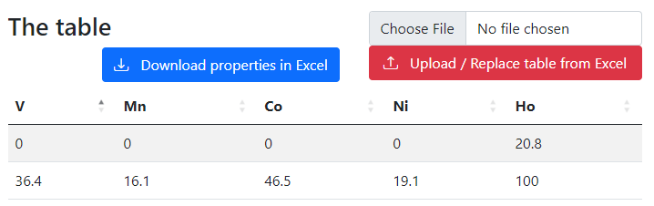
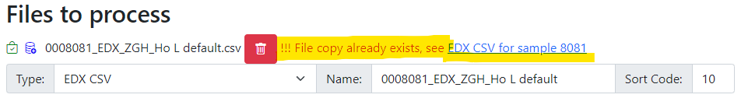
RDMS DropZone: Staged Files (before import)
Check data to import:
Properties
(after import):
Workflow:
- validate every file;
- check/adjust all properties;
- Import files.
Check for unique documents (based on SHA256):

Slide 16
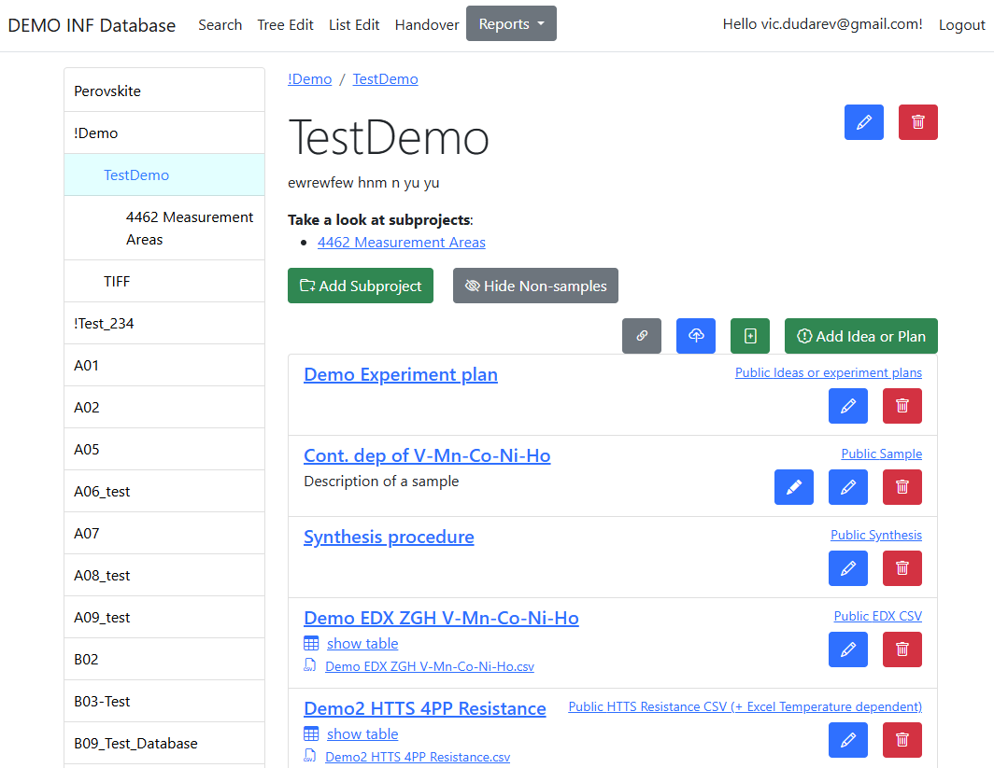

RDMS: Created Objects
After import:
- check all created objects (names, access level, etc…);
- share a link.

Slide 17
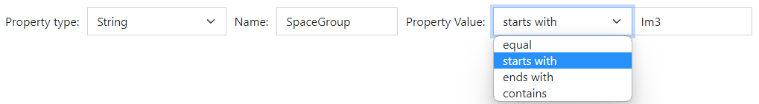
RDMS Extended Properties: the basics
Motivation: to extend object description by adding more data/metadata
All values are to be stored using appropriate data types!
DEFINITION: Data type is a collection or grouping of data values, usually specified by a set of possible values, a set of allowed operations on these values, and/or a representation of these values as machine types.
Supported data types (and their visualization in the search form):
Int – integer values (64-bit signed integer) in range [-9 223 372 036 854 775 808; 9 223 372 036 854 775 807].
Float – double-precision floating-point (8 bytes, IEEE-754), ±5.0×10⁻³²⁴ to ±1.7 × 10³⁰⁸.
String – any characters sequence no longer than 4096 symbols.
BigString – any characters sequence no longer than 2 147 483 647 symbols (2 Gb).
https://en.wikipedia.org/wiki/Data_type

Slide 18
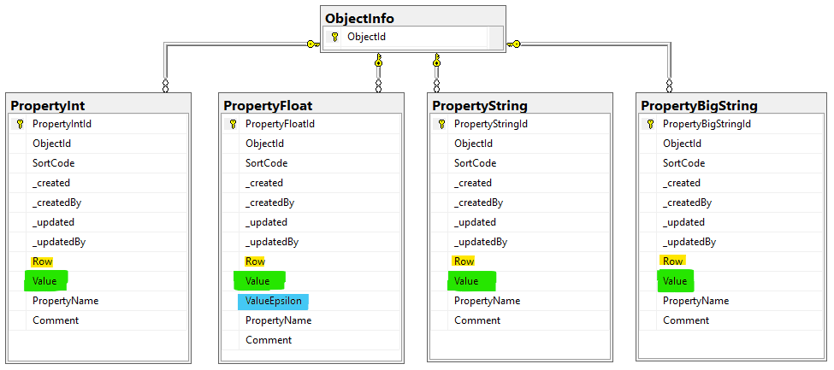
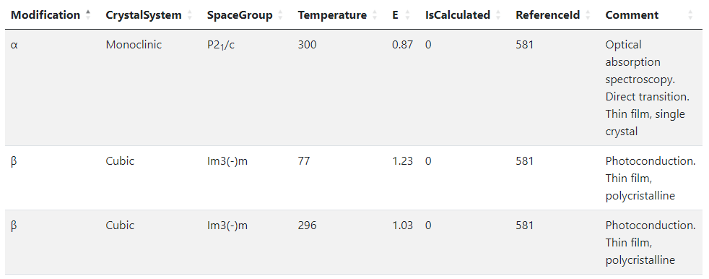
RDMS Extended Properties: Representing Table Data
Use case: add additional properties values (or even a table) to object and afterwards make search on them.
OR
When the existing fields set is not enough…
Task: associate table with object
Row=1
Row=2
Row=3
String x3
Float x2
Int x2
String
Solution: Decompose the table so, that each cell value is stored in Property* table according to cell value type.
Important attributes:
PropertyName – contains column name
Value – contains cell value
Row – contains row number (1, 2, 3, …). If no row number specified – value is threated as object’s property
User view: https://demo.mdi.ruhr-uni-bochum.de/object/ag2s-4870
Admin view: https://demo.mdi.ruhr-uni-bochum.de/adminobject/edititem/4870

Slide 19
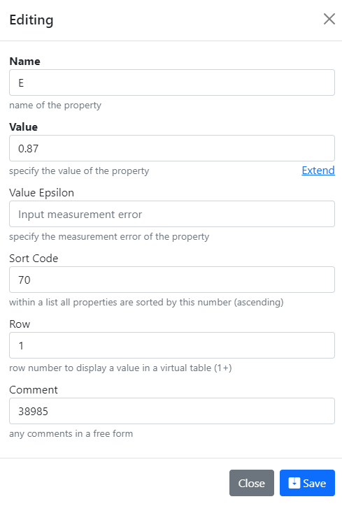
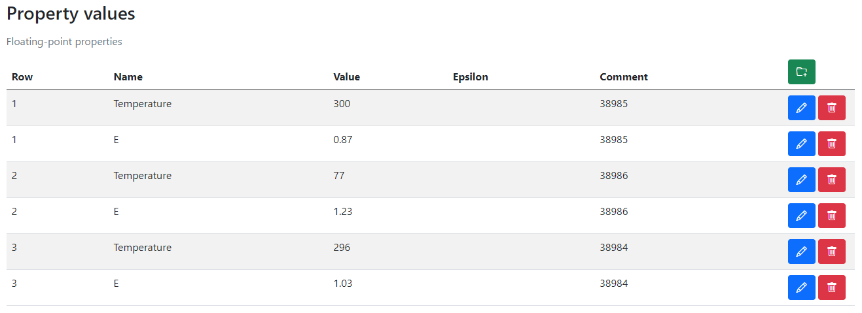
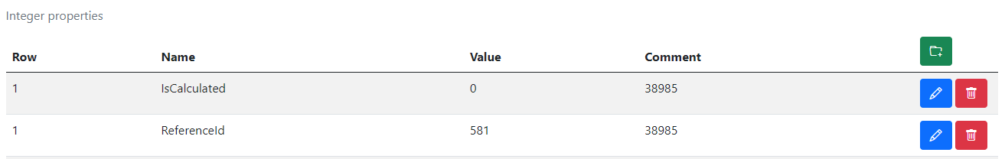
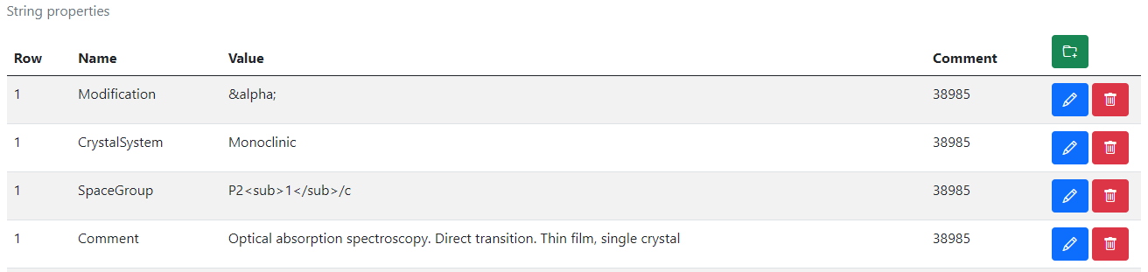
RDMS Extended Properties: Control
Extended Properties Control for object is available according to the object access managements in administration panel for objects.
User view: https://demo.mdi.ruhr-uni-bochum.de/object/ag2s-4870
Admin view: https://demo.mdi.ruhr-uni-bochum.de/adminobject/edititem/4870

Slide 20
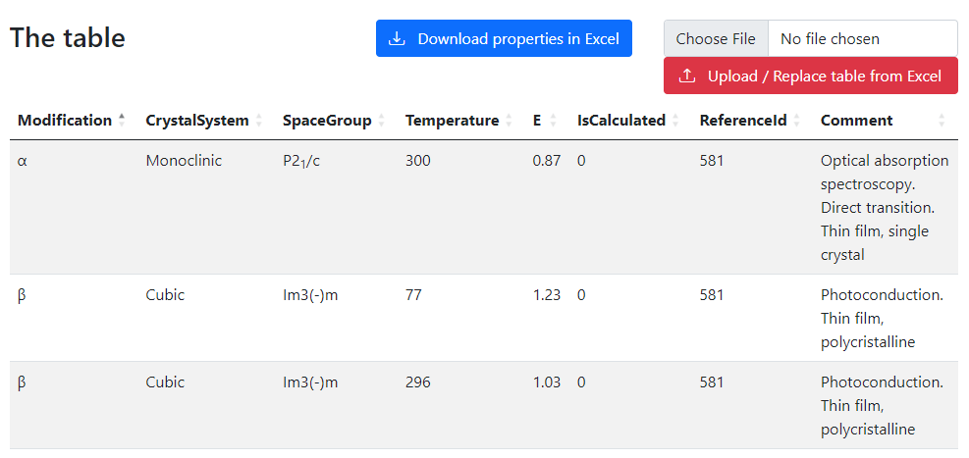
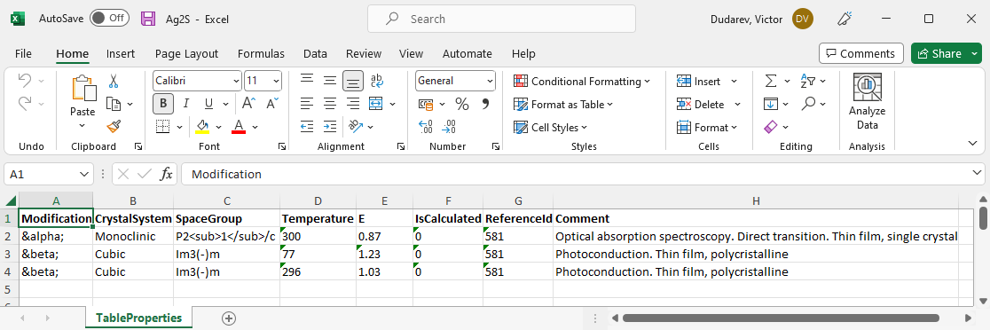
RDMS Extended Properties: Export and Import
Task: make properties modification easy
Steps to do:
Download data
Open in Excel and edit
Upload changed data back to the RDMS
Import
(requires permissions)
https://demo.mdi.ruhr-uni-bochum.de/object/ag2s-4870
Export
https://demo.mdi.ruhr-uni-bochum.de/object/ag2s-4870

Slide 21
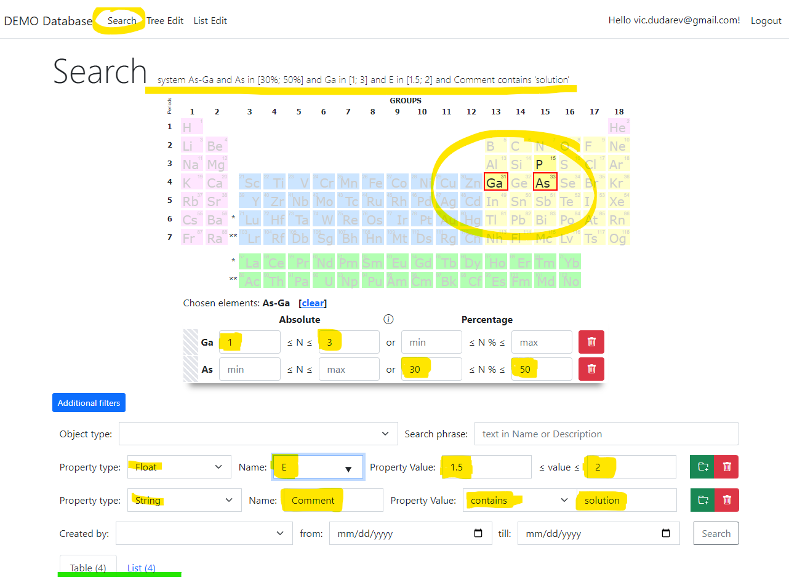
RDMS: Search
Search on:
Chemical system
Composition
Object type
Phrase in object’s Name or Description
Properties values (all available within tenant)
Person created
Creation date
Important feature:
persistent URL on search (share search results easily by URL*).
* - respecting current security context
https://demo.mdi.ruhr-uni-bochum.de/search/
https://demo.mdi.ruhr-uni-bochum.de/search/?system=As-Ga&typeid=8&Aspctmin=30&Aspctmax=50&Gaabsmin=1&Gaabsmax=3&pr0name=E%3Csub%3Eg%3C%2Fsub%3E&pr0type=Float&pr0min=1.5&pr0max=2&pr1name=Comment&pr1type=String&pr1max=3&pr1str=solution&prcnt=2
https://demo.mdi.ruhr-uni-bochum.de/search/?system=As-Ga&typeid=8&Aspctmin=30&Aspctmax=50&Gaabsmin=1&Gaabsmax=3&pr0name=E%3Csub%3Eg%3C%2Fsub%3E&pr0type=Float&pr0min=1.5&pr0max=2&prcnt=1

Slide 22


User-Defined Type Support
Motivation: to support new user-defined object type (UDT) without modifying core RDMS source code
Given: New object type with/without a new arbitrary file format (could be new measurement type result).
Solution (or 5 keys to success):
Templates – define object model (data structure) in terms of key-value pairs / table (properties)
Search – enable search for UDT objects based on defined data model
Validation – provide check for data correctness (valid/invalid)
Data Extraction – if valid, extract data in terms of properties / related object creation
Visualization – display data, including drawing charts / diagrams, etc…
UDT – user-defined type

Slide 23
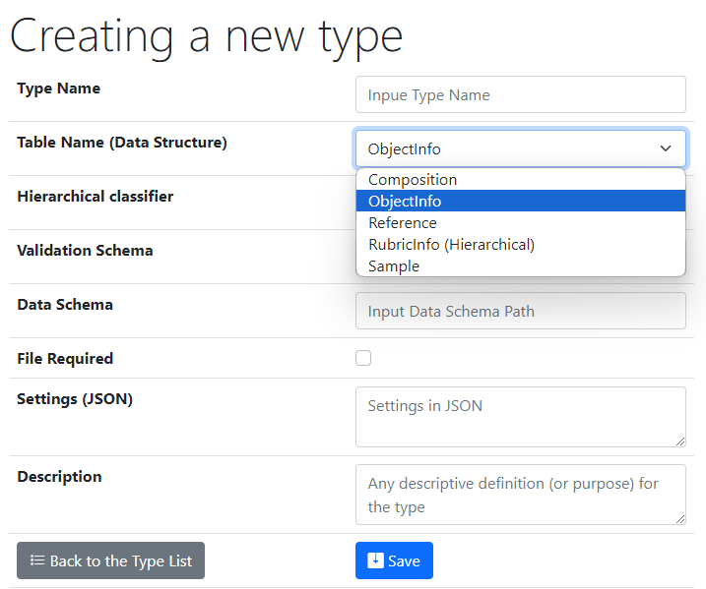
UI to create a new user-defined type
One of predefined base types
Type Name – user-defined type name
Core Object Types:
ObjectInfo – the simplest (bare) object
Sample – chemical system (set of chemical elements), for example Co-O
Composition – chemical composition (set of elements and quantities), for example Co₃O₄
Reference – literature reference (Authors, Title, Year, DOI, etc.)
Validation & Data Schema – only if you have external Web Services ready to validate & extract data from files
File Required – sets the file mandatory (boolean)
Settings (JSON) – type customization in RDMS
{ "CustomEditPath": "/custom/editsample",
"UrlPostVisualizer": "https://abc.de/VisualizeRT" }
Description – comments for type designation
Defining data & behavior
We can further enrich defined object specification by customized (templates!) properties of primitive types: Integer, Float, String.

Slide 24

Ways of customization
Basic (no-code)
  Introducing User-Defined Data Types:
    - List templates
    - Table templates
Shortly illustrated in today’s talk
Simple (client-side code only)
  Page-code injection:
    - HTML
    - Javascript
    - CSS
Development abstraction layers
easy hard
data layout workflow application
External API (server-side code only)
  Validation & Data Extraction for User-Defined Data Types (any language)
Complex (client- & server-side code)
  INF-code adjust (ASP.Net Core App)
    - C#
    - SQL
    - HTML/Javascript/CSS
Complexity

Slide 25
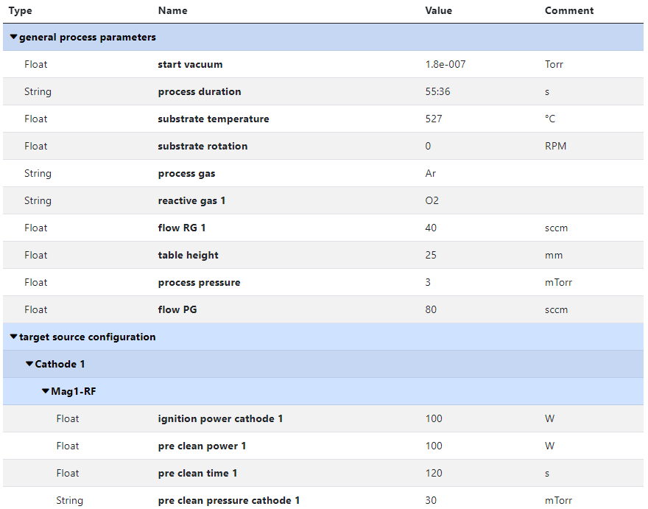
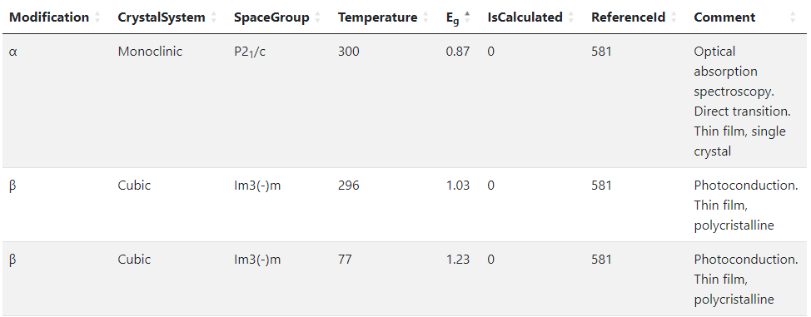
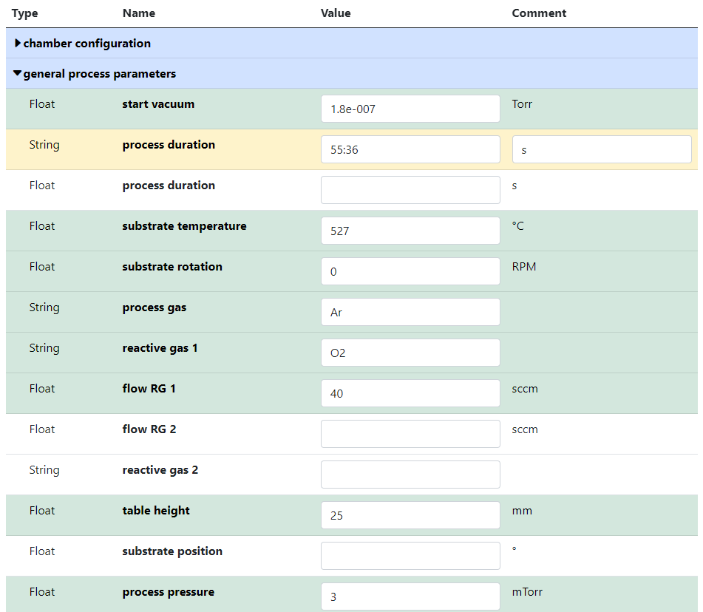


RDMS no-code customisation: Templates for object type
Template
List
(specify sorted properties list with separators)
Create an object with “_Template” name
Specify properties set for a type
Table
(specify table structure: columns & types)
Data in a table with predefined structure
Key-value pairs
https://crc247.mdi.ruhr-uni-bochum.de/object/synthesis-for-sample-8220-co-deposition-221111-k3-3-1922
https://demo.mdi.ruhr-uni-bochum.de/object/ag2s-4870

Slide 26
Customisation via External Services
Motivation: support new data formats (models) without RDMS code change
Solution: RDMS can calls external services to get assistance dealing with new data formats with respect to:
Validation
Data Extraction
Visualisation
Templates for Web Services in Python and C#: see documentation
To provide full object type support (as if it was natively implemented in RDMS) one needs to implement three Web Services

Slide 27
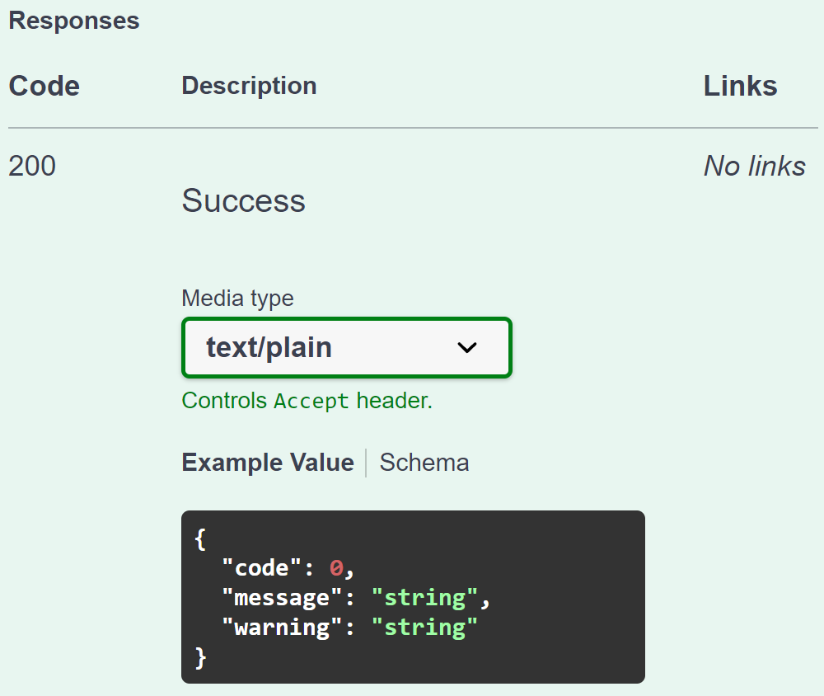
Validation from RDMS perspective: API makes it flexible
Provide a validator for every object type in configuration:
type: built-in type (object instantiated by class name);
https: URL to a REST Service (OpenAPI specification).
{
"Code": 0,
"Message": null,
"Warning": null
}
type:TypeValidationLibrary.TypeValidator_EDX_CSV (interface IFileValidator)
https://validation.matinf.pro/edx/validation
valid
Validation result
via external API call
External service decision
invalid
type
{
"Code": 500,
"Message": "error text",
"Warning": null
}
API – Application Programming Interface
URL – Uniform Resource Locator
REST – REpresentational State Transfer

Slide 28
Type configuration: Data Extraction (external Web Service)
Data extraction & conversion to table tasks are delegated to an external service
Data Extraction
Request URL: HTTPS_DataSchema + ("/databasevaluesbody" | "/tablebody")
Example: Data Schema (for EDX): https://validation.matinf.pro/edx/data
/databasevaluesbody
/tablebody
Data
IDatabaseValuesGetter: properties, compositions, properties for measurement areas
Table
ITableGetter: arbitrary table
(used for table visualisation)
Request URL (data): https://validation.matinf.pro/edx/data/databasevaluesbody Request URL (table): https://validation.matinf.pro/edx/data/table
see next slides…
Data schema values (current status):
{
"DataTable": [
{
"Index": "1",
"V": 31.3,
"Mn": 2.7,
"Co": 22.6,
"Ni": 6,
"Ho": 37.4
},
...
],
"Coordinates": {
"CoordinateNames": [],
"HasCoordinates": false
},
"Dependencies": {
"DependencyNames": [
"Index"
],
"HasDependencies": true
}
}
Data Schema | Comments | Author
type:TypeValidationLibrary.TypeValidator_EDX_CSV | EDX | Victor
https://validation.matinf.pro/edx/data | EDX | Victor
https://htts.matinf.pro/resistance/csv/data | HTTS Resistance CSV | Azadeh
https://htts.matinf.pro/resistance/txt/data | HTTS Resistance TXT | Azadeh
https://thickness.matinf.pro/thickness/xlsx/data | Thickness XLSX | Azadeh
https://thickness.matinf.pro/thickness/txt/data | Thickness TXT | Azadeh
https://validation.matinf.pro/

Slide 29



RDMS: Data Visualization
Materials Library Visualization
Configurable XY-charts
https://dim.mdi.ruhr-uni-bochum.de/file/csv/6691

Slide 30




Sample: Customised Form vs Standard Template
the same functionality
With client only customization (some JavaScript) the layout could be adjusted, so the form looks the same like in a fully customised form (left figure).
https://crc247.mdi.ruhr-uni-bochum.de/custom/editsample/0/?idr=1079&returl=%2Frubric%2Fa01_ag-au-pd-pt-x

Slide 31



Sample Customised Form (programming)
List from subproject
- Customised sample input
List from JS-template
Standard chemical system
Customisation with UI form / JS
https://crc247.mdi.ruhr-uni-bochum.de/custom/editsample/0/?idr=1079&returl=%2Frubric%2Fa01_ag-au-pd-pt-x

Slide 32
Sample Templated Form (no-code)
List from subproject (links)
=> - Templated sample input
List from subproject (values)
Standard chemical system
https://crc247.mdi.ruhr-uni-bochum.de/adminobject/newitem/6?idr=-1&ido=0&returl=%2Frubric%2Ffunding-period-1

Slide 33


Use Case: Sample Transformation Workflow
Create Processing State & Split Sample
Sample_2a_2
(subsample 2a state 2)
polishing
Documents2a_2
Sample_2a
(subsample 2a)
Sample
(initial state)
annealing
Sample_2
(changed state 2)
splitting
Sample_2b_2
(subsample 2b state 2)
oxidation
Sample_2b
(subsample 2b)
Documents
Documents2
Documents2b_2

Slide 34

Materials Library: integrating heterogeneous data
Typical Materials Library Data Lifecycle:
Sputtering:
Add Sample object (chemical system + substrate)
Add Synthesis object (sputtering parameters)
Characterisation:
Add processed EDX (342 Composition objects)
  Composition == Measurement Area
Add Other Characterisation Documents (Photo, XRD, Resistance, Thickness, Bandgap, etc…)
Storage, Curation, Search (on properties retrieved from devices / file formats), Reporting:
Find compositions with given properties in a certain range (across all known materials libraries)
Find by synthesis parameters
Find by chemical system / creation date / author / text / properties, etc…
Reports
Measurement Area
(composition)
Phases: [ Phase₁,
…, Phase_{N} ]
Resistance: __ Ohm
Thickness: __ nm
Bandgap: __ eV
…
ML – Materials Library
EDX – Energy-dispersive X-ray spectroscopy
XRD – X-ray diffraction analysis

Slide 35
Data extraction: adding data to Compositions (MAs)
{
"CompositionsForSampleUpdate": [
{
"Predicate": {
"Properties": [
{
"Type": 2,
"Name": "Measurement Area",
"Value": 1
}
]
},
"DeletePreviousProperties": false,
"Properties": [
{
"PropertyId": 0,
"Type": 1,
"Name": "R",
"Value": 34143346,
"ValueEpsilon": null,
"SortCode": 10,
"Row": null,
"Comment": "Resistance (Room Temperature) for Measurement Area 1"
}
]
},
...
],
"DeletePreviousProperties": true,
"Properties": [
{
"PropertyId": 0,
"Type": 1,
"Name": "R",
"Value": 97692.43229,
"ValueEpsilon": null,
"SortCode": 10,
"Row": 1,
"Comment": "Minimal Resistance (Room Temperature) of Materials Library (of all 342 MAs)"
},
{
"PropertyId": 0,
"Type": 1,
"Name": "R",
"Value": 34143346,
"ValueEpsilon": null,
"SortCode": 10,
"Row": 2,
"Comment": "Maximal Resistance (Room Temperature) of Materials Library (of all 342 MAs)"
}
]
}
Use case: adding characterisation data after EDX is done.
Resistance for MA 1
Sample
EDX
Composition
R
Resistance
x 342
Resistance range for the sample (whole ML)
Data import:
Locate parent sample object.
Find measurement area collection.
Find a certain Measurement Area (corresponding to a predicate, e.g. MA index).
Add properties values to a composition corresponding to a measurement area index.
http://htts.matinf.pro/

Slide 36

Use Case: Sample -> EDX -> Resistance & Search
Create Project
Add Sample to Project
Add EDX document (342 Measurement Areas (MA), i.e. 342 Compositions)
Add Resistance document (associate property values to every MA)
Search for Composition with a given Resistance
Composition – an object representing one of 342 measurement areas
Container for other properties, associated with a certain measurement area
https://crc1625.mdi.ruhr-uni-bochum.de/search/?system=Ni-V&typeid=8&Nipctmin=15&Nipctmax=20&pr0name=R&pr0type=Float&pr0min=10000000&pr0max=11111111&prcnt=1

Slide 37



Tracking Samples or Handover event: initialisation
Motivation (C03): to track sample location / shipping
In “physically transferrable” objects (samples), find a green handover button
Select the recipient and press a blue button.
Select recipient
Specify Amount (optional)
Specify Comments
click

Slide 38



Tracking Samples or Handover event: delivering / delivered
Handover event is created
Recipient is notified by e-mail
3) Recipient should add comments and confirm the handover.
4) Confirmed
+ e-mail notification for sender

Slide 39

Tracking Samples or Handover event: user overview
Incoming
Outgoing
https://crc247.mdi.ruhr-uni-bochum.de/handover

Slide 40

Tracking Samples or Handover event: project overview
Pending handovers (unconfirmed)
Successful handover
https://crc247.mdi.ruhr-uni-bochum.de/rubric/area-c_c03

Slide 41



RDMS: Advanced Interlink Objects
a
a
c
Example: establishing graph above objects
b
directed graph
To add associated objects:
0) Go to “List edit” or select object to edit
1) Select associated object type (optional filter)
2) Input search phrase, contained in the Name of the desired object to be associated
3) Select (if required) link/association type object.
4) Drag & Drop desired object(s) from search result list to the area / adjust list
5) Save changes
Important: Reverse associations allow to browse reverse- directional associations.
User view: https://demo.mdi.ruhr-uni-bochum.de/object/ag2s-4870
Admin view: https://demo.mdi.ruhr-uni-bochum.de/adminobject/edititem/4870

Slide 42




Graph: always think about object connections
How many options are there to add object to DB?
In Project: add unlinked objects.
https://mdi.matinf.pro/rubric/industry
Add “top level” objects
Add “children/dependent” objects
In Object (under associated objects): add linked objects.
https://mdi.matinf.pro/object/standard-screening-crc-aka-tobias-report-103066
https://mdi.matinf.pro/rubric/industry
https://mdi.matinf.pro/object/standard-screening-crc-aka-tobias-report-103066

Slide 43

Unclassified samples: these should not exist anymore…
Goal: all samples should have a parent “Idea or Experiment Plan” / “Request for synthesis”
https://mdi.matinf.pro/report/unclassifiedsamples

Slide 44

Oriented Graph: interlink & don’t mess up with directions
In all objects:
Control associated objects (children)
Child objects
Add a new (child) object + association
Parent objects
Idea or Plan
Sample
Synthesis
Request for Synthesis
Characterisations:
EDX, XRD, Resistance, Bandgap, …
342
x
Compositions

Slide 45



Graph visualisation
Motivation: understand relationship between objects
on double Click on the node:
incremental graph expansion (add parents/children)
Interactive graph
on Click: object description
JSON
https://mdi.matinf.pro/object/co-cu-mo-ni-equiatomic-library-117099
https://mdi.matinf.pro/object/graph/co-cu-mo-ni-equiatomic-library-117099

Slide 46


Reports & Statistics: Objects
Objects Statistics:
Objects (w.r.t. types)
Projects
Object Links
Feature:
Filter by person
https://crc247.mdi.ruhr-uni-bochum.de/report/objectsstatistics

Slide 47


Reports & Statistics: Users
Users Statistics:
Objects
Projects
Links
https://crc247.mdi.ruhr-uni-bochum.de/report/usersstatistics

Slide 48






Source Control (GitLab)
Everybody’s welcome!
Feel free to contribute to open source!
Core INF project:
https://gitlab.ruhr-uni-bochum.de/vic/infproject
Shared projects (WebCompact):
1) Administration User Interface (Identity Manager UI):
https://gitlab.ruhr-uni-bochum.de/vic/identitymanagerui
2) Web Application General Library (WebUtilsLib):
https://gitlab.ruhr-uni-bochum.de/vic/webutilslib
https://gitlab.ruhr-uni-bochum.de

Slide 49
Documentation
The link is in the footer on every page:
Documentation content:
User manual
  Many thanks to: Irina Roslyakova, Felix Thelen, Alan Savan, Tobias Piotrowiak, Jill Fortmann, Ellen Suhr, Sabrina Baha, Florian Lourens, Valerie Strotkötter, Rico Zehl, Patrick Marx, Aurelija Mockute, Elaheh Akbarnejad, Sigurd Thienhaus
Presentations, videos
Database structure description (tables and views)
User-defined type (UDT) system:
  Object type configuration
  UDT support API (validation, data extraction, visualization; templates is C#/Python are availbale)
  UDT: supported formats (EDX, Resistance, Thickness, XRD is coming soon, …)
System settings
Tenant settings
API
Source code
https://crc247.mdi.ruhr-uni-bochum.de/home/doc

Slide 50

RDMS Free Playground
  https://inf.mdi.ruhr-uni-bochum.de/
Playground to test RDMS (multiple tenants with shared users list):
https://inf.mdi.ruhr-uni-bochum.de/
Login and Password (User role): User1@user.org
Login and Password (PowerUser role): PowerUser1@user.org
Login and Password (Administrator role): Admin1@user.org
https://inf.mdi.ruhr-uni-bochum.de/
Notes:
https://qr.io/

Slide 51

Research Workflow
and RDMS Object Types Interconnection
Research workflow support in RDMS
Defines characterizations
Provides report on samples & measurements
Idea or Plan
Calculation / Compu-tational Composition
Sample
Treatment:
annealing,
oxidation,
polishing, …
Sample_2
Report
Request for Synthesis
Characterisation:
EDX, XRD, Resistance, Bandgap, …
Characterisation:
EDX, XRD, Resistance, Bandgap, …
EDX – Energy-Dispersive X-ray spectroscopy (to determine composition)
XRD – X-Ray Diffraction (to determine crystallographic structure)
RDM Image source: Yazdi, M., Politze, M. and Müller, M. (2024) ‘A Novel Approach to Outlining Research Data Management Life Cycle: A Case Study’, Research gate, accessed 15.05.2024

Slide 52
Live Demo
Goal: create interconnected objects (FAIR)
Idea or Experiment Plan
Sample (342-grid materials library)
Synthesis
EDX (composition data)
Resistance data
Search for data w.r.t. composition & resistance
Get Integrated Dataset for a sample
https://vdudarev.ru

Slide 53
Thanks for your kind attention
Questions & Answers
Use Google Doc: https://docs.google.com/document/d/1XqDlaSxRxqnigCT2mpn5jptllRlWgObB/edit
https://vdudarev.ru

