Slide 1

Demonstration of
Research Data Management System for CRC247
Dr.
V. Dudarev
Victor Dudarev

Slide 2
Agenda
    CRC/TRR 247 Registration overview
    RDMS Core features at a glance
    Demo (on https://inf.mdi.ruhr-uni-bochum.de/):
      Project tree management
      Object type creation
      Templates (properties and table)
      Adding a new Object
      Searching for documents
      Batch document import
    Q&A
RDMS: Research Data Management System

Slide 3
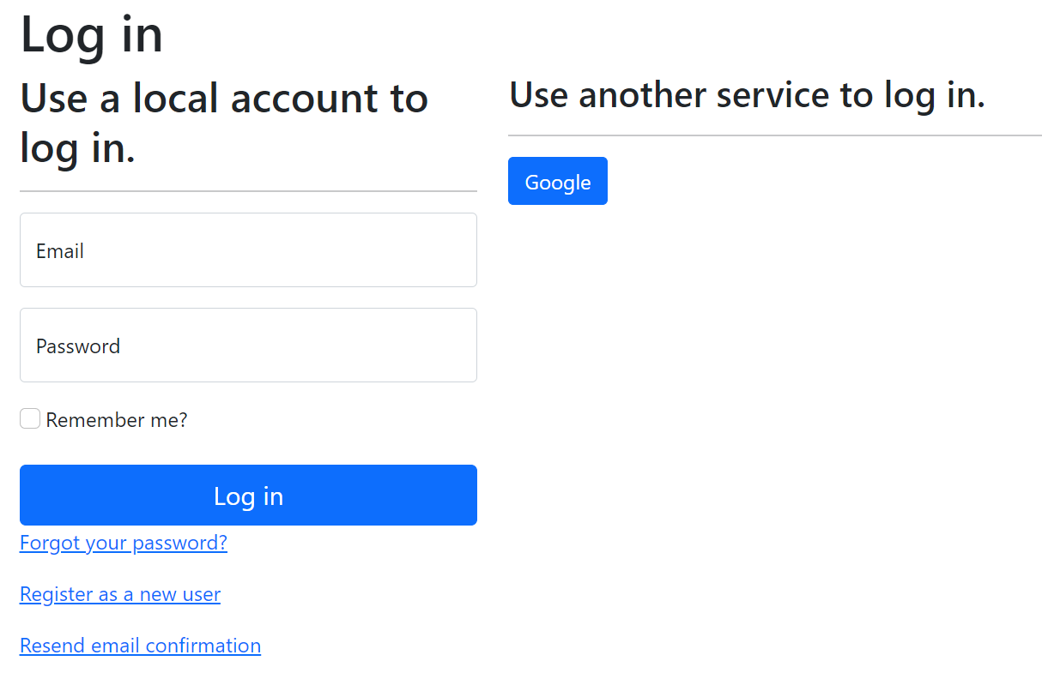
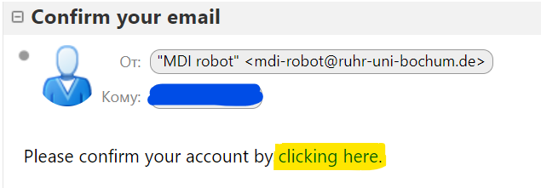
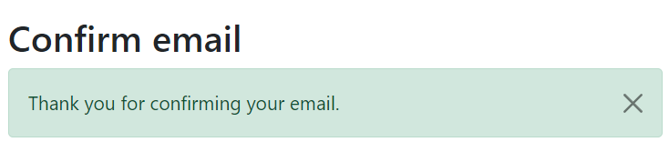
RDMS: Registration and Authorization
Application access level is determined by the current user context.
Two-way registration (choose any):
using external provider (OpenID Connect), e.g. Google (external authentication authority is used, no credentials are stored locally).
using local account (credentials are stored internally);
In both cases, an e-mail address is required, and its successful verification is a prerequisite for access.
After e-mail confirmation, the user is considered active, but does not have an assigned user group.
https://openid.net
https://en.wikipedia.org/wiki/Authentication
https://en.wikipedia.org/wiki/Authorization

Slide 4
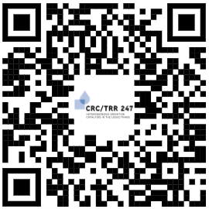
RDMS in Production
Production mode (https://crc247.mdi.ruhr-uni-bochum.de/):
You need to register with Google account or create your own account (email/password) and confirm e-mail (warning: user created with no role assigned).
Other information on this slide is omitted due to confidential reasons.
https://crc247.mdi.ruhr-uni-bochum.de/
Everything runs 24x7 on a dedicated VM within a new server (INF funding).
All data are backed up weekly on a dedicated external backup device.
No disaster tolerance: all devices are physically in a single server room.
Notes:
https://qr.io/

Slide 5

RDMS Core Features
Support for multiple Tenants;
Custom Project Tree;
User-defined Object Type support:
  Document Validation
  Data Extraction
  Data Visualization
  Properties Templates
  Table Templates
Batch Import of Documents
UI Customization (with HTML/JS/CSS injection)
System
(qualitative composition)
In-S
Substance
(quantitative composition)
In₂S₃
Modification
(crystal structure type)
β-In₂S₃
…
RDMS: Research Data Management System

Slide 6
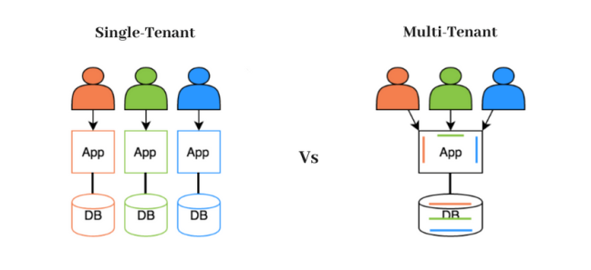
RDMS: Multiple Tenant Support
What is Tenant?
Short answer:
Tenant – separate (distinct) instance of a software application that
is used by a single organization or group of users.
Long answer:
Tenant is a customer account that has its own set of users, data, and configuration settings, and is isolated from other tenants in the same software application. This concept is commonly used in Software as a Service (SaaS) applications, where a single software application is hosted in the cloud and is made available to multiple customers as separate tenants. This allows each customer to have their own instance of the application, with their own data, settings, and customizations, while still sharing the underlying infrastructure and resources of the application
Conclusion:
Tenants are useful for separate SFB projects / workgroups / materials data repositories. For example:
          Test: https://inf.mdi.ruhr-uni-bochum.de/
          Production: https://crc247.mdi.ruhr-uni-bochum.de/
https://en.wikipedia.org/wiki/Multitenancy

Slide 7
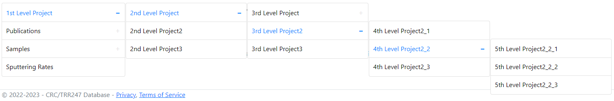
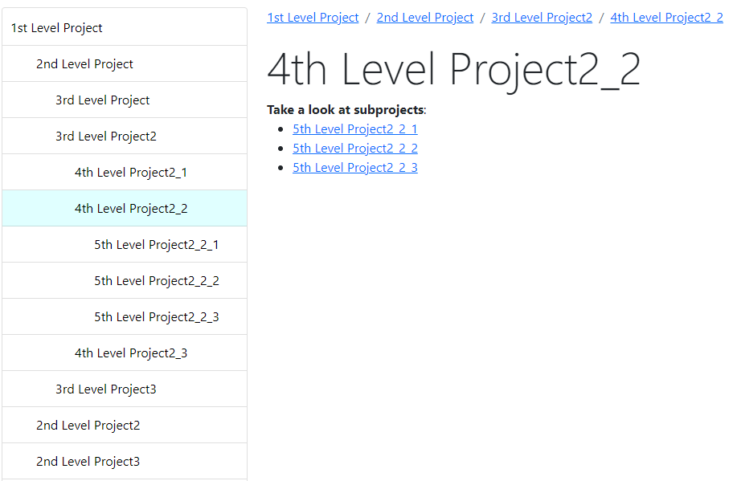
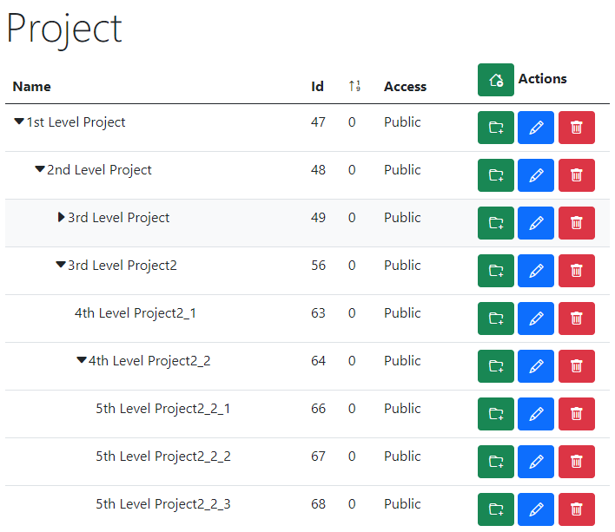
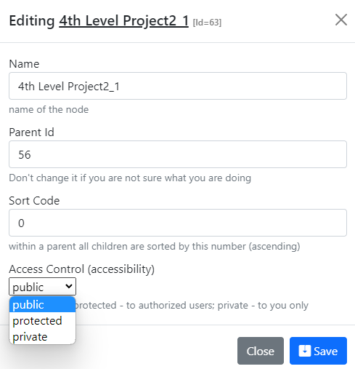
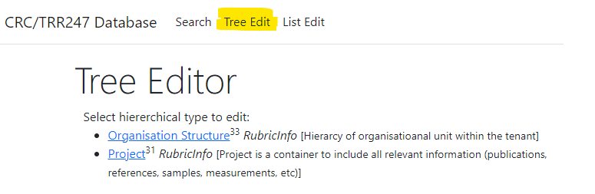
RDMS Project Tree: control and display
Display for users in Web Application
Control (admin):
Name
Parent Id
Sort Code
Access
https://demo.mdi.ruhr-uni-bochum.de/

Slide 8
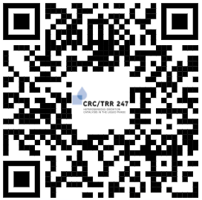
RDMS FREE Playground
Let’s create a project
(with your name!)
https://inf.mdi.ruhr-uni-bochum.de/
Playground to test RDMS (multiple tenants with shared users list):
https://inf.mdi.ruhr-uni-bochum.de/
Login and Password (User role): User1@user.org
Login and Password (PowerUser role): PowerUser1@user.org
Login and Password (Administrator role): Admin1@user.org
https://inf.mdi.ruhr-uni-bochum.de/
Notes:
https://qr.io/

Slide 9
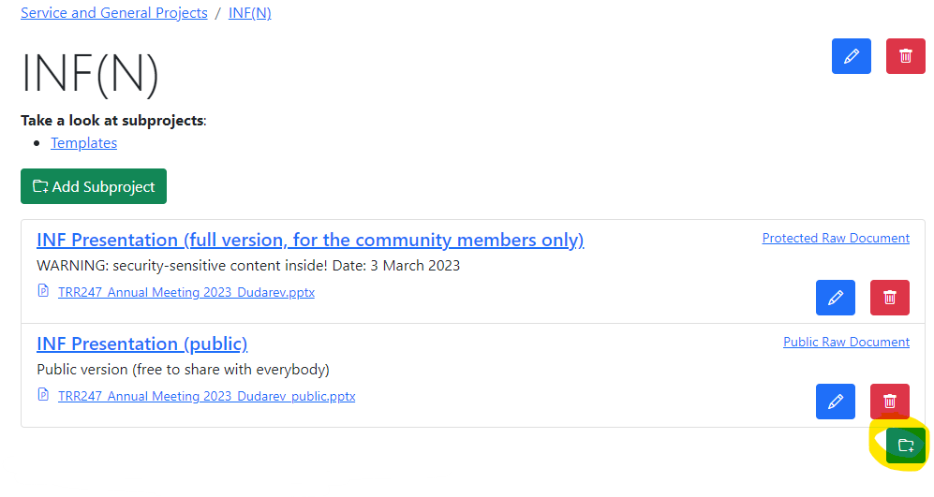
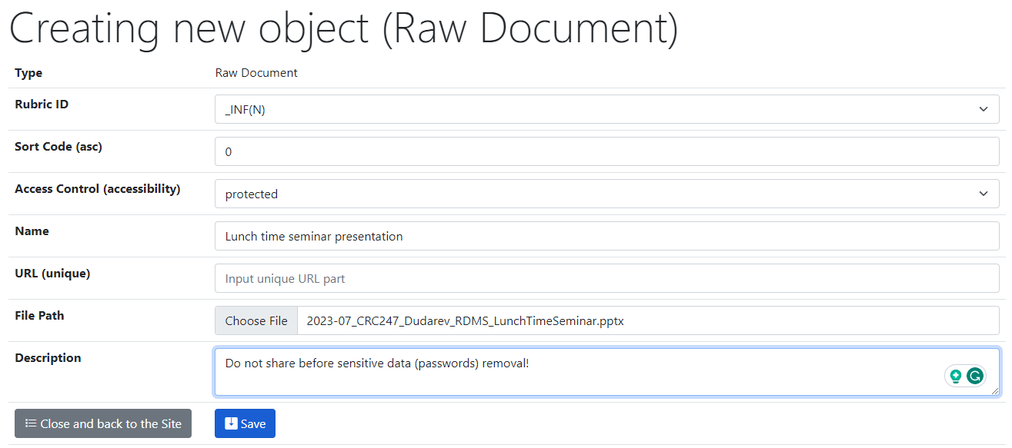
RDMS basics: Create an object (upload document)
Task: upload current presentation (select: Raw Document as a type)
Step 1: go to project (use project tree)
Step 2: press small green button
Step 3: fill information & specify the file
Step 4: press blue Save button
https://crc247.mdi.ruhr-uni-bochum.de/rubric/service-and-general-projects_infn

Slide 10
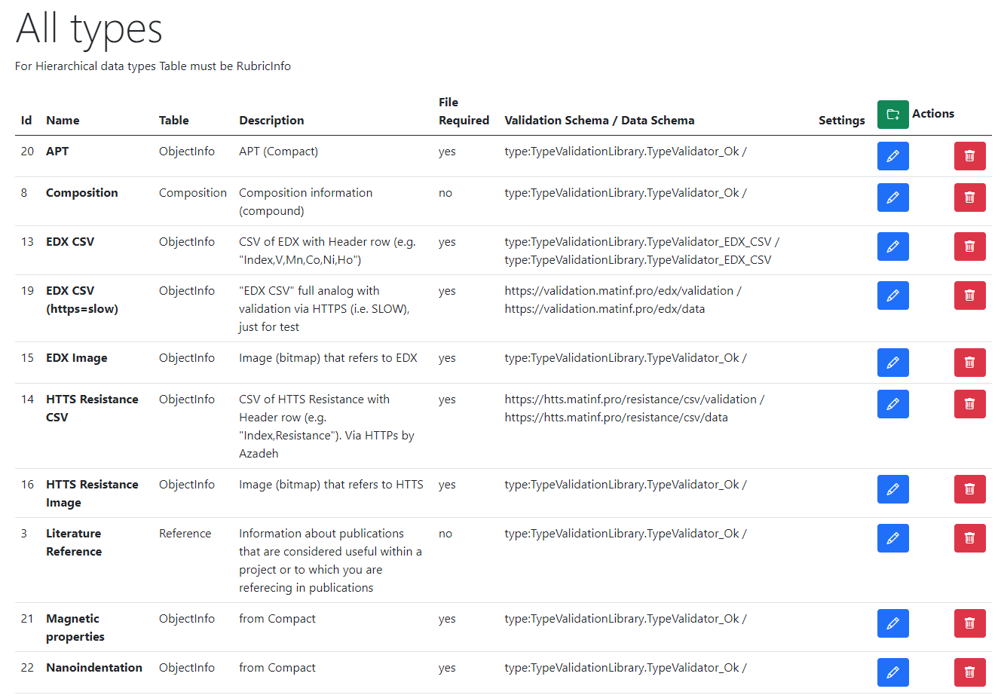
RDMS Extensibility: User-defined Object Types
Task: introduce new object types
New Data Type
Based on existing tables
(hierarchical and non-hierarchical)
New Data Structures
(new table & code to fit particular requirements)
Added by admin (UI)
Approximate time: 3 minutes
Just add a new object type specification (assign validator; data extractor; data visualizer, etc…)
To be done manually
Approximate time: 1 week
Tasks: develop and add new table; define read / write logic with respect to mandatory (or optional) fields and types; reflect to OOP model and provide consistency check (validators); develop import / export and search facilities, etc.
UI Customization: HTML / JS / CSS injection

Slide 11

COMPACT: You should NEVER do like this
All values are strings… no checks… which leads to weird values (3,3% cases)
The greatest hits:
Name | Value | Unit
pre clean time 4 | 11s | s
pre clean time 4 | 150 (total) | s
pre clean time 4 | 40+40+40+200 | s
pre clean time 4 | 4min | s
pre clean time 4 | 50s each step and 30 | s
pre clean time 4 | ramped, 150 total | s
pre clean time 1 | ca 300 | s
process duration | Ti(600s)/Pt(260s) | s
process duration | cca 7000 | s
process duration | Ni: 270, Pt: 180 | s
process duration | Ti(600s)/Pt(260s) | s
process duration | 8:30min | s
process duration | 900-x GV closed | s
process duration | 4h | s
process duration | 45min | s
process duration | 3:11:01 | s
process duration | 300s total (see comm | s
process duration | 25 loops | s
process duration | 17400(4h50min) | s
process duration | 125 and 1800 | s
flow RG 1 | 7.5-7.1 | sccm
end vacuum | Interlock! | Torr
end vacuum | $§% | Torr
Name | Value | Unit
load cathode 1 | 79% | %
pulse length cathode 1 | 40,10,40,10,40,19860 | µs
current cathode 4 | 0:36 | A
current cathode 4 | 0.42 (0.41) | A
current cathode 4 | 87 mA | A
peak current cathode 3 | 50; 45 | A
frequency cathode 4 | 10k | Hz
frequency cathode 3 | 10 kHz | Hz
frequency cathode 3 | 10K | Hz
A1 shutter position | - | mm
table height | 35(!) | mm
table height | 0 (min) | mm
table height | 5mm (Aufbau 20 mm) | mm
table height | lowered | mm
table height | lowest | mm
table height | min | mm
pre clean pressure cathode 2 | 2E-10 mbar | mTorr
pre clean pressure cathode 2 | 1.0E10-2 mbar | mTorr
process pressure | N2 | mTorr
deposition rate 3 | 0.248/5 | nm/s
deposition rate 3 | 0.242 x 20% | nm/s
substrate rotation | yes | RPM
substrate rotation | rotation | RPM
substrate rotation | on | RPM
substrate rotation | oscillation | RPM
substrate rotation | Off | RPM
substrate rotation | max | RPM
substrate rotation | auto | RPM
substrate rotation | fast | RPM
substrate rotation | 70% | RPM
substrate rotation | 41 (max auf Skala) | RPM
substrate rotation | ? | RPM
Name | Value | Unit
voltage cathode 3 | 5i9oui | V
voltage cathode 3 | 98-->114 | V
voltage cathode 3 | 4-5 | V
voltage cathode 3 | 700-720 | V
voltage cathode 3 | 643; 660 | V
voltage cathode 2 | "0V" | V
voltage cathode 2 | 200...271 | V
pre clean power 6 | 200 (ramped 50/100/1 | W
pre clean power 6 | 50/100/150/200 | W
pre clean power 6 | ramped up to 200 | W
pre clean power 6 | ramped until 200 | W
power cathode 3 | 109 (115 set) | W
power cathode 3 | 30W | W
power forward cathode 2 | set180 (178) | W
pre clean power 2 | ramp | W
pre clean power 2 | 244V, 0.249 A | W
ignition power cathode 1 | xy | W
ignition power cathode 1 | 5o | W
power cathode 2 | 124 (130 set) | W
power cathode 2 | 20/30 | W
power cathode 2 | 48 (local) | W
https://en.wikipedia.org/wiki/Data_type

Slide 12
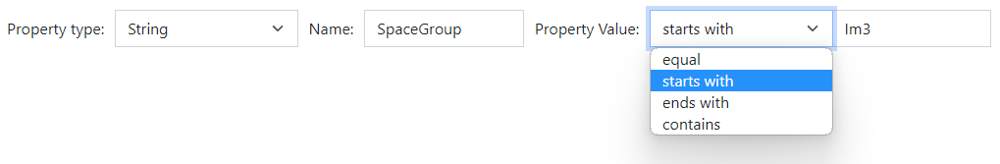
RDMS: Extended Properties (the basics)
All values are to be stored using appropriate data types!
DEFINITION: Data type is a collection or grouping of data values, usually specified by a set of possible values, a set of allowed operations on these values, and/or a representation of these values as machine types.
Supported data types (and their visualization in the search form):
Int – integer values (64-bit signed integer) in range [-9 223 372 036 854 775 808; 9 223 372 036 854 775 807].
Float – double-precision floating-point (8 bytes, IEEE-754), ±5.0×10⁻³²⁴ to ±1.7 × 10³⁰⁸ (~15 significant digits).
String – any characters sequence no longer than 4096 symbols.
BigString – any characters sequence no longer than 2 147 483 647 symbols (2 Gb).
https://en.wikipedia.org/wiki/Data_type

Slide 13
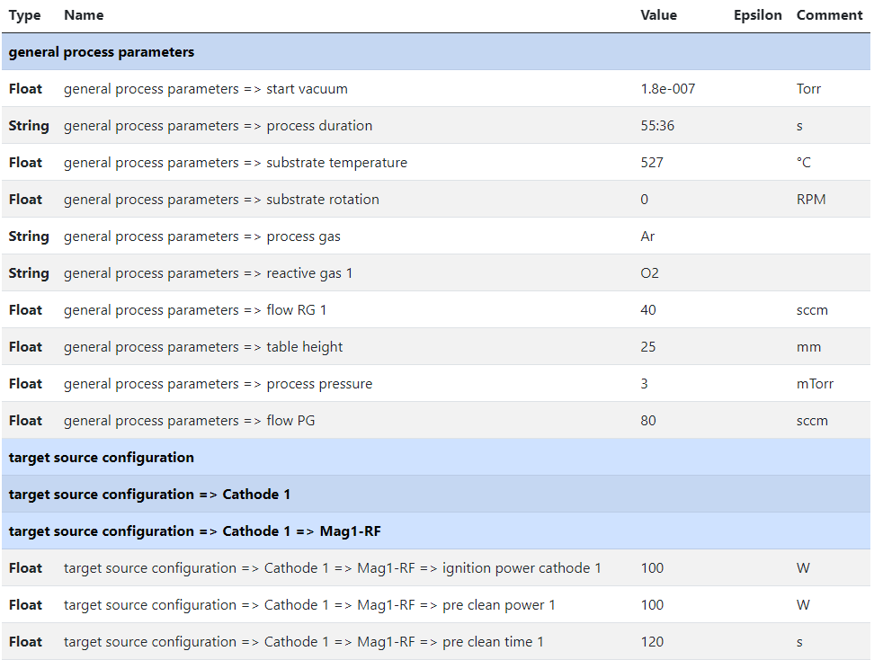
RDMS Object‘s Flexibility: Extended Properties
Measurement Units
Use case: add additional properties values to object and afterward make search on them.
Task: associate typed properties with object Synthesis parameters
Values Types
Separators
(logical blocks)
SortCode
https://crc247.mdi.ruhr-uni-bochum.de/object/synthesis-for-sample-8220-co-deposition-221111-k3-3-1922

Slide 14
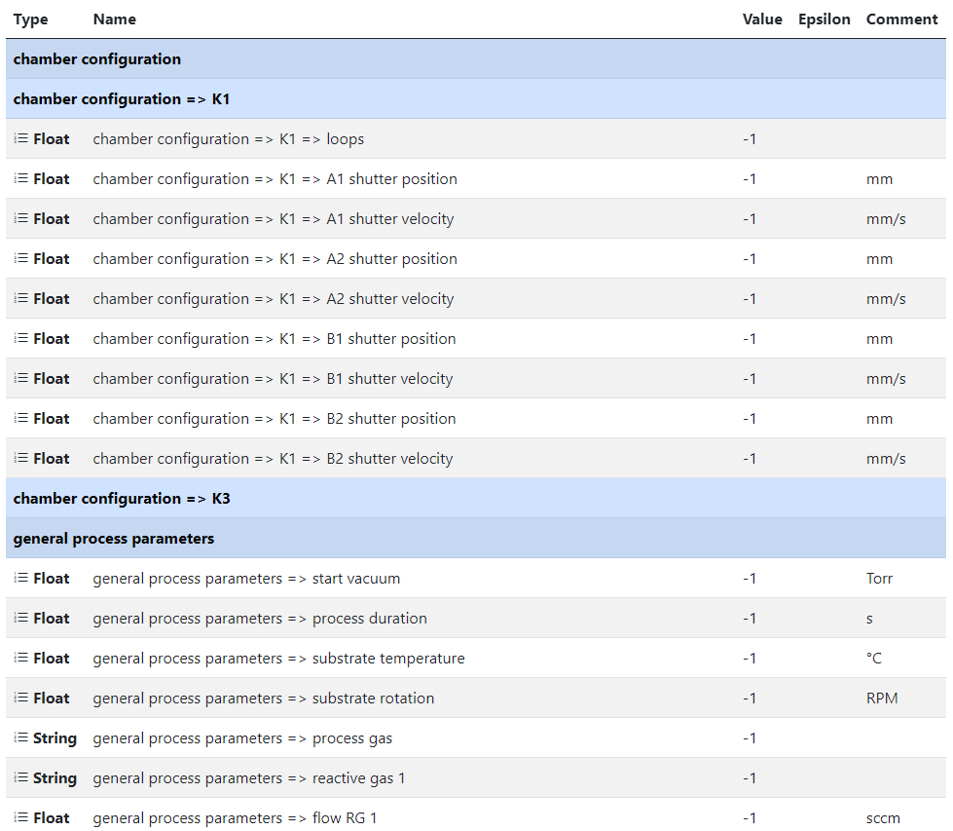
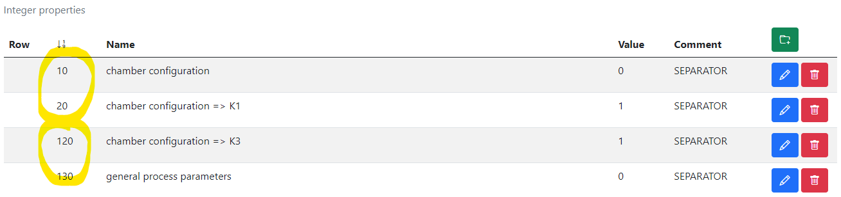
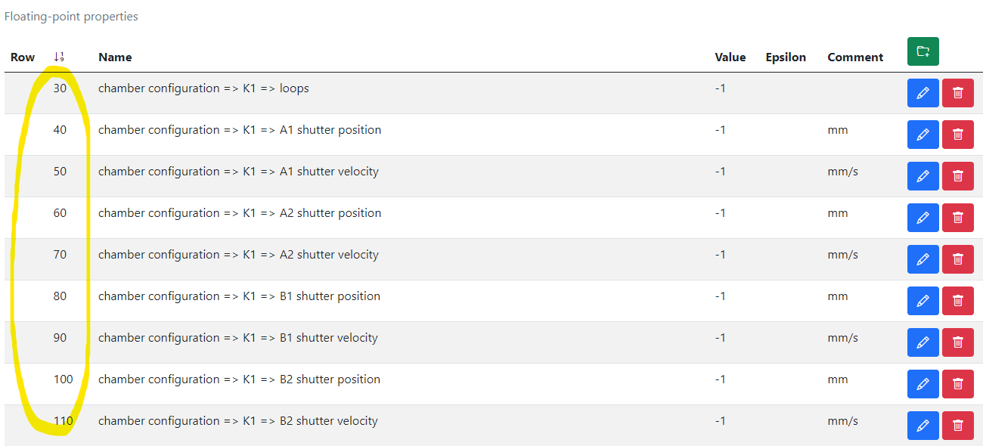
RDMS Extended Properties: Defining Template
Measurement Units
Use case: to facilitated data edit we need to template extended properties for specified.
Task: create template for synthesis parameters => create object with “_Template” name.
1) Create separators, blue captions to create named sections (Comment == SEPARATOR)
2) Create placeholders (float, int, string)
https://crc247.mdi.ruhr-uni-bochum.de/adminobject/edititem/1956/?returl=%2Fobject%2F_template-1956
https://crc247.mdi.ruhr-uni-bochum.de/object/_template-1956

Slide 15
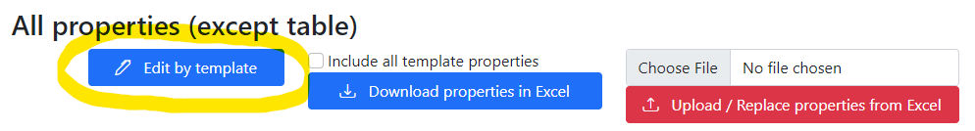
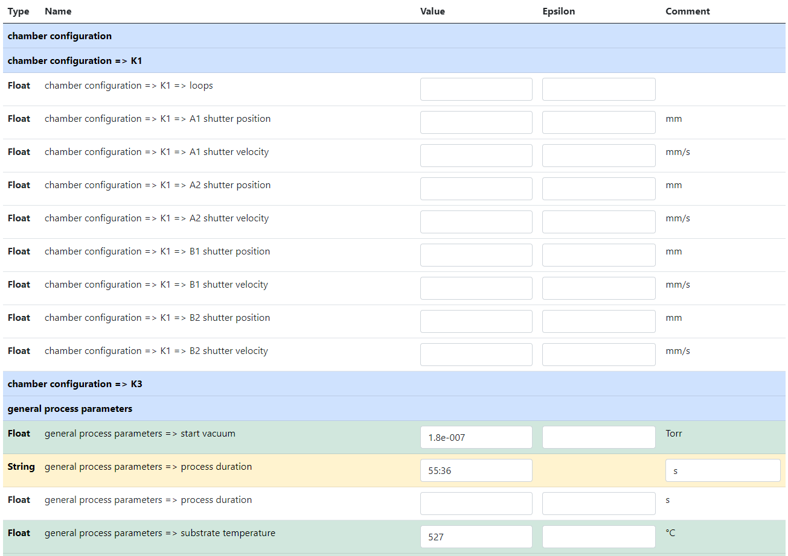
RDMS Extended Properties: Using Template to fill in data
Use case: take advantage of created template during data input.
Task: edit synthesis properties.
Empty values
(white)
Values Types
SortCode
Separators
(logical blocks)
Filled values
(green)
Out of template values
(yellow)
https://crc247.mdi.ruhr-uni-bochum.de/object/synthesis-for-sample-8220-co-deposition-221111-k3-3-1922
https://crc247.mdi.ruhr-uni-bochum.de/properties/edititem/1922

Slide 16
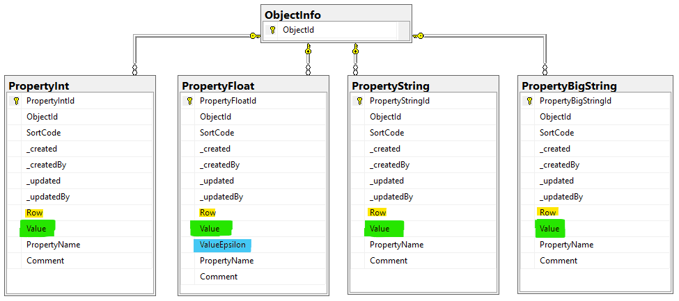
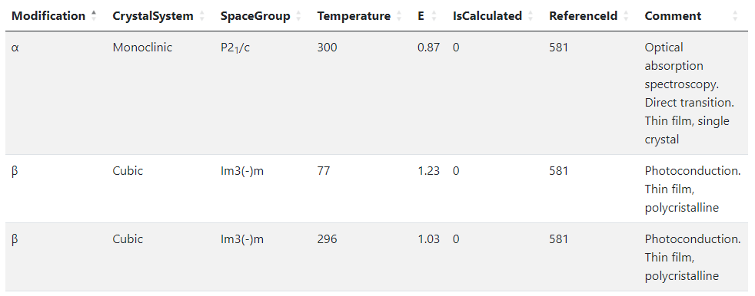
RDMS Object‘s Flexibility: Extended Properties (table data)
Use case: add additional properties values (or even a table) to object and afterward make search on them.
OR
When the existing fields set is not enough…
Task: associate table with object
Row=1
Row=2
Row=3
String x3
Float x2
Int x2
String
Solution: Decompose the table so, that each cell value is stored in Property* table according to cell value type.
Important attributes:
PropertyName – contains column name
Value – contains cell value
Row – contains row number (1, 2, 3, …). If no row number specified – value is threated as object’s property
User view: https://demo.mdi.ruhr-uni-bochum.de/object/ag2s-4870
Admin view: https://demo.mdi.ruhr-uni-bochum.de/adminobject/edititem/4870

Slide 17
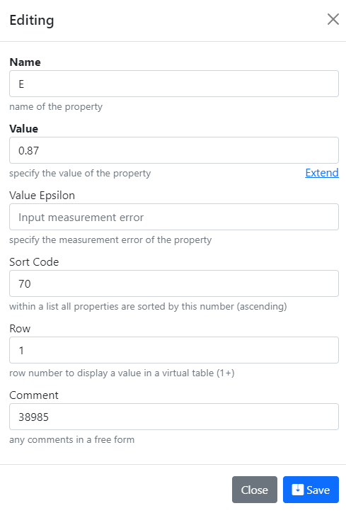
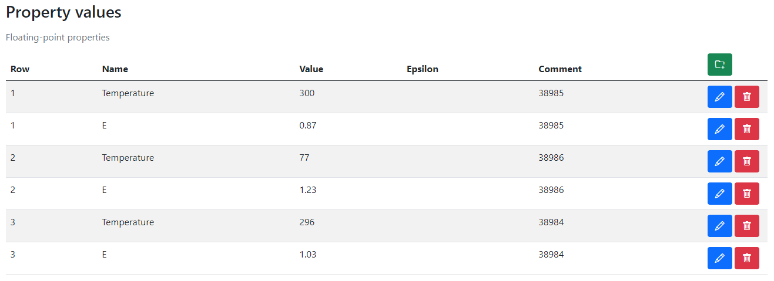
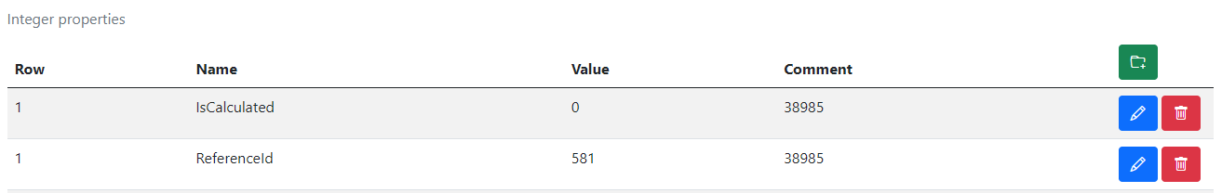
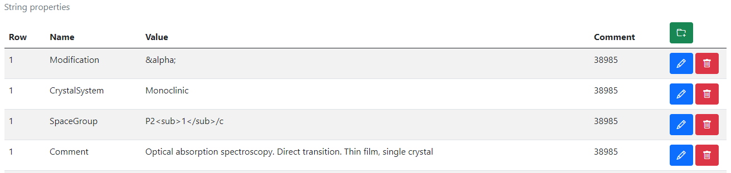
RDMS Extended Properties Control
Extended Properties Control for object is available according to the object access managements in administration panel for objects.
User view: https://demo.mdi.ruhr-uni-bochum.de/object/ag2s-4870
Admin view: https://demo.mdi.ruhr-uni-bochum.de/adminobject/edititem/4870

Slide 18
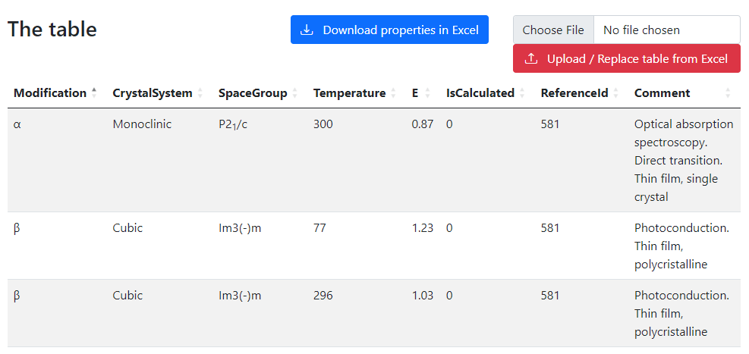
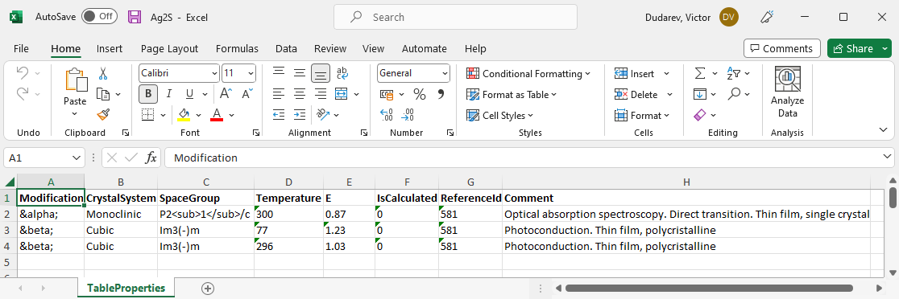
RDMS Extended Properties: Export and Import
Task: make properties modification easy
Steps:
Download data
Open in Excel and edit
Upload changed data back to the RDMS
Import
(requires permissions)
https://demo.mdi.ruhr-uni-bochum.de/object/ag2s-4870
Export
https://demo.mdi.ruhr-uni-bochum.de/object/ag2s-4870

Slide 19
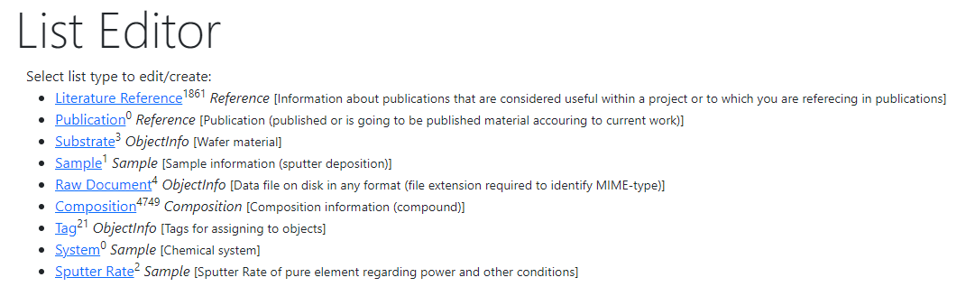
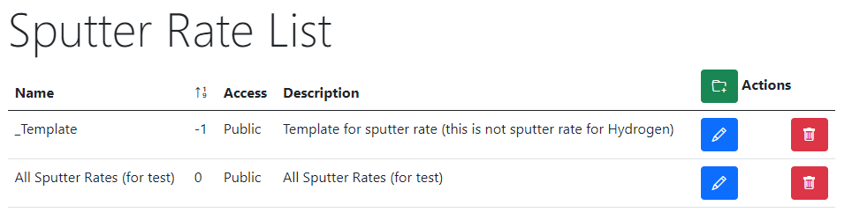
RDMS Extended Properties: Table Templates for data types
Task: define Table Template for properties
with respect to particular type
Steps:
After creating a data type (e.g. based on existing table) create a “_Template” object of given type: https://demo.mdi.ruhr-uni-bochum.de/adminobject/list/11
Add Columns of desired table to corresponding Properties (w.r.t. data type: Float / Int / String / BigString) with Row=-1 – predefined template:
https://demo.mdi.ruhr-uni-bochum.de/adminobject/edititem/6650
Create a new object and in UI press “Download properties in Excel” button: https://demo.mdi.ruhr-uni-bochum.de/object/all-sputter-rates-for-test-6651 to get template in Excel
Modify template in Excel file and upload the data: https://demo.mdi.ruhr-uni-bochum.de/object/all-sputter-rates-for-test-6651 (test passed: 16 columns and 468 rows)
https://demo.mdi.ruhr-uni-bochum.de/object/all-sputter-rates-for-test-6651
https://demo.mdi.ruhr-uni-bochum.de/object/_templatesputterrate

Slide 20
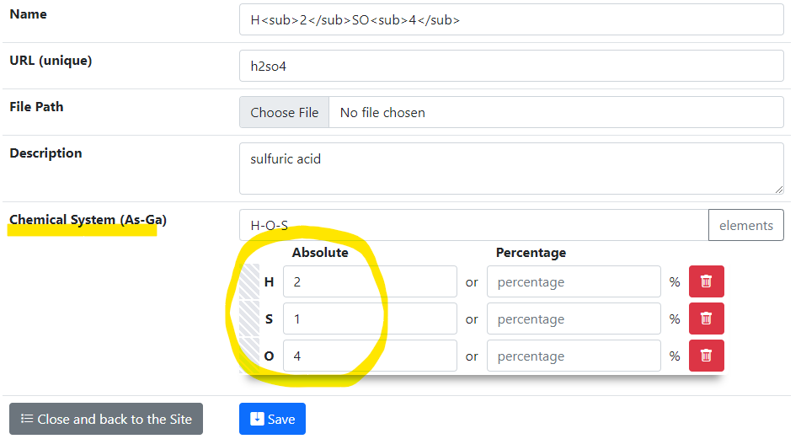
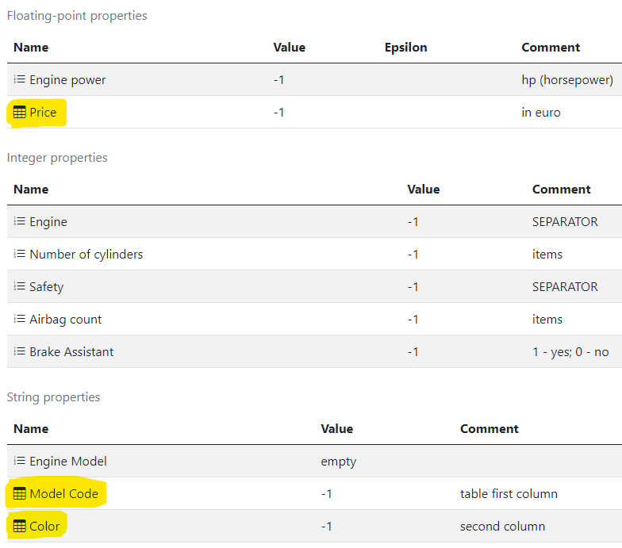
Demo_1 Goal: Create type for Compositions
Task: Create type for Compositions with a template (for properties and tables)
Target interface: Template specification:

Slide 21
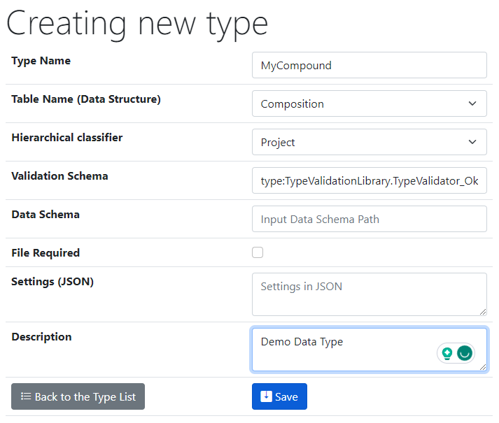
Demo_1: Edit form for properties
Task: Create a new type (Administrator role): List Edit => Control Types
Base (inherited functionality)
Basic validator (ok)

Slide 22
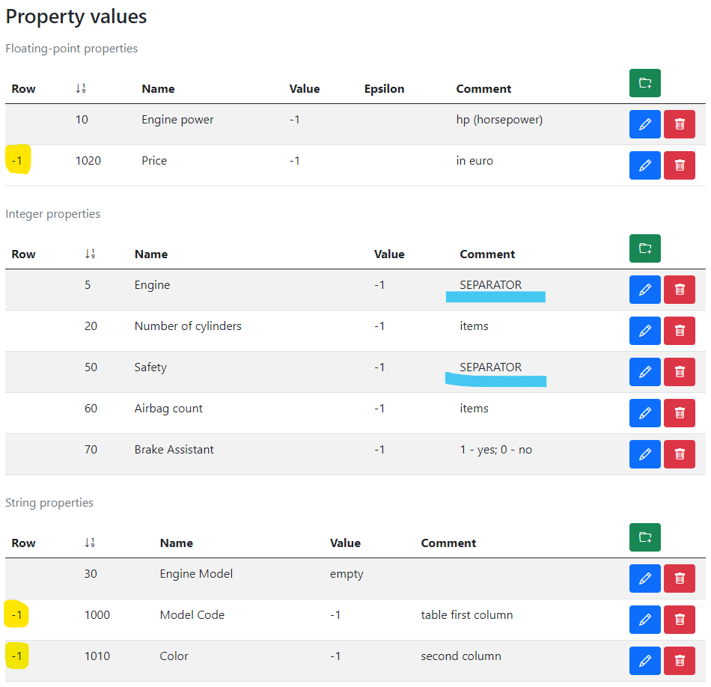
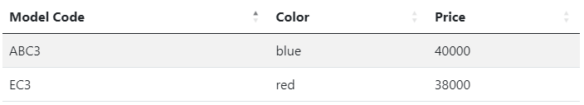
Demo_1: Hands on the labs!
Sort Code
Task: Define properties set in _Template
Table Properties
Other
(non-table)
properties
Separators
Table example (according to template)

Slide 23
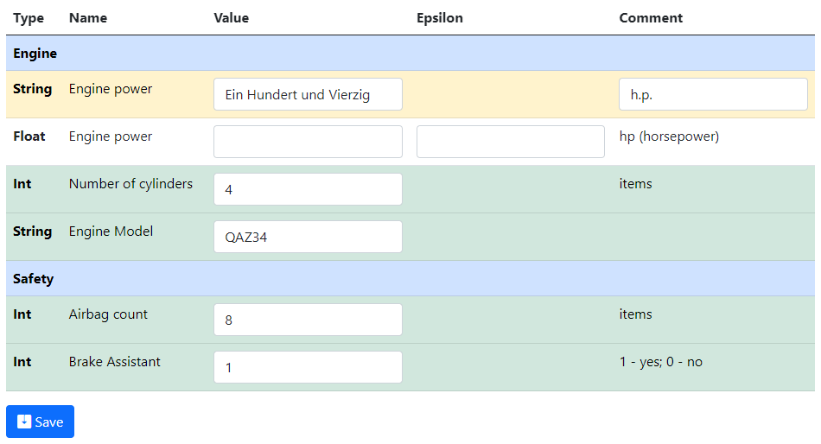
Demo_1: Edit form for properties
Task: Edit properties in new objects according to the template
Separators
Property (out of template)
Missing value
Filled values (according to template)
TO DO: Create a new object of your type and fill in properties values

Slide 24
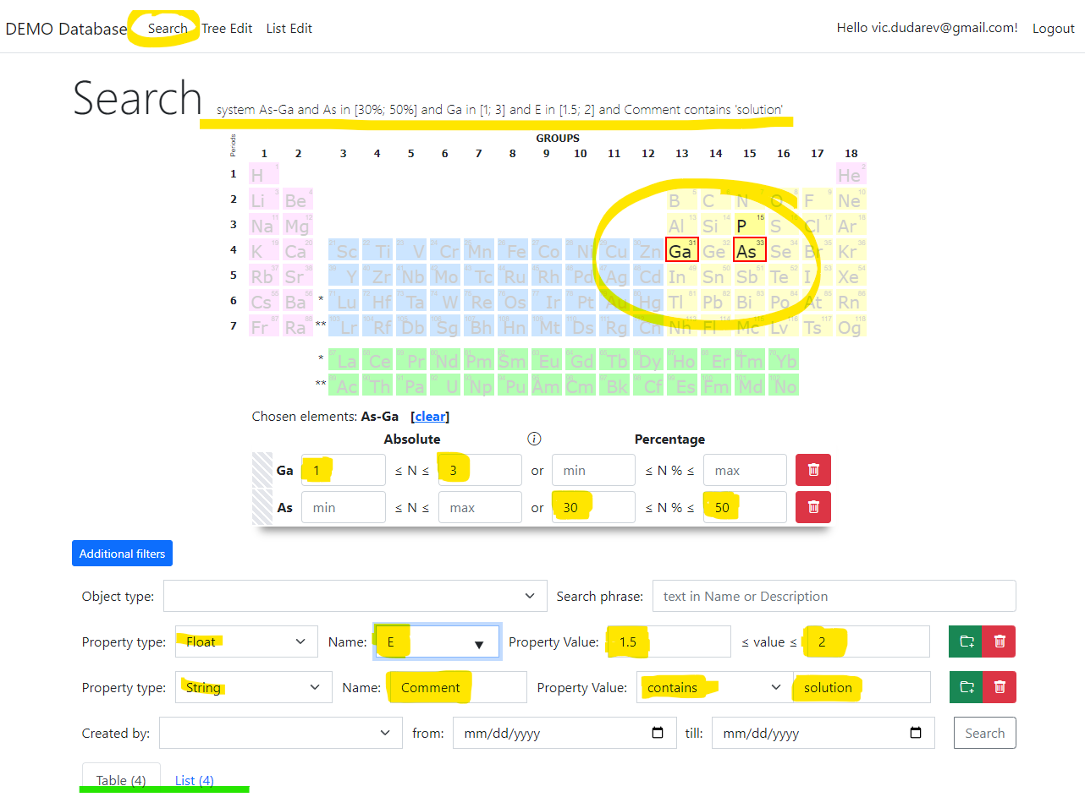
RDMS: Search
Search on:
Chemical system
Composition
Object type
Phrase in object’s Name or Description
Properties values (all available within tenant)
Person created
Creation date
Important feature:
persistent URL on search (share search results easily by URL*).
* - respecting current security context
Task: make properties modification easy
TO DO: search for your created object
https://demo.mdi.ruhr-uni-bochum.de/search/
https://demo.mdi.ruhr-uni-bochum.de/search/?system=As-Ga&typeid=8&Aspctmin=30&Aspctmax=50&Gaabsmin=1&Gaabsmax=3&pr0name=E%3Csub%3Eg%3C%2Fsub%3E&pr0type=Float&pr0min=1.5&pr0max=2&pr1name=Comment&pr1type=String&pr1max=3&pr1str=solution&prcnt=2
https://demo.mdi.ruhr-uni-bochum.de/search/?system=As-Ga&typeid=8&Aspctmin=30&Aspctmax=50&Gaabsmin=1&Gaabsmax=3&pr0name=E%3Csub%3Eg%3C%2Fsub%3E&pr0type=Float&pr0min=1.5&pr0max=2&prcnt=1

Slide 25
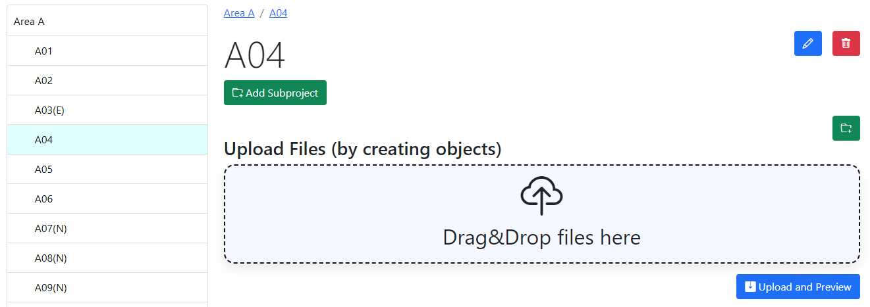
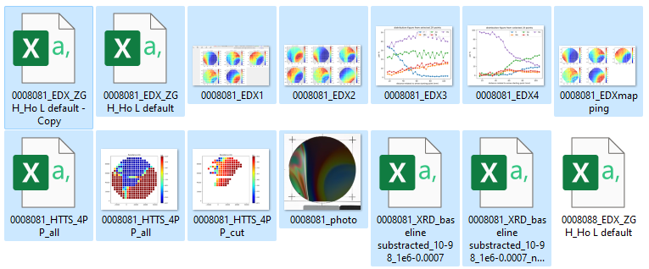
RDMS DropZone Tasks: Batch Data Validation & Import
Task: validate documents & import data
Implemented Features:
Automatic type detection;
Uniqueness check;
Data validation (build-in + external);
Data import.
TO DO: Drag&Drop files to create objects in batch!

Slide 26
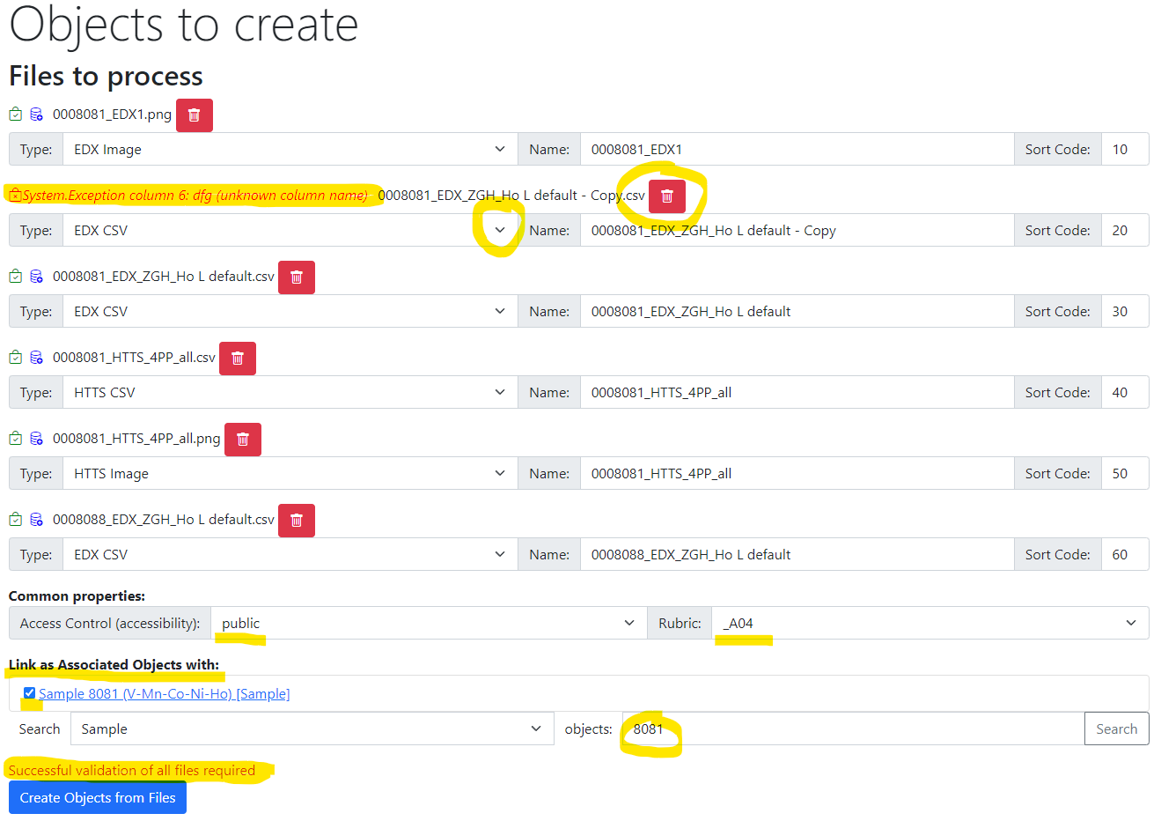
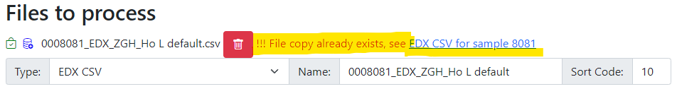
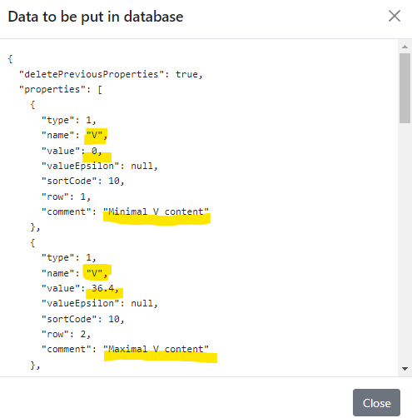
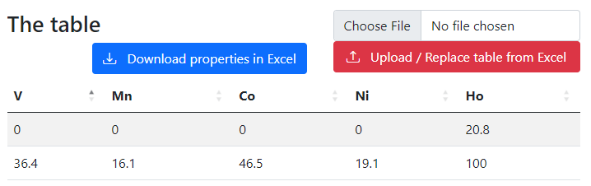
RDMS DropZone: Staged Files (before import)
Check for unique documents (based on SHA256 hash):
Check data to import:
Properties
(after import):
Workflow:
- validate every file;
- check/adjust all properties;
- Import files.

Slide 27
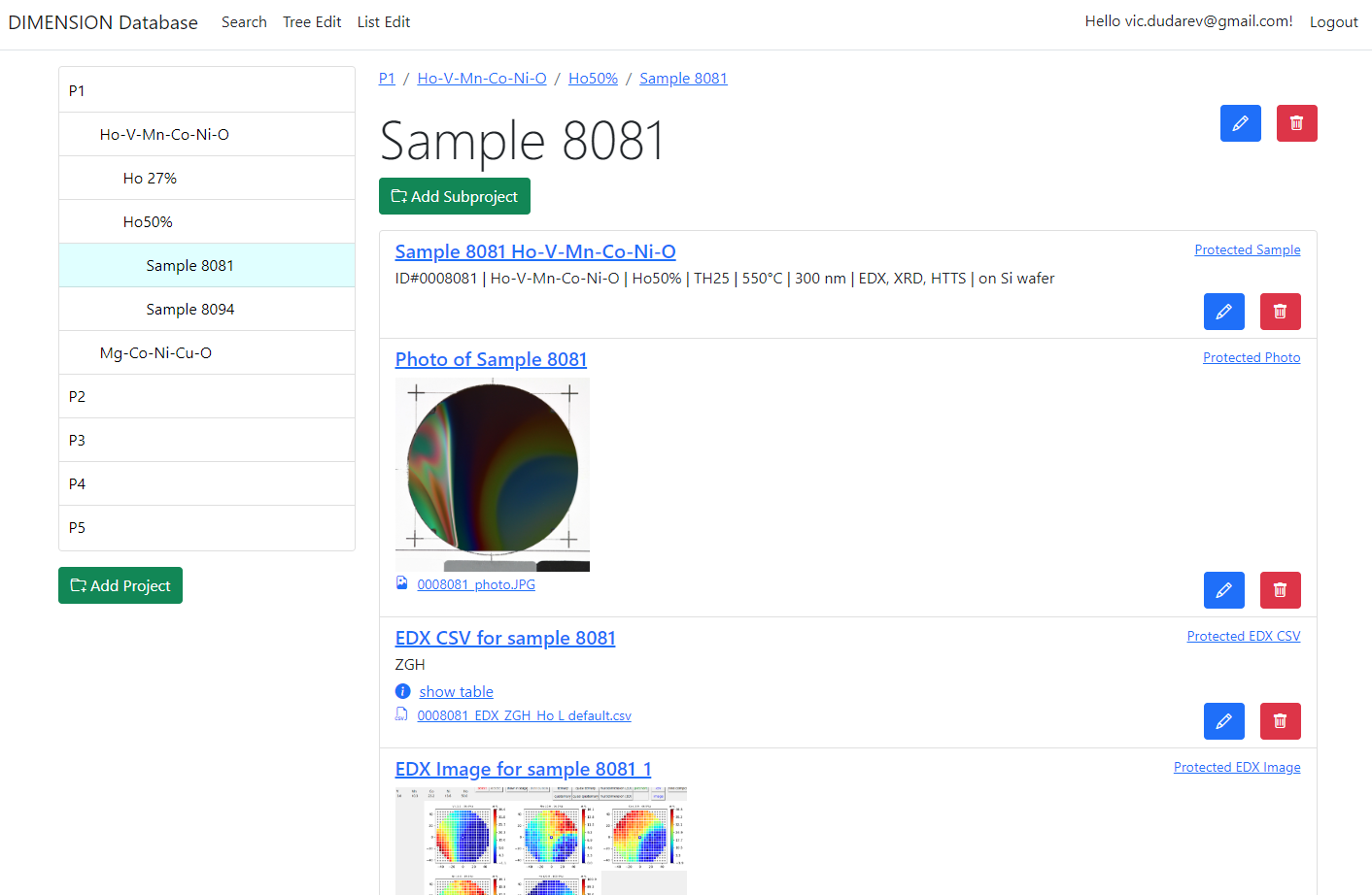

RDMS: Created Objects
After import:
- check all created objects (names, access level, etc…);
- share a link.

Slide 28
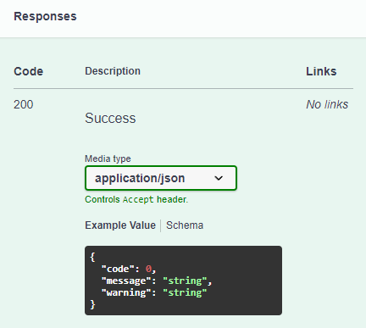
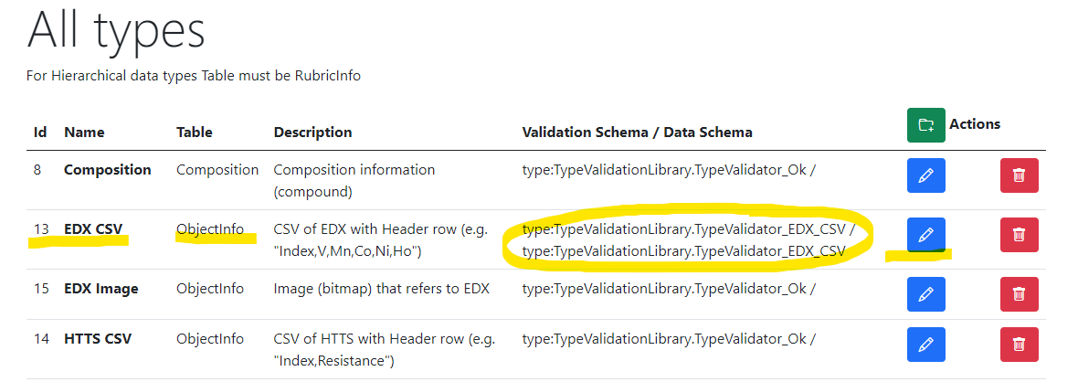
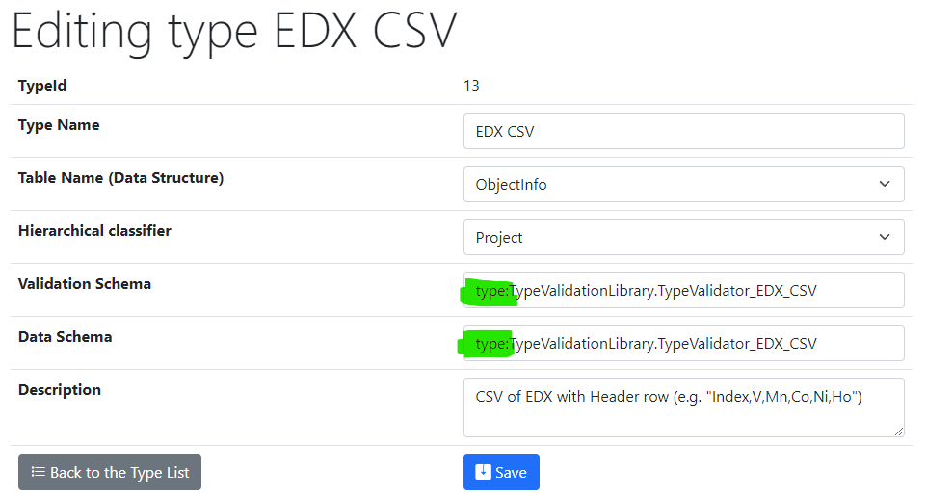
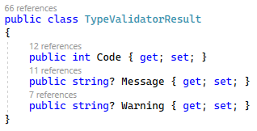
RDMS Extensibility: Type Configuration and Flexibility
Task: introduce new types and configure them (validation and data import)
Validation & Data Schema Protocols:
type: built-in type (object instantiated by class name);
https: URL to a REST Web Service (OpenAPI specification).

Slide 29
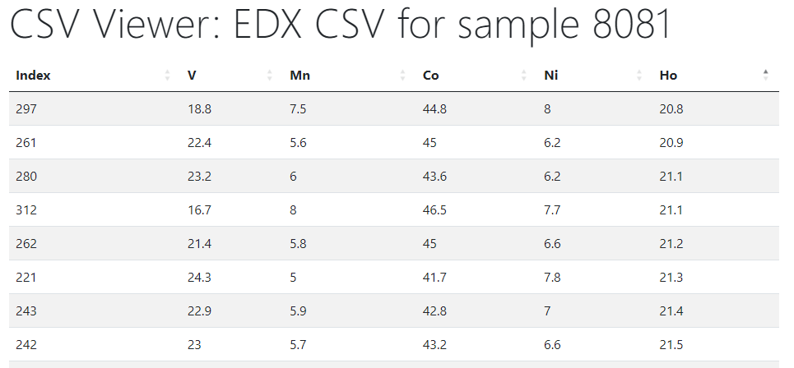


RDMS: CSV Visualization
Materials Library Visualization
Configurable XY-charts
https://dim.mdi.ruhr-uni-bochum.de/file/csv/6691

Slide 30
Thanks for your kind attention
Demonstration
Q&A
Victor Dudarev
Victor.Dudarev@rub.de
https://vdudarev.ru

