Slide 1
Project INF:
“Research Data Management –
State of the Art”
Victor Dudarev, Alfred Ludwig

Slide 2
Agenda
    Funding Period 1 Data: Recovery Status
    Hardware INFrastructure
    INF Workshop (7-9 Nov 2023)
    User-Defined Object Type & Customization
    Templates
    Sample Transformation Workflow
    Tracking Samples (Handover Event)
    Reports & Statistics
    Use case: Project -> Sample -> EDX -> Resistance
    Q&A
EDX - Energy-Dispersive X-ray spectroscopy

Slide 3

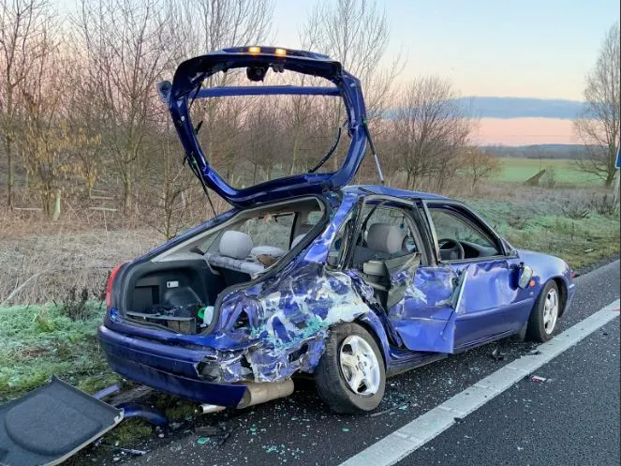

Funding Period 1 Data: Access Request
Request: please, provide an access to the FP1 virtual machine
Expectations Reality
Response: we finally have received the files that were on the Server. The ZIM provided us with an archive file of the entire drive. Since the virtual servers were affected by the hack and got encrypted, they made us aware that some files are in the folder "lost+found" since they couldn't be restored in their original position. I hope the archive will provide the Data you need (+ 59 Gb of files)
Official Response from 8 November 2023

Slide 4
Funding Period 1 Data: Full Recovery Probability
Current status: not runnable (corrupted) disk image.
Investigation results:
footprints of Ubuntu 18.04.6 LTS OS
footprints of Postgree SQL v10 RDMS
footprints of Django v 2.1
valid Postgree SQL backup as of 14.10.2023:
- database structure is reverse engineered (743 Sample; 595 Experiments; 141 Documents)
- conversion to the new system is being done
Estimations: at least recovery to the state as of 14.10.2023 (probably as of shutdown), w.r.t. lost files (should be done during spring 2024).
OS – Operating System
RDMS – Relational Database Management System

Slide 5
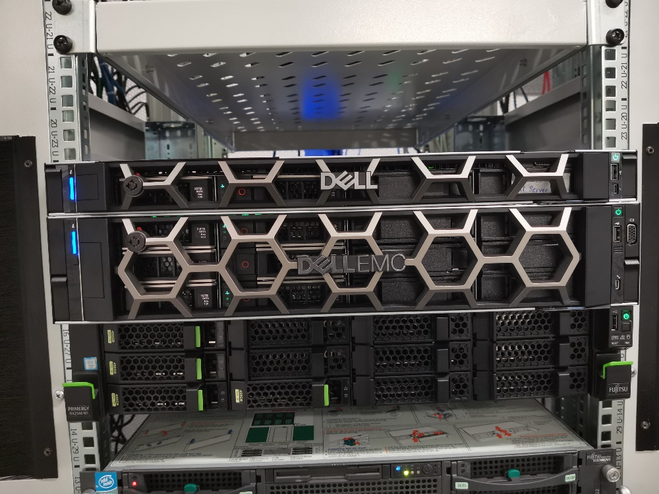
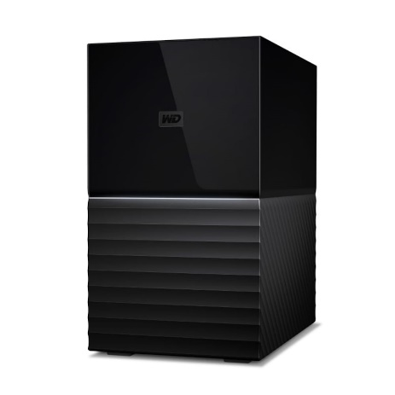
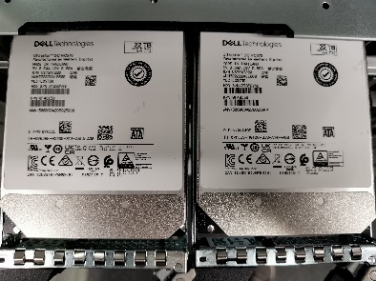
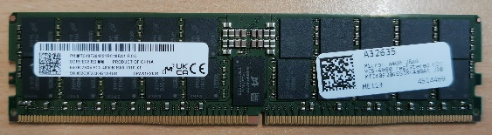

IT Infrastructure: current status
Our own CRC/TRR 247 IT infrastructure (from 2022):
2U Dell PowerEdge R750 (42 Tb RAID 5)
External Backup: WD My Book Duo (21 Tb)
Currently used (CRC/TRR 247): 9 Gb of 42 Tb
Bought in 2023 (backup server):
1U Dell PowerEdge R6615 (basic server)
INFrastructure plans this year:
upgrade 1U backup server (more storage & RAM)
            +
provide disaster tolerance (collocation)
Everything runs 24x7 on a dedicated VM within a new server (INF funding).
All data are backed up weekly on a dedicated external backup device.
No disaster tolerance: all devices are physically in a single server room.

Slide 6
Collocation requirements (for 1U Dell PowerEdge R6615)
Backup server collocation in other building/university (DUE?)
Requirements for collocation:
1) 1 Unit place in the server rack (the smallest unit size available)
2) 2 x 220V power sockets for redundant power supply
3) two Ethernet sockets (RJ-45) to connect the server:
first is for KVM - remote control (could be slow connection even 100 Mbit port is fine)
second is for HOST/VMs - at least 1 Gigabit (better 10 Gigabit) Ethernet socket
4) 3 x IPv4 IP-addresses (KVM, HOST, VM)
5) access to ACL / Firewall management (ability to open certain ports for provided IP-addresses for some networks)
6) an opportunity to negotiate a physical access to server (probably accompanied by some authorized personnel) in case of hardware failure / technical maintenance
1U server collocation barter:
we give our 1U server to your DC
we place your 1U server in our DC
KVM – Keyboard, Video, Mouse (Remote access)
VM – Virtual Machine
DC – Data Center (Server Room)

Slide 7
INF RDMS Workshop (7-9 November 2023)
Talks on research data management:
Introduction: importance of research data management (by Irina Roslyakova)
Overview of RDMS infrastructure for CRC 247
Overview of CRC 247 database and use cases
Object Type Support Request on example of C04 (EDX Data)
Use Case: how to manage project tree and add your data
Use Case: how to create a user-defined object type and configure a template
Practice sessions:
Hands-On 1: each project tries to add their data in CRC 247 RDMS
Hands-On 2: each project tries to search for data from partner projects
Data types matrix:
https://docs.google.com/spreadsheets/d/1F-lAFeeYF2I3komTPoLZJjhnWz5VhXwC/edit?usp=sharing&ouid=117346421118620353373&rtpof=true&sd=true
RDMS – Research Data Management System

Slide 8

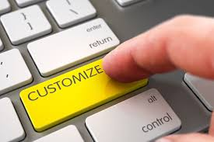
What about customization?
Basic (no-code)
  Introducing User-Defined Data Types:
    List templates
    Table templates
Simple (client-side code only)
  Page-code injection:
    HTML
    Javascript
    CSS
Complex (client- & server-side code)
  INF-code adjust (ASP.Net Core App)
    C#
    SQL
    HTML/Javascript/CSS

Slide 9
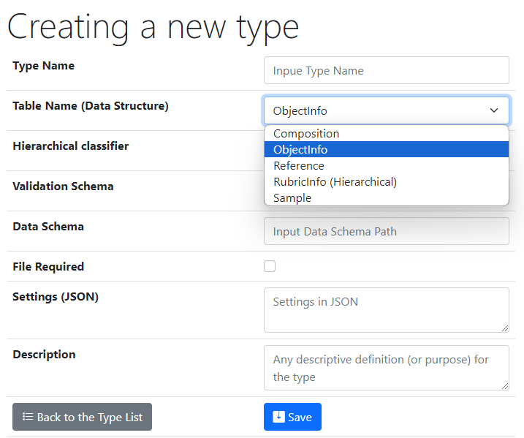
UI to create a new user-defined type
Type Name – user-defined type name
Core Object Types:
ObjectInfo – the simplest (bare) object
Sample – chemical system (set of chemical elements), for example Co-O
Composition – chemical composition (set of elements and quantities), for example Co₃O₄
Reference – literature reference (Authors, Title, Year, DOI, etc.)
Validation & Data Schema – only if you have external Web Services ready to validate & extract data from files
File Required – sets the file mandatory
Settings (JSON) – customization of type for RDMS
{ "CustomEditPath": "/custom/editsample",
"UrlPostVisualizer": "https://abc.de/VisualizeRT" }
Description – comments for type designation
We can further enrich defined object specification by customized (templates!) properties of primitive types: Integer, Float, String.

Slide 10
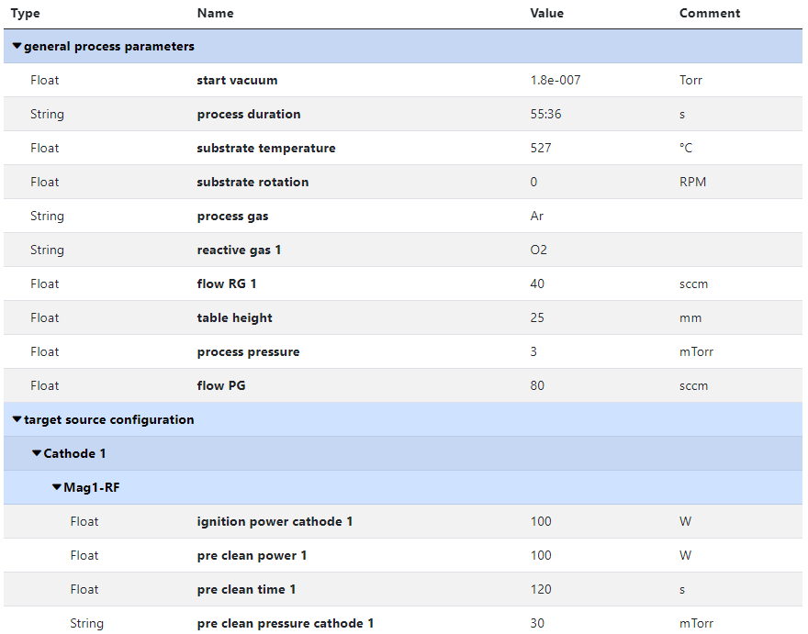
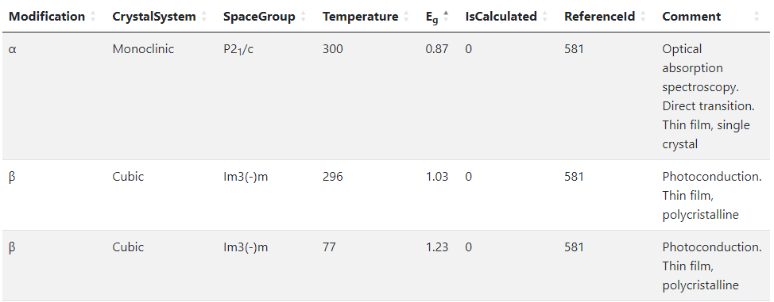
RDMS Templates for type
Template
List
(specify sorted properties list with separators)
Create an object with “_Template” name
Specify properties set
Table
(specify table structure: columns & types)
Data in a table with predefined structure
Key-value pairs
https://crc247.mdi.ruhr-uni-bochum.de/object/synthesis-for-sample-8220-co-deposition-221111-k3-3-1922
https://demo.mdi.ruhr-uni-bochum.de/object/ag2s-4870

Slide 11
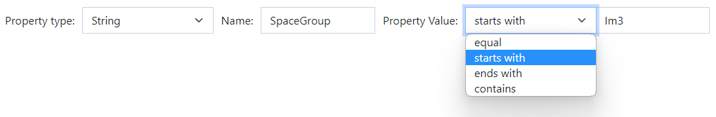
RDMS: Extended Properties (the basics)
All values are to be stored using appropriate data types!
DEFINITION: Data type is a collection or grouping of data values, usually specified by a set of possible values, a set of allowed operations on these values, and/or a representation of these values as machine types.
Supported data types (and their visualization in the search form):
Int – integer values (64-bit signed integer) in range [-9 223 372 036 854 775 808; 9 223 372 036 854 775 807].
Float – double-precision floating-point (8 bytes, IEEE-754), ±5.0×10⁻³²⁴ to ±1.7 × 10³⁰⁸.
String – any characters sequence no longer than 4096 symbols.
BigString – any characters sequence no longer than 2 147 483 647 symbols (2 Gb).
https://en.wikipedia.org/wiki/Data_type

Slide 12
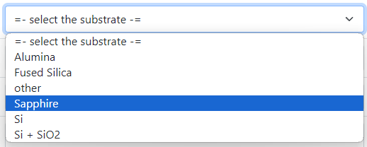

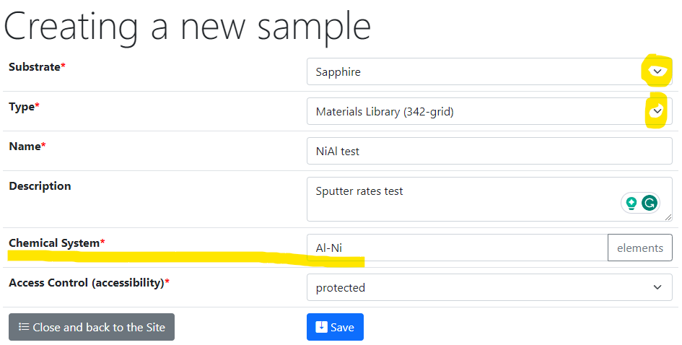
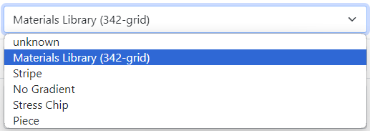
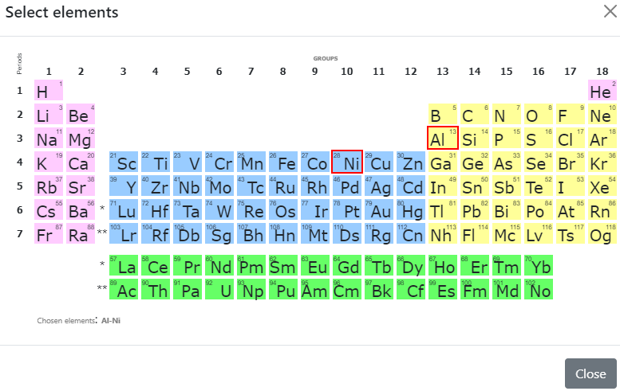
Sample Customised Form
List from subproject
- Customised sample input
List from JS-template
Standard chemical system
Customisation with UI form / JS
https://crc247.mdi.ruhr-uni-bochum.de/custom/editsample/0/?idr=179&returl=%2Frubric%2Farea-c_c04

Slide 13
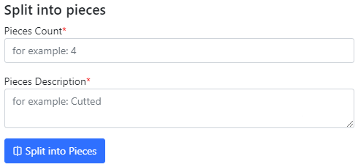
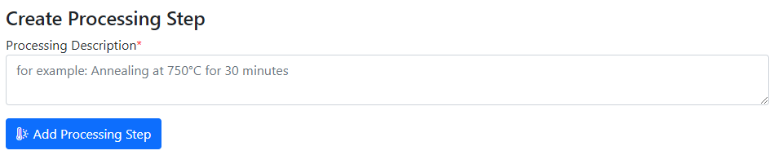
Use Case: Sample Transformation Workflow
Create Processing State & Split Sample
Sample_2a_2
(subsample 2a state 2)
polishing
Documents2a_2
Sample_2a
(subsample 2a)
annealing
splitting
Sample_2b_2
(subsample 2b state 2)
Sample
(initial state)
Sample_2
(changed state 2)
oxidation
Sample_2b
(subsample 2b)
documents
documents2
Documents2b_2
https://mdi.matinf.pro/custom/editsample/43508/?idr=2748&returl=%252Frubric%252Ftest

Slide 14
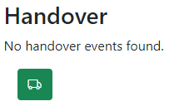
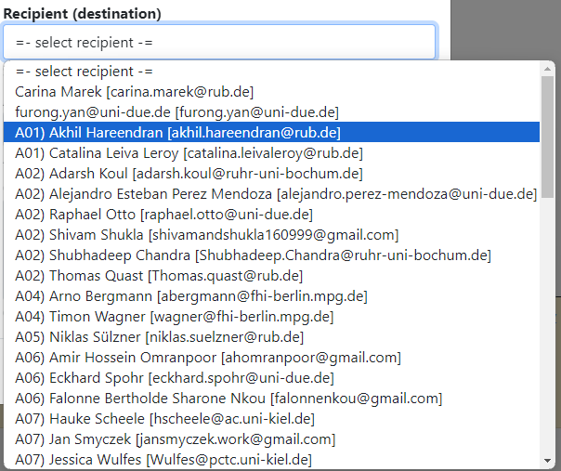
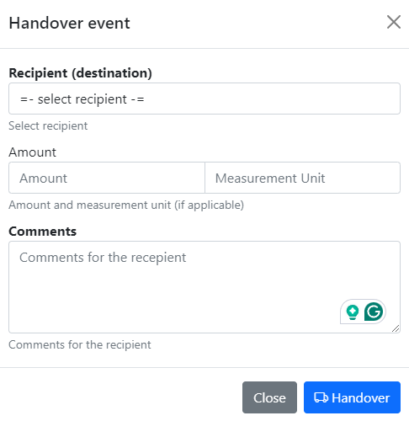
Tracking Samples or Handover event: initialisation
In “physically transferrable” objects (samples), find a green handover button
Select the recipient and press a blue button.
Select recipient
Specify Amount (optional)
Specify Comments
click

Slide 15
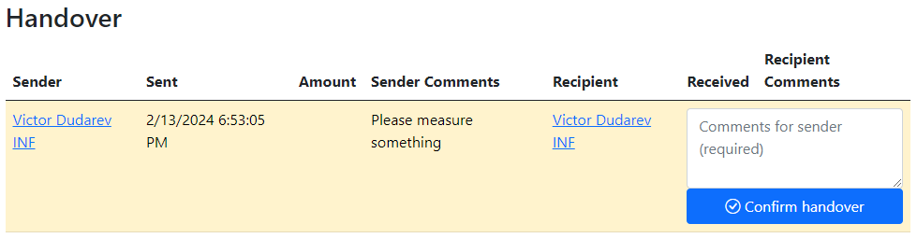
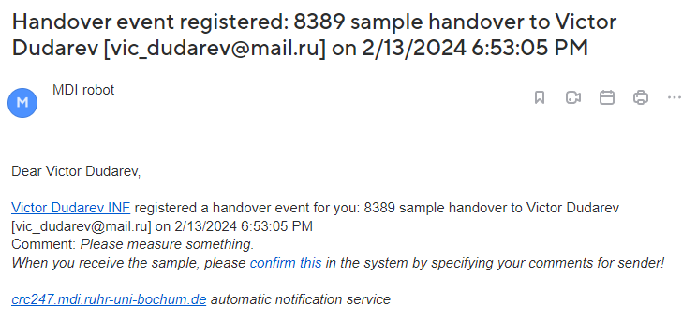
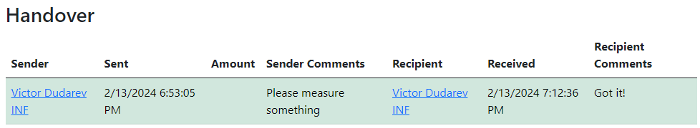
Tracking Samples or Handover event: delivering / delivered
Handover event is created
Recipient is notified by e-mail
3) Recipient should add comments and confirm the handover.
4) Confirmed
+ e-mail notification for sender

Slide 16
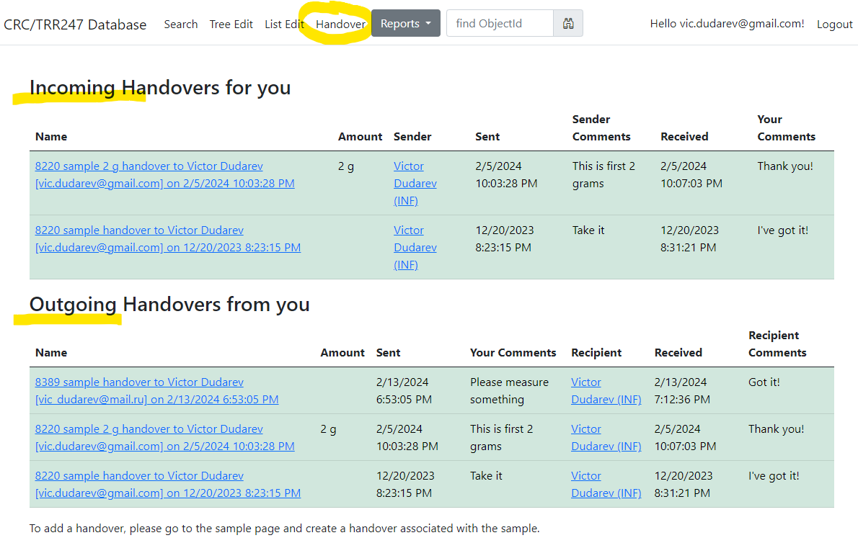
Tracking Samples or Handover event: user overview
Incoming
Outgoing
https://crc247.mdi.ruhr-uni-bochum.de/handover

Slide 17
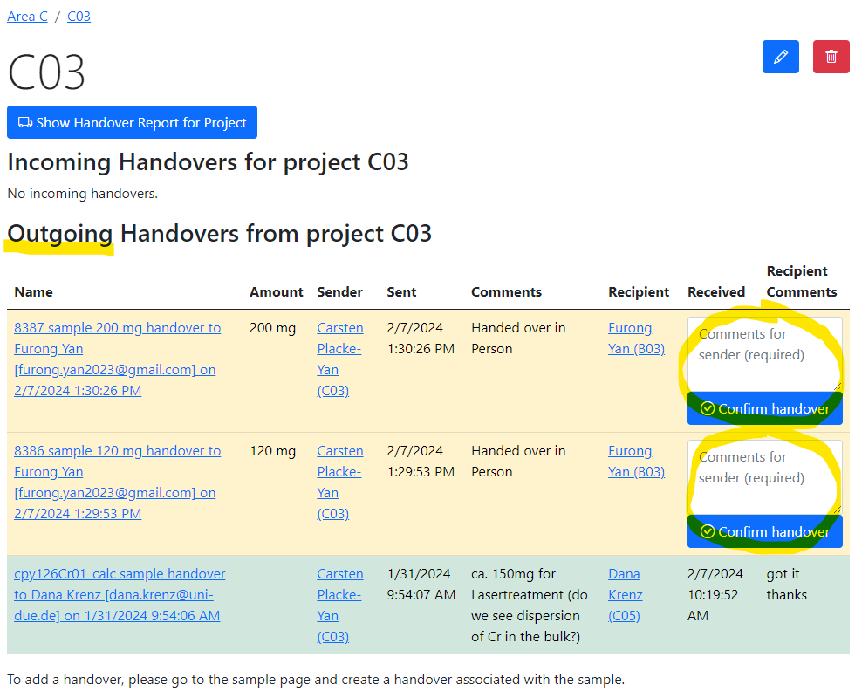
Tracking Samples or Handover event: project overview
Pending handovers (unconfirmed)
Successful handover
https://crc247.mdi.ruhr-uni-bochum.de/rubric/area-c_c03

Slide 18

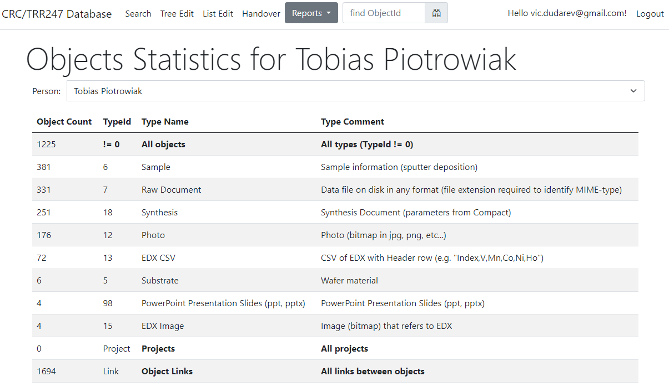
Reports & Statistics: Objects
Objects Statistics:
Objects (w.r.t. types)
Projects
Object Links
Feature:
Filter by person
https://crc247.mdi.ruhr-uni-bochum.de/report/objectsstatistics

Slide 19
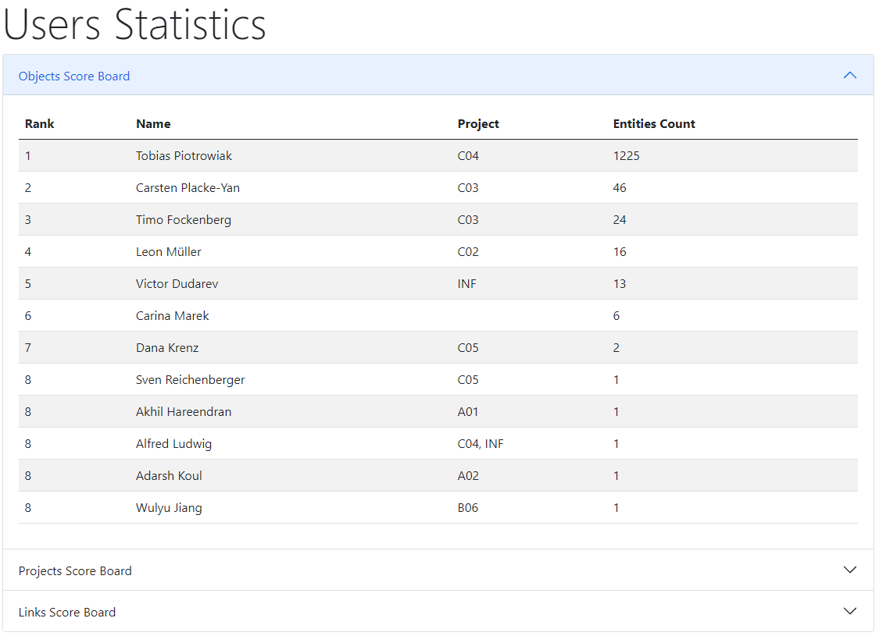

Reports & Statistics: Users
Users Statistics:
Objects
Projects
Links
https://crc247.mdi.ruhr-uni-bochum.de/report/usersstatistics

Slide 20



Project-wide Statistics / Person-wide Statistics
Even more is to be implemented…
Questions:
How productive is project/person in terms of adding data (objects creation)?
Is project subtree clearly structured (for manual subprojects traversing)?
What is the most referenced / liked object?
Awards from INF (the winner is…):
The most productive data creator award project/person
The people’s choice award: project subtree clarity
The citation / popularity award
?

Slide 21
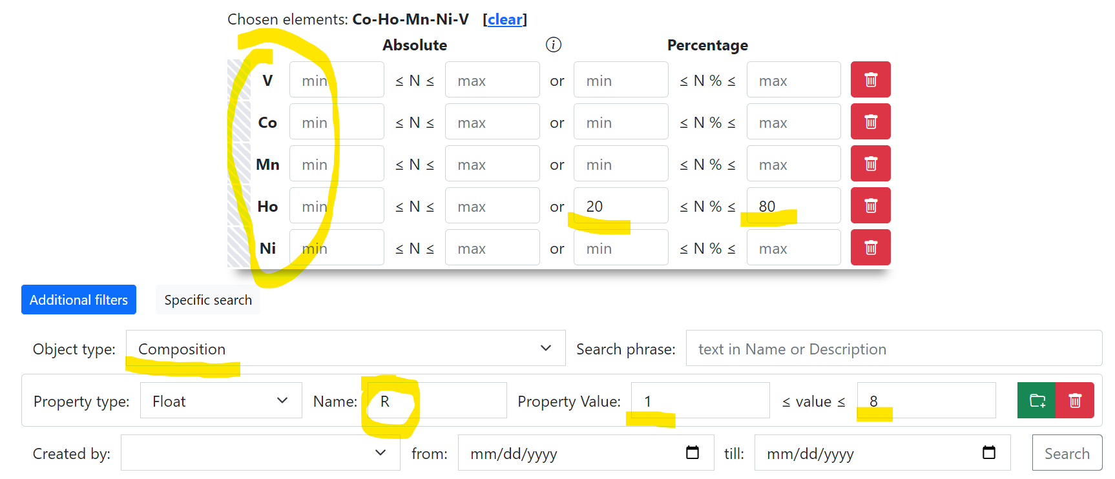
Use Case: Sample -> EDX -> Resistance
Create Project
Add Sample to Project
Add EDX document (342 Measurement Areas (MA), i.e. 342 Compositions)
Add Resistance document (associate property values to every MA)
Search for Composition with a given Resistance
Composition – object representing one of 342 measurement area
Container for other properties, associated with a certain measurement area
https://localhost:7106/search/?system=Co-Ho-Mn-Ni-V&typeid=8&Hopctmin=20&Hopctmax=80&pr0name=R&pr0type=Float&pr0min=1&pr0max=8&prcnt=1

Slide 22
Thanks for your kind attention
Q&A
Victor Dudarev
Victor.Dudarev@rub.de
https://vdudarev.ru

