Slide 1
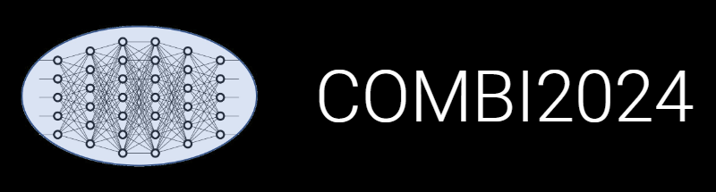

INF Update: Theory meets Experiment,
Publications
Victor Dudarev, Alfred Ludwig

Slide 2
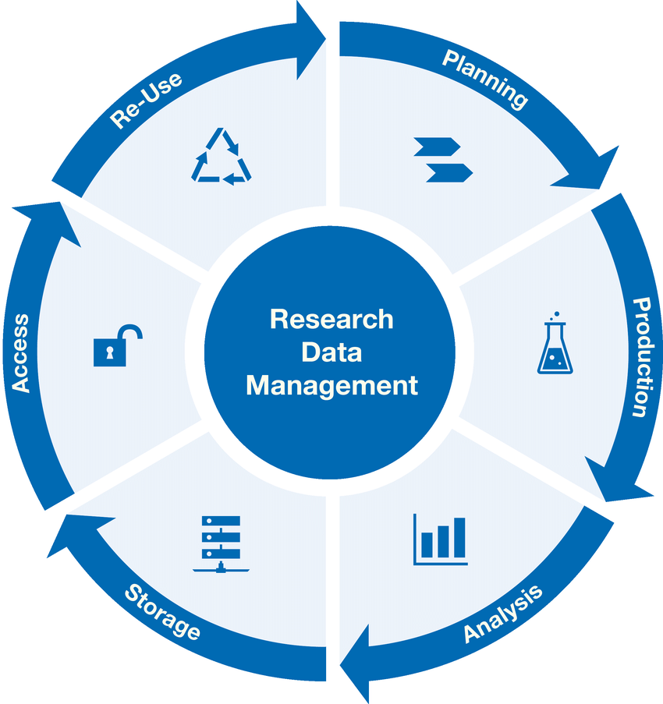
Research Workflow
and RDMS Object Types Interconnection
Research workflow support in RDMS
Defines characterisations
Provides report on samples & measurements
Idea or Plan
Calculation / Compu-tational Composition
Sample
Treatment:
annealing,
oxidation,
polishing, …
Sample_2
Report
Request for Synthesis
Characterisation:
EDX, XRD, Resistance, Bandgap, …
Characterisation:
EDX, XRD, Resistance, Bandgap, …
EDX – Energy-Dispersive X-ray spectroscopy (to determine composition)
XRD – X-Ray Diffraction (to determine crystallographic structure)
RDM Image source: Yazdi, M., Politze, M. and Müller, M. (2024) ‘A Novel Approach to Outlining Research Data Management Life Cycle: A Case Study’, Research gate, accessed 15.05.2024

Slide 3
Theory & Experiment: Chemical systems & compositions
Theory Types Experiment Types
RDMS Object Types
System
(qualitative composition)
Sample; FP1_Sample; Electrodeposited Sample
System
Calculation/Computational Sample
Co-O
Calculation/Computational Composition
Substance
(quantitative composition)
Nanoparticle powder sample;
Volume Composition; Surface Composition
Co₃O₄
Phase or Crystal Structure (cif)
Modification
(crystal structure type)
CIF XRD Measurement (cif)
β-Co₃O₄
…

Slide 4
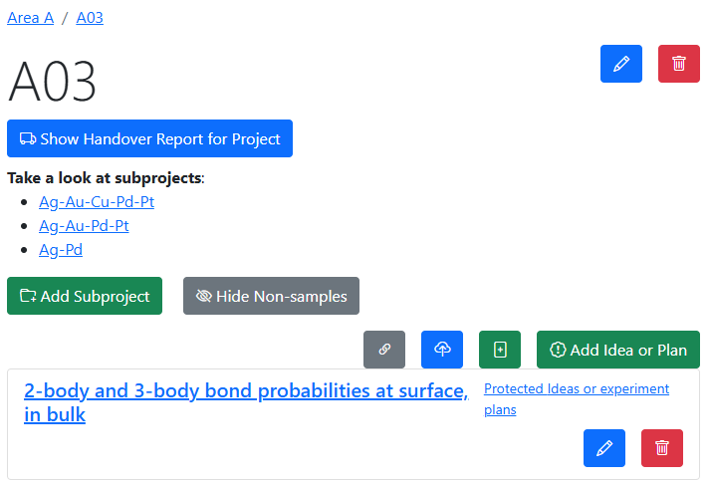
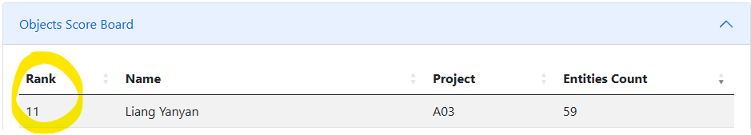
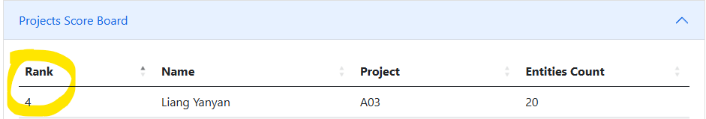

Interlinking objects: A03 use case (Liang Yanyan)
Summary:
Objects: 59
  Idea/experiment plan: 1
  Python Script (ipynb): 1
  Simulation Database (CSV): 57
Projects: 20
Links: 0
Data by Liang Yanyan:
https://crc1625.mdi.ruhr-uni-bochum.de/rubric/a03
https://crc1625.mdi.ruhr-uni-bochum.de/report/usersstatistics

Slide 5
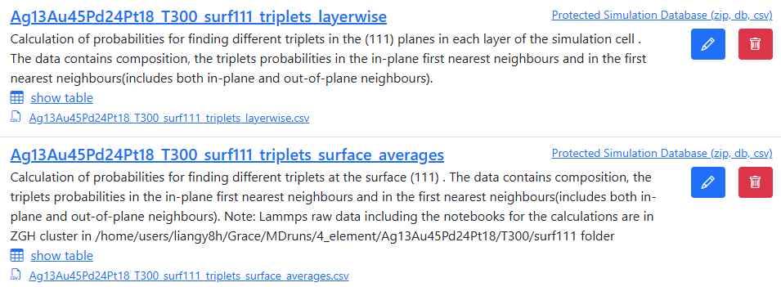
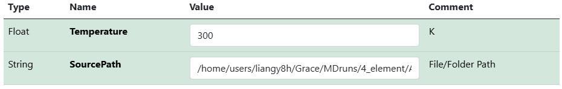

Establishing properties/template: A03 use case (Liang Yanyan)
Inconsistent description (w.r.t. folder path specification)
List of the objects:
Properties to extract:
Temperature
Data Source
Template:
Data by Liang Yanyan:
https://crc1625.mdi.ruhr-uni-bochum.de/rubric/a03_agaupdpt_ag13_au45_pd24_pt18_surface-segregation-in-111-at-t300k

Slide 6
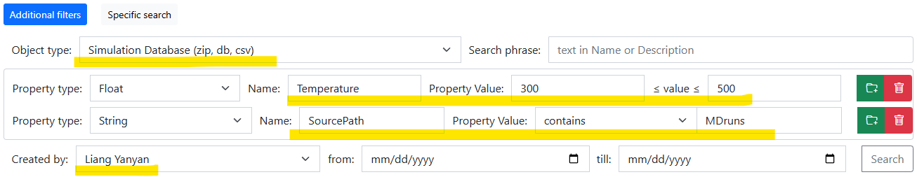



Search: A03 use case (Liang Yanyan)
Use properties on search:
Temperature in [300; 500] and SourcePath contains 'MDruns' and type is Simulation Database (zip, db, csv) and user-creator is Liang Yanyan
Data by Liang Yanyan:
https://crc1625.mdi.ruhr-uni-bochum.de/search/?typeid=94&createdbyuser=47&pr0name=Temperature&pr0type=Float&pr0min=300&pr0max=500&pr1name=SourcePath&pr1type=String&pr1max=3&pr1str=MDruns&prcnt=2

Slide 7
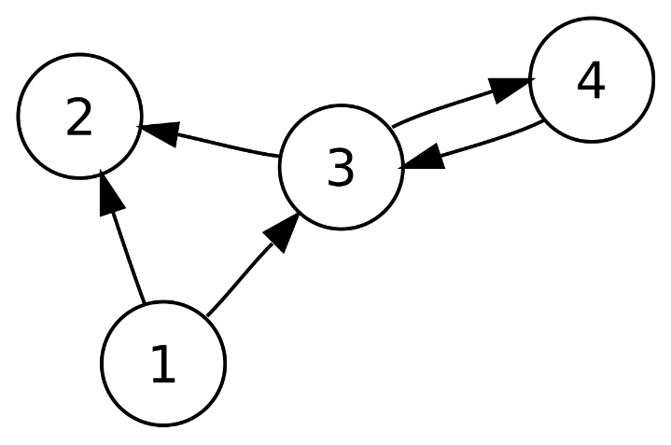
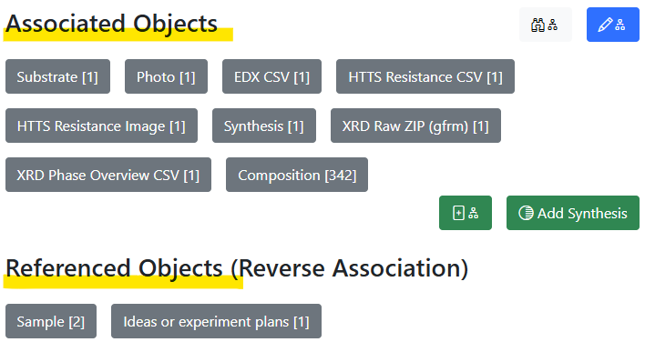
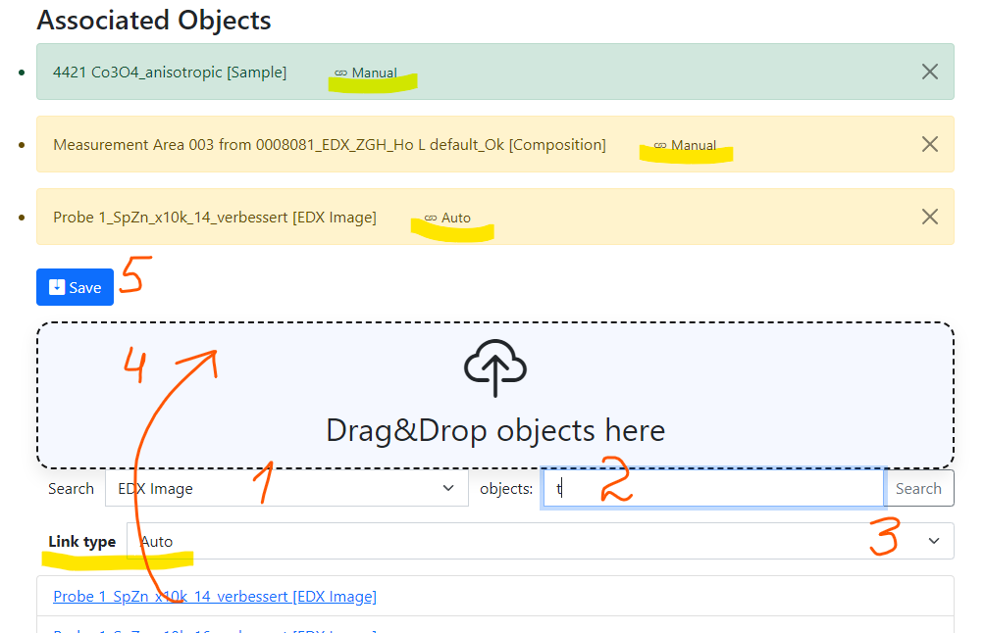
RDMS: Advanced Interlink Objects
a
a
c
Example: establishing graph above objects
b
directed graph
To add associated objects:
0) Go to “List edit” or select object to edit
1) Select associated object type (optional filter)
2) Input search phrase, contained in the Name of the desired object to be associated
3) Select (if required) link/association type object.
4) Drag & Drop desired object(s) from search result list to the area / adjust list
5) Save changes
Important: Reverse associations allow to browse reverse- directional associations.
User view: https://demo.mdi.ruhr-uni-bochum.de/object/ag2s-4870
Admin view: https://demo.mdi.ruhr-uni-bochum.de/adminobject/edititem/4870

Slide 8
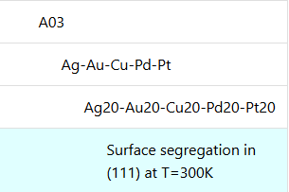
A03 use case: adding missing objects and links
Initial object structure: Idea, Simulation database
Desired object structure: Idea -> System -> Composition -> Simulation database
Motivation: fill the gap between an “Idea” and “Simulation database”
Types: System: Calculation/Computational Sample
Composition: Calculation/Computational Composition
Idea or Plan
Missing part
System_1
System_N
…
Composition_1-1
Composition_1-K
Composition_N-1
Composition_N-L
Sim DB_{i}
Sim DB_{i}
Sim DB_{i}
Sim DB_{i}
Sim DB_{i}
Sim DB_{i}
Sim DB_{i}
Sim DB_{i}
https://crc1625.mdi.ruhr-uni-bochum.de/rubric/a03
https://crc1625.mdi.ruhr-uni-bochum.de/rubric/a03_ag-au-cu-pd-pt

Slide 9
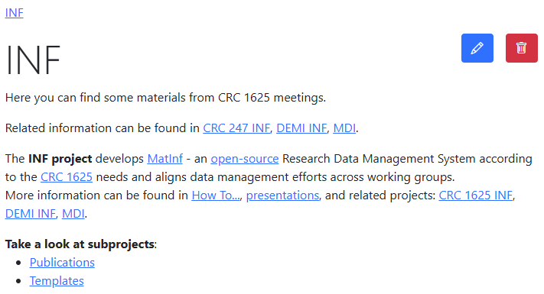
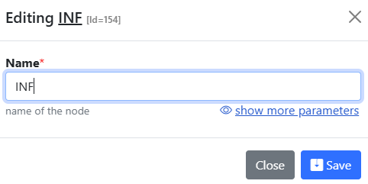
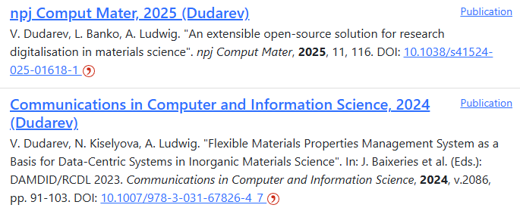
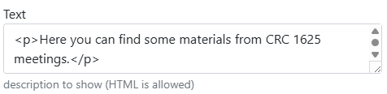
Project Page and Publication List
Please provide the project description and publication list on your project page:
https://crc1625.mdi.ruhr-uni-bochum.de/rubric/inf_publications
https://crc247.mdi.ruhr-uni-bochum.de/rubric/area-c_c04

Slide 10
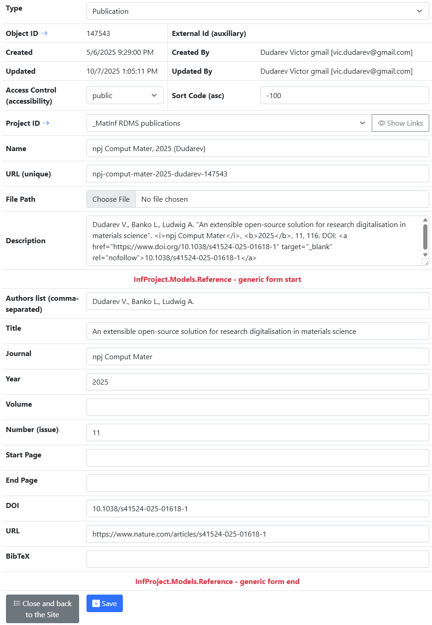
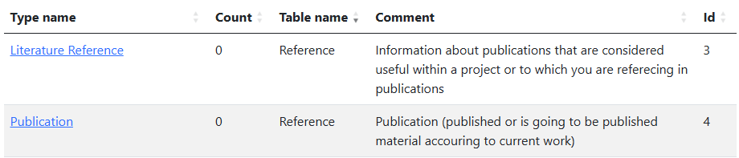
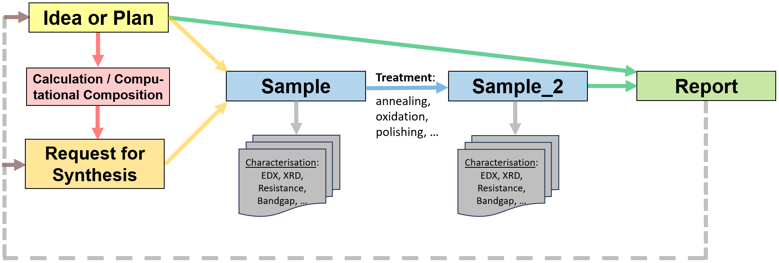
Publications in RDMS
Two types (based on Reference table):
Store publications / presentations / reports in RDMS:
Alternative types to conclude your findings:
PowerPoint Presentation Slides
Report
Video
Audio
https://crc1625.mdi.ruhr-uni-bochum.de/rubric/inf_publications
https://crc247.mdi.ruhr-uni-bochum.de/rubric/area-c_c04

Slide 11
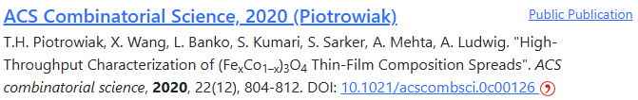
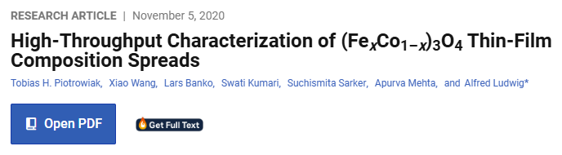
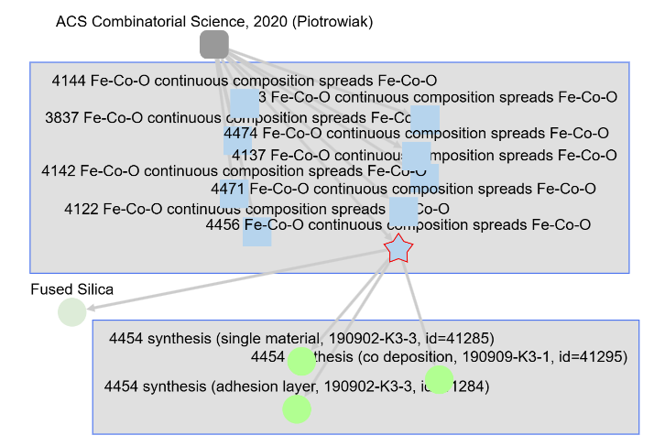

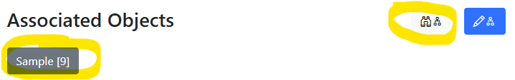
Good Publication = Publication with Data
Publication in RDMS
Article text on publisher’s web site
Objects/data accessible from the publication object
Related objects/data
https://crc247.mdi.ruhr-uni-bochum.de/rubric/area-c_c04
https://pubs.acs.org/doi/10.1021/acscombsci.0c00126

Slide 12
Thanks for your kind attention
Questions & Answers
Misuse of types in RDMS: Publication
https://crc247.mdi.ruhr-uni-bochum.de/rubric/area-c_c03_molecular-clusters_publication
Victor Dudarev
Victor.Dudarev@rub.de
https://vdudarev.ru

Slide 13

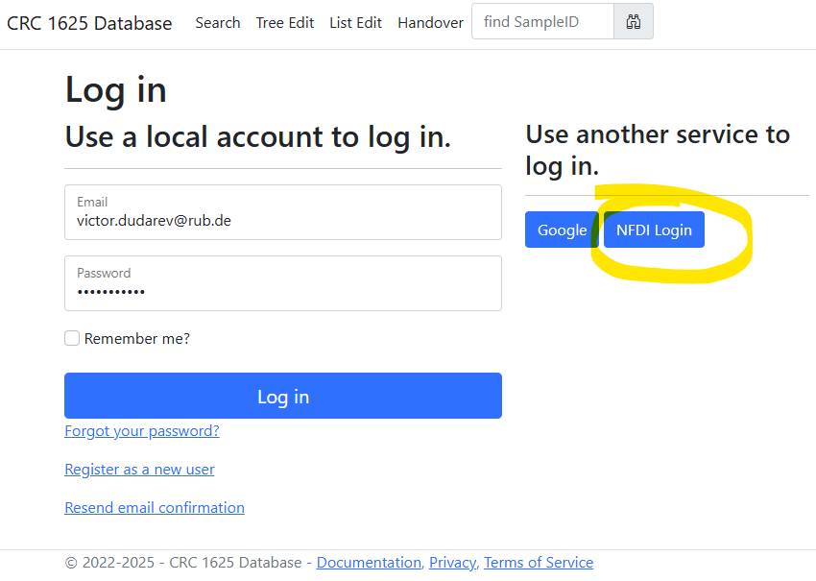
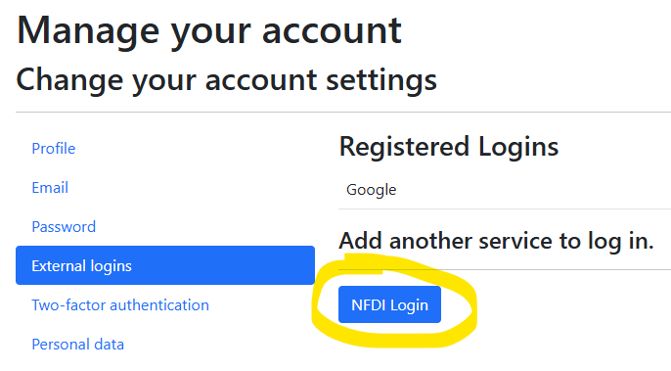
NFDI Login: use your institutional account in RDMS
Motivation: allow use any institutional account to log in.
Hint for existing users: bind with institutional account:
Go to your profile
Select “External Logins”
Click on “NFDI Login” and follow the instructions
The best case: password + Google + Institutional Account (NFDI Login / Helmholtz ID).
https://base4nfdi.de/projects/iam4nfdi
https://iam.services.base4nfdi.de

Slide 14
Access Level Update: New “Partner” Access Level
Motivation:
Enable external collaborators to have limited data access in the RDMS (objects with Public and Partner access levels are visible/accessible).
Data access policy is controlled via Data Access Levels.
Five Access Levels:
Public (for anonymous users, search engines):
    - objects are available to everybody regardless of authorization (visible to internet search engines);
^{NEW} Partner (for external users / collaborations)^{NEW}:
    - objects are visible to the authorized users with a Partner claim (and at least User role assigned);
Protected (by default, visible to the community only):
- objects are visible to the community (available to authorized users with at least User role assigned);
ProtectedNDA (restricted visibility):
- objects are visible to the authorized users (at least User role assigned) with NDA claim set OR to Administrators;
Private (person’s secret, but open for Administrators):
- objects are visible to the user-creator (at least PowerUser role assigned);
- objects are visible to all users of Administrator role.
relaxed
User’s Access Claim:
Partner
NDA
strict
Protected is default access level in CRC
NDA - Non-Disclosure Agreement

Slide 15
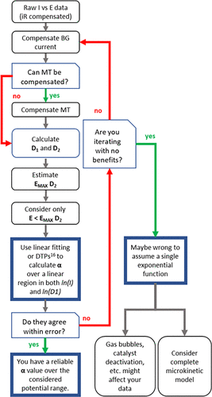
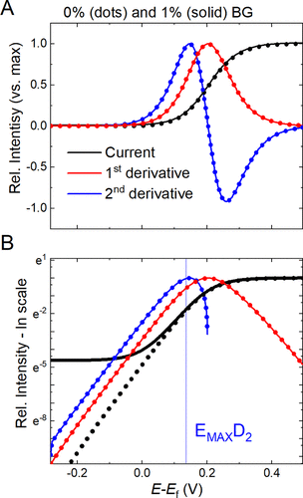
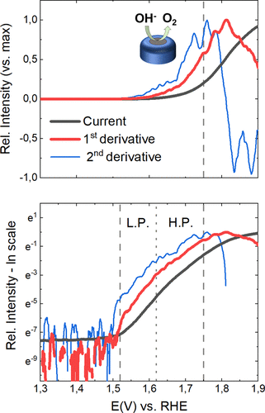
Catalyst Benchmark: Differential Tafel Analysis
Motivation: evaluate catalysts
Manuel Corva, Niclas Blanc, Christoph J. Bondue, and Kristina Tschulik
Differential Tafel Analysis: A Quick and Robust Tool to Inspect and Benchmark Charge Transfer in Electrocatalysis
ACS Catalysis 2022 12 (21), 13805-13812. DOI: 10.1021/acscatal.2c03581
https://pubs.acs.org/doi/10.1021/acscatal.2c03581

Slide 16
Source Data: diverse csv&txt formats (different potentiostats)
File............: lsv_lsv1_case_a_19_07_2023_12_19_42_0001 - JUL,19.2023
System..........:
Temperature.....: 49.2+-0.0C
Time............: 12:19:42-12:22:50
Scan mode.......: 5mV/s
Comment.........:
Electr.area/sqcm:
Reference.......: 0.4500929, 0.3194414 PO,PF,Imi-4.0e-01 ,Ima 4.0e-01 , -2, 11272
Lines: 187
Columns: 3
Number Time/s Potential/V Current/A
1 0 0.000 -3.800e-05
2 1.004 0.003 -1.086e-05
3 2.005 0.008 -7.868e-06
4 3.006 0.013 -6.100e-06
5 4.006 0.018 -4.871e-06
6 5.007 0.023 -3.926e-06
7 6.008 0.028 -3.146e-06
8 7.009 0.033 -2.464e-06
9 8.01 0.038 -1.842e-06
10 9.019 0.040 -1.873e-06
Experiment:, charge balanced
Start date:, 08 April 2025
Start time:, 18:08:35 +02:00
Time (s), Voltage (V), Current (A), Reverse I (A), Charge (C), V Range (), I Range ()
1029.63, -0.01006696, -9.316599e-06, , 0.001817496, 1, 5
1029.64, -0.009909317, -8.931254e-06, , 0.001817407, 1, 5
1029.65, -0.01006696, -9.187112e-06, , 0.001817315, 1, 5
1029.66, -0.01006696, -8.931254e-06, , 0.001817225, 1, 5
1029.67, -0.01006696, -1.038215e-05, , 0.001817121, 1, 5
1029.68, -0.01006696, -9.085705e-06, , 0.001817031, 1, 5
1029.69, -0.009751666, -8.836088e-06, , 0.001816942, 1, 5
1029.7, -0.009751666, -8.811126e-06, , 0.001816854, 1, 5
1029.71, -0.009594016, -8.432022e-06, , 0.00181677, 1, 5
1029.72, -0.009594016, -9.441408e-06, , 0.001816675, 1, 5
1029.73, -0.009594016, -8.533429e-06, , 0.00181659, 1, 5
1029.74, -0.009594016, -9.32284e-06, , 0.001816497, 1, 5
1029.75, -0.009594016, -8.851689e-06, , 0.001816408, 1, 5
WE(1).Potential (V) WE(1).Current (A) Time (s)
0.442474365234375 2.40173339843749E-06 1178.14680902547
0.44500732421875 2.08740234375E-06 1180.5882150193
0.447357177734375 1.89819335937499E-06 1183.02962101314
0.4498291015625 1.873779296875E-06 1185.47102700697
0.45233154296875 1.82189941406249E-06 1187.91243300081
0.4547119140625 2.20947265625E-06 1190.35383899465
0.457122802734375 1.910400390625E-06 1192.79524498848
0.45953369140625 2.6123046875E-06 1195.23665098232
0.462005615234375 1.8890380859375E-06 1197.67805697615
0.4644775390625 2.3651123046875E-06 1200.11946296999
0.466888427734375 1.7974853515625E-06 1202.56086896383
0.469329833984375 2.4444580078125E-06 1205.00227495766
0.47174072265625 2.81982421875E-06 1207.4436809515
0.474151611328125 2.57263183593751E-06 1209.88508694533
https://en.wikipedia.org/wiki/Potentiostat

Slide 17
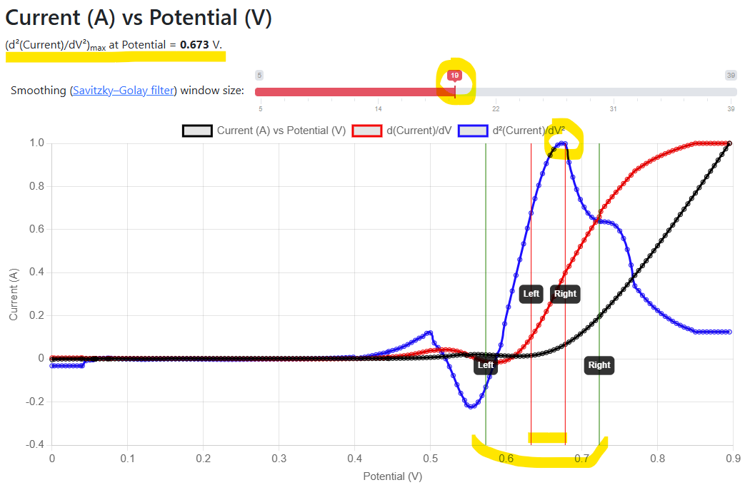
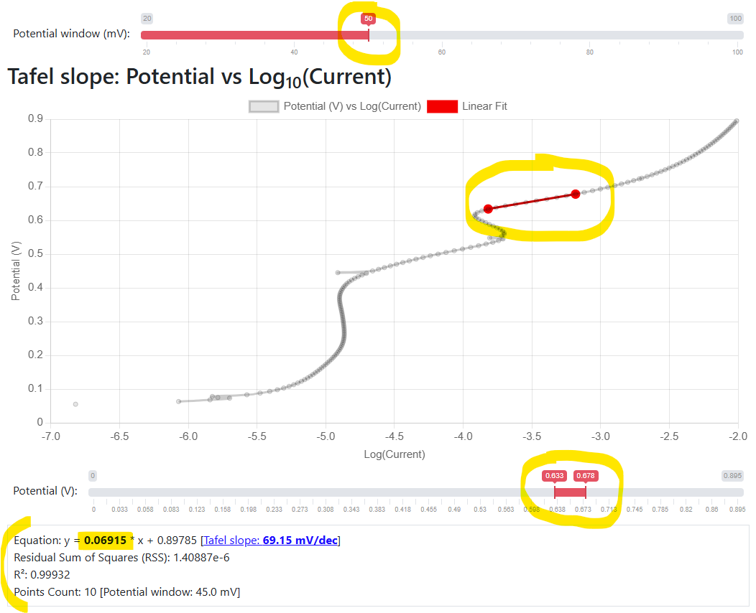
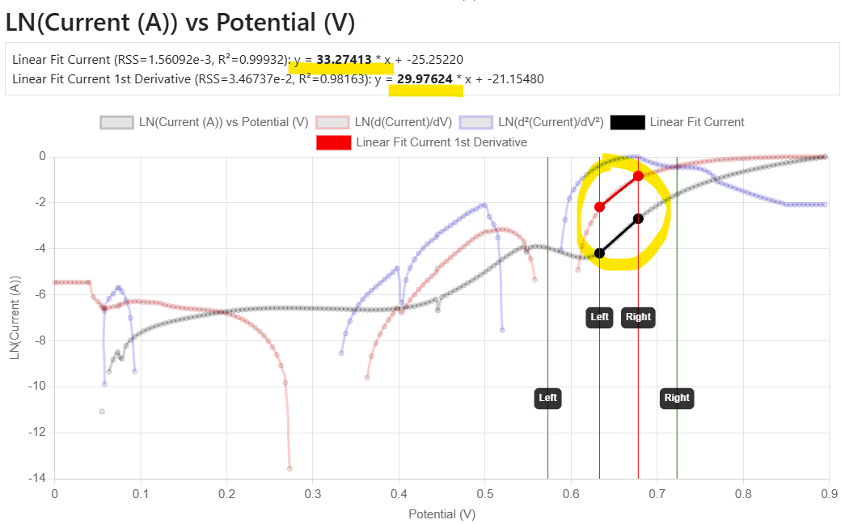
Demo: Tafel slope calculation
Motivation: provide a standard benchmark to evaluate catalysts
https://inf.mdi.ruhr-uni-bochum.de/object/lsv_900mv_5mvpers_19_07_2023_cpy88_0_calc_ecbalanced_04_co3o4nps-on-gc_01-m-koh-29544

