Slide 1
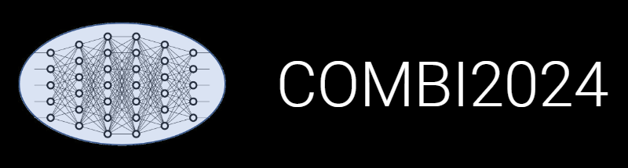

INF: Publications Management
Victor Dudarev, Alfred Ludwig

Slide 2
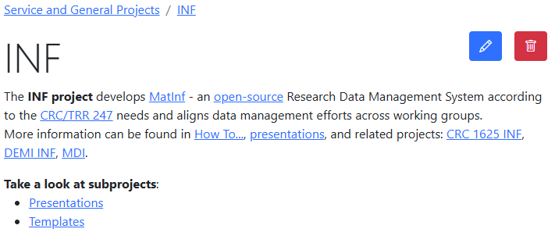
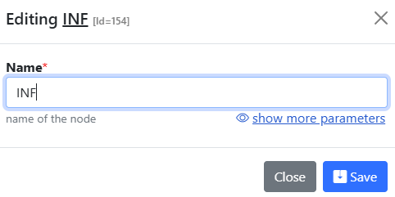
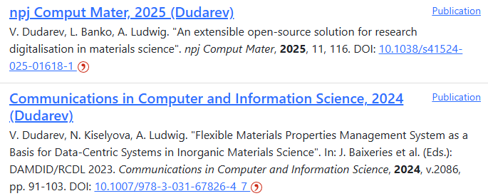
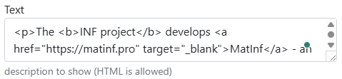
Project Page and Publication List
Please provide the project description and publication list on your project page:
https://crc247.mdi.ruhr-uni-bochum.de/rubric/service-and-general-projects_inf
https://crc247.mdi.ruhr-uni-bochum.de/rubric/area-c_c04

Slide 3
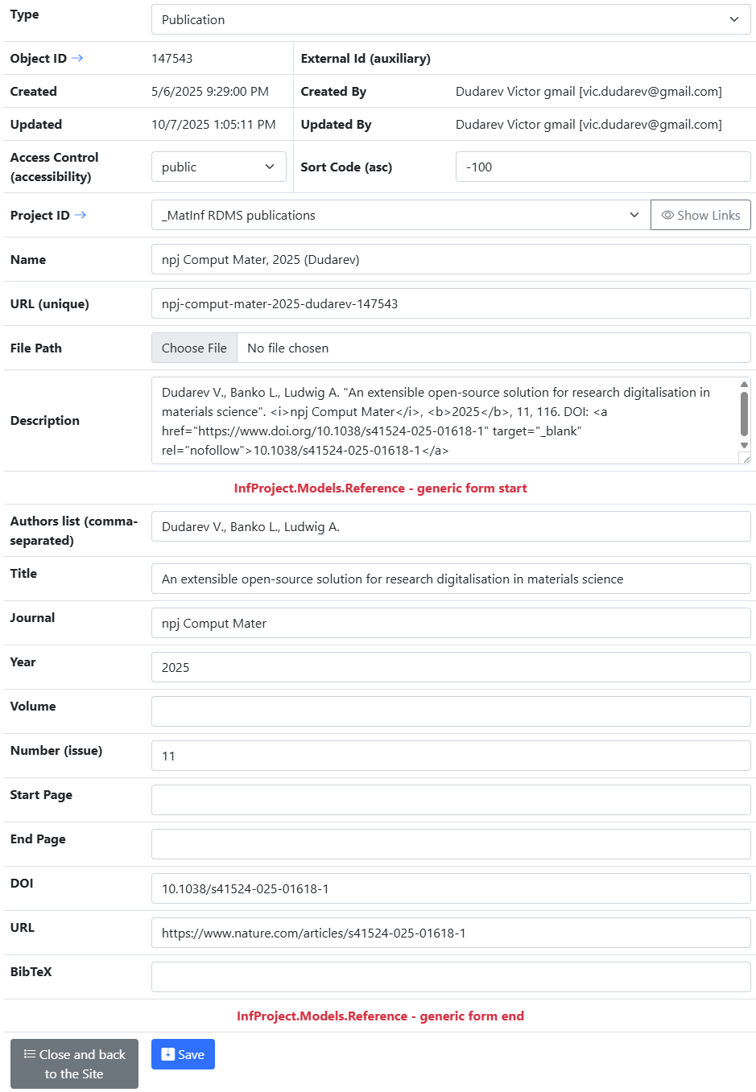
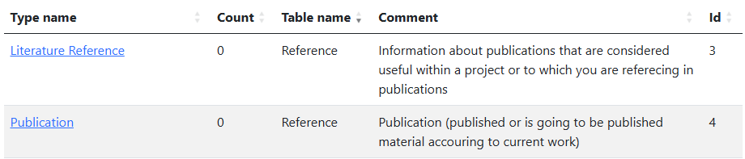
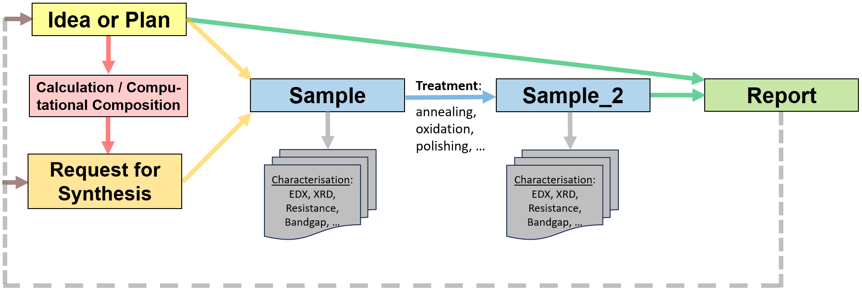
Publications in RDMS
Two types (based on Reference table):
Store publications / presentations / reports in RDMS:
Alternative types to conclude your findings:
PowerPoint Presentation Slides
Report
Video
Audio
https://crc247.mdi.ruhr-uni-bochum.de/rubric/service-and-general-projects_inf
https://crc247.mdi.ruhr-uni-bochum.de/rubric/area-c_c04

Slide 4
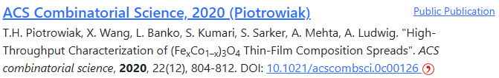
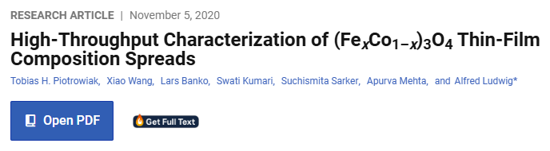
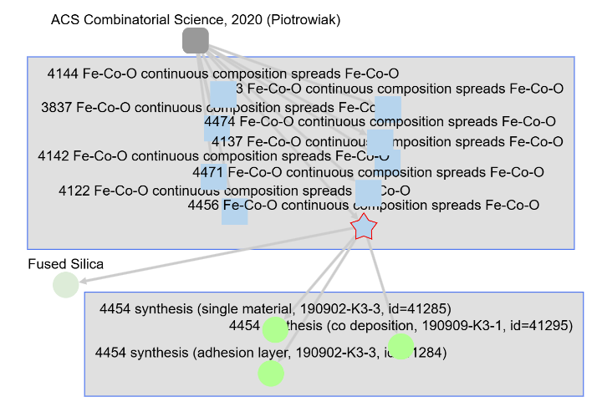

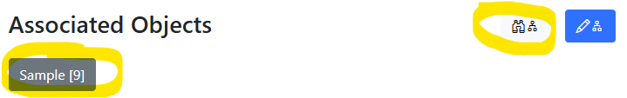
Good Publication = Publication with Data
Publication in RDMS
Article text on publisher’s web site
Objects/data accessible from the publication object
Related objects/data
The nearest plans: enable the creation and upload of RO-Crate (data and metadata) to Zenodo, allowing you to obtain a DOI for FAIR data sharing in your article.
https://crc247.mdi.ruhr-uni-bochum.de/rubric/area-c_c04
https://pubs.acs.org/doi/10.1021/acscombsci.0c00126
https://www.researchobject.org/ro-crate/

Slide 5
Hands-on Session
Topics:
“DMP Light”: adding data description for your project;
Publication List Management: adding publications.
Home Assignment:
prepare a short text (1-2 paragraphs) describing your project in terms of data contributions:
  What do you add?
  What types do you use?
  Your suggestions: What is missing (types/parameters/workflow)?
prepare a list of project publications (including DOI, URL);
prepare a list of literature references, relevant for your project and guiding your research (including DOI, URL).
Date&Time of hands-on session will be announced by Carina.
DMP – Data Management Plan

Slide 6
Other RDMS Updates
Topics:
NFDI Login
“Partner” Access Level

Slide 7

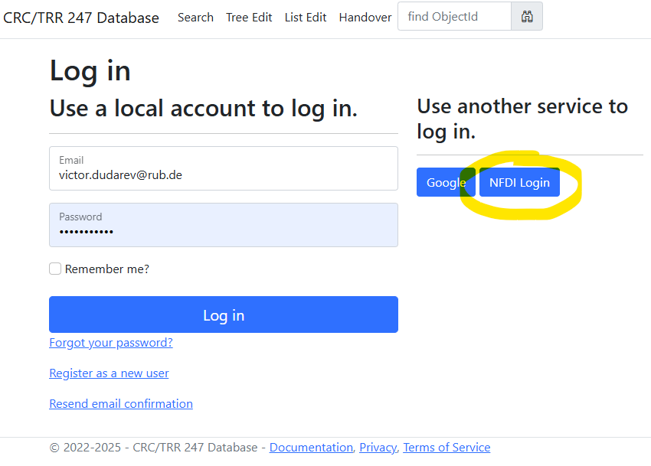
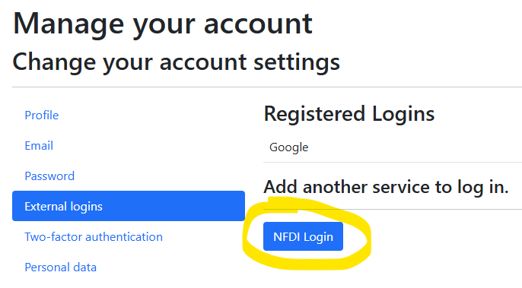
NFDI Login: use your institutional account in RDMS
Motivation: allow use any institutional account to log in.
Hint for existing users: bind with institutional account:
Go to your profile
Select “External Logins”
Click on “NFDI Login” and follow the instructions
The best case: password + Google + Institutional Account (NFDI Login / Helmholtz ID/AAI).
NFDI - Nationale Forschungsdateninfrastruktur
AAI - Authentication and Authorisation Infrastructure
https://base4nfdi.de/projects/iam4nfdi https://iam.services.base4nfdi.de

Slide 8
Access Level Update: New “Partner” Access Level
Motivation:
Enable external collaborators to have limited data access in the RDMS (objects with Public and Partner access levels are visible/accessible).
Data access policy is controlled via Data Access Levels.
Five Access Levels:
Public (for anonymous users, search engines):
    - objects are available to everybody regardless of authorization (visible to internet search engines);
^{NEW} Partner (for external users / collaborations)^{NEW}:
    - objects are visible to the authorized users with a Partner claim (and at least User role assigned);
Protected (by default, visible to the community only):
- objects are visible to the community (available to authorized users with at least User role assigned);
ProtectedNDA (restricted visibility):
- objects are visible to the authorized users (at least User role assigned) with NDA claim set OR to Administrators;
Private (person’s secret, but open for Administrators):
- objects are visible to the user-creator (at least PowerUser role assigned);
- objects are visible to all users of Administrator role.
relaxed
User’s Access Claim:
Partner
NDA
strict
Protected is default access level in CRC
NDA - Non-Disclosure Agreement

Slide 9
Thanks for your kind attention
Questions & Answers
Victor Dudarev
Victor.Dudarev@rub.de
https://vdudarev.ru

