Slide 1
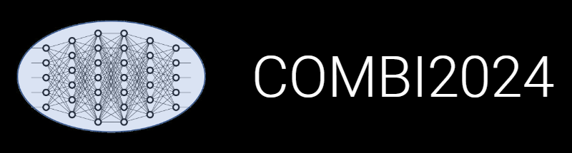

INF: Publications Management
Victor Dudarev, Alfred Ludwig

Slide 2
Research Workflow
and RDMS Object Types Interconnection
Defines characterisations
Provides report on samples & measurements
Idea or Plan
Calculation / Compu-tational Composition
Treatment:
annealing,
oxidation,
polishing, …
Report / Publication
Sample
Sample_2
Request for Synthesis
Characterisation:
EDX, XRD, Resistance, Bandgap, …
Characterisation:
EDX, XRD, Resistance, Bandgap, …
EDX – Energy-Dispersive X-ray spectroscopy (to determine composition) XRD – X-Ray Diffraction (to determine crystallographic structure)
RDM Image source: Yazdi, M., Politze, M. and Müller, M. (2024) ‘A Novel Approach to Outlining Research Data Management Life Cycle: A Case Study’, Research gate, accessed 15.05.2024

Slide 3
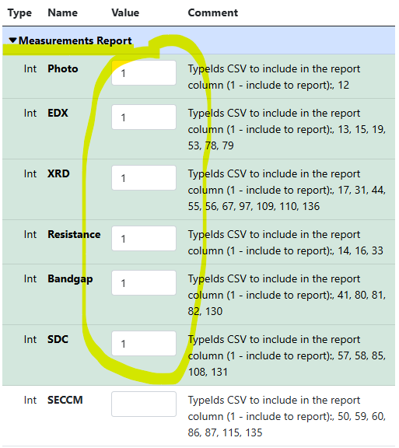
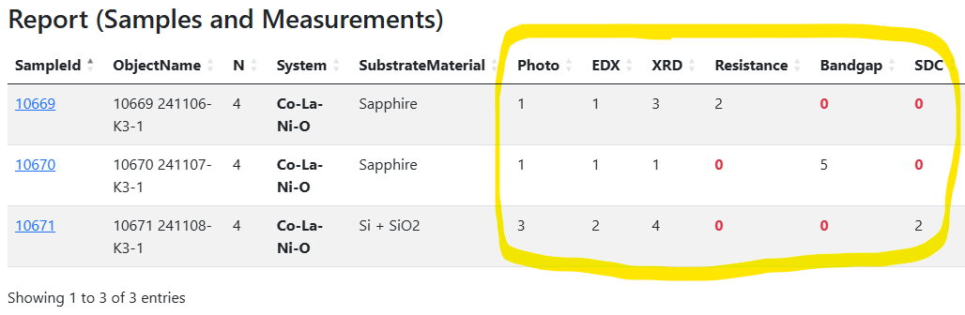

Experiment workflow (characterisation chain)
Solution: set up the workflow by defining characterisation for the experiment (idea or plan)
and track the progress.
Idea or Plan
1) Create “plan” object
2) Define characterisations
3) Add/link samples and
measurements…
4) Monitor workflows via reports in the “plan” object
https://crc247.mdi.ruhr-uni-bochum.de/rubric/area-c_c04_la-co-x-o-ccs-2024_la-co-ni-o
https://crc247.mdi.ruhr-uni-bochum.de/object/la-co-ni-o-exploration-147192

Slide 4
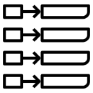
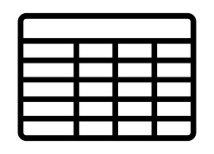
RDM Evolution: from Documents to Facts
Document-oriented Graph Factographic
project
project
project
1
1
1
key-value
subproject
subproject
subproject
subproject
subproject
subproject
2
3
4
5
6
2
3
4
5
6
2
3
4
5
6
subsubproject
subsubproject
subsubproject
7
7
7
table

Slide 5
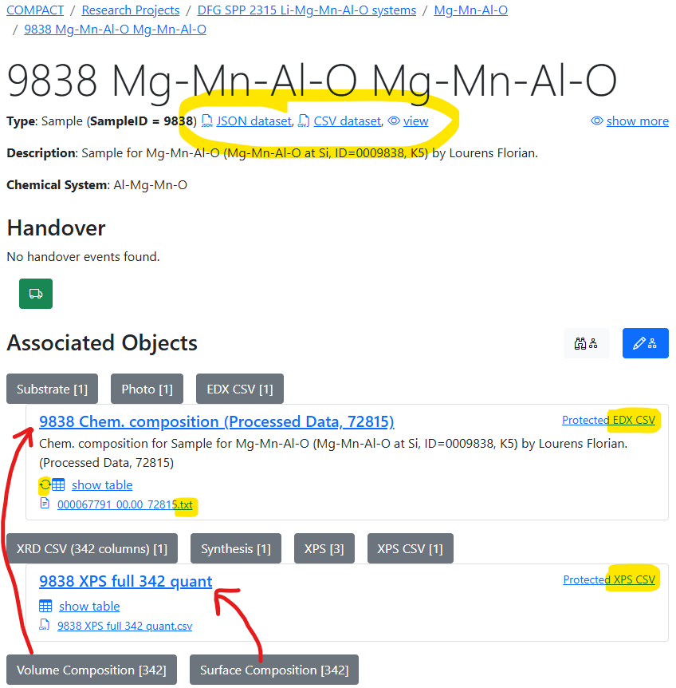
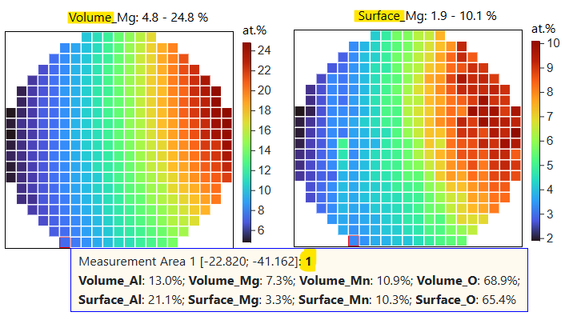
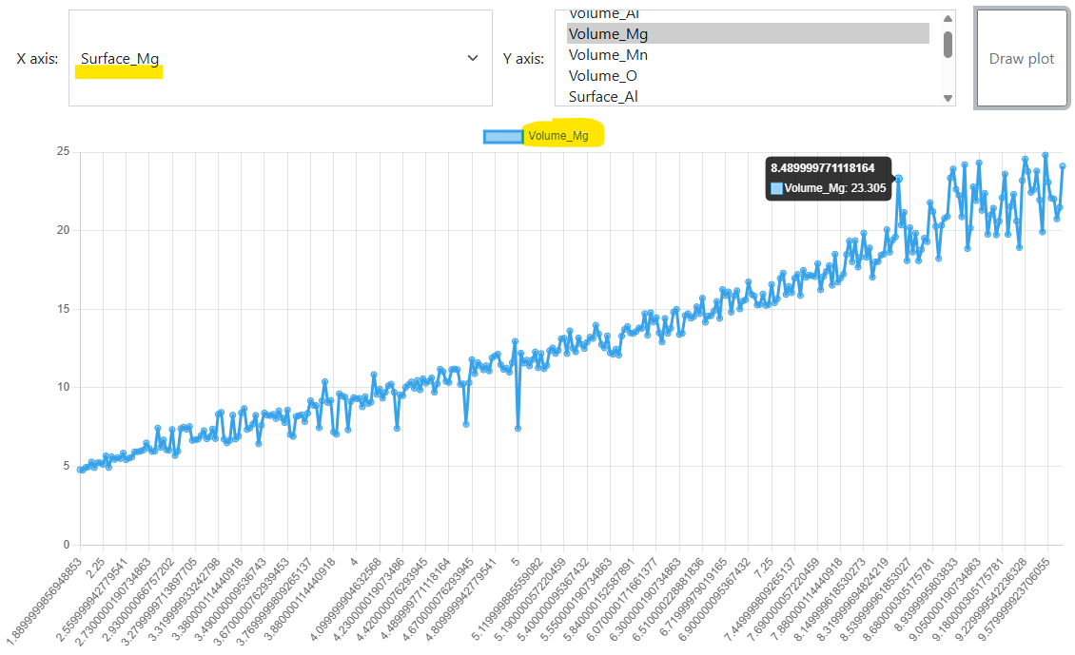
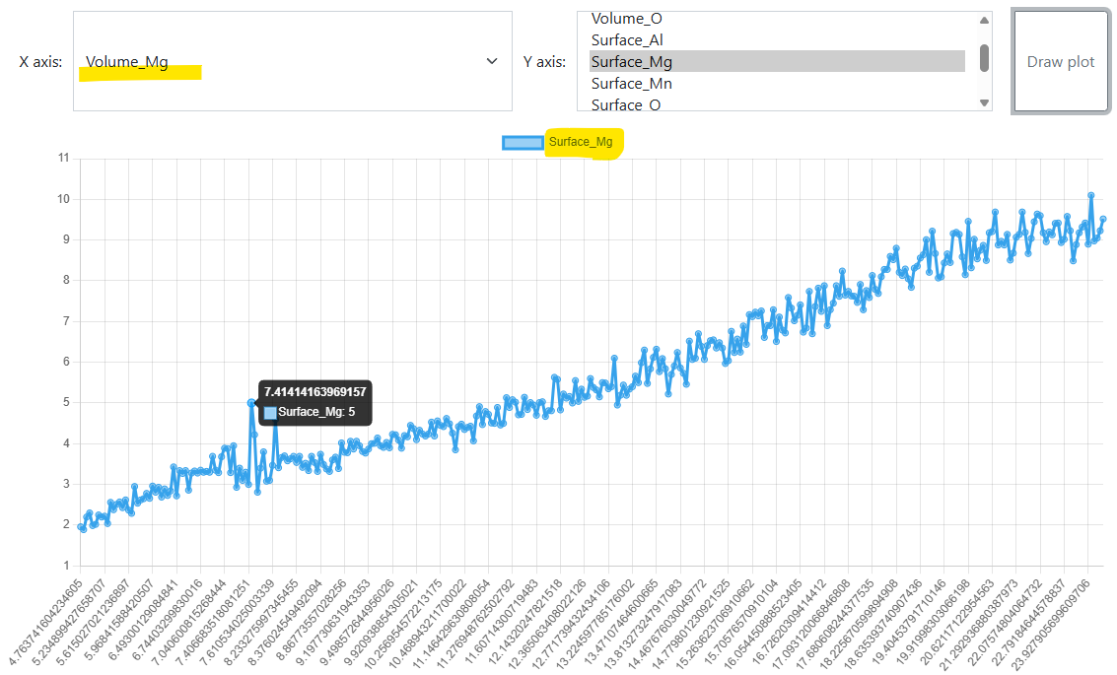
Sample 9838: EDX & XPS
Comparison: volume vs surface composition
Mg: Volume vs Surface Mg: Surface vs. volume
https://inf.mdi.ruhr-uni-bochum.de/object/sample-demo-29196 Source: https://mdi.matinf.pro/object/9838-mg-mn-al-o-mg-mn-al-o-56489

Slide 6
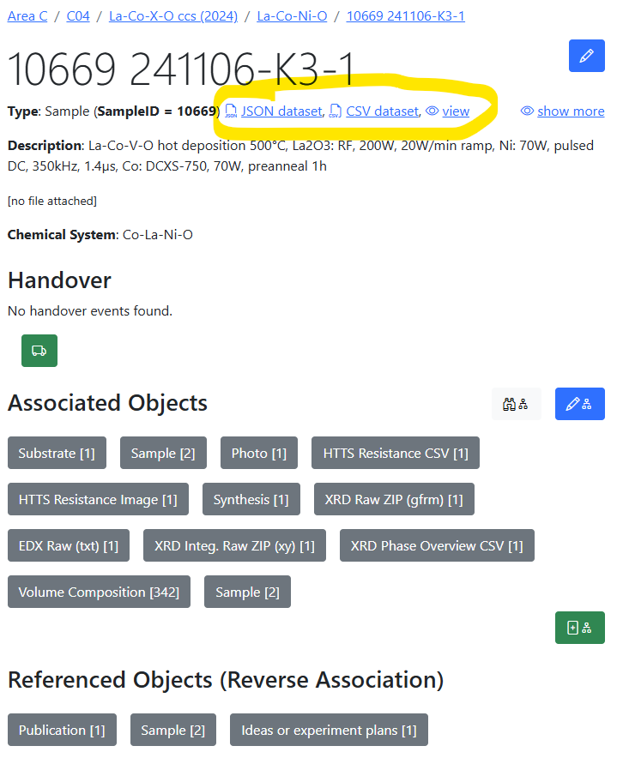
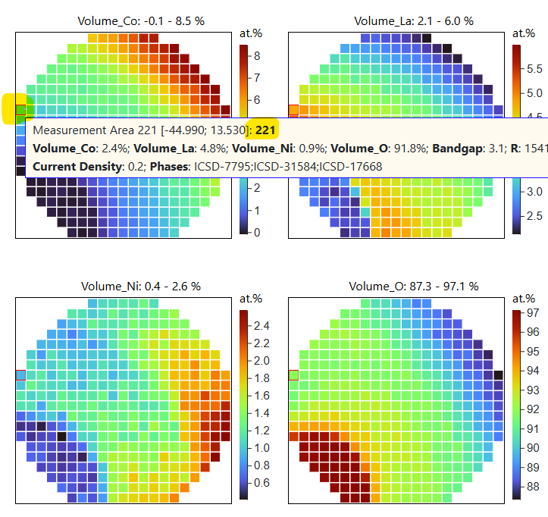
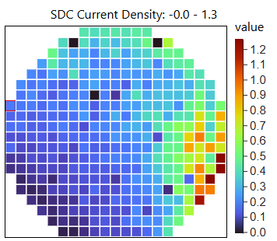
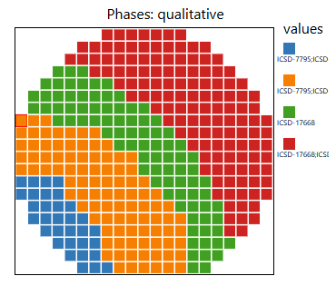
Sample 10669: Data integration
Visualisation: all properties
https://crc247.mdi.ruhr-uni-bochum.de/object/la-co-ni-o-exploration-147192
https://crc247.mdi.ruhr-uni-bochum.de/object/241106-k3-1-106937
https://crc247.mdi.ruhr-uni-bochum.de/object/arxiv-2025-marx-150024

Slide 7
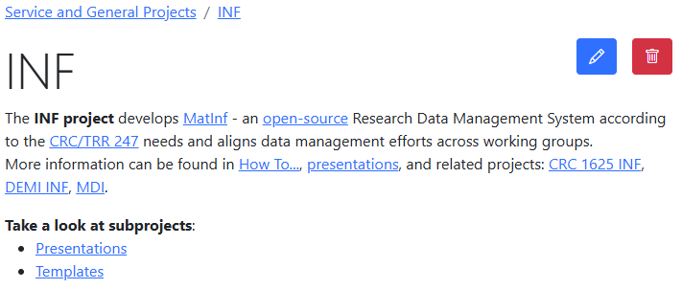
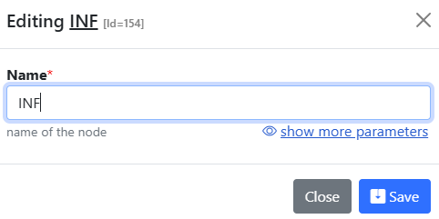
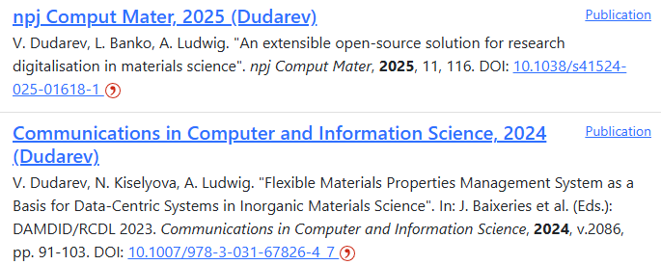
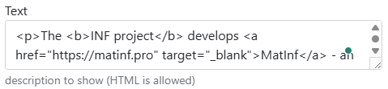
Project Page and Publication List
Please provide the project description and publication list on your project page:
https://crc247.mdi.ruhr-uni-bochum.de/rubric/service-and-general-projects_inf
https://crc247.mdi.ruhr-uni-bochum.de/rubric/area-c_c04

Slide 8
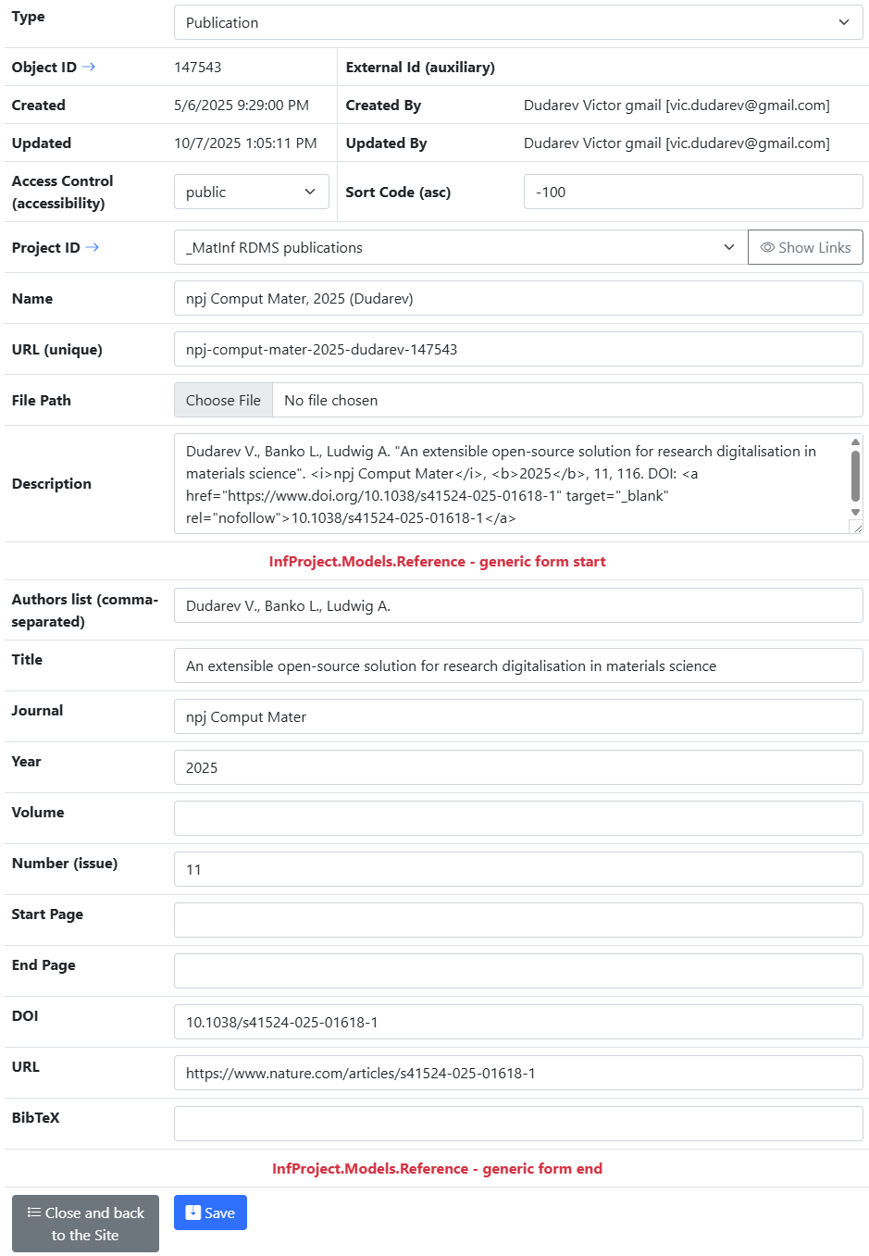
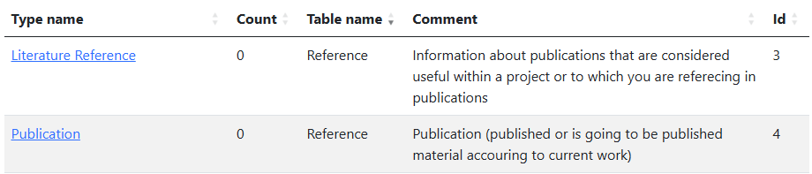
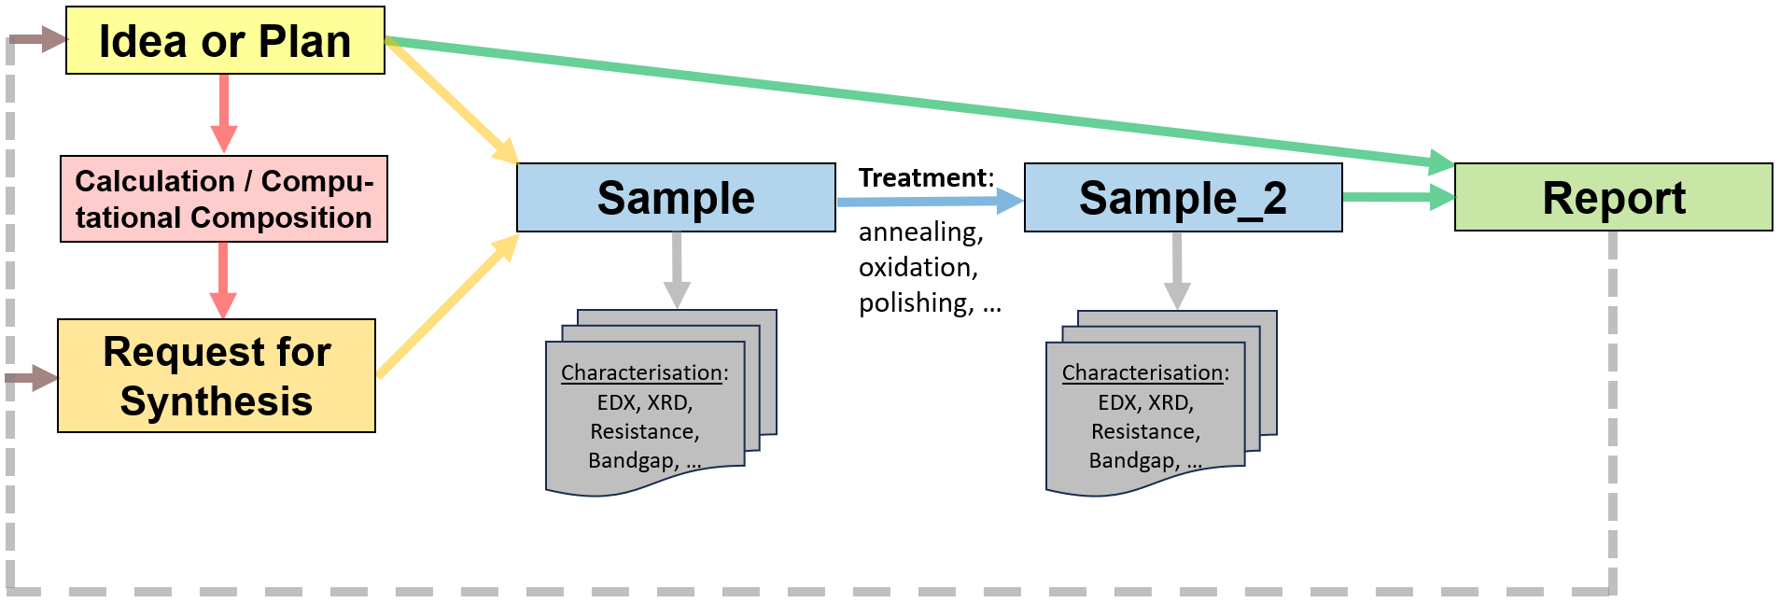
Publications in RDMS
Two types (based on Reference table):
Store publications / presentations / reports in RDMS:
Alternative types to conclude your findings:
PowerPoint Presentation Slides
Report
Video
Audio
https://crc247.mdi.ruhr-uni-bochum.de/rubric/service-and-general-projects_inf
https://crc247.mdi.ruhr-uni-bochum.de/rubric/area-c_c04

Slide 9
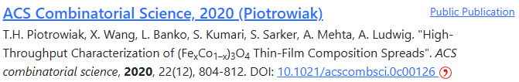
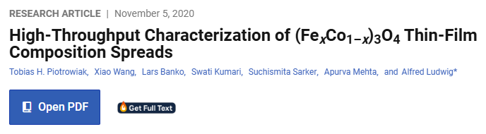
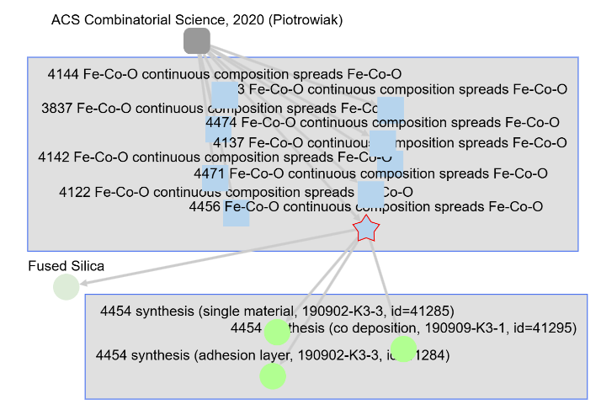

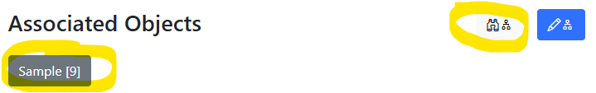
Good Publication = Publication with Data
Publication in RDMS
Article text on publisher’s web site
Objects/data accessible from the publication object
Related objects/data
The nearest plans: enable the creation and upload of RO-Crate (data and metadata) to Zenodo, allowing you to obtain a DOI for FAIR data sharing in your article.
https://crc247.mdi.ruhr-uni-bochum.de/rubric/area-c_c04
https://pubs.acs.org/doi/10.1021/acscombsci.0c00126
https://www.researchobject.org/ro-crate/

Slide 10
Hands-on Session
Topics:
“DMP Light”: adding data description for your project;
Publication List Management: adding publications.
Home Assignment:
prepare a short text (1-2 paragraphs) describing your project in terms of data contributions:
  What do you add?
  What types do you use?
  Your suggestions: What is missing (types/parameters/workflow)?
prepare a list of project publications (including DOI, URL);
prepare a list of literature references, relevant for your project and guiding your research (including DOI, URL).
DMP – Data Management Plan

Slide 11
Other RDMS Updates
Topics:
NFDI Login
“Partner” Access Level

Slide 12

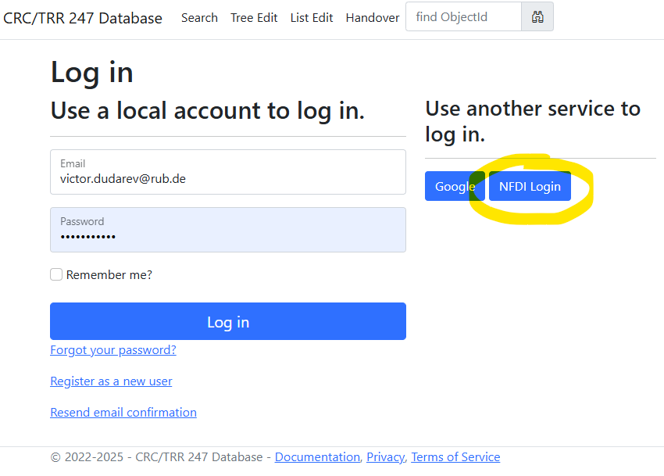
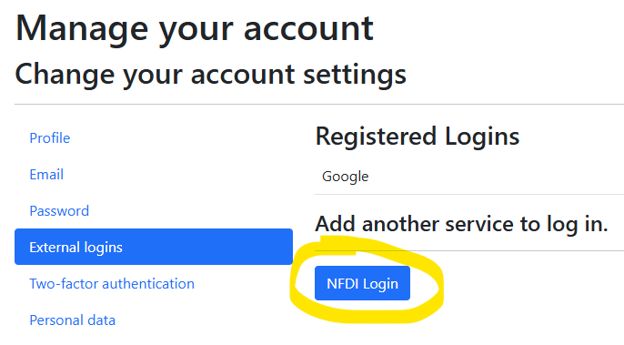
NFDI Login: use your institutional account in RDMS
Motivation: allow use any institutional account to log in.
Hint for existing users: bind with institutional account:
Go to your profile
Select “External Logins”
Click on “NFDI Login” and follow the instructions
The best case: password + Google + Institutional Account (NFDI Login / Helmholtz ID/AAI).
NFDI - Nationale Forschungsdateninfrastruktur
AAI - Authentication and Authorisation Infrastructure
https://base4nfdi.de/projects/iam4nfdi https://iam.services.base4nfdi.de

Slide 13
Access Level Update: New “Partner” Access Level
Motivation:
Enable external collaborators to have limited data access in the RDMS (objects with Public and Partner access levels are visible/accessible).
Data access policy is controlled via Data Access Levels.
Five Access Levels:
Public (for anonymous users, search engines):
    - objects are available to everybody regardless of authorization (visible to internet search engines);
^{NEW} Partner (for external users / collaborations)^{NEW}:
    - objects are visible to the authorized users with a Partner claim (and at least User role assigned);
Protected (by default, visible to the community only):
- objects are visible to the community (available to authorized users with at least User role assigned);
ProtectedNDA (restricted visibility):
- objects are visible to the authorized users (at least User role assigned) with NDA claim set OR to Administrators;
Private (person’s secret, but open for Administrators):
- objects are visible to the user-creator (at least PowerUser role assigned);
- objects are visible to all users of Administrator role.
relaxed
User’s Access Claim:
Partner
NDA
strict
Protected is default access level in CRC
NDA - Non-Disclosure Agreement

Slide 14
Thanks for your kind attention
Questions & Answers
Victor Dudarev
Victor.Dudarev@rub.de
https://vdudarev.ru

