Slide 1
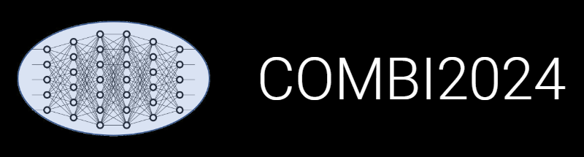

From RDMS to DOI:
Publishing Research Data alongside Articles
Victor
Dudarev

Slide 2
Agenda
Motivation: reproducibility crisis & data publication requirements
Data Publication strategy
External Data publication:
  Access Levels consistency
  License consistency
  Contributors/authors list
  Script to create “experiment snapshot”: (meta)data + documents
  Script to publish on Zenodo for DOI minting
Code publication and reproducibility (via Jupyter4NFDI)
Other RDMS updates:
  Interactive visualizations
  Search improvement
  Statistic overview

Slide 3
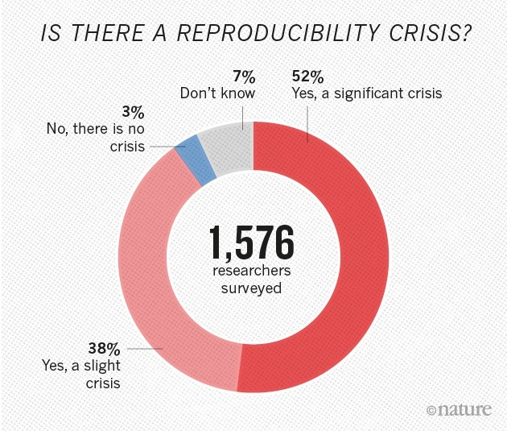
Reproducibility Crisis
Reproducibility or replicability crisis, refers to widespread failures to reproduce published scientific results.
Main Factors:
Publication Bias: Journals often prioritize publishing novel and positive results, leading to the neglect of negative findings or replication studies.
Questionable Research Practices: Researchers may engage in practices like p-hacking (manipulating data to achieve statistical significance) and HARKing (hypothesizing after results are known), which can distort results.
Inadequate Statistical Methods: Suboptimal statistical analyses can lead to erroneous conclusions, making replication challenging.
Lack of Data Sharing: Many researchers do not make their data and methods openly accessible, hindering the ability of others to verify and replicate their work.
Pressure to Publish: The “publish or perish” culture can incentivize quantity over quality, encouraging rushed and less rigorous research.
Baker, M. 1,500 scientists lift the lid on reproducibility. Nature 533, 452–454 (2016). https://doi.org/10.1038/533452a

Slide 4
Motivation: Referencing Data in Papers
Prof. Doris Segets (Uni-UDE):
“paper statement «data available on the request» almost killed CRC 1411”.
Conclusion: no "data available on the request" => RDMS => DOI
Our step-by-step actions:
Store all data in RDMS (protected by default);
Make the data public (if it supports a publication; use an “idea or plan”);
Get DOI for data and reference it in your publication: make a copy of publication’s data in Zenodo to get DOI.
Benefits: FAIR Open Data == Data reuse in future (essential for projects to survive / don’t repeat yourself or colleagues). Be FAIR!
How to do it in a right way?
FAIR: https://www.go-fair.org/fair-principles/

Slide 5
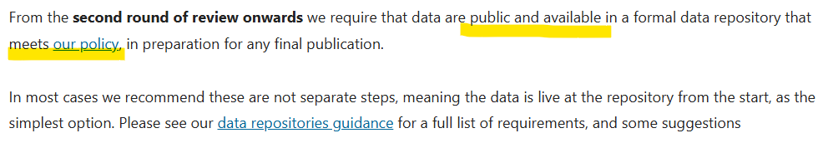
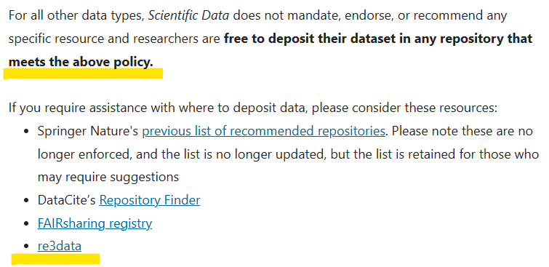
Data publication requirements: Nature Scientific Data case
Dataset deposition requirements:
Repository policy:
https://www.nature.com/sdata/submission-guidelines
https://www.nature.com/sdata/policies/repositories

Slide 6

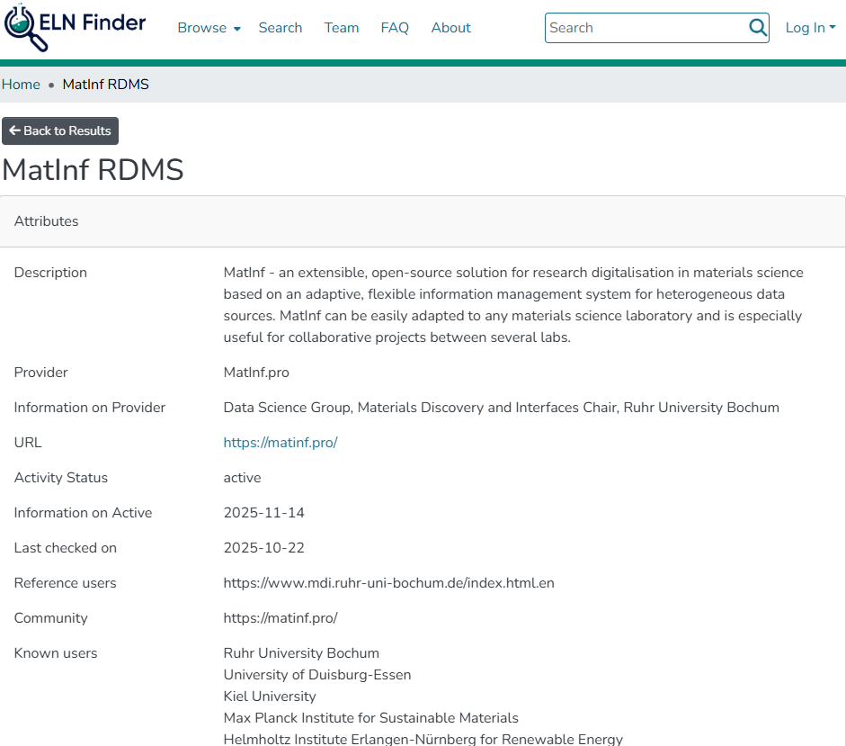
MatInf RDMS on ELN Finder
MatInf RDMS Recognition
A record on ELN Finder:
Open Source (MIT License)
Pricing: Free
On-premises, Software as a Service
Customizable user interface
Client-side and server-side customizations
User-Defined types
Native support for basic chemical entities
Compositional range search
https://eln-finder.ulb.tu-darmstadt.de/items/8aefad94-9f2d-4b40-b94f-21c9419eb3be

Slide 7
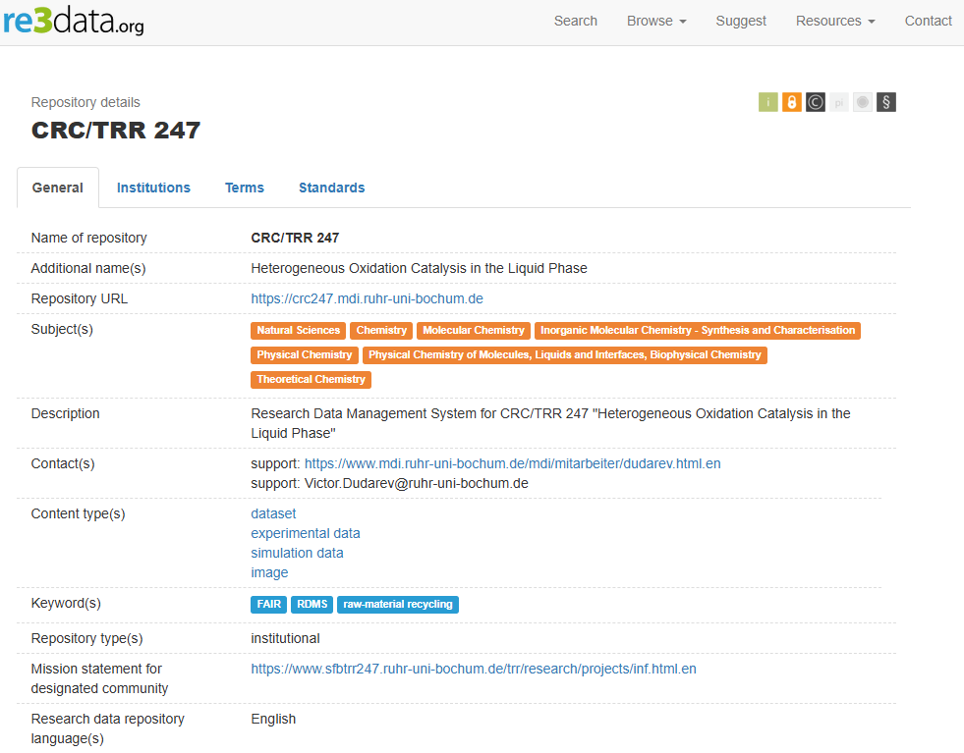
CRC/TRR 277 Repository on re3data.org
CRC/TRR 277 Repository Recognition
after rigorous peer-review process.
Implication:
CRC/TRR 277 Repo satisfies strict Springer Data Repository Guidance rules.
Conclusion:
CRC/TRR 277 Repo can be user to publish data in Nature Scientific Data, etc...
https://www.re3data.org/repository/r3d100014712
re3data.org: CRC/TRR 247; editing status 2026-02-06; re3data.org - Registry of Research Data Repositories. https://doi.org/10.17616/R31NJNUG, last accessed: 2026-06-10
https://www.nature.com/sdata/policies/repositories

Slide 8
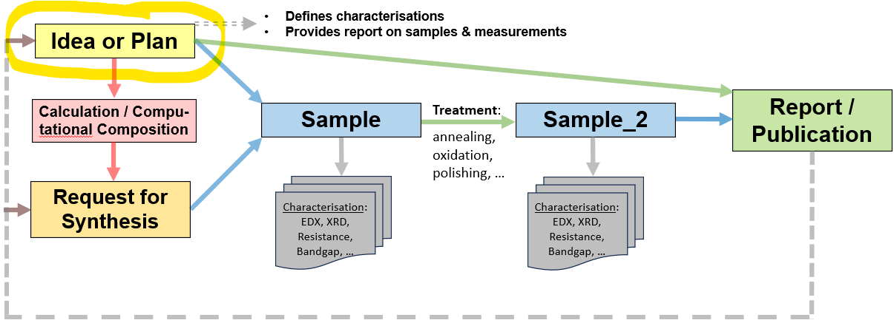
Data Publication workflow: a plan
Prerequisite: you have data
Goal: publish a Data Paper
Steps:
For the subgraph: enable public access and harmonize licenses
Create data snapshot (zip archive)
Archive a snapshot on Zenodo in the CRC 247 community and get DOI
Write down DOI in the RDMS in the root object “Idea or Plan” object
Optional: create a notebook in Jupyter4NFDI and reference both RDMS and Zenodo
Use a template to create a “Data Availability Statement”
Use a template to create a “Code Availability Statement”

Slide 9
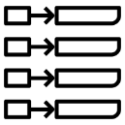
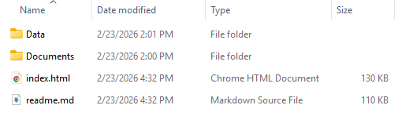

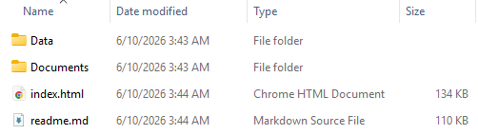


Dual Data Access Publication Strategy
Live Research Data Layer
Archival Snapshot Layer
CRC/TRR 247 Community on Zenodo
project
Research snapshots
1
key-value
Version 1 (DOI)
subproject
subproject
2
3
4
6
Bi-directional links
5
Version 2 (DOI)
subsubproject
7
table
…

Slide 10

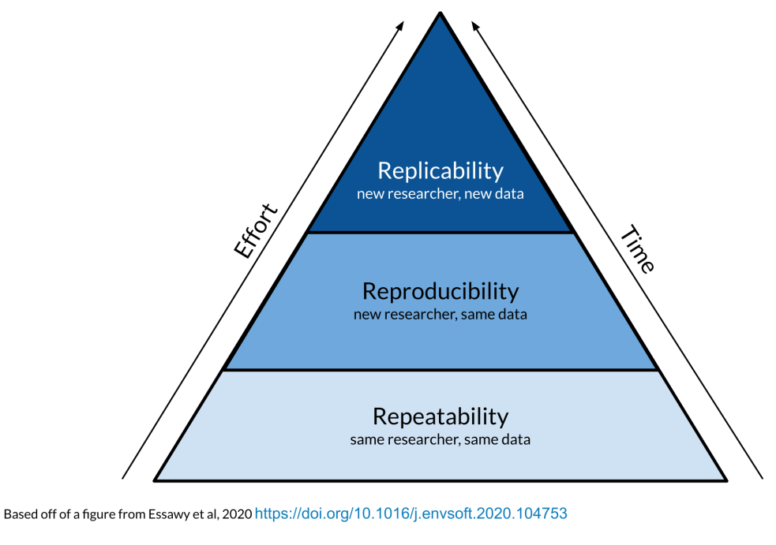
Reproducibility via executable documents
Jupyter4NFDI:
offers centralized service for Jupyter Notebooks
available within and beyond the NFDI
simplifies user access (via IAM4NFDI)
repo2docker integration
custom docker images
Real-Time Collaboration (concurrent team work)
Storage Mount
shareable links (PID) for Jupyter configurations
https://base4nfdi.de/projects/jupyter4nfdi
https://nfdi-jupyter.de/
https://hub.nfdi-jupyter.de/ IAM - Identity and Access Management

Slide 11
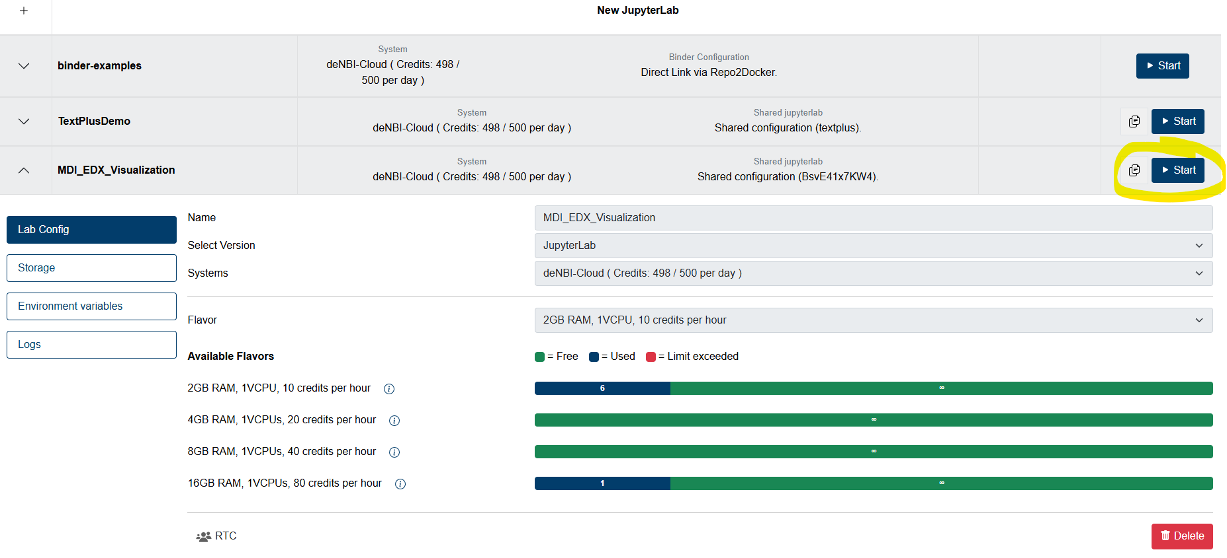
Reproducibility: a persistent link to an excutable
https://hub.nfdi-jupyter.de/
https://hub.nfdi-jupyter.de/share/BsvE41x7KW4

Slide 12
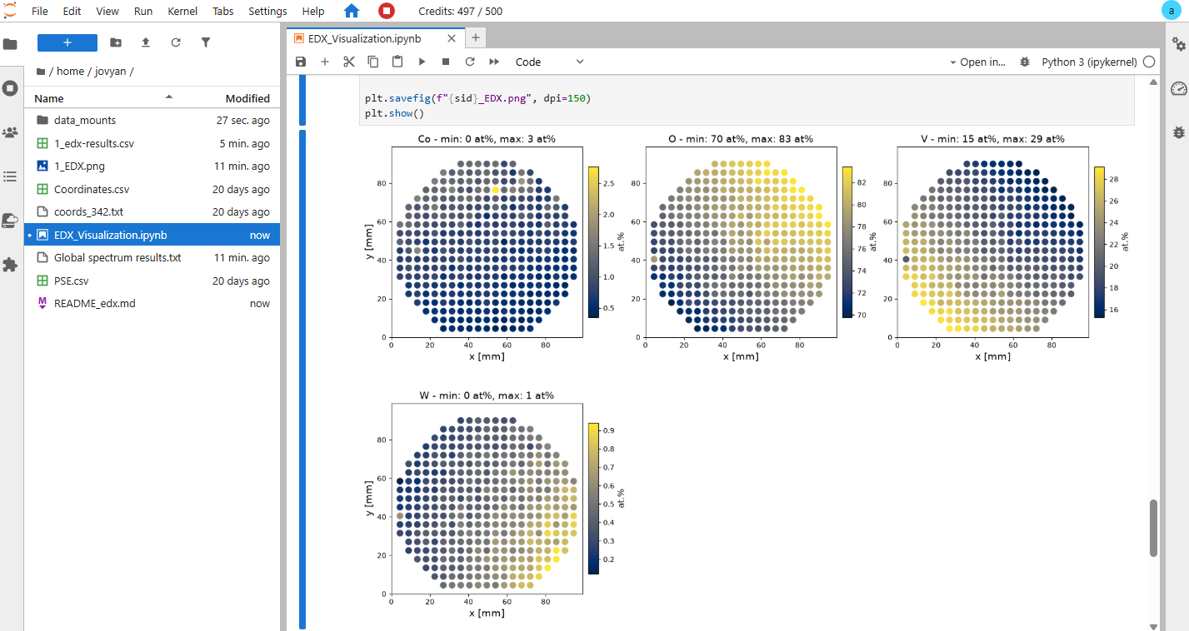
Reproducibility example: an EDX visualization
https://hub.nfdi-jupyter.de/
https://hub.nfdi-jupyter.de/share/BsvE41x7KW4

Slide 13


Triad for a perfect publication support
DOI
Live Research Data Layer
Archival Snapshot Layer
Persistent URLs (PIDs)
URL:
Live data
DOI:
Data archive
replicability
reproducibility
Executable documents
DOI – Digital Object Identifier
URL – Uniform Resource Locator
PID – Persistent Identifier

Slide 14
Object Graph as a Research Workflow Representation
STAR paradigm: Statefulness, Traceability, Aim, and Result
Defines characterisations
Provides report on samples & measurements
Idea or Plan
Calculation / Compu-tational Composition
Treatment:
annealing,
oxidation,
polishing, …
Report / Publication
Sample
Sample_2
Request for Synthesis
Characterisation:
EDX, XRD, Resistance, Bandgap, …
Characterisation:
EDX, XRD, Resistance, Bandgap, …
EDX – Energy-Dispersive X-ray spectroscopy (to determine composition) XRD – X-Ray Diffraction (to determine crystallographic structure)

Slide 15
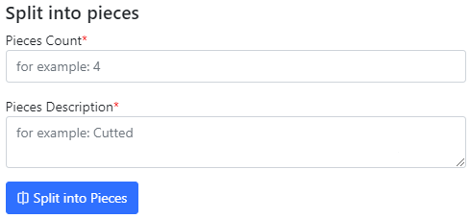
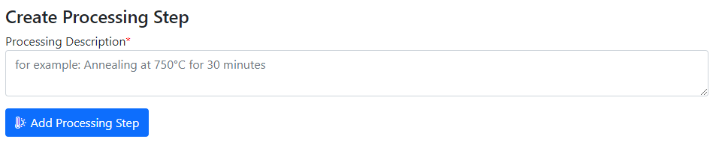
Statefulness: Sample Transformation Workflow
Create Processing State & Split Sample
Sample_2a_2
(subsample 2a state 2)
polishing
Documents2a_2
Sample_2a
(subsample 2a)
annealing
splitting
Sample_2b_2
(subsample 2b state 2)
Sample
(initial state)
Sample_2
(changed state 2)
oxidation
Sample_2b
(subsample 2b)
documents
documents2
Documents2b_2
https://crc1625.mdi.ruhr-uni-bochum.de/object/10472-agauirpdpt-on-au-111-on-mica-34573

Slide 16
Goal: RDMS evolution towards AI-ready datasets
Document-oriented Graph Factographic
project
project
project
1
1
1
key-value
subproject
subproject
subproject
subproject
subproject
subproject
2
3
4
5
6
2
3
4
5
6
2
3
4
5
6
subsubproject
subsubproject
subsubproject
7
7
7
table
RDMS: Research Data Management System
Notes:
Statefulness, Traceability, Aim, and Result

Slide 17

Documents workflow: Standardisation, Testing, Extraction
Failure
Type-dependent mechanisms
fail
document
MatInf RDMS
Data
validation
user
/ API
ok
Data extraction
JSON
Persisting
(document + data)
objects
properties
Database
document
View
SHA-256
link
File
storage
Data visualisation
document
HTML

Slide 18
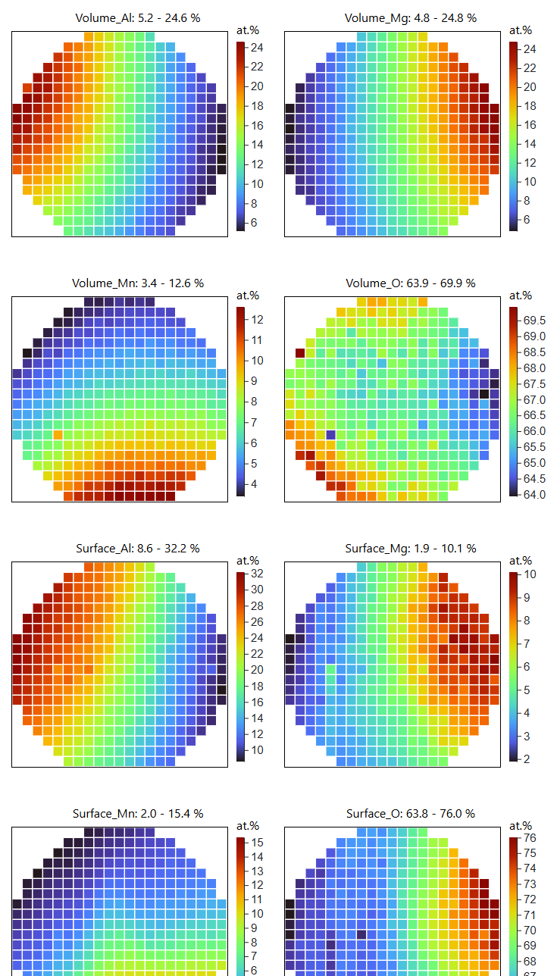
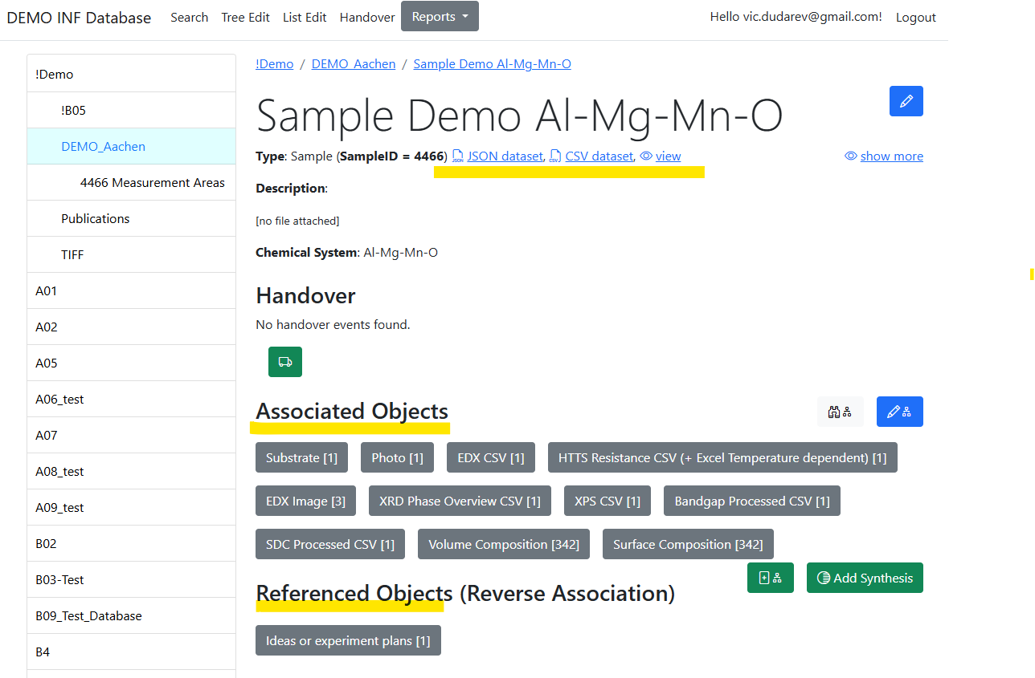
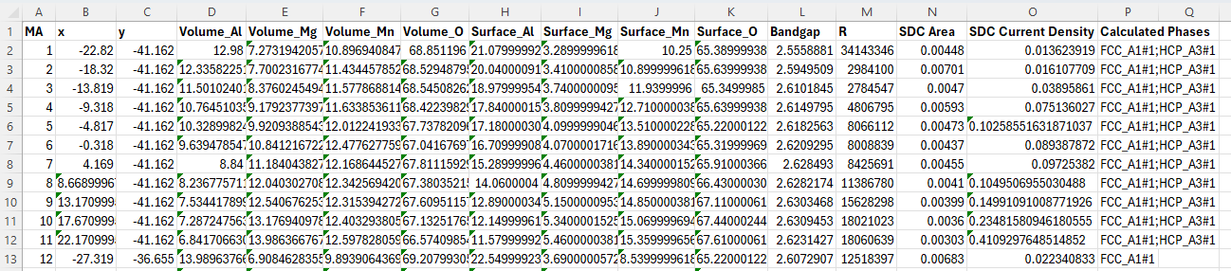
Data Integration: AI-ready datasets
Example: Volume & Surface compositions, Bandgap, Resistance, Catalytic activity
https://inf.mdi.ruhr-uni-bochum.de/object/sample-demo-29196

Slide 19
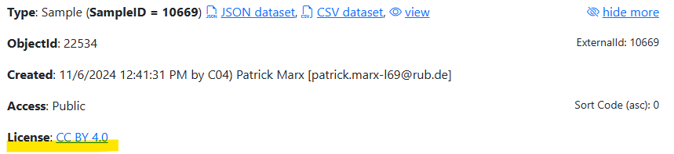
Licenses in objects
Goal: accompany objects/data with explicit data sharing terms.
Default: tenant’s license (CC BY 4.0), configured for a tenant
Adjustment – set License (String) property for the object:
Name: “License”
Value: <License_Name> (e.g., “CC BY 4.0”)
Comment: <License_URL> (e.g., “https://creativecommons.org/licenses/by/4.0/”)
https://crc247.mdi.ruhr-uni-bochum.de/object/241106-k3-1-106937
Possible licenses: https://creativecommons.org/licenses/

Slide 20
RDMS Access Levels
Motivation:
Managing data access policy using the Access Control attribute at the individual object level.
RDMS data access policy is controlled via Access Levels
Five Access Levels:
Public (for anonymous users, search engines):
    - objects are available to everybody regardless of authorization (visible to internet search engines);
^{NEW} Partner (for external users / collaborations)^{NEW}:
    - objects are visible to the authorized users with a Partner claim (and at least User role assigned);
Protected (by default, visible to the community only):
- objects are visible to the community (available to authorized users with at least User role assigned);
ProtectedNDA (restricted visibility):
- objects are visible to the authorized users (at least User role assigned) with NDA claim set OR to Administrators;
Private (person’s secret, but open for Administrators):
- objects are visible to the user-creator (at least PowerUser role assigned);
- objects are visible to all users of Administrator role.
relaxed
User’s Access Claim:
Partner
NDA
strict
Protected is default access level in the CRC
NDA - Non-Disclosure Agreement

Slide 21

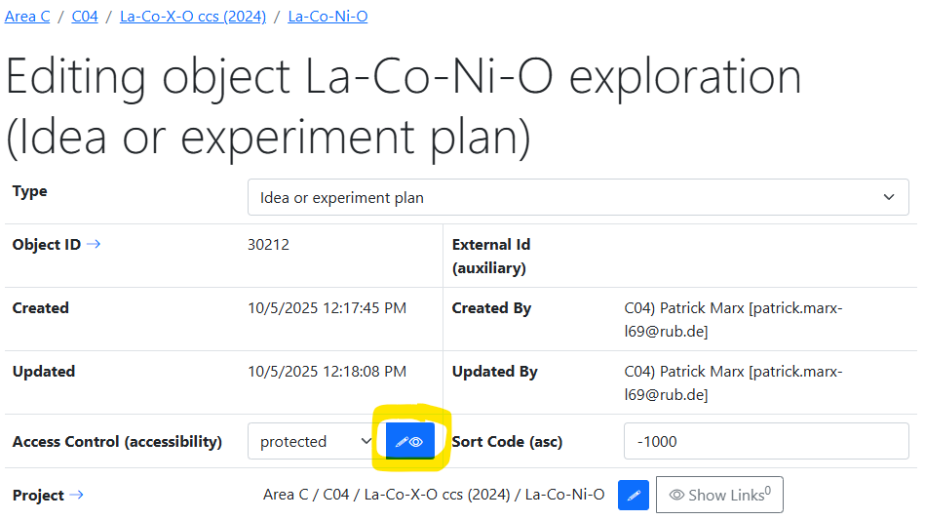
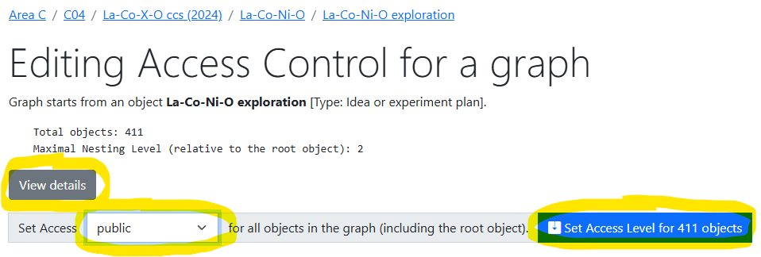
Data publication
Goal:
Change Access Control for entire object graph
Making objects public
Detailed statistics:
Access Control
Licenses
Authors (Creators)
Full Object list for a graph
https://crc247.mdi.ruhr-uni-bochum.de/adminobject/edititem/30212/?returl=%2Fobject%2Fla-co-ni-o-exploration-147192
https://crc247.mdi.ruhr-uni-bochum.de/adminobject/editgraph/30212?mode=AccessControl

Slide 22
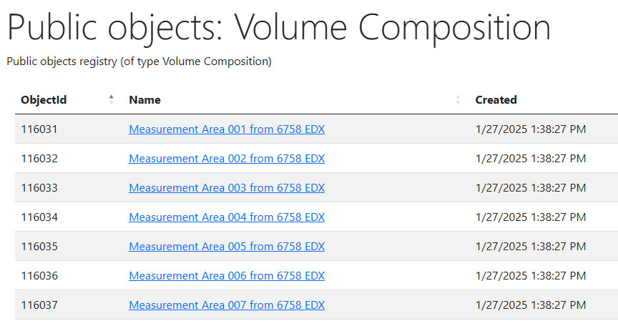
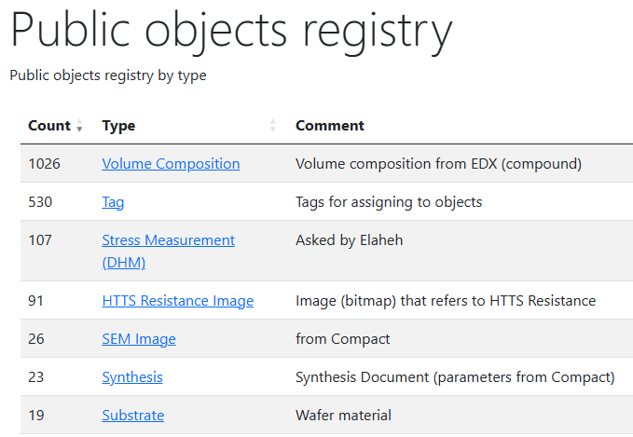
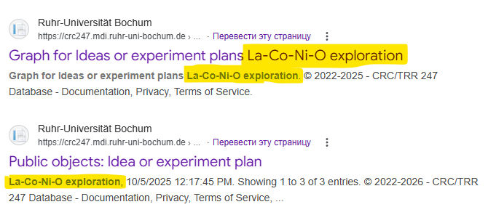
Public objects registry
Goal:
make public objects findable for search bots
To do: generate sitemap.xml (metadata for search bots)
https://crc247.mdi.ruhr-uni-bochum.de/public https://crc247.mdi.ruhr-uni-bochum.de/public/type/8
https://www.google.com/search?q=la-co-ni-o+exploration+site%3Acrc247.mdi.ruhr-uni-bochum.de

Slide 23
Data snapshot script
Python code on the top of VRO API
Goal:
Create a graph snapshot (folder with (meta)data) to publish on external repositories (Zenodo, etc).
Input:
Tenant URL (https://crc247.mdi.ruhr-uni-bochum.de)
VRO API Key (assigned to user by an administrator upon request; to do: GUI for power users…)
root ObjectId (top-level object, e.g., “idea or experiment plan”)
Output:
A folder that contains:
readme.md (+ links to live data)
index.html (+links to live data)
Data folder (with CSV and JSON)
  + index.csv / index.json – all basic objects metadata in a graph
Documents (with files associated)
https://gitlab.ruhr-uni-bochum.de/vic/infproject/-/tree/master/SCRIPTS/Extract_ExperimentData
python VroApi.py --object-id 30212 --tenant-url "https://crc247.mdi.ruhr-uni-bochum.de" --api-key "<VRO_API_Key>" --publish-dir "Publish"

Slide 24
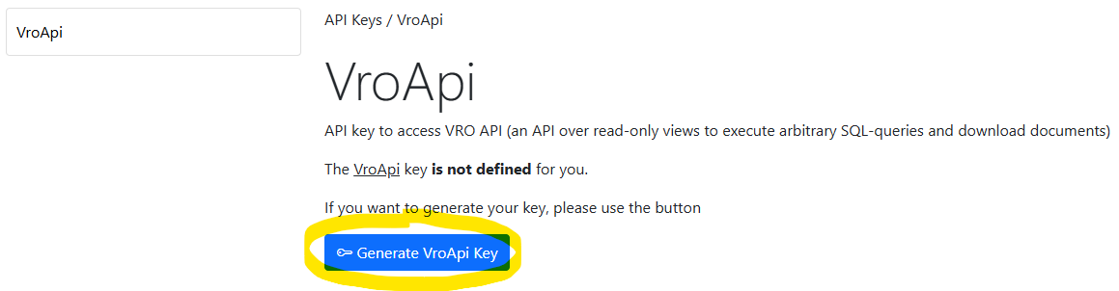
How do I get an API Key?
Goal:
Generate VRO API Key (to directly access database for data snapshot creation).
Actions:
1) Go to the API Keys page using the link in the footer:
2) Select VroApi to see the Generate VroApi Key button and activate it:
https://crc247.mdi.ruhr-uni-bochum.de/adminsecrets
https://crc247.mdi.ruhr-uni-bochum.de/adminsecrets/key/1

Slide 25
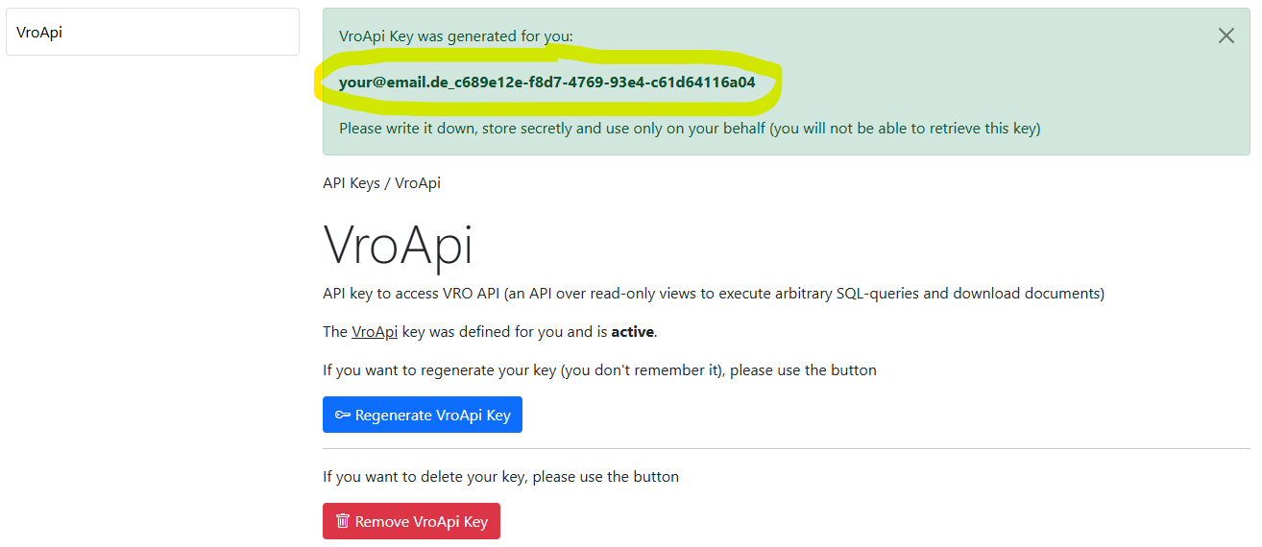
Copy the API Key and keep it secret
You see the API Key only once, save it:
https://crc247.mdi.ruhr-uni-bochum.de/adminsecrets
https://crc247.mdi.ruhr-uni-bochum.de/adminsecrets/key/1

Slide 26
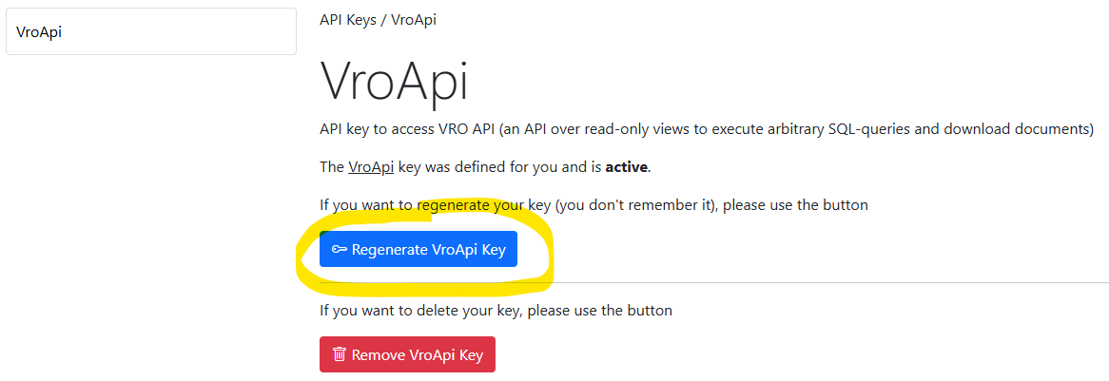
What do I do if I don’t know/remember my key
Solution: Regenerate the VRO API Key
https://crc247.mdi.ruhr-uni-bochum.de/adminsecrets
https://crc247.mdi.ruhr-uni-bochum.de/adminsecrets/key/1

Slide 27
DOI: Snapshot archival (publication) script
Python code on the top of Zenodo API
Goal:
Zip data and create a Zenodo publication to mint a DOI.
Input:
ZenodoConnection.json (API token; IsSandbox)
PublicationMetadata.json (title, authors, keywords, license, Zenodo community [CRC 247], etc…)
Data folder (to make a Zip-archive and sent to Zenodo)
Output:
A Zenodo record with URL/DOI
Create DOI property in the “idea or experiment plan” object.
data.zip
DOI
https://gitlab.ruhr-uni-bochum.de/vic/infproject/-/tree/master/SCRIPTS/PublishToZenodo
python “Publish" ZenodoConnection_Sandbox.json PublicationMetadata_Sandbox.json false
DOI – Digital Object Identifier

Slide 28
Data Availability Statement
Goal:
reference archival data snapshot (DOI)
reference live research data (URL)
A typical Data Availability Statement for a dual data access strategy implemented can be:
Just fill in placeholders
The research data supporting the findings of this study are publicly available through the Zenodo repository under DOI: <DOI>. The published dataset represents an archival snapshot corresponding to the data used in this publication.
The current version of the dataset, including subsequent updates and corrections, is available through the MatInf Research Data Management System at: <URL_idea_plan>.

Slide 29
Code Availability Statement
Goal:
reference executable documents / notebooks with reproducibility (URL_Jupyter4NFDI)
reference source code used during publication (DOI_source_code)*
reference source code repository to provide access to the last source code version (URL_public_Git_repository)
A typical Code Availability Statement for a complete publication triad implemented can be:
just fill in placeholders
The computational workflows used to generate the results presented in this study are available as Jupyter notebooks at: <URL_Jupyter4NFDI>. The notebooks contain all scripts, processing steps, and visualization procedures required to reproduce the analyses described in this publication.
Complete source code corresponding to the one used in this publication is available on Zenodo at: <DOI_source_code>. Current source code version is available at: <URL_public_Git_repository>.
* Zenodo is integrated with GitHub and can create snapshots of the source code as associate DOI to them

Slide 30


Summary: publication workflow
Prerequisite: you have data
Goal: publish a Data Paper
Steps:
For the subgraph: enable public access and harmonize licenses
  In the RDMS GUI:
Create data snapshot (extract all the subgraph)
  py-script in /Scripts/Extract_ExperimentData
Archive a snapshot on Zenodo in the CRC 247 community and get DOI
  py-script in /Scripts/PublishToZenodo or Zenodo GUI (community)
Write down DOI in the RDMS in the root object “Idea or Plan” object
  In the RDMS GUI:
Optional: create notebook(s) in Jupyter4NFDI and reference both RDMS and Zenodo
  Use https://hub.nfdi-jupyter.de/
Use a template to create a “Data Availability Statement”
Optional: use a template to create a “Code Availability Statement”
public
data.zip
DOI

Slide 31

Ok…
What’s new?
DB structure adjusted (ObjectInfo: ObjectFileSize introduced, IsPublished removed, etc.)
VRO API views changed accordingly
Successful RDMS Migration to .Net 10 (LTS)
DB migrated to SQL Server 2025 (vectors, RegExp, JSON native type, optimized locking)
Goal: publish data…

Slide 32
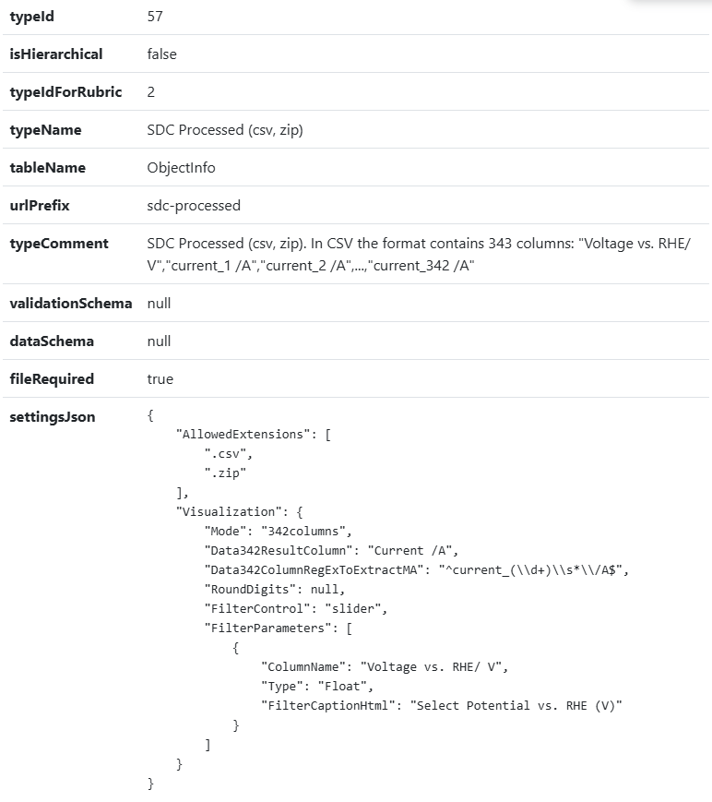
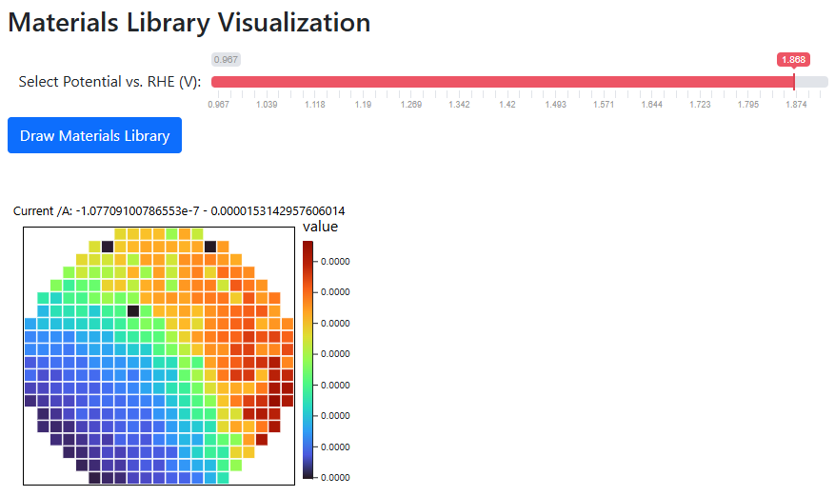
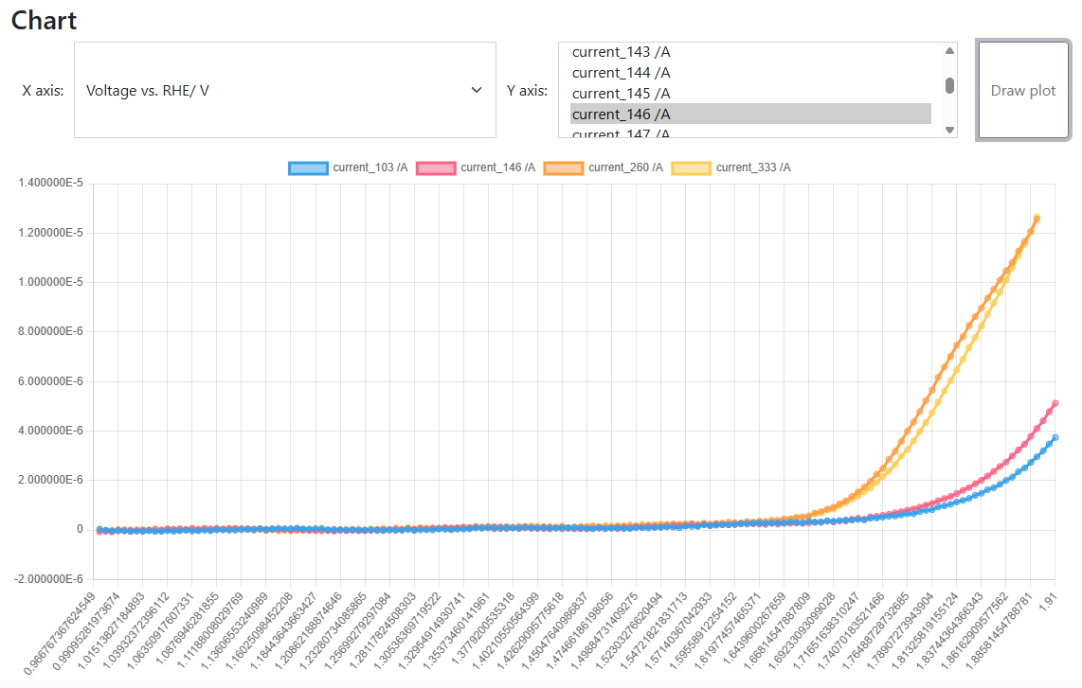
Sliders in data visualizations
Goal: Implement interactive data visualization
Use case:
SDC Processed (csv, zip) type
CSV with fixed format
Strange things in experiments (discovery or mistake?):
https://crc247.mdi.ruhr-uni-bochum.de/file/csv/22677
https://crc247.mdi.ruhr-uni-bochum.de/file/csv/22674
Quality Assurance
(personal responsibility)
SDC Processed (csv, zip): https://crc247.mdi.ruhr-uni-bochum.de/object/20250204_0010671_colanio_ph12_8_oer_lsv_eis-22680
Visualization with a slider: https://crc247.mdi.ruhr-uni-bochum.de/file/csv/22680

Slide 33

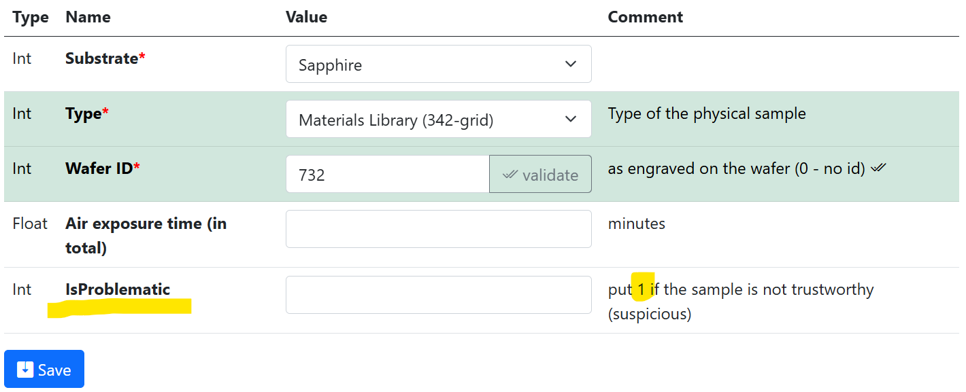
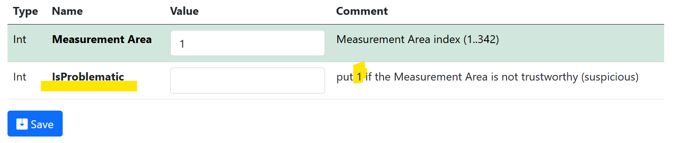
Towards Curation: Flagging unreliable data
Motivation: mark/flag suspicious samples / samples regions (measurement areas) => IsProblematic property
Sample properties
Volume composition properties

Slide 34
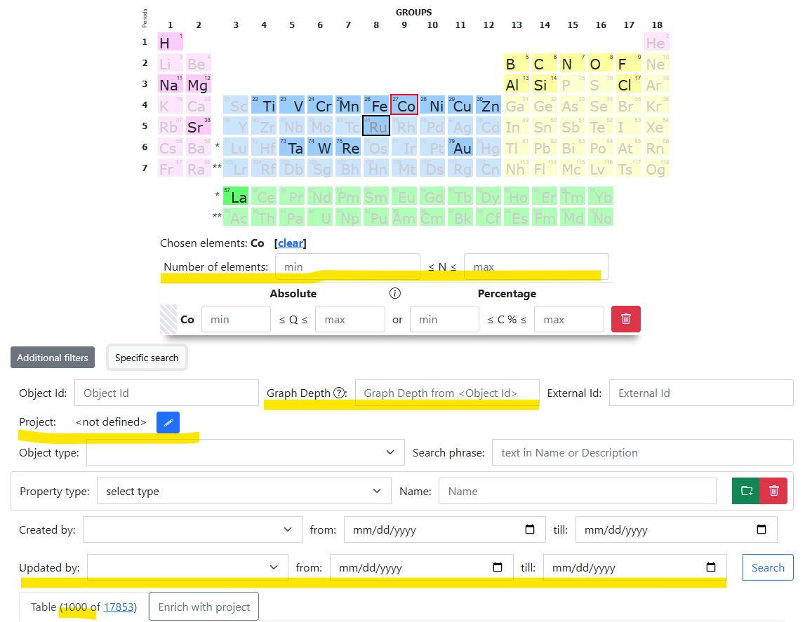
RDMS: Search Criteria Extension
Motivation: add more search criteria to increase expressiveness
New search parameters (as named in query string):
rid – Rubric identifier (to search objects only within specified rubric)
nmin – Minimal number of distinct elements
nmax – Maximal number of distinct elements
olonl – Graph depth (root in <Object Id> node)
updatedbyuser – user, who updated the data
updatedmin – minimal datatime stamp of object update
updatedmax – maximal datatime stamp of object update
pgsize – search page size in objects (1000 – default)
pgn – search page number (1 – default)
By default: top 1000 search results…
https://crc247.mdi.ruhr-uni-bochum.de/search/?system=Co&pgsize=1000

Slide 35
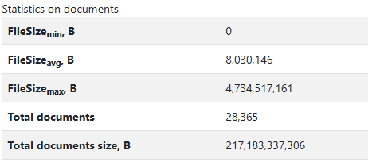
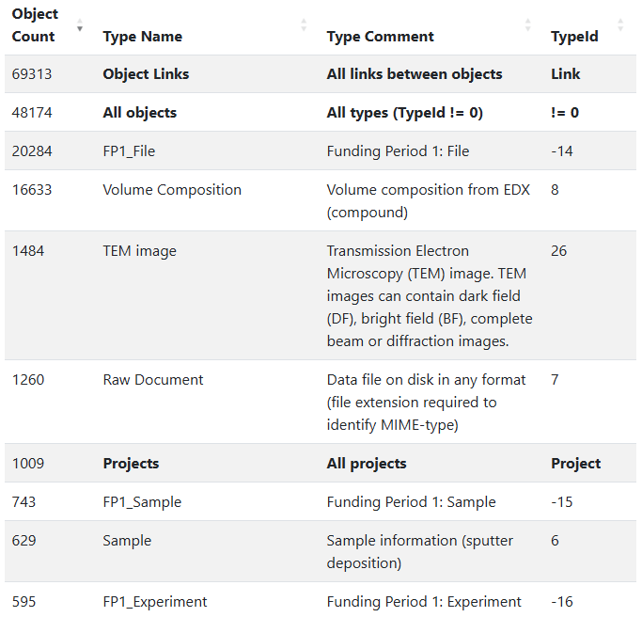
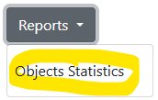
How many data do we have?
Task: raw data volume evaluation
Documents (files):
Total number: 28365
Total volume: 217 Gb
SQL Database:
48 k Objects (16 k volume compositions - auto)
69 k Links (between objects)
1009 Projects
Total rows (all tables): 330 k
Total volume: 75 Mb
General raw statistics: https://crc247.mdi.ruhr-uni-bochum.de/home/general
Objects Statistics report: https://crc247.mdi.ruhr-uni-bochum.de/report/objectsstatistics

Slide 36

RDMS Free Playground
Questions & Answers
Thanks for your kind attention
  https://inf.mdi.ruhr-uni-bochum.de/
Playground to test RDMS (multiple tenants with shared users list):
https://inf.mdi.ruhr-uni-bochum.de/
Login and Password (User role): User1@user.org
Login and Password (PowerUser role): PowerUser1@user.org
Login and Password (Administrator role): Admin1@user.org
https://vdudarev.ru
Notes:
https://qr.io/

Slide 37

Outlook: Architecture
Application Services
Web Application
users
Visualisation
Controller
View
Web API Services
Model
API
agents
Validation
Data Access Layer
Data Extraction
Dapper
IO (SMB/S3)
Queue
External Type Support Services
Database
File Storages
Apache
Kafka
Database
Databases
Storage Services
Message Bus
MatInf – Research Data Management System

Slide 38
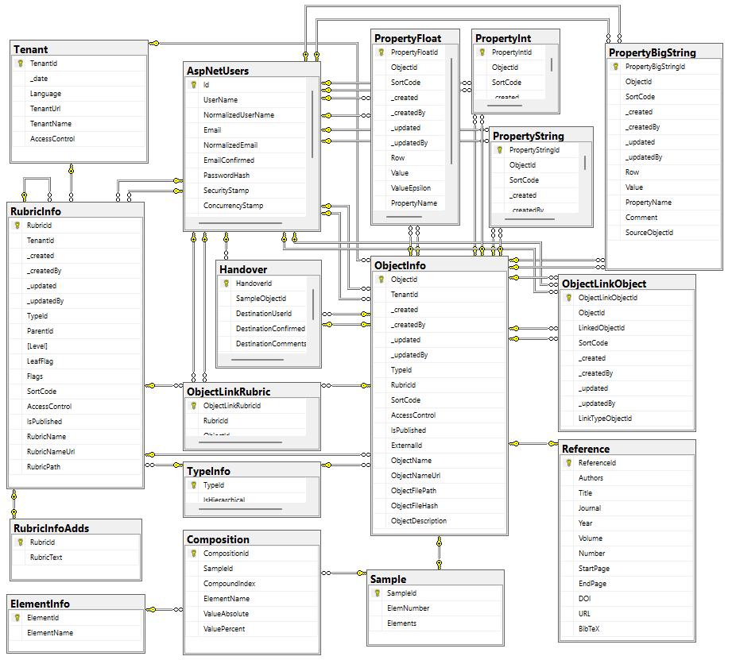

Data Acquisition API: Dashboards & Datasets
The RDMS exposes all data as read-only views
and downloadable documents
API user can introduce any queries over views
POST /vroapi/v1/execute
Executes SQL statement and returns a dataset (in JSON)
GET /vroapi/v1/download
Downloads document by specified identifier (ObjectId)
Database schema documentation:
https://crc247.mdi.ruhr-uni-bochum.de/home/doc
https://crc247.mdi.ruhr-uni-bochum.de/home/doc

Slide 39
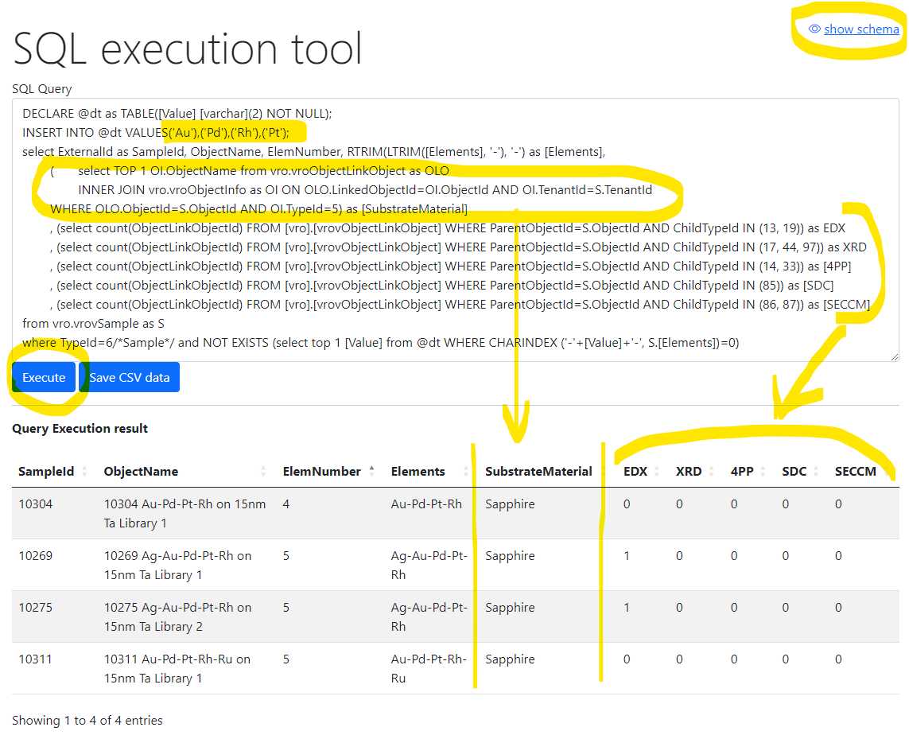
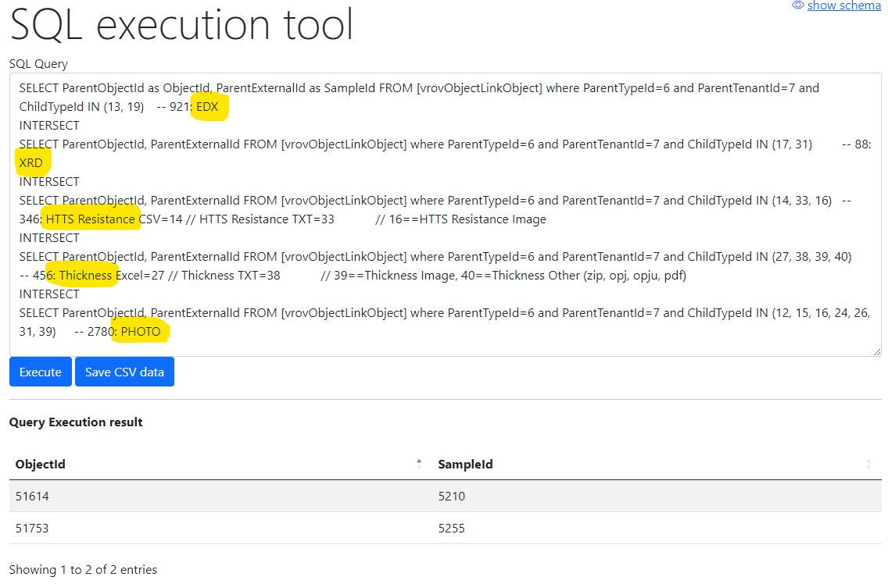
Flexible data queries for advances users
Database schema documentation:
https://mdi.matinf.pro/home/doc
Show samples having Au-Pd-Rh-Pt and how many characterization documents for them we have (EDX, XRD, 4PP, SDC, SECCM)
Show samples (identifiers) that have all enlisted characterisations: EDX, XRD, Resistance, Thickness, Photo
https://mdi.matinf.pro/vroui
EDX - Energy-Dispersive X-ray spectroscopy; XRD - X-ray diffraction; 4PP – 4 Points Measurement (Resistance);
SDC - Scanning Droplet Cell; SECCM - Scanning ElectroChemical Cell Microscopy

Slide 40
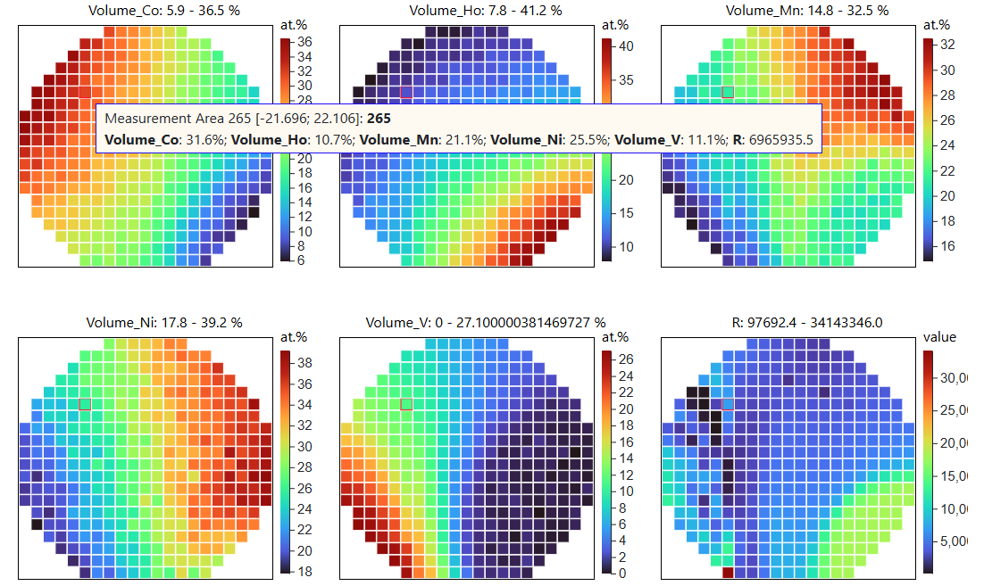
RDMS: Getting a Composition-Property Dataset
Goal: explore a materials library and get composition-property dataset
Workflow:
Create a materials library (Sample) & create Sample (Synthesis?) object in RDMS
Measure compositions in a high-throughput way (EDX) & upload to RDMS
Measure property (4PP Resistance) in a high-throughput way & upload to RDMS
In RDMS: download a dataset (in CSV), containing 342 composition-property data points
In RDMS: visualize a composition-property dataset and draw conclusions
Sample
EDX
4PP
Resistance
EDX – Energy-Dispersive X-ray spectroscopy (to determine composition) 4PP – 4-Point Probe structure)
https://inf.mdi.ruhr-uni-bochum.de/object/sample-demo-29196
https://inf.mdi.ruhr-uni-bochum.de/dataset/sampleshowascsv/29196

Slide 41
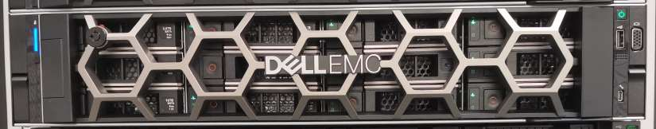

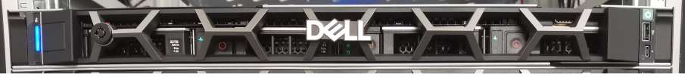
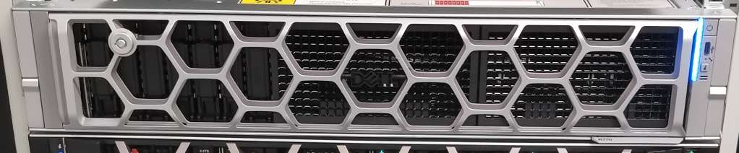
RDMS: Are my data safe?
IC OST Server Room
RUB DC
2 km
Main
Daily/weekly backups
Data
External
Storage
Weekly
backups
Backup
Monitoring
Compute
https://matinf.pro/crc247-fp2-inf-report.htm

Slide 42
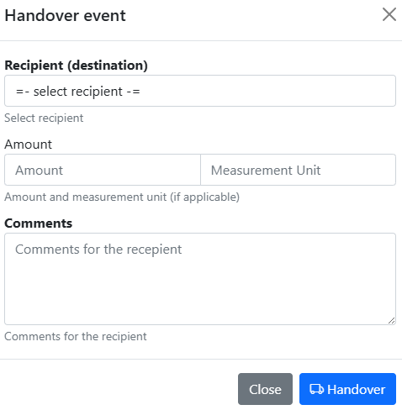
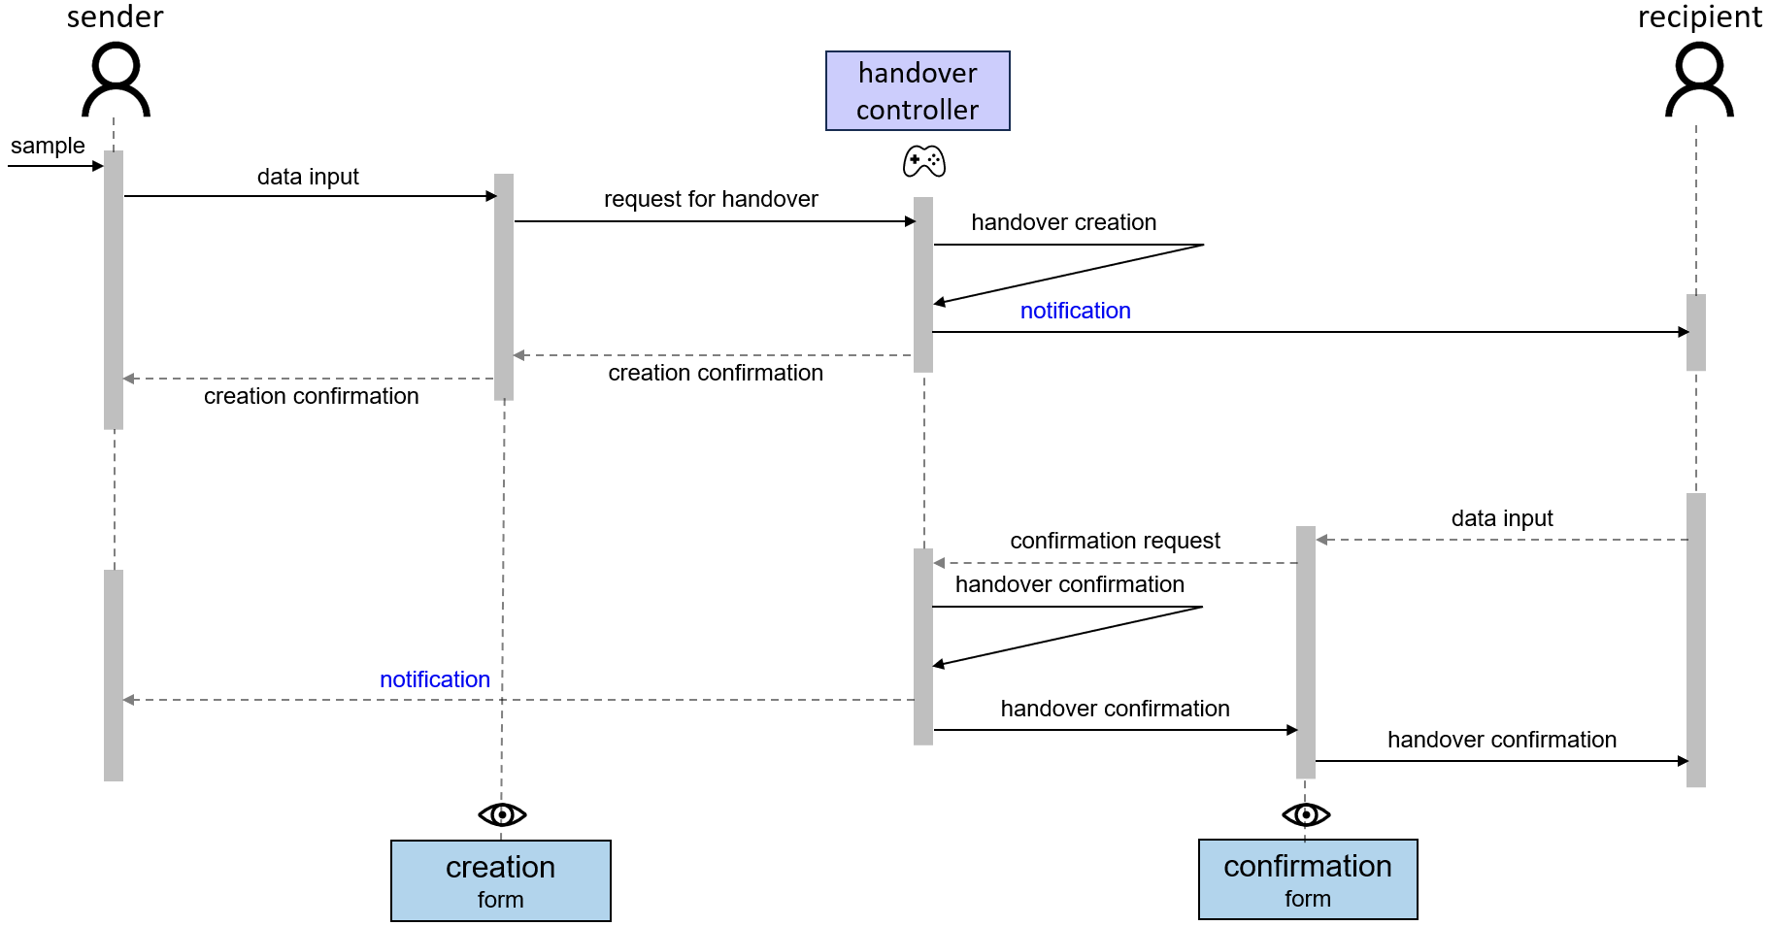

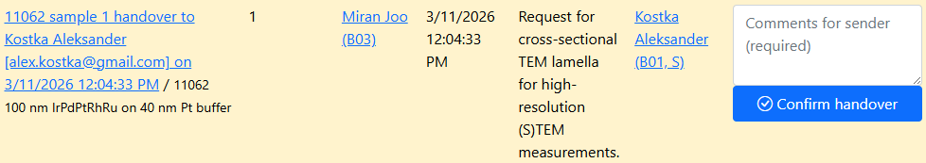
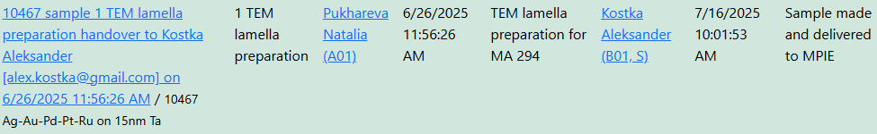
Traceability: Handovers Workflow
Motivation: trace samples (who holds the sample?)
https://crc1625.mdi.ruhr-uni-bochum.de/rubric/s

