Slide 1
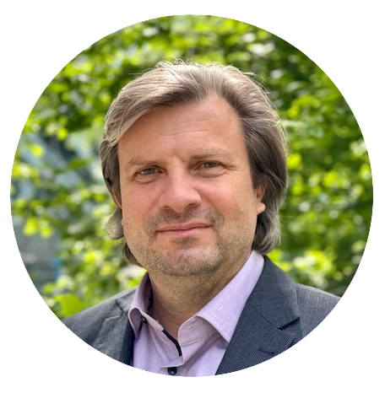
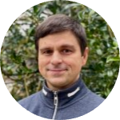
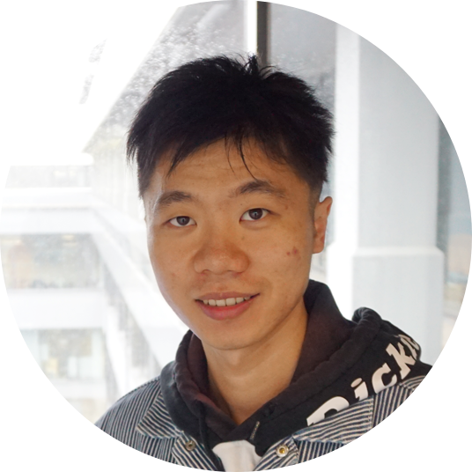







INF
Alfred Ludwig
Towards Automated Research Data Management
for AI-Driven Knowledge Discovery
Victor Dudarev
Lei Zhang
Materials Discovery and Interfaces, Ruhr University Bochum

Slide 2

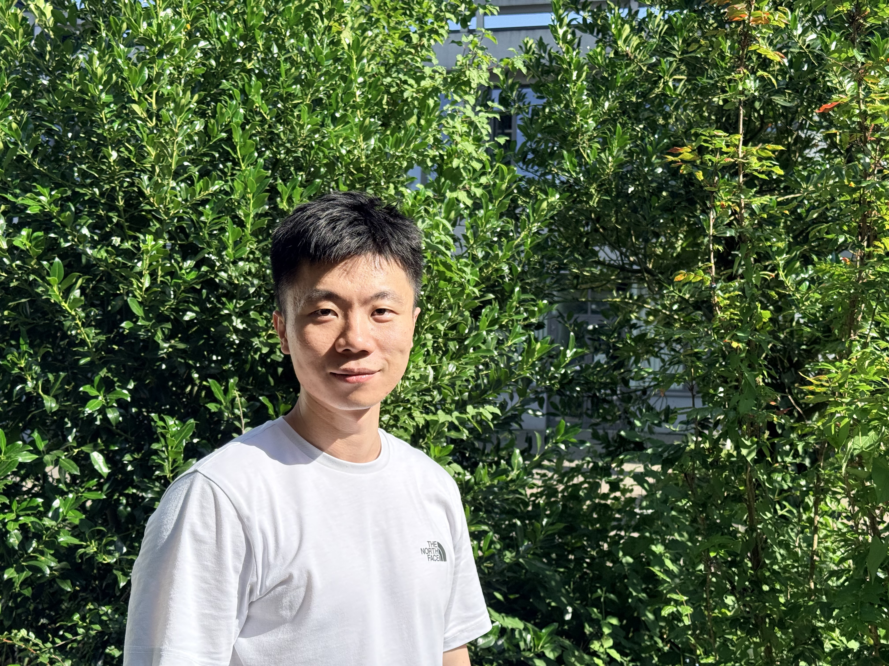

Lei Zhang
Project INF
Reusable datasets for CRC/TRR 247
RDMS record audits and dataset export
Documentation for reusing experimental measurements
Alfred Ludwig
Ruhr University Bochum (RUB)
lei.zhang-w2i@rub.de
Materials research and research data management

Slide 3
Research support throughout your project
Your dataset, supported throughout your research
I help you build and maintain it, with RDMS tailored to your needs.
Tools and workflow in development
Plan
Build
Access
Publish
Before the first experiment
Results with their context
View anytime. Download as needed.
Work towards a dataset paper
Unexpected results can still be valuable
when the data are well documented.

Slide 4
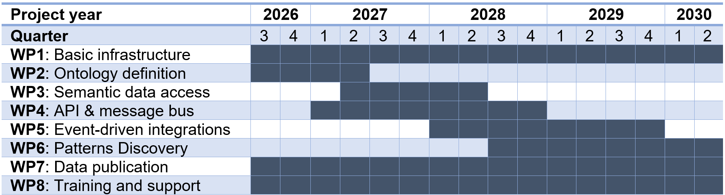
Work Packages Schedule
Permanent Running Packages:
WP1: Basic infrastructure
WP7: Data publication
WP8: Training and support

Slide 5
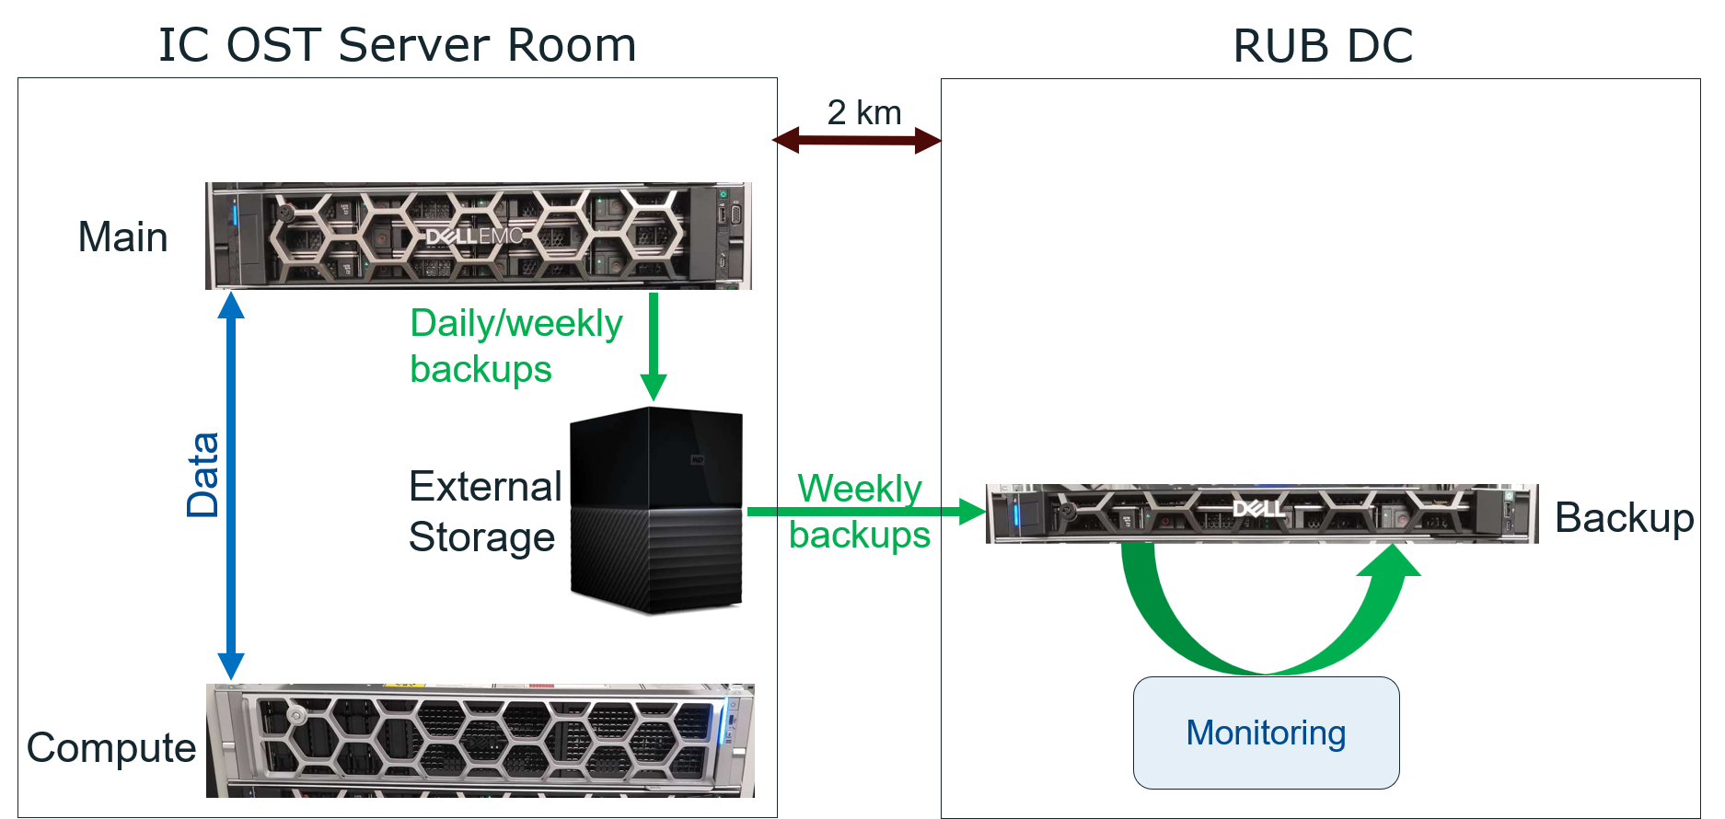


WP1: Basic infrastructure
Dedicated disaster-tolerant hardware INFrastructure:
Main server (Dell PowerEdge R750)
External backup storage (connected to the main server)
Backup server (Dell PowerEdge R6615)
Compute server (Dell PowerEdge R770)
Key INFrastructure features:
distributed across two geographically separated Data Centres (DC)
backup mechanisms (ensuring disaster resilience)
each DC maintains a complete copy of the data and a ready-to-launch Virtual Machine (VM)
automated monitoring of hardware and backup systems (notifications in the event of incidents)

Slide 6




In a collaboration with NFDI-MatWerk and CRC 1625
WP2: Ontology definition
Semantic access to accumulated materials data is possible through
the use of a number of available ontologies:
PMD core
Elementary Multiperspective Material Ontology (EMMO)
in combination with QUDT (Quantities, Units, Dimensions, and Types Ontologies).
+ possible further adaptation and extension of semantic descriptions
EMMO

Slide 7

WP3: Semantic data access
MatInf
MSE-KG
Enabling sematic data access:
SPARQL endpoint to MatInf data (on top of existing MatInf read-only API)
Integration with the Materials Science and Engineering Knowledge Graph (MSE-KG) from NFDI-MatWerk
MSE-KG – Materials Science and Engineering Knowledge Graph
SPARQL – SPARQL Protocol and RDF Query Language

Slide 8
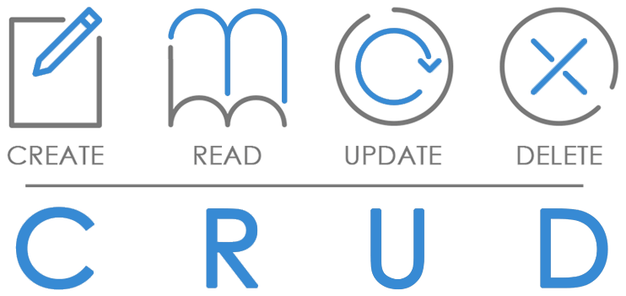
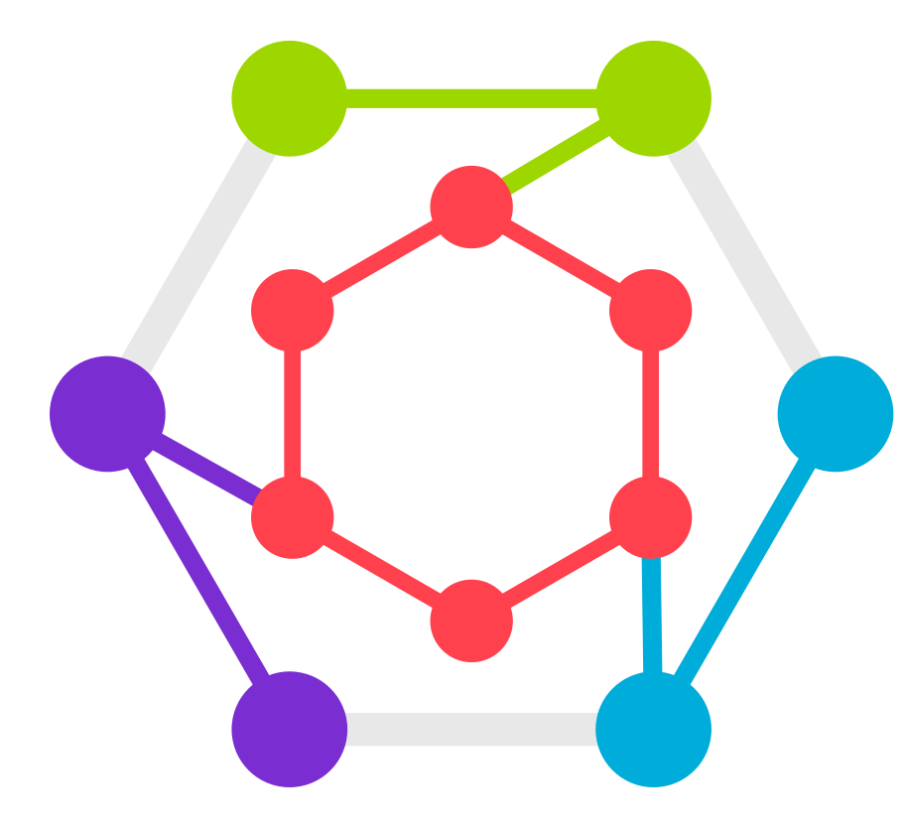

To Be Implemented
WP4: Additional APIs & message bus
low-level CRUD REST API
high-level API for measurement devices
OPTIMADE API wrapper
Apache Kafka message bus integration (for asynchronous communication)
OPTIMADE – Open Databases Integration for Materials Design

Slide 9
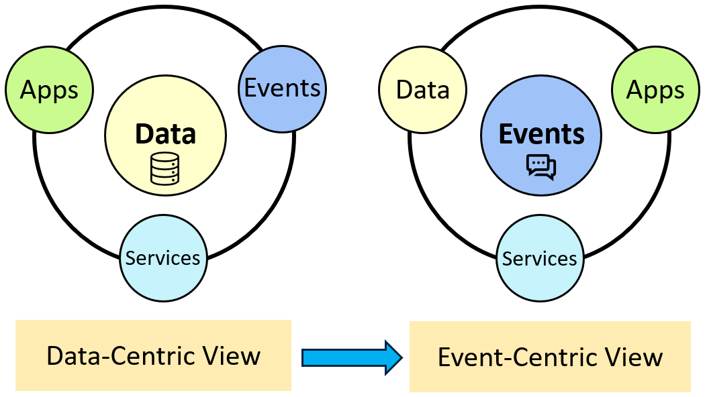
Enabling event-driven integrations for agents
WP5: Event-driven integrations
Infrastructure
MatInf events
MatInf Subscription API
MatInf events catalogue
External events catalogue
Subscribe/unsubscribe to events
Outcome
durable storage of events for up to one week
integration with external, loosely coupled systems (e.g., MSE-KG)
incremental construction of Knowledge Graph (KG) for CRC/TRR 247 directly from MatInf events

Slide 10
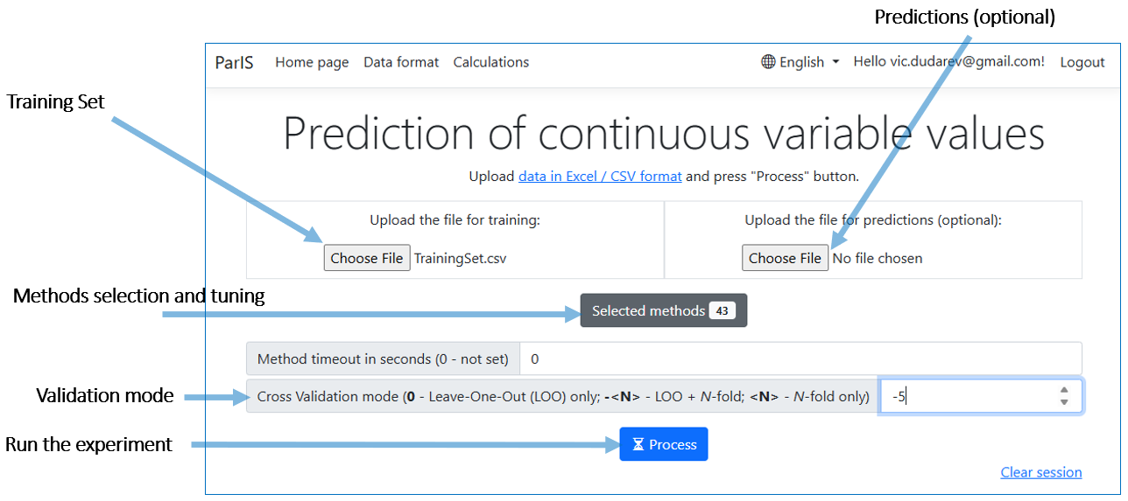
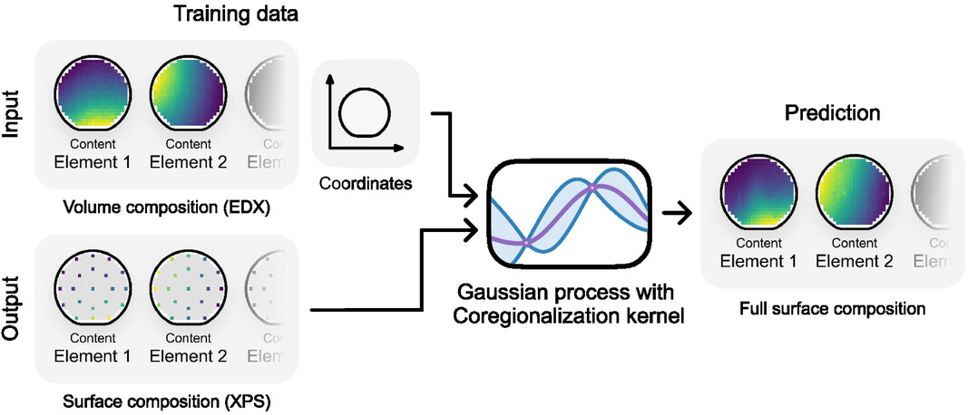
WP6: Pattern Discovery (Towards AI-driven knowledge discovery)
Development of predictive models:
ParIS – system for continuous properties prediction (40+ Machine Learning methods)
    composition-property
    structure-property
active learning (accelerating measurements)

Slide 11
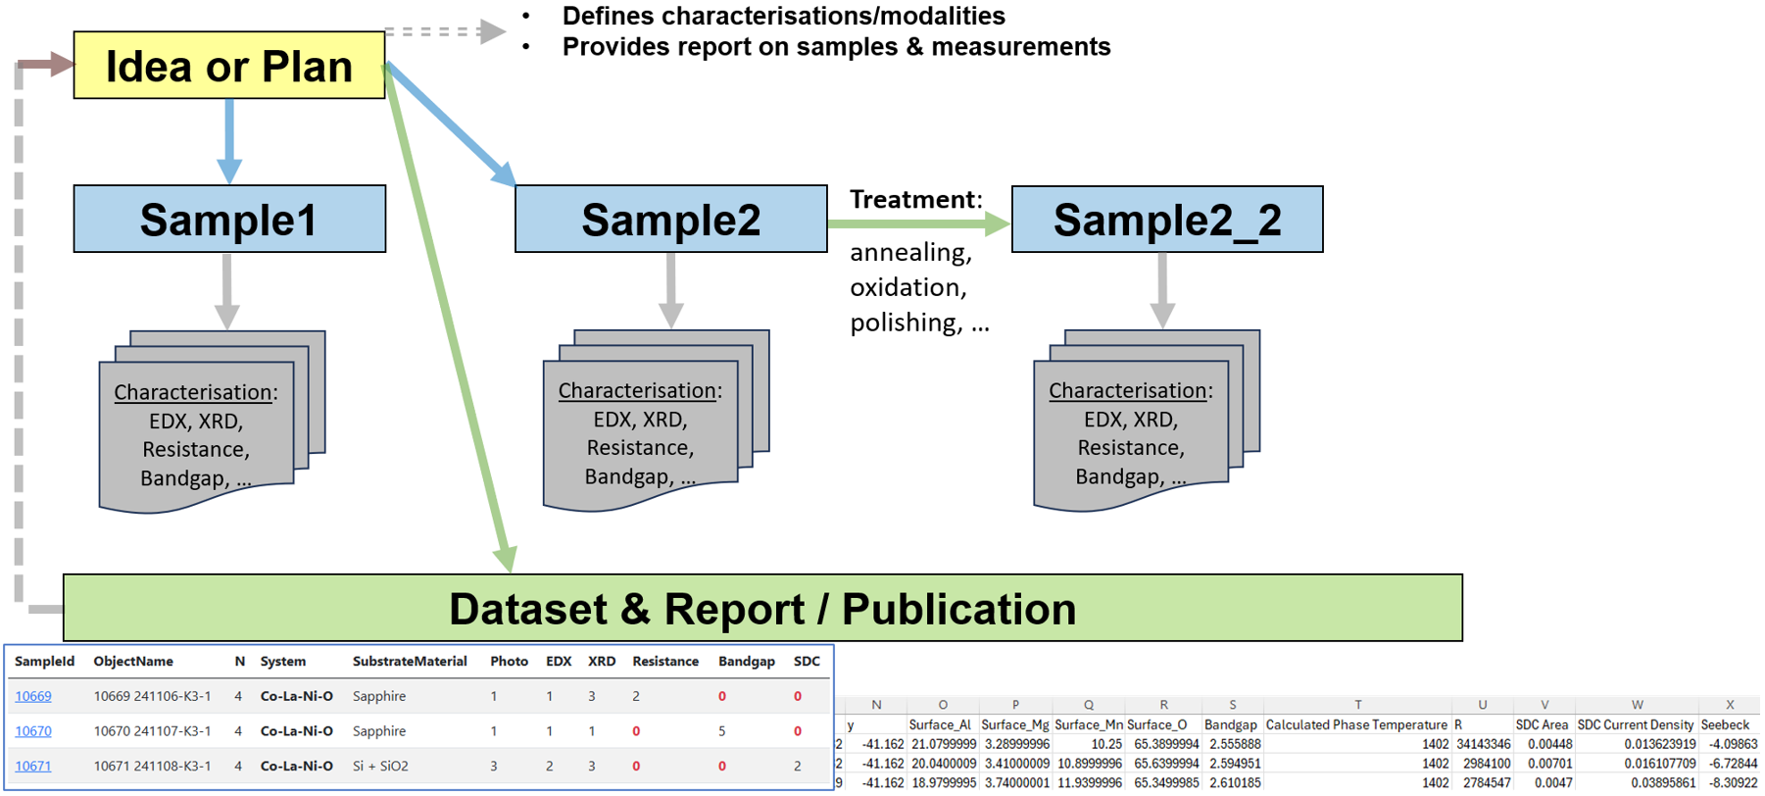
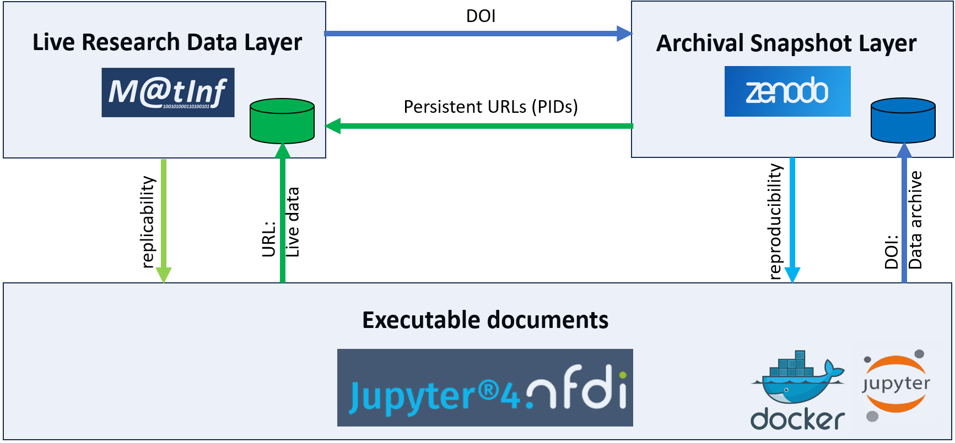
Integrated FAIR datasets publication
WP7: Data publication
RO-Crate objects support in MatInf
MatInf integrated datasets (data from multiple research documents) publication with persistent URL
one-click data publication to Zenodo
(using RO-Crate)
multi-step curation workflows in RUB ReSeeD

Slide 12


Training and support for community members
WP8: Training and support
Training and user support
regular FAIR RDM training with hands-on workshops and individual consultations
onboarding for new consortium members and continuous user feedback for system improvement
Outreach and education
promotion of open, data-driven research through outreach activities
RDM course for Computer Science students at RUB, including a session on MatInf

Slide 13
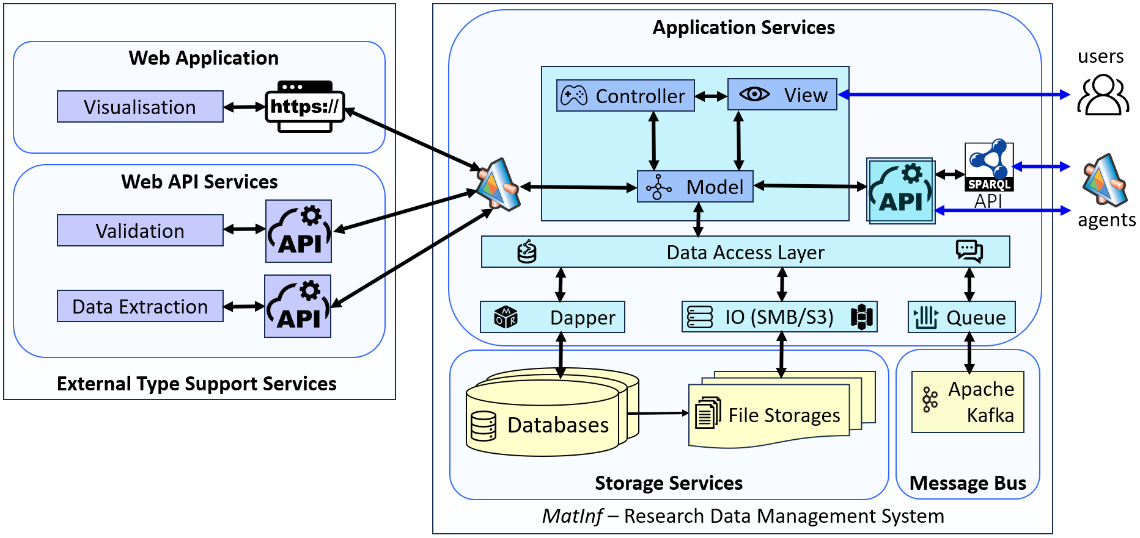

MatInf architecture
Extensible Architecture

Slide 14
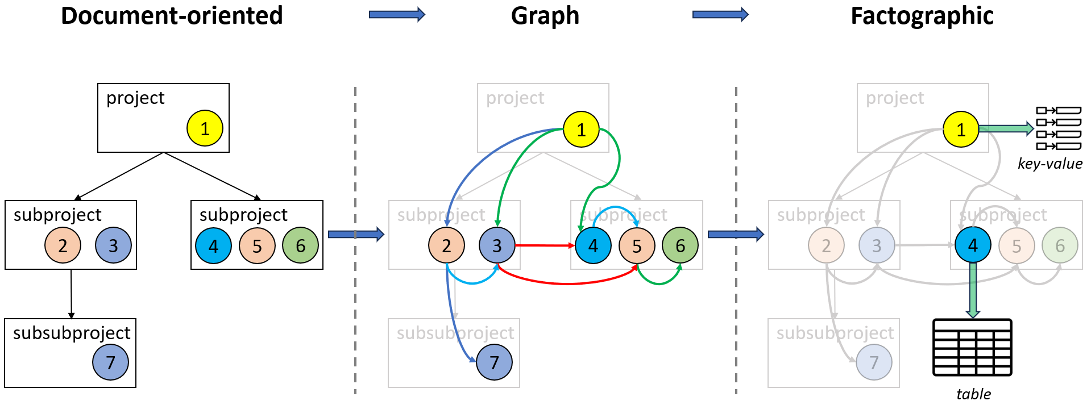
RDMS evolves towards enabling AI-ready datasets
Documents/Types standardization – basis for datasets
By standardising documents and defining data schemas, MatInf RDMS object types become truly facto-graphic by integrating external Web services via API for data validation, extraction, and visualisation

Slide 15
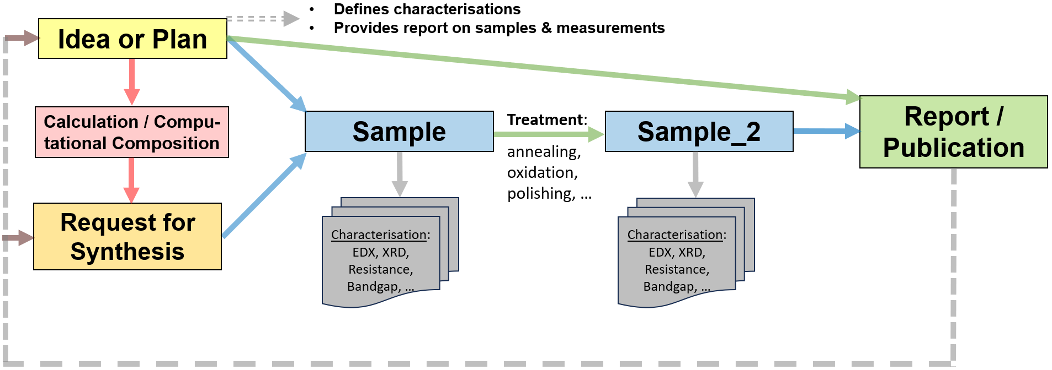
STAR paradigm: Statefulness, Traceability, Aim, and Result
Object Graph as a Research Workflow Representation

Slide 16
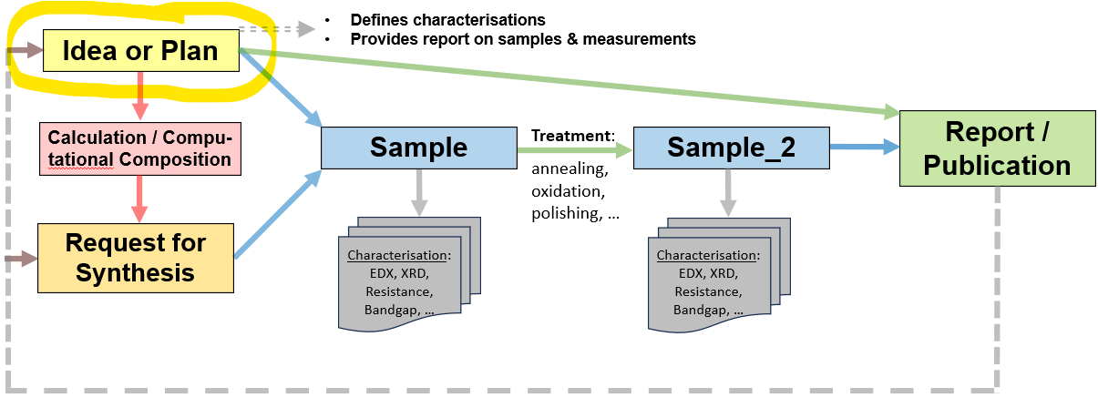
Data Publication workflow: a plan
Prerequisite: you have data
Goal: publish Data Papers
Steps:
For the subgraph: enable public access and harmonize licenses
Create data snapshot (zip archive)
Archive a snapshot on Zenodo in the CRC 247 community and get DOI
Write down DOI in the RDMS in the root object “Idea or Plan” object
Optional: create a notebook in Jupyter4NFDI and reference both RDMS and Zenodo
Use a template to create a “Data Availability Statement”
Use a template to create a “Code Availability Statement”

Slide 17
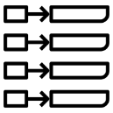
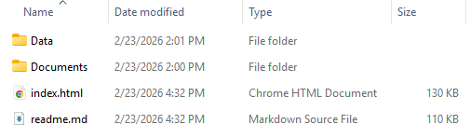

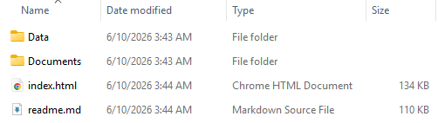

Dual Data Access Publication Strategy
Live Research Data Layer
Archival Snapshot Layer
CRC/TRR 247 Community on Zenodo
project
1
Research snapshots
key-value
Version 1 (DOI)
subproject
subproject
2
3
4
6
Bi-directional links
5
Version 2 (DOI)
subsubproject
7
table
…

Slide 18


Triad for a perfect publication support
DOI
Live Research Data Layer
Archival Snapshot Layer
Persistent URLs (PIDs)
URL:
Live data
DOI:
Data archive
replicability
reproducibility
Executable documents

Slide 19
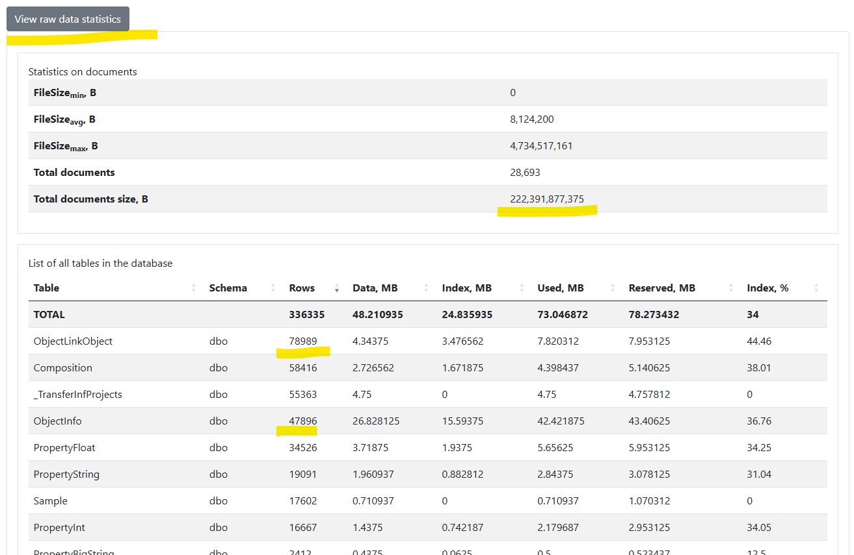
Reports: Live Statistics (overall)
https://crc247.mdi.ruhr-uni-bochum.de/home/general

Slide 20
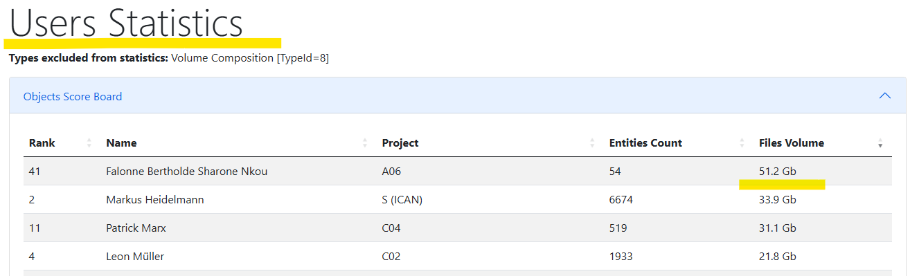
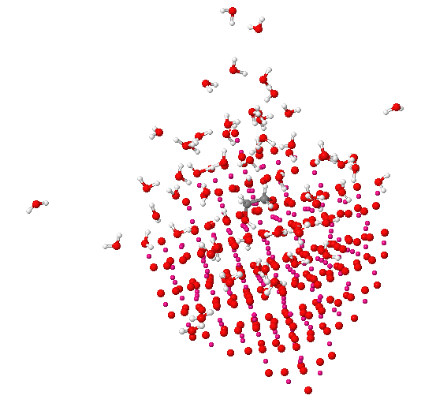
Reports: Live Statistics (Users Statistics / Data volume)
Reports / User Statistics: https://crc247.mdi.ruhr-uni-bochum.de/report/usersstatistics?excludeTypes=8
https://crc247.mdi.ruhr-uni-bochum.de/object/1gly_60wm-b-29741

Slide 21
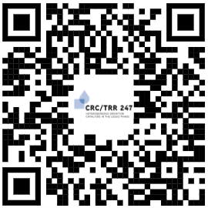
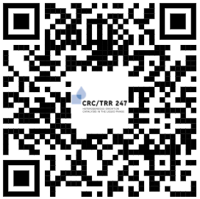
Important links
Thanks for your kind attention
https://crc247.mdi.ruhr-uni-bochum.de/
https://inf.mdi.ruhr-uni-bochum.de/
Production CRC/TRR 247 instance.
Playground to test RDMS (multiple tenants with shared users list):
https://inf.mdi.ruhr-uni-bochum.de/
Login and Password (User role): User1@user.org
Login and Password (PowerUser role): PowerUser1@user.org
Login and Password (Administrator role): Admin1@user.org

Slide 22
INF
Alfred Ludwig
MatInf RDMS Hands-On Session
Victor Dudarev
Lei Zhang
Materials Discovery and Interfaces, Ruhr University Bochum

Slide 23
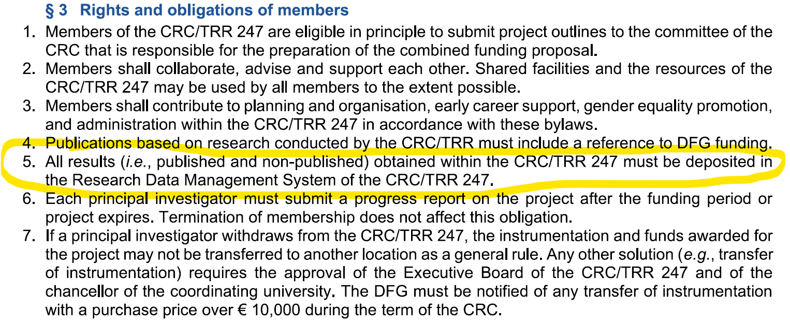
RDMS USAGE OBLIGATIONS

Slide 24

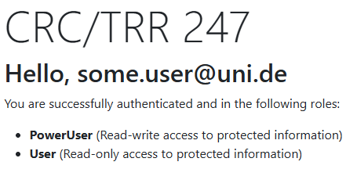
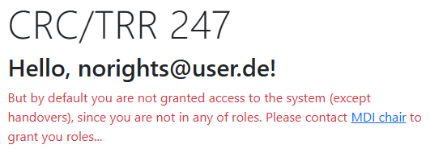
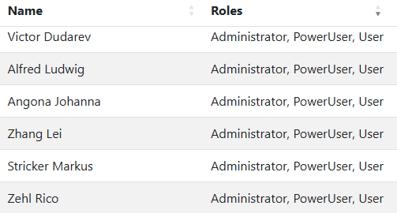
Go to CRC 247 Home Page (and login)
Do I have access?
Contact Administrators:
https://crc247.mdi.ruhr-uni-bochum.de/

Slide 25
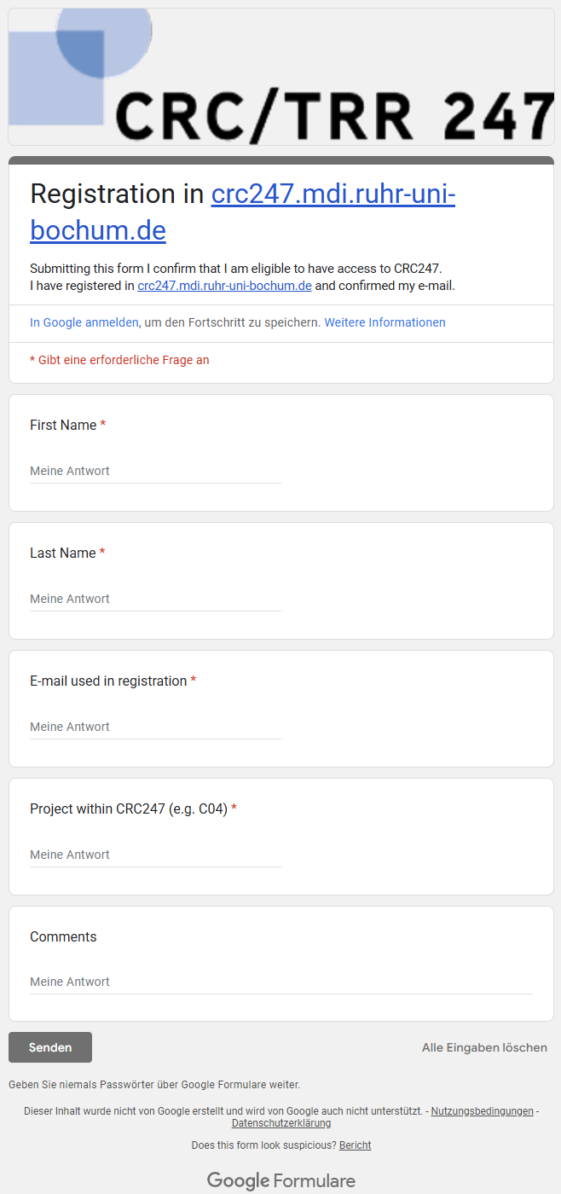
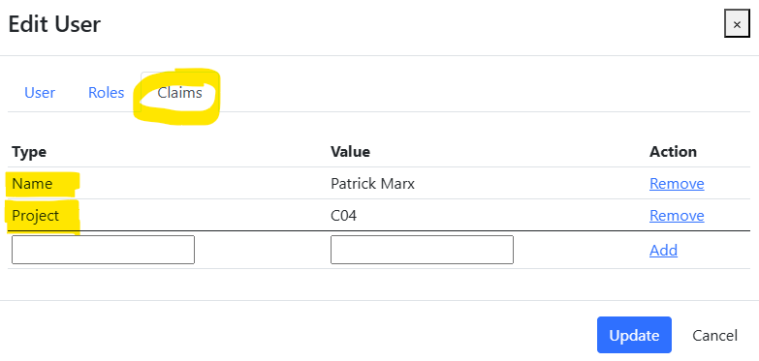
In case you Don’t have access…
Production (https://crc247.mdi.ruhr-uni-bochum.de):
You need to register with Google account or create your own account (email/password) and confirm e-mail (warning: user created with no role assigned).
Fill the access request form https://forms.gle/tkZeweU6kStRCoKp7, specifying your e-mail, used in registration, your name, project (e.g. A02) and optional comments.
Wait… After manual processing you will be assigned by default a PowerUser role and you are in power of adding data ))
Important for Administrators!
Please, assign the following claims:
Name
Project
Administrators:
Victor Dudarev,
Lei Zhang,
Johanna Angona,
Alfred Ludwig

Slide 26
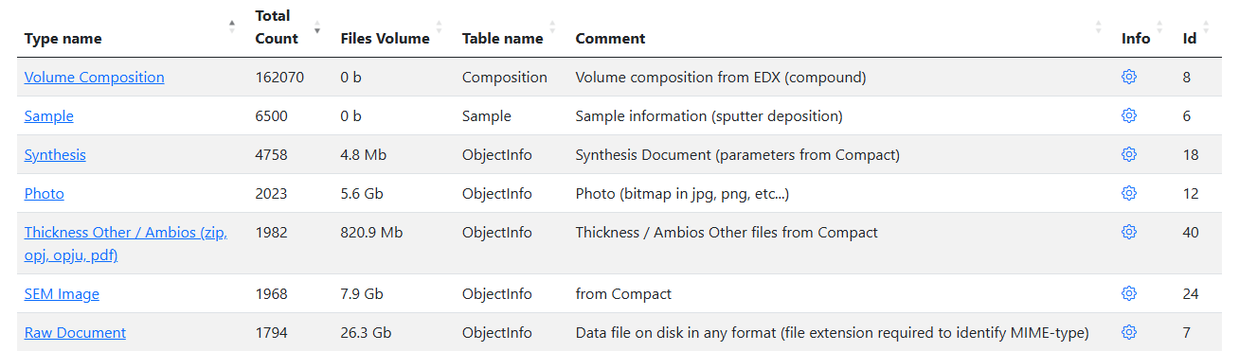
Know the types we have (https://crc247.mdi.ruhr-uni-bochum.de/adminobject):
FP3: RDMS Types Review
Type – a kind of object (objects of the same type are “comparable”, have the “same format”).
Every project: know the types, that you use! (we can add types => contact us!)
Write an RDMS Data Management Plan for your project (light, a page of text):
    state what types of objects you need to find (created by other projects);
    what types do you contribute to?
    how do you link your contribution with other object types?
See C04 as an example!

Slide 27
Any experiments here:
Playground (sandbox)
https://inf.mdi.ruhr-uni-bochum.de/
Playground to test RDMS (multiple tenants with shared users list):
https://inf.mdi.ruhr-uni-bochum.de/
Login and Password (User role): User1@user.org
Login and Password (PowerUser role): PowerUser1@user.org
Login and Password (Administrator role): Admin1@user.org

Slide 28
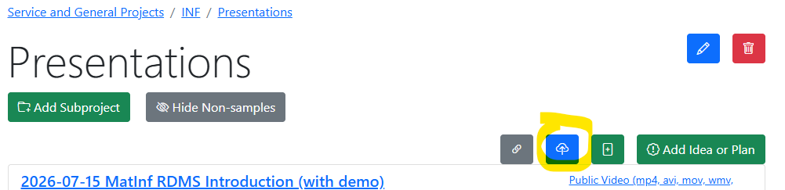
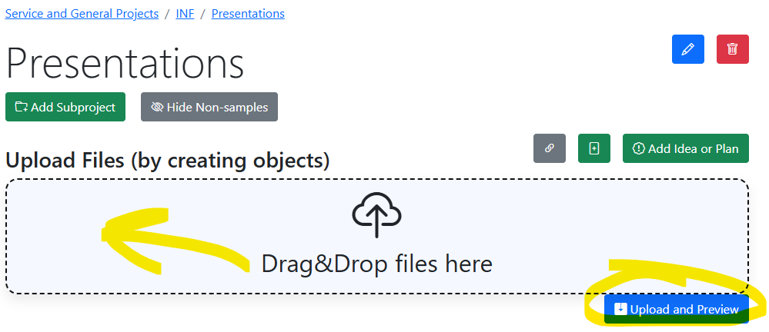
Task 1: upload your presentation
Locate your project folder
Drag & drop presentation file
https://crc247.mdi.ruhr-uni-bochum.de/

Slide 29
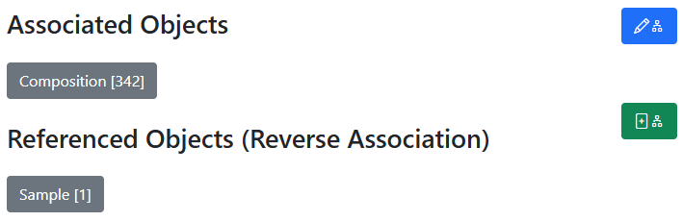
Oriented Graph: interlink & don’t mess up with directions
In all objects:
Control associated objects (children)
Child objects
Add a new (child) object + association
Parent objects
Idea or Plan
Sample
Synthesis
Request for Synthesis
Characterisations:
EDX, XRD, Resistance, Bandgap, …
342
x
Compositions

Slide 30
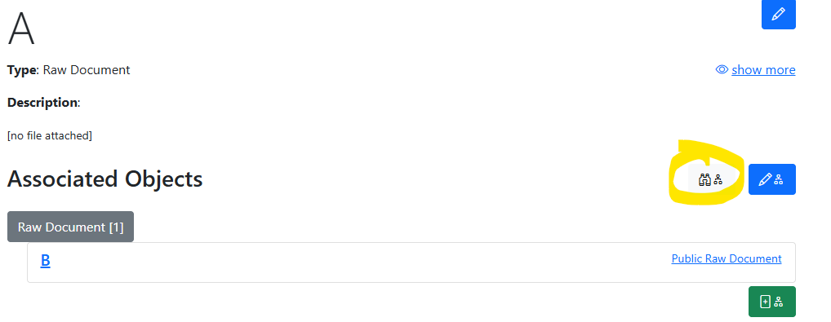
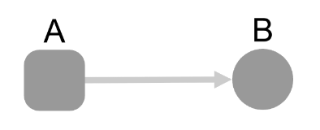
Task 2: Upload two documents & link/relink them
0) Use a playground at https://inf.mdi.ruhr-uni-bochum.de/ and create an account (use Admin to associate User&PowerUser roles)
Upload two documents “Raw ” (or create two objects):
Link the documents as shown here (A -> B)
Hint: check “View links (Graph)”
3) Relink the documents another way around (B -> A)
Hint: check “View links (Graph)”
A
B
A
B
A
B

